Slide 1
USV Lab 1
System Identification
Find simple transfer function models
to approximate the steering and yaw response

Slide 2
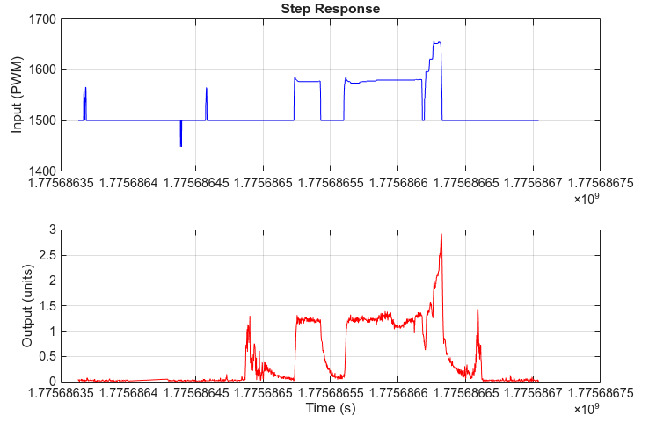
Objectives
Given the experimental dataset
Create two first-order transfer function models (surge and yaw-rate) to approximate the USV dynamics for use in feedback control design.
These models allow us to simulate the USV in MATLAB.

Slide 3
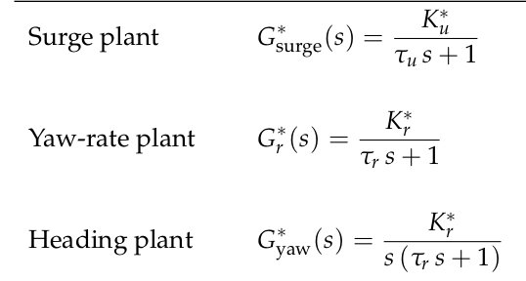
Load data — preprocessed ArduPilot log containing actuator commands and vehicle response.
Select channel — choose one input/output pair (e.g. throttle → speed, rudder → yaw rate).
Isolate a step — manually clip a single clean step response and zero the time axis.
Scale input — convert PWM to normalized effort (±1).
Initial estimate — read DC gain and time constant off the plot by inspection.
Curve fit — refine parameters with lsqcurvefit to match the experimental data.
Result — identified first-order model

Slide 4
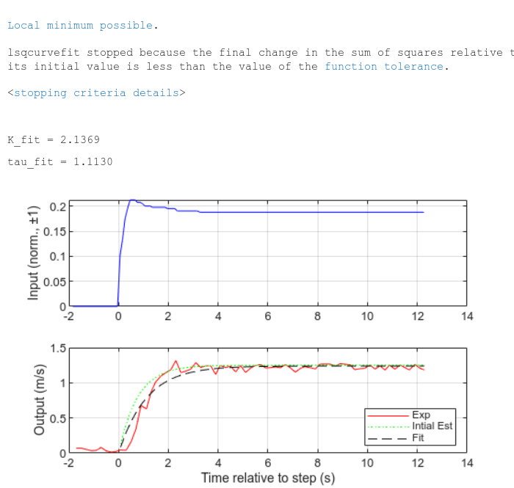


Model: General Form
Model: System Identification

Slide 5
Lab 1: Presentation
Presentation
  Title with team name and member names
  Two slides. Each slide has
    Final step response data plot with correct units.
    Table with model parameters
    Transfer function expression
  May use the following slides as a template.
  Submit as pptx file. Shared copy, but each person submits via Sakai

Slide 6
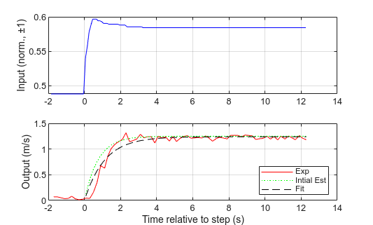

USV Surge Model Identification
Model Parameter | Value | Units
DC Gain (Kdc) | 2.14 | m/s
Time Constant (tau) | 1.11 | s

Slide 7
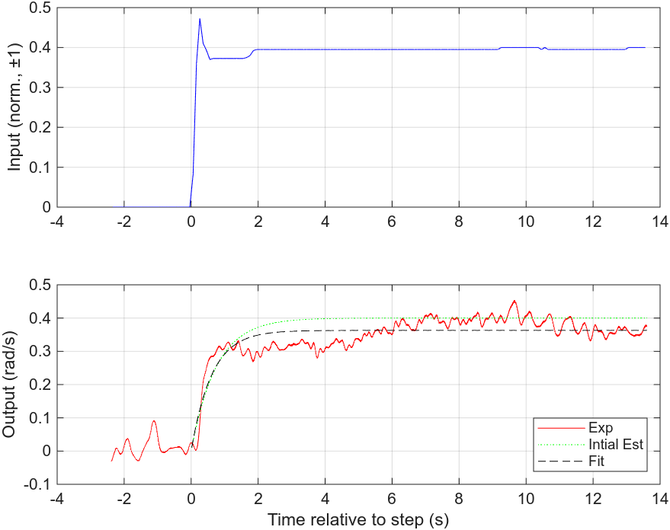

USV Yaw-Rate Model Identification
Model Parameter | Value | Units
DC Gain (Kdc) | 0.52 | rad/s
Time Constant (tau) | 0.61 | s

Slide 8
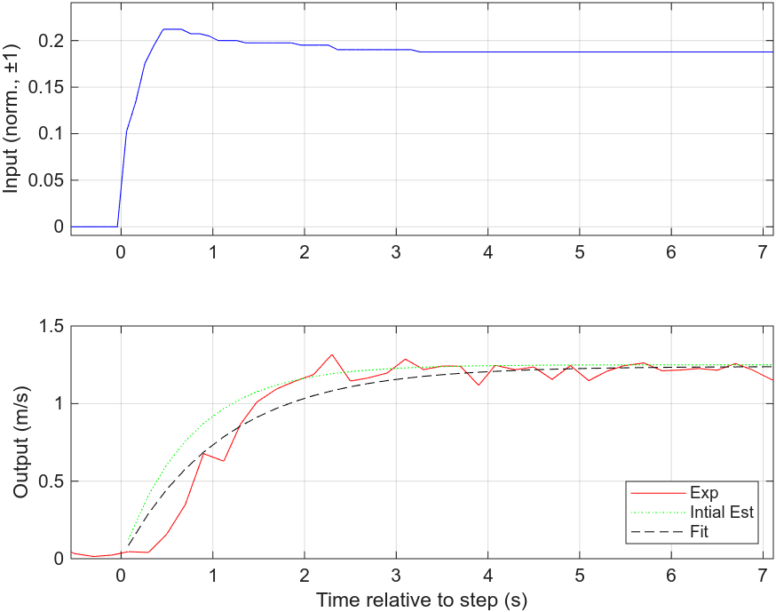
Model Limitations
There are always "unmodelled dynamics". The challenge is knowing how much is sufficient.

Slide 9
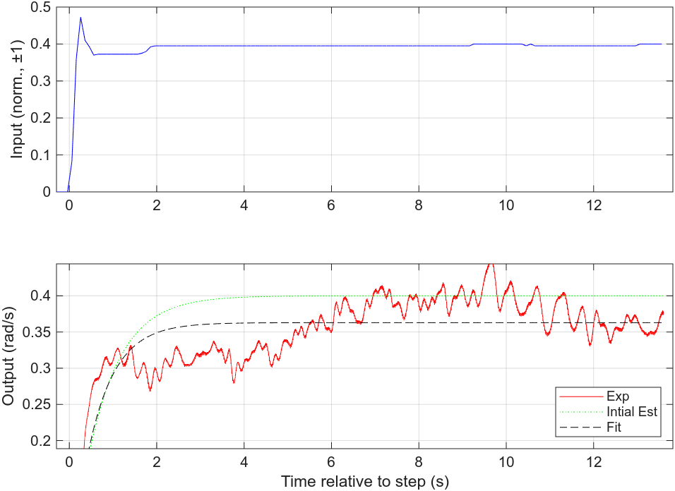
Model Limitations
There are always "unmodelled dynamics". The challenge is knowing how much is sufficient.

