Slide 1

Simplifying the usage of persistent distributed data with dataClay
Alex Barceló
alex.barcelo@bsc.es
Workflows and Distributed Computing Group
BSC Training Course
February 7, 2025
This work has received funding from the European Union's HORIZON research and innovation programme under grant agreement No. 101135513.

Slide 2
Course logistics
We would like to see your faces!
  At least when you speak (if possible)
If you have any question during the explanation, you can either interrupt, raise your hand, or type it in the chat. We love questions!
All materials of this course are publicly available.
  https://github.com/bsc-dom/training-dataclay-2025/
  If we missed anything (or you catch a mistake) send us an email :)
Exercises and demonstrations will be run in your laptop.
You need Docker and Python to follow the hands-on sessions.

Slide 3
Outline
Roundtable (10:00 – 10:30)
  Presentation and background of participants
Session 1 (10:30 - 11:00): Introduction to dataClay
  Motivation
  dataClay in a nutshell
  Storage as a building block
Session 2 (11:00 – 13:00): Hands-on with dataClay
Lunch break (13:00 – 14:30)
Session 3 (14:30 – 15:00): Advanced usage of dataClay and external libraries
Session 2 (15:00 – 17:00): Second hands-on

Slide 4
Session 1:
Introduction to dataClay
BSC Trainig Course

Slide 5

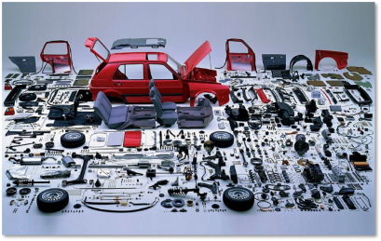


Motivation
From the application point of view...
In-memory data access
  Data is not structured in tables like in a database
  Data is linked according to needs of program
  Data items are found by following a link or using an iterator
Persistent data should behave in a similar way
  Less code (transformation between in-memory and persistence)
  More locality (execution close to where data is)
  Easier job for developer: it doesn’t care whether data is
    In memory
    In persistent storage

Slide 6
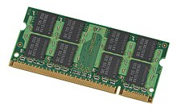



Motivation
From the hardware point of view…
New storage technologies are becoming available: Non-volatile Memories
Latency
Hot data
Caching
indexing
in-memory
Analytics OLTP
Database Web Hosting
Mail Servers CRM
VOD Media Streaming Surveillance
Data Warehouse Content Delivery
Archive Backup
Memory - 0.1µs
NVM - 1µs
SSD - 100 µs
HDD - 1,000 µs
Cold data
Notes:
Tapes below, caches and registers above
Performance similar to memory, capacity similar to disk

Slide 7
Motivation
From a distributed point of view…
Complex Data Management when placing data in highly distributed environment. Latency, data locality on operations, execution, access protocols, security, etc.
Staging data in and staging data out. Complexities, dead code, efforts for transforming data.
Sending data, producer and consumer asymmetry.
Notes:
Tapes below, caches and registers above
Performance similar to memory, capacity similar to disk

Slide 8
Distributed data management (r)evolution
In programmer’s mind:
Objects and data structures
In the past
  Map application data structures to database tables or files
  Manage transformations from the application
  Decide where to place data to exploit parallelism, and manage it from the application
Our vision
  Define the best data structures for the application
  Just focus on the application itself, forget about managing persistence and data placement
Complexity: Divergence between our mental model and reality
In storage:
Tables or files
Notes:
Also with the help of parallel programming models (that we will introduce later combined with the data management solutions)

Slide 9




Distributed active object store for HPC and big data applications
  Supports Python applications including all its popular libraries
A single data model to manage transparently:
  Persistent and volatile data
  Local and remote data
Inherently exploits data locality
  Objects = data + methods
In-memory
  Objects ready to be used
  No transformations or serializations
Notes:
An object can be an integer, a collection, a graph…
Hides complexity of distribution
Fully integrated with OO model: data model includes behaviour
OO API: Access persistent objects by navigation (as in memory)
Holds an execution environament within the data Store, where objects are ready to be accessed and received method invocations (already instantiated).

Slide 10
Why use object abstractions?
Objects can be made persistent
Applications can operate on persistent
and in-memory objects seamlessly
Producer-consumer applications can easily share objects
Flat object space shared across nodes
Data transfers are avoided (in-situ processing)
Producer app
o2
o1
o1

Slide 11
Why use object abstractions?
Objects can be made persistent
Applications can operate on persistent
and in-memory objects seamlessly
Producer-consumer applications can easily share objects
Flat object space shared across nodes
Data transfers are avoided (in-situ processing)
make_persistent
Producer app
o2
o1
o1

Slide 12
Why use object abstractions?
Objects can be made persistent
Applications can operate on persistent
and in-memory objects seamlessly
Producer-consumer applications can easily share objects
Flat object space shared across nodes
Data transfers are avoided (in-situ processing)
make_persistent
Producer app
Consumer app
o2
o3
o1
o1
No transformations needed
Notes:
Transformations are avoided (contrary to files), and also disk accesses are reduced as the object is cached in the data store.
Objects are managed through their identifiers, regardless of their location.

Slide 13
DataClayObject Interface: StorageObject
A class that enriches Python objects with generic data storage and access functionalities
StorageObject
Stores the object “self”
Alias is optional and unique per class
make_persistent(self, alias=None)
get_by_alias(cls, alias)
delete_alias(cls, alias)
“Retrieves” an object
Alias is required
Deletes the alias of an object
DataClayObject
Notes:
Alias és únic per classe.
Delete may delete the object immediately from storage, or eventually (i.e. no guarantees that the object is immediately deleted from disk) depending on the storage solution that implements the StorageAPI. In any case, behavior is the same from the point of view of the application (object is not accessible anymore, from the application that deletes it and from any other)

Slide 14
DataClayObject Interface: Typing annotations
Each class to be persisted inherits from StorageObject
Use the standard Python 3.x typing annotations for properties:
We support (allegedly) any Python data structure. Known and tested ones:
  Built-in types: int, bool, float, str, list, dict
  Numpy arrays
  User-defined types
  PyTorch and Tensorflow models
class Person(DataClayObject):
name: str
age: int
dog: Dog
Notes:
Numpy implementació: np.save

Slide 15
Example: application with persistent objects
class Person(DataClayObject):
name: str
age: int
Initialize a client
Use the classes normally
To store an object, call its make_persistent method
  Related objects will be made persistent recursively
To update a persistent object, just use the assignment instruction
  Changes will be persistent, too
You can use aliases on objects
  Assign it in make_persistent
  Retrieve it with get_by_alias
  Optional! Use only for Very Important Objects
from mymodel import Person, Other
from dataclay import Client
client = Client(...)
client.start()
a = Person("John", 42)
a.make_persistent()
b = Other()
b.relation = Other()
b.make_persistent("sample36")
c = Other.get_by_alias("sample35")
c.relation = Other()
Notes:
Don’t need to look at what the application does (it does just silly things to exemplify the different ways in which an object can be used/accessed).

Slide 16
Example: application with persistent objects
class Person(DataClayObject):
name: str
age: int
Initialize a client
Use the classes normally
To store an object, call its make_persistent method
  Related objects will be made persistent recursively
To update a persistent object, just use the assignment instruction
  Changes will be persistent, too
You can use aliases on objects
  Assign it in make_persistent
  Retrieve it with get_by_alias
  Optional! Use only for Very Important Objects
from mymodel import Person, Other
from dataclay import Client
client = Client(...)
client.start()
a = Person("John", 42)
a.make_persistent()
b = Other()
b.relation = Other()
b.make_persistent("sample36")
c = Other.get_by_alias("sample35")
c.relation = Other()
Notes:
Don’t need to look at what the application does (it does just silly things to exemplify the different ways in which an object can be used/accessed).

Slide 17
Example: application with persistent objects
class Person(DataClayObject):
name: str
age: int
Initialize a client
Use the classes normally
To store an object, call its make_persistent method
  Related objects will be made persistent recursively
To update a persistent object, just use the assignment instruction
  Changes will be persistent, too
You can use aliases on objects
  Assign it in make_persistent
  Retrieve it with get_by_alias
  Optional! Use only for Very Important Objects
from mymodel import Person, Other
from dataclay import Client
client = Client(...)
client.start()
a = Person("John", 42)
a.make_persistent()
b = Other()
b.relation = Other()
b.make_persistent("sample36")
c = Other.get_by_alias("sample35")
c.relation = Other()
Notes:
Don’t need to look at what the application does (it does just silly things to exemplify the different ways in which an object can be used/accessed).

Slide 18
Example: application with persistent objects
class Person(DataClayObject):
name: str
age: int
Initialize a client
Use the classes normally
To store an object, call its make_persistent method
  Related objects will be made persistent recursively
To update a persistent object, just use the assignment instruction
  Changes will be persistent, too
You can use aliases on objects
  Assign it in make_persistent
  Retrieve it with get_by_alias
  Optional! Use only for Very Important Objects
from mymodel import Person, Other
from dataclay import Client
client = Client(...)
client.start()
a = Person("John", 42)
a.make_persistent()
b = Other()
b.relation = Other()
b.make_persistent("sample36")
c = Other.get_by_alias("sample35")
c.relation = Other()
Notes:
Don’t need to look at what the application does (it does just silly things to exemplify the different ways in which an object can be used/accessed).

Slide 19
Example: application with persistent objects
class Person(DataClayObject):
name: str
age: int
Initialize a client
Use the classes normally
To store an object, call its make_persistent method
  Related objects will be made persistent recursively
To update a persistent object, just use the assignment instruction
  Changes will be persistent, too
You can use aliases on objects
  Assign it in make_persistent
  Retrieve it with get_by_alias
  Optional! Use only for Very Important Objects
from mymodel import Person, Other
from dataclay import Client
client = Client(...)
client.start()
a = Person("John", 42)
a.make_persistent()
b = Other()
b.relation = Other()
b.make_persistent("sample36")
c = Other.get_by_alias("sample35")
c.relation = Other()
Notes:
Don’t need to look at what the application does (it does just silly things to exemplify the different ways in which an object can be used/accessed).

Slide 20
Example: application with persistent objects
class Person(DataClayObject):
name: str
age: int
Initialize a client
Use the classes normally
To store an object, call its make_persistent method
  Related objects will be made persistent recursively
To update a persistent object, just use the assignment instruction
  Changes will be persistent, too
You can use aliases on objects
  Assign it in make_persistent
  Retrieve it with get_by_alias
  Optional! Use only for Very Important Objects
from mymodel import Person, Other
from dataclay import Client
client = Client(...)
client.start()
a = Person("John", 42)
a.make_persistent()
b = Other()
b.relation = Other()
b.make_persistent("sample36")
c = Other.get_by_alias("sample35")
c.relation = Other()
Notes:
Don’t need to look at what the application does (it does just silly things to exemplify the different ways in which an object can be used/accessed).

Slide 21
Example: application with persistent objects
class Person(DataClayObject):
name: str
age: int
Initialize a client
Use the classes normally
To store an object, call its make_persistent method
  Related objects will be made persistent recursively
To update a persistent object, just use the assignment instruction
  Changes will be persistent, too
You can use aliases on objects
  Assign it in make_persistent
  Retrieve it with get_by_alias
  Optional! Use only for Very Important Objects
from mymodel import Person, Other
from dataclay import Client
client = Client(...)
client.start()
a = Person("John", 42)
a.make_persistent()
b = Other()
b.relation = Other()
b.make_persistent("sample36")
c = Other.get_by_alias("sample35")
c.relation = Other()
Notes:
Don’t need to look at what the application does (it does just silly things to exemplify the different ways in which an object can be used/accessed).

Slide 22

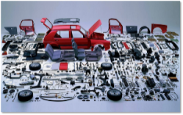
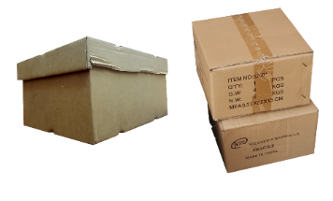

The active mechanism
dataClay is an Active Object Store for High Performance Computing, Big Data and Computing Continuum applications
Design principles
  Same data model for in-memory and persistent data
    Avoid transformations
  Bring computation close to the data
    Avoid communications and data transfers
Integrated with the COMPSs parallel programming model and runtime
Notes:
Avoid transformations: facilitate programming + improve performance
NVM: Computation can be done directly on stored data, without moving it to RAM
dataClay i COMPSs poden treballar junts o per separat.

Slide 23

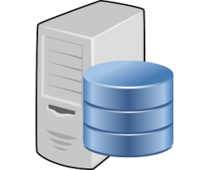

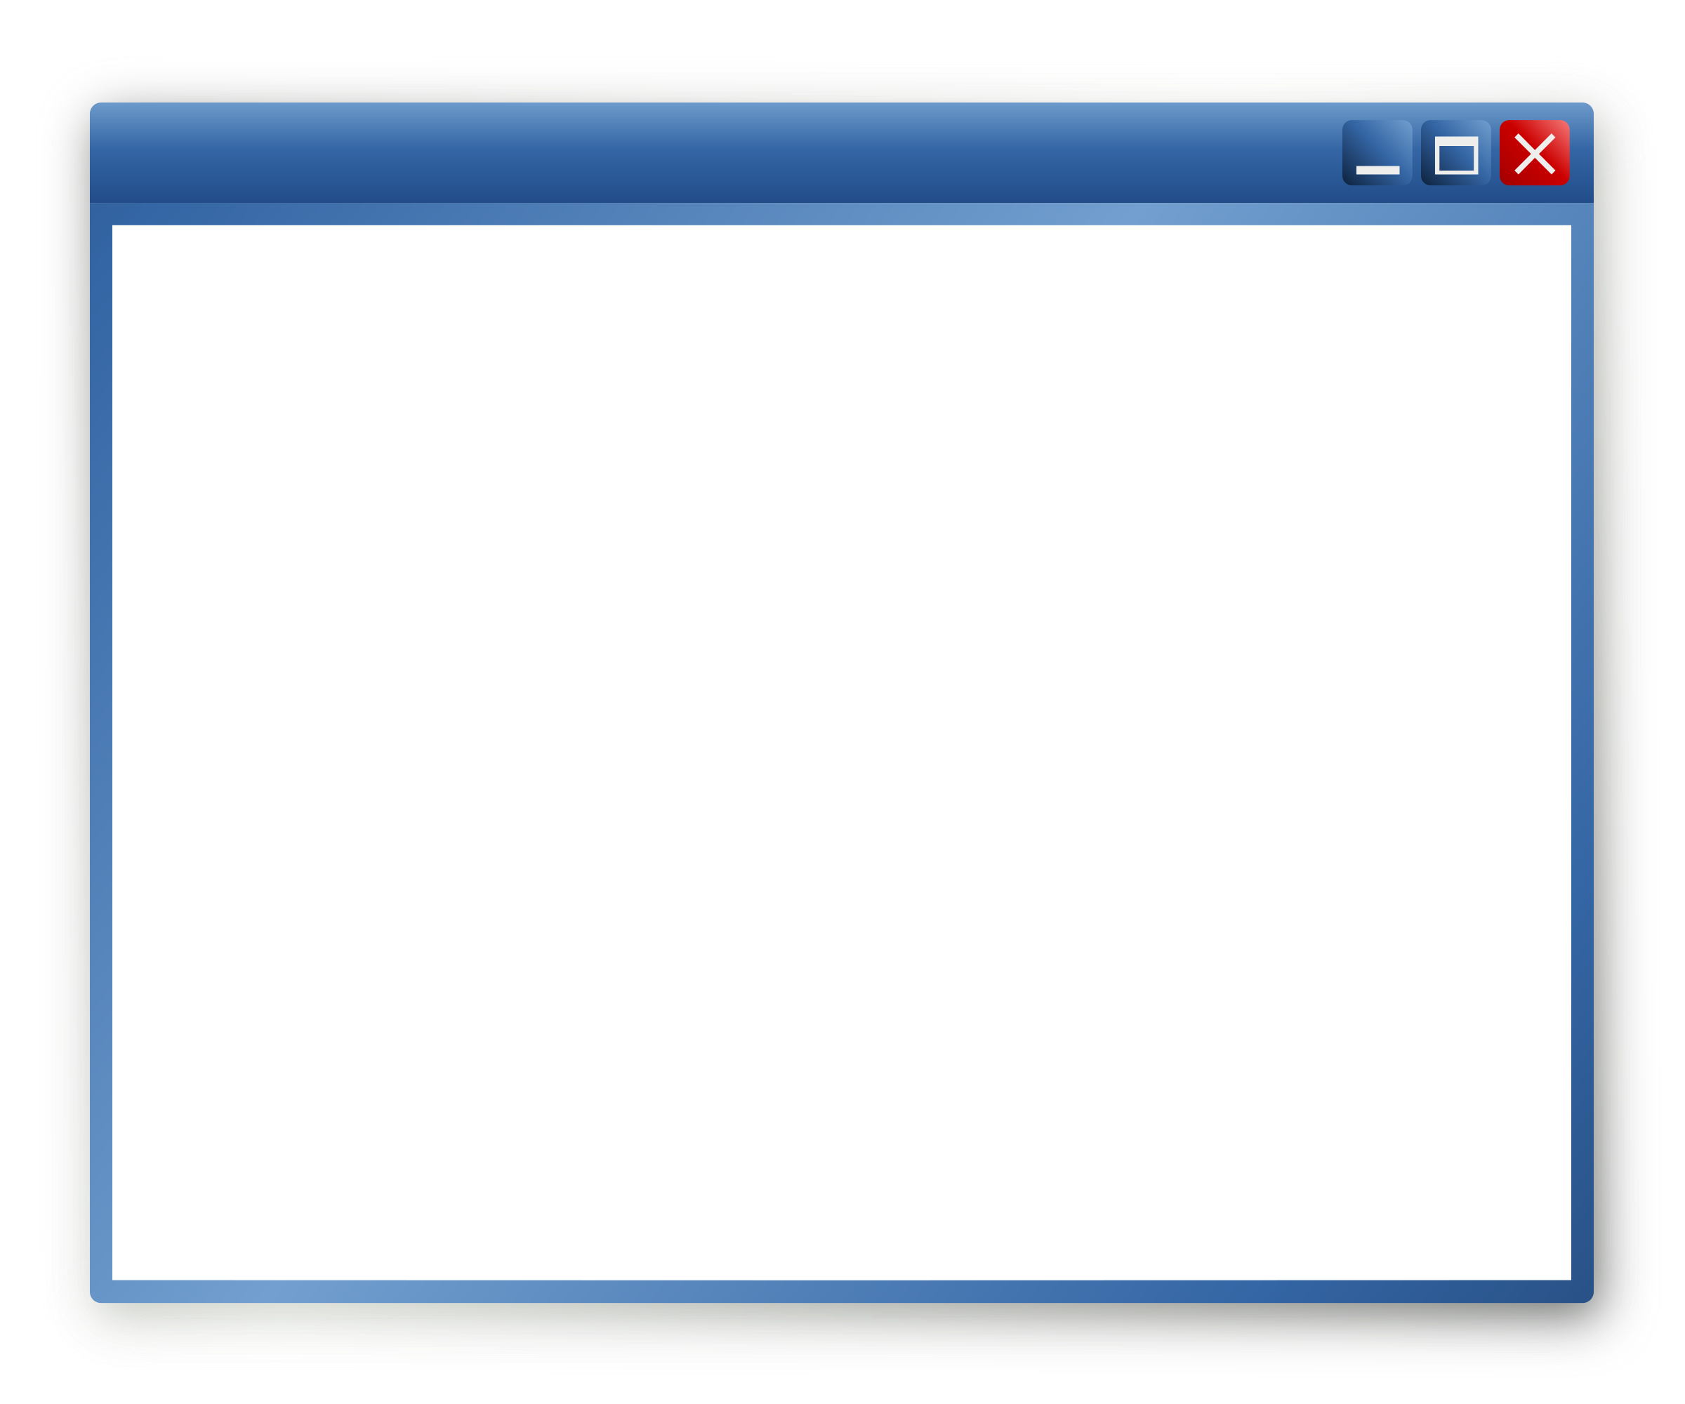
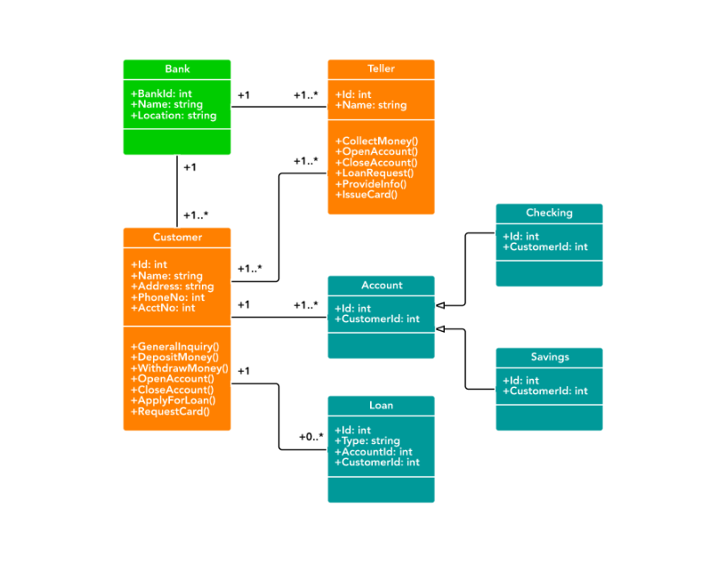

Active storage
Metadata
Method invocation
Application
return
N backends
Storage and execution
Data model
Application
Client lib
Registered class
from mydatamodel import SampleClass
...
a = SampleClass()
a.make_persistent()
a.func()
from dataclay import DataClayObject, activemethod
class SampleClass(DataClayObject):
...
@activemethod
def func(self):
self.counter += 1

Slide 24
Session 2:
Hands-on with dataClay
BSC Training Course

Slide 26
Session 3:
Advanced usage of dataClay and external libraries
BSC Training Course

Slide 27
Active storage
Metadata
Method invocation
Application
return
N backends
Storage and execution
Data model
Application
Client lib
Registered class
from mydatamodel import SampleClass
...
a = SampleClass()
a.make_persistent()
a.func()
from dataclay import DataClayObject, activemethod
class SampleClass(DataClayObject):
...
@activemethod
def func(self):
self.counter += 1

Slide 28

Building foundation
Taking object stores as a starting point
  Provides scalability
Adding semantics to objects
  Enables managing data at fine granularity
Associating behavior to stored objects
  Avoids data movements
Implementation using object-oriented abstractions
  Natural way of joining data and computation: performance
  Structure and behavior customizable per type: scalability
  Arbitrary data structures: representation of the domain
Notes:
Bringing computation close to data by design
Enabling the execution of arbitrary code within the data store, thus moving only results instead of all the data
Sobre això també:
Avoiding serializations and deserializations
Minimizing communications
Minimizing I/O in the critical execution path
Leverage the concept of objects both to hide storage and data distribution details, and at the same time improve performance of big data and high-performance computing (HPC) applications.
(de https://blog.acolyer.org/2019/12/11/a-tale-of-two-abstractions/): A bit like the promise of object stores (for a brief period in the mid-late nineties I remember these being all the rage) the ideal is that programmers don’t need to think about two different representations for volatile (in-memory) and persistent data representations.

Slide 29

dataClay HPC usage
Efficient resource usage is crucial
  dataClay avoids data transfers
  No bandwidth wasted
Distribution!
  dataClay distributes objects
  Distributed computation can leverage distributed objects
Efficient communication and efficient execution
  Fast communication libraries used
  Execution is handled by underlying libraries
  (don’t reinvent the wheel)

Slide 30
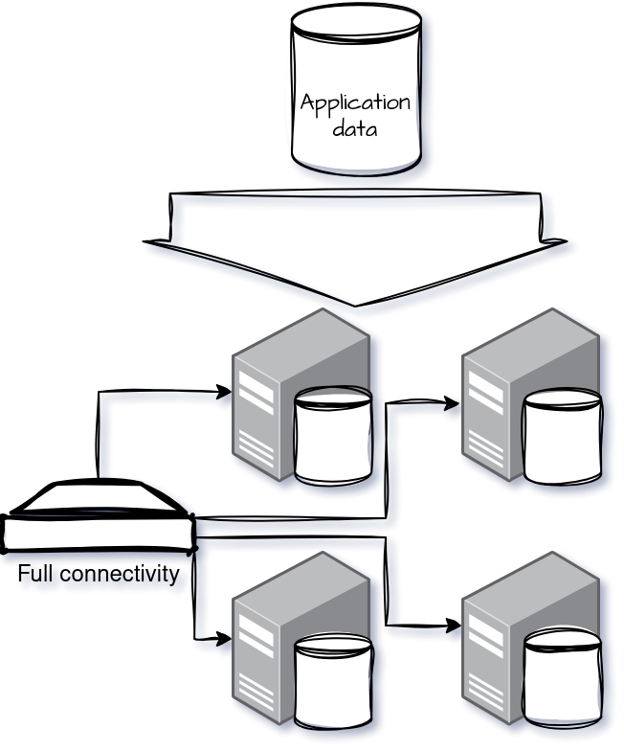
dataClay HPC usage: Architecture
Application data is distributed across all available resources
dataClay backends running on computation nodes
Full connectivity between backends and clients
Trivial to distribute computation
  Integration with COMPSs, framework for execution of parallel applications for distributed infrastructures, available.
Execution takes advantage of local resources

Slide 31
dataClay HPC usage
Example: Integration with COMPSs
class Block(DataClayObject):
...
@task(...)
@activemethod
def long_eval(self, value):
...
Annotate methods with:
  First, @task decorator from COMPSs
  Afterwards, @activemethod decorator from dataClay
For more information, check https://compss.bsc.es or the COMPSs training course
(earlier this week) or contact our group.

Slide 32
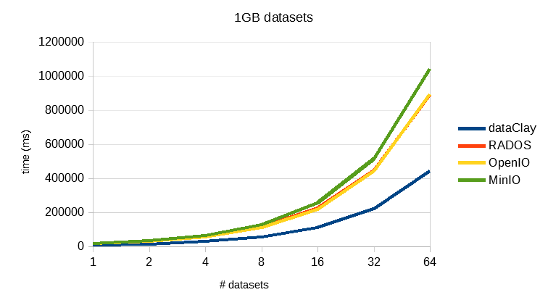
dataClay HPC usage: Performance improvement
Processing a dataset (an int array) and returning 50% of its elements as a result
  1GB per dataset
Executed in Grid5000, 4 nodes
  128 GB RAM, 48 cores
Comparison with other object stores
  With RADOS, OpenIO and MinIO the datasets are returned to the application, where the processing is applied
  As the amount of data grows, performance gains with dataClay increase
  Same happens as the size of the result decreases (not shown)
The difference is even higher when using Non-Volatile Memories instead of disk

Slide 33

dataClay in the
Computing Continuum
Edge-to-cloud
  Runs on RPi and Jetson
  Runs on kubernetes and containerized environments
Supports heterogeneous topologies
  x86, ARM, containers, bare metal
  Presence of accelerators
  Having different hardware in different backends
Pluggable ACL policies
  Privacy
  Monetization
  Multi-tenancy
Notes:
Hem hagut d’adaptar els nostres productes HPC per a entorns IoT/edge (requisits/assumpcions diferents)
Xarxa lenta I inestable (no sempre present)
Agents independents (poden treballar sols però tb com a “cluster”)
Devices petits, edge-to-cloud continuum

Slide 34
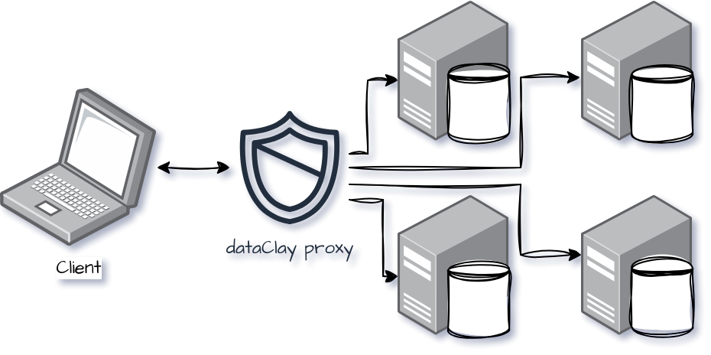
Access control on dataClay
This dataClay proxy is part of the dataClay software stack.
Pluggable and modular reverse proxy to dataClay services
Implement any ACL, audit, throttle, etc. mechanism on top of the dataClay ecosystem

Slide 35
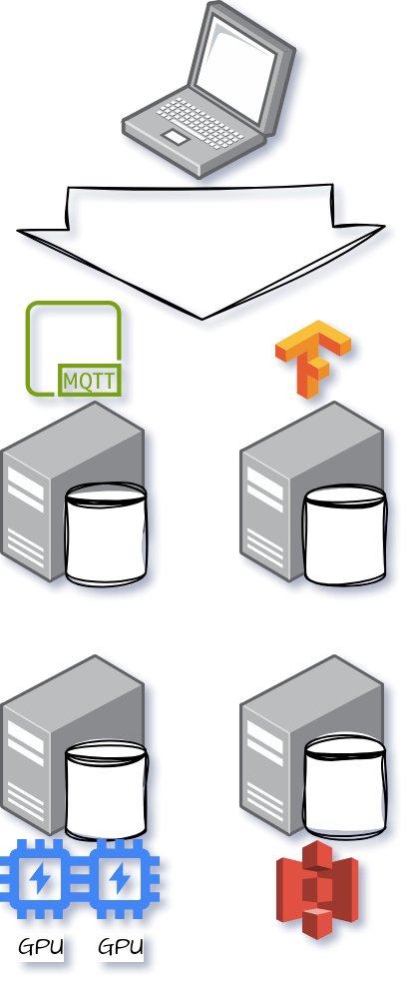
Using remote resources
Applications can make use of resources available in the backends
Simplify development cycle
  Implement classes normally
  Use classes normally
  Data model (classes) will have the resource locally
Fully use the hardware resources available
Fully use network resources available
Have persistency with no extra development cost
  Trained AI models
  Broker producers & consumers
  Etc.

Slide 36
Final Notes
Some links, before the final hands-on:
Research page: https://www.bsc.es/dataclay
GitHub: https://github.com/bsc-dom/dataclay
  Source code
  Examples
Documentation: https://dataclay.readthedocs.io/
Contact and support: support-dataclay@bsc.es

Slide 37
Session 4:
Second hands-on
BSC Training Course

Slide 38
This work has received funding from the European Union's HORIZON research and innovation programme under grant agreement No. 101135513.

