Slide 1
Test Case - Smart Support
Submitted by :Group-13 (21f1003002, 21f1003442, 21f1003481)

Slide 2
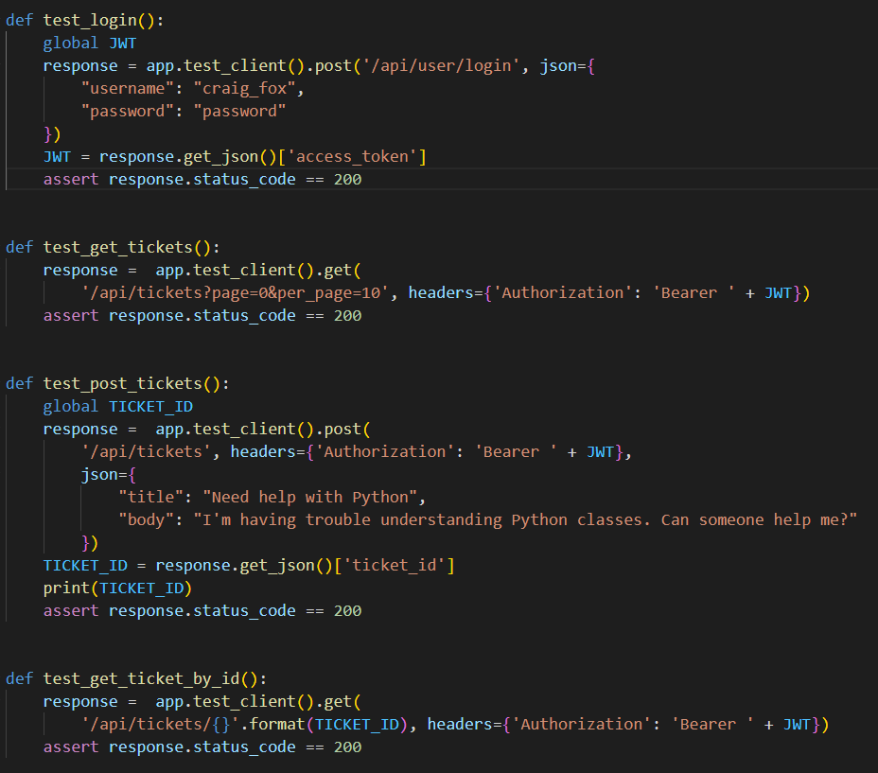
We have implemented API testing using pytest for CRUD APIs for the Ticket model in our application

Slide 3
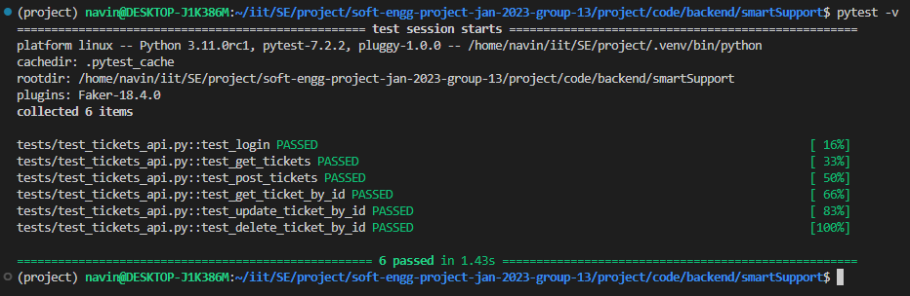
So far we have implemented 6 test cases for Ticket APIs (including 1 for the Login API)

Slide 4
Some other test cases that we are considering

Slide 5
Test to get all comments for a valid ticket ID
Page being tested: get_comments function
Inputs: A valid ticket ID in the URL and an authenticated JWT token
Expected output: A JSON response with status code 200 and a list of all comments for the given ticket ID in descending order of creation time
Actual output: Same as expected output
Result: Success

Slide 6
Test to get a single comment by ID
Page being tested: get_comment function
Inputs: A valid comment ID in the URL and an authenticated JWT token
Expected output: A JSON response with status code 200 and the comment details for the given ID
Actual output: Same as expected output
Result: Success

Slide 7
Test to add a new comment to a valid ticket
Page being tested: post_comment function
Inputs: A valid ticket ID in the URL, a valid JWT token, and a JSON payload with a "body" field containing the comment text
Expected output: A JSON response with status code 200 and the details of the newly created comment, including the comment ID and creation time
Actual output: Same as expected output
Result: Success

Slide 8
Test to update an existing comment
Page being tested: put_comment function
Inputs: A valid comment ID in the URL, a valid JWT token, and a JSON payload with a "body" field containing the updated comment text
Expected output: A JSON response with status code 200 and the details of the updated comment, including the comment ID and creation time
Actual output: Same as expected output
Result: Success

Slide 9
Test to delete an existing comment
Page being tested: delete_comment function
Inputs: A valid comment ID in the URL and a valid JWT token
Expected output: A JSON response with status code 204 and no content
Actual output: Same as expected output
Result: Success

Slide 10
Test to mark a comment as the solution for a ticket
Page being tested: mark_comment_as_solution function
Inputs: A valid comment ID in the URL and a valid JWT token
Expected output: A JSON response with status code 200 and the details of the marked comment, including the comment ID and creation time. The associated ticket status should also be updated to "Resolved"
Actual output: Same as expected output
Result: Success

Slide 11
Besides the tests mentioned in previous pages, there can be tests written for:
User CRUD operations
Tickets Voting operations
Tags CRUD operations
FAQs CRUD operations

