Slide 1
Schedule and Design - Smart Support
Submitted by :Group-13 (21f1003002, 21f1003442, 21f1003481)
Project Scheduling Tool Used - JIRA

Slide 2
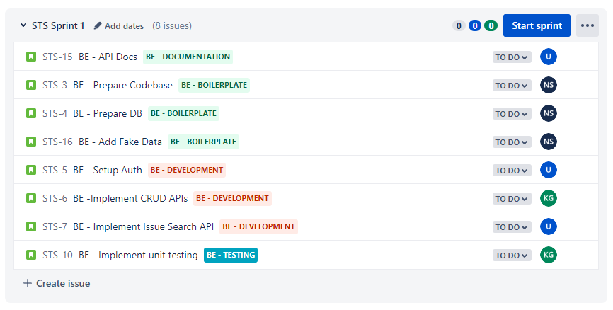
Sprint 1

Slide 3
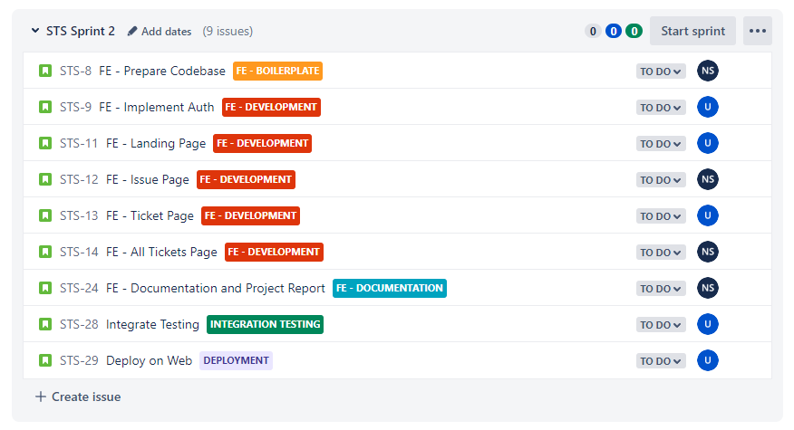
Sprint 2

Slide 4
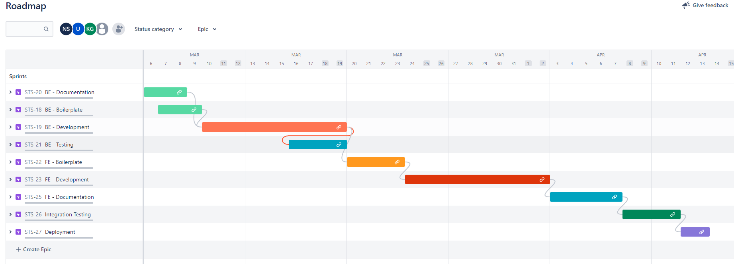
Gant Chart

Slide 5
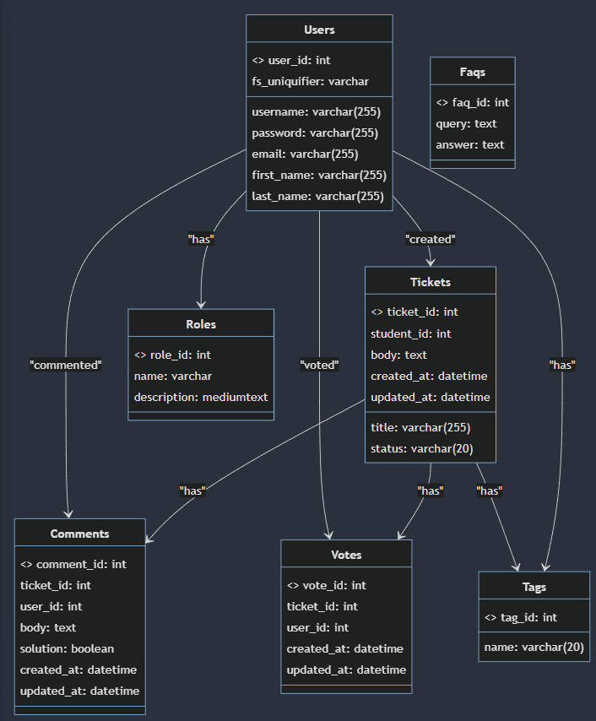
Class Diagram

Slide 6
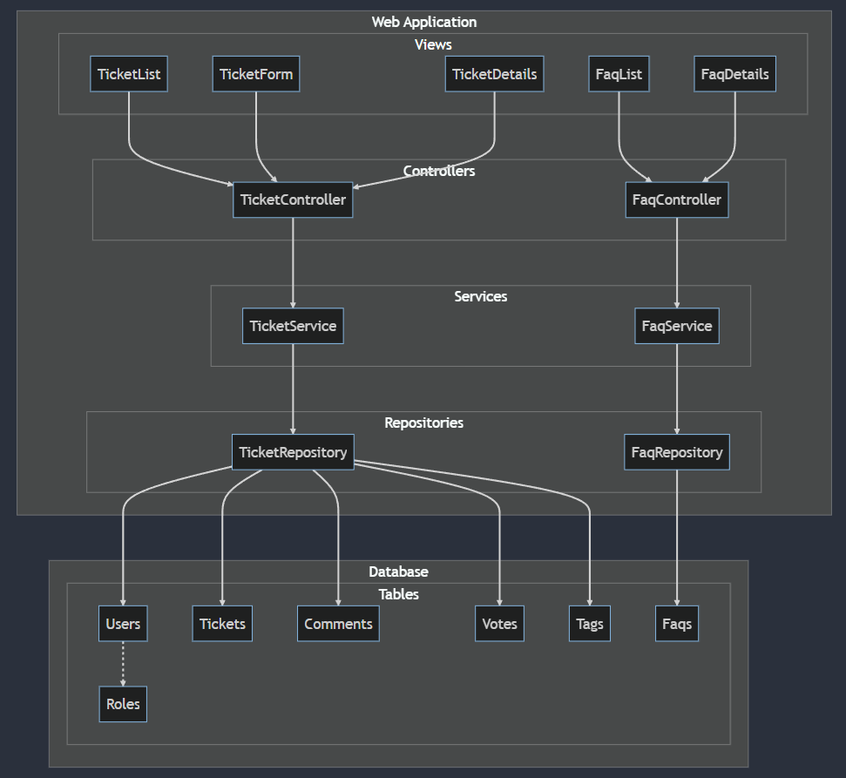
Component Design

Slide 7
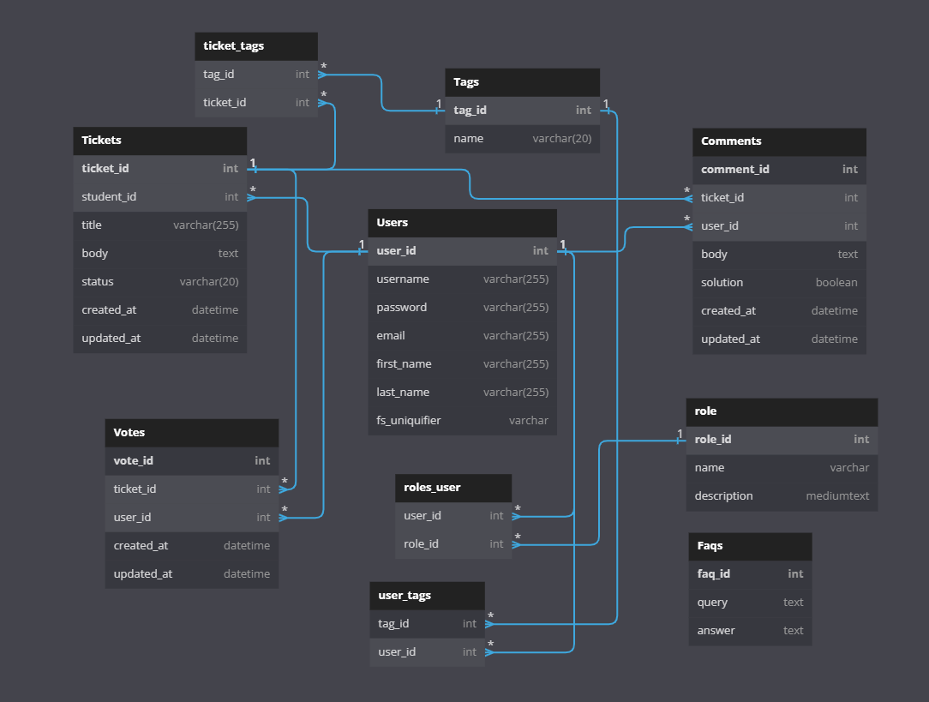
DB Schema

Slide 8
Scrum Meeting 1: Date: 2023-02-10 Time: 9:00 PM
Attendees:
Uday
Navin
Krishu
Agenda:
Getting to know each other
Assign roles
Discuss general structure and timeline of the project
Minutes:
Each member introduced themselves.
Roles were discussed
Discussed general structure of the project.

Slide 9
Scrum Meeting 2: Date: 2023-02-15 Time: 10:00 PM
Attendees:
Uday
Navin
Agenda:
Review of Milestone 2 Submission
Discussion of upcoming milestone goals
Standardize theme of all wireframes
Minutes:
Some mock user stories discussed.
General theme for all wireframe pages were discussed.
A few mock wireframes were developed.
The team discussed other business, including the need for a clearer definition of roles and responsibilities.

Slide 10
Scrum Meeting 3: Date: 2023-02-23 Time: 9:30 PM
Attendees:
Uday
Navin
Agenda:
Finalise Milestone 2 Submission
Discussion of upcoming milestone goals
Minutes:
Final user stories and wireframe were designed by Navin
Uday recommended some changes to wireframes
Final Milestone 2 draft was prepared.

Slide 11
Scrum Meeting 4: Date: 2023-03-02 Time: 10:30 PM
Attendees:
Uday
Navin
Agenda:
Discuss tools to be used for Milestone 3
Assign roles
Create Timeline of the project.
Minutes:
Jira was decided upon for project scheduling
Two sprints were discussed and scheduled on Jira
Categories (Epics) and their issues/tasks were created and added to their respective sprints.
Timeline was decided for each issues/task.
Issues/Tasks were assigned to each member.

