Slide 1
Web Services
Web2.0 services

Slide 2
Where are we?
# | Title
1 | Introduction
2 | Web Science
3 | Service Science
4 | Web services
5 | Web2.0 services
6 | Semantic Web
7 | Web Service Modeling Ontology (WSMO)
8 | Web Service Modeling Language (WSML)
9 | Web Service Execution Environment (WSMX)
10 | OWL-S and others
11 | Light-weight Annotations
12 | Applications
13 | Mobile Services

Slide 3
Outline
Motivation
Technical solution
  REST Conceptual Overview
  RESTful Web Service Technologies
    HTTP
    XML
    JSON
    AJAX
    WADL
Illustration by a larger example
Extensions
Summary
Resources

Slide 4
Motivation

Slide 5
Motivation
What is Web 2.0?
  Commonly associated with web applications that facilitate interactive information sharing, interoperability, user-centered design and collaboration on the WWW¹.
  Usually connected with the notions of read-write web, social web but also programmable web².
Typical characteristics of Web 2.0 applications
  Users can produce and consume data on a Web 2.0 site
  Web is used as a participation platform
  Users can run software applications entirely through a Web browser
  Data and services can be easily combined to create mashups
¹ Taken from http://en.wikipedia.org/wiki/Web_2.0
² http://www.programmableweb.com

Slide 6





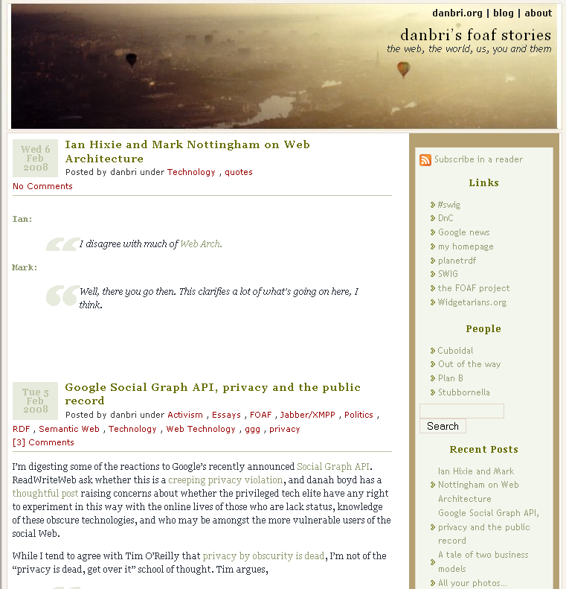







Motivation
Examples

Slide 7
Motivation
Examples
File Sharing:
  Flickr (Images),
  YouTube (Videos),
  Wikipedia (Online Encyclopedia),
  Blogs,
  Open Source Community (Linux).
File Management
  Tagging
Social Websites and Communication:
  Facebook,
  LastFM,
  StudiVZ,
  LinkedIn, Xing.
Open Systems: APIs, partly open source; allow extensions by users.

Slide 8

Motivation
Examples
Facebook - Internet platform for creation of social networks
  More than 400 million active users
  50% of our active users log on to Facebook in any given day
  More than 35 million users update their status each day
  More than 60 million status updates posted each day
  More than 3 billion photos uploaded to the site each month
  More than 5 billion pieces of content (web links, news stories, blog posts, notes, photo albums, etc.) shared each week
  More than 3.5 million events created each month
  More than 3 million active Pages on Facebook
  More than 1.5 million local businesses have active Pages on Facebook
¹ Taken from http://www.facebook.com/press/info.php?statistics on June 6th, 2010.

Slide 9
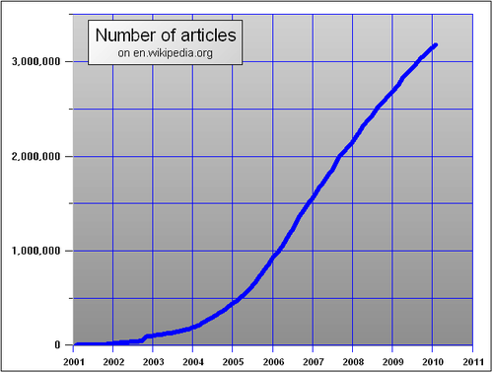

Motivation
Examples
Wikipedia - Free Online Encyclopedia
  3,315,577 Articles (English Wikipedia)¹
  12,485,100 registered users¹
  Clever mechanisms combined with human intelligence
  High quality articles
  Self-organized control
  Semi-openess
¹ Taken from http://en.wikipedia.org/wiki/Special:Statistics on June 6th, 2010.

Slide 10
Motivation
Examples
YouTube video portal - free upload and download of videos
  Exceeds 2 billion views a day¹
  24 hours of video uploaded every minute
  70% of YouTube’s traffic comes from outside the U.S.
  Google paid 1.6 Billion dollars for YouTube in 2006.
¹ Taken from http://www.viralblog.com/research/youtube-statistics on June 6th, 2010.

Slide 11
Motivation
Large quantities of data are on the Web
The data needs to be managed in an appropriate manner
  Retrieved, queried, analyzed, transformed, transferred, stored, etc.
Technical solutions are needed to enable a truly Programmable Web
  Easy integration of data and services on the Web
  Desktop apps should work with Web apps
    Flickr uploadr, Google calendar update/sync
  Web apps should work with the other Web apps
    LinkedIn can import your Facebook friends
    Facebook can import your Dopplr trips
  Mashups should be enabled
    Easy service composition
The solution can be seen in the form of Web 2.0 services

Slide 12
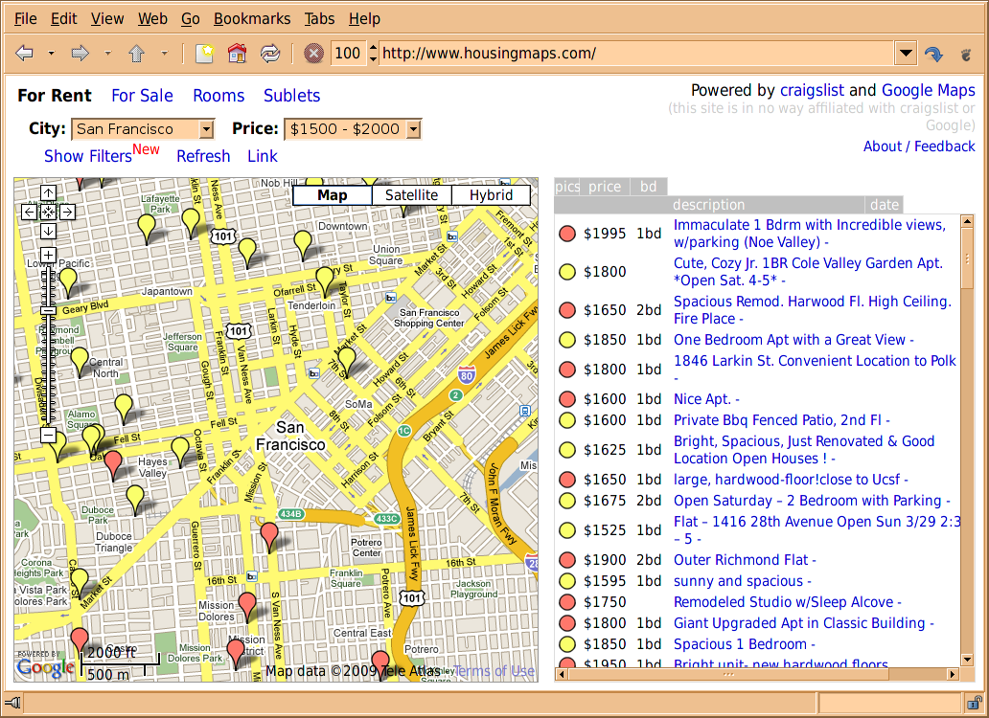
Motivation
Example Mashup: Housingmaps.com

Slide 13
Motivation
Example Mashup: Housingmaps.com
Housingmaps.com is a mashup created of
  Craigslist
    A centralized network of online communities, featuring free online classified advertisements – with sections devoted to jobs, housing, personals, for sale, services, community, gigs, résumés, and discussion forums.
  Google Maps
    The properties described in Craigslist are placed on a map.
The true power of the applied Web 2.0 approach comes from the fact that it is "in no way affiliated with craigslist or Google”
  It consumes Web 2.0 services provided by Craigslist and Google

Slide 14
Motivation
Web APIs & Services
Data providers usually have an incentive to offer Web APIs
  Web 2.0 services enable easier access to data
  Google maps, Geonames, phone location…
  Microformats (vcard, calendar, review…)
  Data feeds
Various functionalities are offered through Web APIs
  Publishing, messaging, payment…
Web 2.0 facilitates user involvement through “reverse” APIs (leveraging on human computation)
  Amazon Mechanical Turk, ESP game…
Overall Web APIs are powering the vision of the Web as a computational platform

Slide 15
TECHNICAL SOLUTION
RESTful Web Services
Conceptual Overview

Slide 16
Conceptual Overview
Requirements
Requirements supported by REST-enabled systems stem from the requirements addressed by any system following Web architecture¹:
  Simplicity
    Low barrier of entry, fast adoption of Web APIs.
  Extensibility
    Allowing growth and flexibility.
  Distributed hypermedia
    Relying on the established concepts of hyperlinked content.
  Scalability at the Web level
    Should rely on technologies/protocols supporting scalable solutions.
  Independent deployment
    Coexistence of old and new
¹ Taken from http://www.ics.uci.edu/~fielding/pubs/dissertation/web_arch_domain.htmon June 6th, 2010.

Slide 17
Conceptual Overview
Requirements - Simplicity
Participation in the creation of information is voluntary
  Low entry-barrier is necessary
Hypermedia has simple and general user interface
  The same interface is used for all information sources
  Hypermedia relationships are flexible – unlimited structuring
  Users can be guided through reading by manipulating links
  Simple queries are incorporated for searching purposes
Partial availability of the overall system doesn’t prevent the authoring of the content
  Hypermedia authoring language is simple and capable of using existing tools
  Unavailability of referenced information allows further authoring
  References to the content are easily exchanged
Communication can be viewed and interactively tested by developers

Slide 18
Conceptual Overview
Requirements - Extensibility
User requirements change over time just as society does
The system must avoid locking to the deployed solutions
  The limitations must be easily resolvable
A system with the goal to be long-lived as the Web must be prepared for change.

Slide 19
Conceptual Overview
Requirements – Distributed Hypermedia
Hypermedia includes application control information embedded within the presentation of information.
Distributed hypermedia allows the content and control information to be stored at remote locations.
  Transfer of large amounts of data is needed while a user interacts with content.
Users are quite sensitive to perceived latency
  Time between link selection and information rendering
  Information is distributed across the global network
  Network interactions must be minimized.

Slide 20
Conceptual Overview
Requirements – Internet Scale
The Web is Internet-scale distributed hypermedia system
The Web must answer to to the problem of anarchic scalability
  The constituent systems are not centrally managed neither have a common goal
  Parts must continue to operate even under unanticipated load, or when given malformed or maliciously constructed data.
Security becomes a significant concern
  Multiple trust boundaries may be present in any communication
  Additional authentication must be in place before trust can be given
  Authentication may degrade scalability

Slide 21
Conceptual Overview
Requirements – Independent Deployment
Systems must be prepared for gradual and fragmented change
  Old and new implementations may co-exist without preventing the new implementations to achieve their full potential.
Existing design decisions must acknowledge future extensions.
Old systems must be easily identifiable
  Legacy behavior can be encapsulated without impacting newly deployed subsystems
The architecture must allow deployment of new elements in a partial and iterative fashion
  Not possible to enforce deployment order.

Slide 22
Conceptual Overview
Representational State Transfer (REST)
Representational State Transfer (REST)
  A style of software architecture for distributed hypermedia systems such as the World Wide Web.
REST is basically client/server architectural style
  Requests and responses are built around the transfer of "representations" of "resources".
Architectural style means
  Set of architectural constraints.
  Not a concrete architecture.
  An architecture may adopt REST constraints.
HTTP is the main and the best example of a REST style implementation
  But it should not be confused with REST

Slide 23
Conceptual Overview
Major REST principles
Information is organized in the form of resources
  Sources of specific information,
  Referenced with a global identifier (e.g., a URI in HTTP).
Components of the network (user agents and origin servers) communicate via a standardized interface (e.g., HTTP)
  exchange representations of these resources (the actual documents conveying the information).
Any number of connectors (e.g., clients, servers, caches, tunnels, etc.) can mediate the request, but each does so without being concern about anything but its own request
  an application can interact with a resource by knowing two things: the identifier of the resource and the action required
  no need to know whether there are caches, proxies, gateways, firewalls, tunnels, or anything else between it and resource
  The application needs to understand the format of the information (representation) returned.

Slide 24
Conceptual Overview
REST Architectural Constrains (1)
Client-server
  Separation of concerns
    Clients are separated from servers by a uniform interface.
  Networking
    Clients are not concerned with data storage, which remains internal to each server, so that the portability of client code is improved. Servers are not concerned with the user interface or user state, so that servers can be simpler and more scalable.
  Independent evolution
    Servers and clients may also be replaced and developed independently, as long as the interface is not altered.

Slide 25
Conceptual Overview
REST Architectural Constrains (2)
Stateless communication
  Scalability, reliability
    No client context being stored on the server between requests. Each request from any client contains all of the information necessary to service the request.
  Resources are conversationally stateless
    Any conversational state is held in the client.
Uniform Interface
  Simplicity (vs. efficiency)
  Large-grained hypermedia data transfer
  Example: Create, Retrieve, Update, Delete

Slide 26
Conceptual Overview
REST Architectural Constrains (3)
Caching
  Efficiency, scalability
    Well-managed caching partially or completely eliminates some client-server interactions, further improving scalability and performance.
  Consistency issues
    As on the World Wide Web, clients are able to cache responses. Responses must therefore, implicitly or explicitly, define themselves as cacheable or not, to prevent clients reusing stale or inappropriate data in response to further requests.
Code-on-demand
  Extending client functionality
    Servers are able to temporarily extend or customize the functionality of a client by transferring to it logic that it can execute. Examples of this may include compiled components such as Java applets and client-side scripts such as JavaScript.

Slide 27
Conceptual Overview
RESTful Web Service definition
A RESTful Web service is:
  A set of Web resources.
  Interlinked.
  Data-centric, not functionality-centric.
  Machine-oriented.
Like Web applications, but for machines.
Like WS-*, but with more Web resources.
WS-* stands for a variety of specifications related to SOAP-based Web Services.

Slide 28
Conceptual Overview
WS- vs REST: A quick comparison
WS-
listEntries()
addEntry()
getEntry()
deleteEntry()
updateEntry()
collection
service
RESTful
listEntries()
addEntry()
getEntry()
deleteEntry()
updateEntry()
collection
entry
entry
entry

Slide 29
Conceptual Overview
WS- vs REST: A quick comparison
A SOAP service (WS-) has a single endpoint that handles all the operations – therefore it has to have an application-specific interface.
A RESTful service has a number of resources (the collection, each entry), so the operations can be distributed onto the resources and mapped to a small uniform set of operations.

Slide 30
Conceptual Overview
High-level example: hotel booking
Hotel booking service
hotel
info
search
results
service
description
payment
my bookings
confirmation

Slide 31
Conceptual Overview
High-level example: hotel booking
Hotel booking workflow
  Retrieve service description
  Submit search criteria according to description
  Retrieve linked details of interesting hotels
  Submit payment details according to selected rate description
  Retrieve confirmation of booking
2b. Retrieve list of user's bookings

Slide 32
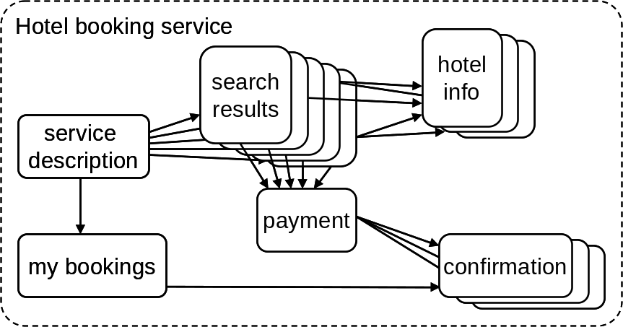
Conceptual Overview
High-level example: hotel booking
hypermedia -> operations
search(date, city)
→ list of hotels & rates
getHotelDetails(hotel)
→ hotel details
reserve(rate, creditCard)
→ confirmationID
getConfirmationDetails(confID)
→ confirmation details
listMyBookings()
→ list of confirmationIDs
nouns vs. verbs

Slide 33
Technologies
Todays’s set of technologies, protocols and languages used to apply RESTful paradigm:
  HTTP as the basis
  XML and JSON for data exchange
  AJAX for client-side programming (e.g. browser)
There exists an attempt to develop WSDL-like definition language for describing RESTful services
  Web Application Description Language (WADL)

Slide 34
TECHNICAL SOLUTION
TECHNOLOGIES
Hypertext Transfer Protocol (HTTP)

Slide 35
HTTP
Overview
Hypertext Transfer Protocol (HTTP)
  A protocol for distributed, collaborative, hypermedia information systems.
  A request/response standard typical of client-server computing.
  Currently dominant version is HTTP/1.1.
Massively used to deliver content over the Web
  Web browsers and spiders are relying on HTTP.
The protocol is not constrained to TPC/IP
  It only presumes a reliable transport.
Resources accessed by HTTP are identified by URIs (more specifically URLs), using the http URI schemes.

Slide 36
HTTP
Request-response format
Request consists of
  Request line, such as GET /images/logo.gif HTTP/1.1, which requests a resource called /images/logo.gif from server.
  Headers, such as Accept-Language: en
  An empty line
  An optional message body
Response consists of
  Status line which includes numeric status code and textual reason phrase
  Response headers
  An empty line
  The requested content

Slide 37
HTTP
Request methods
HTTP request methods indicate the desired action to be performed on the identified resource:
  GET
    Requests a representation of the specified resource. GET should not be used for operations that cause side-effects (problematic with robots and crawlers). Those operations are called safe operations.
  POST
    Submits data to be processed (e.g., from an HTML form) to the identified resource. The data is included in the body of the request.
  PUT
    Uploads a representation of the specified resource.
  DELETE
    Deletes the specified resource.

Slide 38
HTTP
Example – Retrieving FOAF profile
Example is relying on curl which is a command line tool used to transfer data with URL syntax
  Supports many protocols such as FTP, FTPS, HTTP, HTTPS, SCP, SFTP, etc.
  More information can be found at http://curl.haxx.se
curl usage pattern is simple:
$ curl -v http://www.google.at
* About to connect() to www.google.at port 80 (#0)
* Trying 74.125.87.104... connected
* Connected to www.google.at (74.125.87.104) port 80 (#0)
> GET / HTTP/1.1
> User-Agent: curl/7.19.6 (i686-pc-cygwin) libcurl/7.19.6 OpenSSL/0.9.8o zlib/1.2.3 libidn/1.18 libssh2/1.2
> Host: www.google.at
> Accept: */*
>
< HTTP/1.1 200 OK
< Date: Sun, 13 Jun 2010 15:13:15 GMT
< Expires: -1
< Cache-Control: private, max-age=0
< Content-Type: text/html; charset=ISO-8859-1
< Set-Cookie: PREF=ID=29937d127162f98f:TM=1276441995:LM=1276441995:S=wQcvUApkDnuGPQEa; expires=Tue, 12-Jun-2012 15:13:15
< Server: gws
< X-XSS-Protection: 1; mode=block
< Transfer-Encoding: chunked
<
<!doctype html><html><head><meta http-equiv="content-type" content="text/html; charset=ISO-8859-1"><title>Google</title> …

Slide 39
HTTP
Example – Retrieving FOAF profile
Srdjans-MacBook-Pro:~ skomazec$ curl -v http://www.sti-innsbruck.at/fileadmin/scripts/foaf.php?id=215
* About to connect() to www.sti-innsbruck.at port 80 (#0)
* Trying 138.232.65.141... connected
* Connected to www.sti-innsbruck.at (138.232.65.141) port 80 (#0)
> GET /fileadmin/scripts/foaf.php?id=215 HTTP/1.1
> User-Agent: curl/7.19.7 (universal-apple-darwin10.0) libcurl/7.19.7 OpenSSL/0.9.8l zlib/1.2.3
> Host: www.sti-innsbruck.at
> Accept: */*
>
< HTTP/1.1 200 OK
< Date: Sun, 06 Jun 2010 15:55:57 GMT
< Server: Apache
< X-Powered-By: PHP/5.2.0-8+etch16
< Content-Length: 944
< Content-Type: text/html; charset=UTF-8
<
<?xml version="1.0" encoding="utf-8"?>
<rdf:RDF
xmlns:rdf="http://www.w3.org/1999/02/22-rdf-syntax-ns#"
xmlns:rdfs="http://www.w3.org/2000/01/rdf-schema#"
xmlns:foaf="http://xmlns.com/foaf/0.1/">
<foaf:PersonalProfileDocument rdf:about="">
<foaf:maker rdf:resource="#me"/>
<foaf:primaryTopic rdf:resource="#me"/>
</foaf:PersonalProfileDocument>
<foaf:Person rdf:ID="me">
<foaf:name>Srdjan Komazec</foaf:name>
<foaf:givenname>Srdjan</foaf:givenname>
<foaf:family_name>Komazec</foaf:family_name>
<foaf:mbox_sha1sum>7348d8f19c568de04c7718880f700fad7acdfab9</foaf:mbox_sha1sum>
<foaf:depiction rdf:resource="http://www.deri.at/fileadmin/images/photos/srdjan_komazec_01.jpg"/>
<foaf:phone rdf:resource="tel:+43-512-507-6425"/>
<foaf:workplaceHomepage rdf:resource="http://www.deri.at"/>
<foaf:workInfoHomepage rdf:resource="http://www.deri.at/about/team/details/?uid=215"/>
</foaf:Person>
* Connection #0 to host www.sti-innsbruck.at left intact
* Closing connection #0
Requested resource

Slide 40
TECHNICAL SOLUTION
TECHNOLOGIES eXtensible Markup Language (XML)

Slide 41
XML
Overview
eXtensible Markup Language (XML)
  A set of rules for encoding documents electronically.
  De-facto standard (W3C Recommendation).
Ubiquitous presence on the Web and the Semantic Web
  Storage and transportation of data (RDF/XML and SOAP),
  Visualization of data (XHTML),
  Application configuration (XML configuration files), etc.
As such it can not be avoided as a possible data format for Web 2.0 Web Services.

Slide 42
XML
Characteristics
As opposed to JSON XML can be verified against a schema expressed in a number of languages such as Document Type Definition (DTD), and XML Schema:
  the vocabulary (element and attribute names),
  the content model (relationships and structure), and
  the data types.
Founded on the standards laying in the core of Web
  Uniform Resource Identifiers (URI)
  Unicode
Well-formedness an XML document
  Properly encoded legal Unicode characters,
  Special syntax characters such as < and & are used only as markup delineation,
  Element tags are correctly nested,
  Element tags are case sensitive,
  There exists a single “root” element.

Slide 43
XML
Example
<?xml version="1.0" encoding="UTF-8"?>
<Person>
<firstName>John</firstName>
<lastName>Smith</lastName>
<age>25</age>
<address>
<streetAddress>21 2nd Street</streetAddress>
<city>New York</city>
<state>NY</state>
<postalCode>10021</postalCode>
</address>
<phoneNumber type="home">212 555-1234</phoneNumber>
<phoneNumber type="fax">646 555-4567</phoneNumber>
<newSubscription>false</newSubscription>
<companyName />
</Person>

Slide 44
TECHNICAL SOLUTION
TECHNOLOGIES
JavaScript Object Notation (JSON)

Slide 45
JSON
Overview
JavaScript Object Notation (JSON)
  A lightweight computer data interchange format.
  Specified in Request For Comment (RFC) 4627.
Represents a simple alternative to XML
  A text-based, human-readable format for representing simple data structures and associative arrays (called objects).
Used by a growing number of services
JavaScript-friendly notation
  Its main application is in Ajax Web application programming.
A serialized object or array
No namespaces, attributes etc.
No schema language (for description, verification)

Slide 46
JSON
Data types
JSON basic data types are
  Number (integer, real, or floating point)
  String (double-quoted Unicode with backslash escaping)
  Boolean (true and false)
  Array (an ordered sequence of values, comma-separated and enclosed in square brackets)
  Object (collection of key:value pairs, comma-separated and enclosed in curly braces)
  null

Slide 47
JSON
Example
{
"firstName": "John",
"lastName": "Smith",
"age": 25,
"address": {
"streetAddress": "21 2nd Street",
"city": "New York",
"state": "NY",
"postalCode": "10021"
},
"phoneNumbers": [
{ "type": "home", "number": "212 555-1234" },
{ "type": "fax", "number": "646 555-4567" }
],
"newSubscription": false,
"companyName": null
}

Slide 48
TECHNICAL SOLUTION
TECHNOLOGIES
Asynchronous JavaScript and XML (AJAX)

Slide 49
AJAX
Overview
Asynchronous JavaScript and XML (AJAX)
  A group of interrelated web development techniques used on the client-side to create interactive web applications
  Web apps can fetch data from the server without refreshing the page
AJAX is used to increase interactivity and dynamism of web pages
Since the technological base is partially shared AJAX and RESTful services make a good match
  Enriching Web pages with the data operated through RESTful services

Slide 50
AJAX
Constituent technologies
(X)HTML and CSS
  Information styling and marking.
Document Object Model (DOM)
  A cross-platform and language-independent convention for representing and interacting with objects in HTML, XHTML and XML documents.
  Objects are accessed through JavaScript
XMLHttpRequest object
  Present in all major browsers
  Method to exchange data between the server and browser in async manner
XML or JavaScript Object Notation - JSON
  Interchange, manipulation and display of data.
JavaScript
  Language which brings all these technologies together

Slide 51
TECHNICAL SOLUTION
TECHNOLOGIES
Web Application Description Language (WADL)

Slide 52
WADL
Quick overview
Web Application Description Language
  No real uptake
  W3C Member Submission
Application ( = our Web service)
  Has resources
  Resources have HTTP methods
  Inputs and outputs can contain links to resources
WADL focuses on resources and hypertext
  As opposed to operations (WSDL)

Slide 53
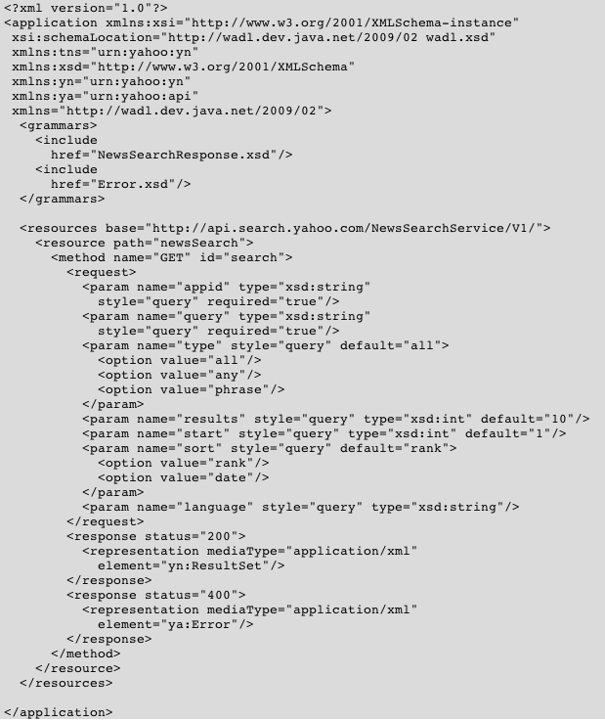
WADL
Example
Example taken from Marc Hadley, Web Application Description Language, W3C Member Submission, http://www.w3.org/Submission/wadl

Slide 54
Illustration By a Larger Example

Slide 55
Illustration By a Larger Example
Twitter REST API
Twitter is social networking and microblogging service that enables its users to send and read messages known as tweets.
Tweets are text-based posts of up to 140 characters displayed on the author's profile page and delivered to the author's subscribers who are known as followers.
Twitter has offered a comprehensive set of RESTful APIs to access core Twitter data: update timelines, status data and user information.
User sensitive data is protected by the HTTP Basic authentication mechanism.

Slide 56
Illustration By a Larger Example
Twitter REST API – GET example – User Timeline
Method: | statuses user_timeline
Description: | Returns the 20 most recent statuses posted from the authenticating user. It's also possible to request another user's timeline via the id parameter.
URL: | http://api.twitter.com/1/statuses/user_timeline.format
Formats: | xml, json, rss, atom
HTTP Method: | GET
Parameters: | id | optional | Specifies the ID or screen name of the user for whom to return the user timeline.
 | since_id | optional | Returns only statuses with an ID greater than (that is, more recent than) the specified ID.
 | max_id | optional | Returns only statuses with an ID less than (that is, older than) or equal to the specified ID.

Slide 57
Illustration By a Larger Example
Twitter REST API – GET example
Srdjans-MacBook-Pro:~ skomazec$ curl -v http://api.twitter.com/1/statuses/user_timeline/google.xml
* About to connect() to api.twitter.com port 80 (#0)
* Trying 168.143.162.45... connected
* Connected to api.twitter.com (168.143.162.45) port 80 (#0)
> GET /1/statuses/user_timeline/google.xml HTTP/1.1
> User-Agent: curl/7.19.7 (universal-apple-darwin10.0) libcurl/7.19.7 OpenSSL/0.9.8l zlib/1.2.3
> Host: api.twitter.com
> Accept: */*
>
< HTTP/1.1 200 OK
< Date: Sun, 06 Jun 2010 16:04:48 GMT
< Server: hi
< Status: 200 OK
…
< Vary: Accept-Encoding
< Connection: close
<
<?xml version="1.0" encoding="UTF-8"?>
<statuses type="array">
<status>
<created_at>Sat Jun 05 15:24:45 +0000 2010</created_at>
<id>15493557859</id>
<text>#subsaturday @youtube channels: Forbes http://goo.gl/BKnh; NHLvideo http://goo.gl/kGlK; CelebrityPlaylists http://goo.gl/BL1y</text>
<source>web</source>
<truncated>false</truncated>
<in_reply_to_status_id></in_reply_to_status_id>
<in_reply_to_user_id></in_reply_to_user_id>
<favorited>false</favorited>
<in_reply_to_screen_name></in_reply_to_screen_name>
<user>
<id>20536157</id>
<name>A Googler</name>
<screen_name>google</screen_name>
<location>Mountain View, CA</location>
<description>News and updates from Google</description>
<profile_image_url>http://a3.twimg.com/profile_images/77186109/favicon_normal.png</profile_image_url>
<url>http://www.google.com/support/</url>
…
Service URL

Slide 58
Illustration By a Larger Example
Twitter REST API – GET example – Statuses Show
Method: | statuses show
Description: | Returns a single status, specified by the id parameter below. The status's author will be returned inline.
URL: | http://api.twitter.com/1/statuses/show/id.format
Formats: | xml, json
HTTP Method: | GET
Parameters: | id | required | The numerical ID of the status to retrieve.
Status is a Web resource!!!

Slide 59
Illustration By a Larger Example
Twitter REST API – GET example
Srdjans-MacBook-Pro:~ skomazec$ curl -v http://api.twitter.com/1/statuses/show/9627441680.xml
* About to connect() to api.twitter.com port 80 (#0)
* Trying 128.242.245.93... connected
* Connected to api.twitter.com (128.242.245.93) port 80 (#0)
> GET /1/statuses/show/9627441680.xml HTTP/1.1
> User-Agent: curl/7.19.7 (universal-apple-darwin10.0) libcurl/7.19.7 OpenSSL/0.9.8l zlib/1.2.3
> Host: api.twitter.com
> Accept: */*
>
< HTTP/1.1 200 OK
< Date: Sun, 06 Jun 2010 16:09:31 GMT
< Server: hi
< Status: 200 OK
< X-Transaction: 1275840571-6663-24393
< X-RateLimit-Limit: 150
…
< Vary: Accept-Encoding
< Connection: close
<
<?xml version="1.0" encoding="UTF-8"?>
<status>
<created_at>Thu Feb 25 14:23:37 +0000 2010</created_at>
<id>9627441680</id>
<text>From our European public policy blog, Amit Singhal explains just how tough search is: http://bit.ly/9UbBSD</text>
<source>&lt;a href=&quot;http://bit.ly&quot; rel=&quot;nofollow&quot;&gt;bit.ly&lt;/a&gt;</source>
<truncated>false</truncated>
…
<user>
<id>20536157</id>
<name>A Googler</name>
<screen_name>google</screen_name>
<location>Mountain View, CA</location>
<description>News and updates from Google</description>
<profile_image_url>http://a3.twimg.com/profile_images/77186109/favicon_normal.png</profile_image_url>
<url>http://www.google.com/support/</url>
<protected>false</protected>
<followers_count>2266241</followers_count>
…
Service URL

Slide 60
Illustration By a Larger Example
Twitter REST API – POST example – Statuses Update
Method: | statuses update
Description: | Updates the authenticating user's status. Requires the status parameter specified below. Request must be a POST. A status update with text identical to the authenticating user's current status will be ignored to prevent duplicates.
URL: | http://api.twitter.com/1/statuses/update.format
Formats: | xml, json
HTTP Method: | POST
Parameters: | status | required | The text of your status update. URL encode as necessary.
 | lat | optional | The location's latitude that this tweet refers to.
 | long | optional | The location's longitude that this tweet refers to.
 | in_reply_to_status_id | optional | The ID of an existing status that the update is in reply to.

Slide 61
Illustration By a Larger Example
Twitter REST API – POST example
Srdjans-MacBook-Pro:~ skomazec$ curl -u skomazec:xxxxxxxx -d 'status=APITest' http://api.twitter.com/1/statuses/update.xml
<?xml version="1.0" encoding="UTF-8"?>
<status>
<created_at>Sun Jun 06 16:30:08 +0000 2010</created_at>
<id>15566102131</id>
<text>APITest</text>
<source>&lt;a href=&quot;http://apiwiki.twitter.com/&quot; rel=&quot;nofollow&quot;&gt;API&lt;/a&gt;</source>
<truncated>false</truncated>
<in_reply_to_status_id></in_reply_to_status_id>
<in_reply_to_user_id></in_reply_to_user_id>
<favorited>false</favorited>
<in_reply_to_screen_name></in_reply_to_screen_name>
<user>
<id>20307518</id>
<name>Srdjan Komazec</name>
<screen_name>skomazec</screen_name>
<location>Innsbruck, Austria</location>
<description></description>
<profile_image_url>http://s.twimg.com/a/1275689140/images/default_profile_0_normal.png</profile_image_url>
<url></url>
<protected>false</protected>
…
<friends_count>3</friends_count>
<created_at>Sat Feb 07 12:51:45 +0000 2009</created_at>
<favourites_count>0</favourites_count>
<utc_offset>3600</utc_offset>
<time_zone>Vienna</time_zone>
…
</user>
<geo/>
<coordinates/>
<place/>
<contributors/>
</status>
HTTP Basic
Authentication
HTTP Post
payload
Service URL

Slide 62
Extensions

Slide 63
Extensions
Semantic descriptions of RESTful services
  hRESTS like a simplified WSDL to annotate Web pages describing service functionality
  MicroWSMO adds semantic annotations (like SAWSDL)
  Annotations can target WSMO-Lite descriptions
Methods to analyze JavaScript in AJAX sites
  The present trend is to pack RESTful functionality in the form of JavaScript libraries
    Google AJAX Search API (http://code.google.com/apis/ajaxsearch)
  Analysis of the code could unveil information about the used services services

Slide 64
Summary

Slide 65
Summary
Web 2.0 technologies are ubiquitously present on today’s Web
  Users are dominant producers of data.
  Data is opened for further processing and integration.
Representational State Transfer (REST) is an architectural style especially suitable to exploit the Web data and offer services on top of the data
  The RESTful systems are compliant with the Web requirements.
  REST brings near the data residing on the Web and the ways to process it.

Slide 66
Summary
RESTful-approach represents a natural way to offer Web Services as opposed to the SOAP-based Web Services
  It builds on top of the architectural style which pervades the Web
  It relies on the proven Web protocol (HTTP) and data formats (XML, JSON).
  It integrates easily with the dominant visualization tool (a.k.a. Web browser) through JavaScript and AJAX.
RESTful-based services are dominating the Service Web
  68% RESTful services vs. 19% SOAP services².
  It is expected that the dominance of RESTful services will grow up in future.
² Statistics retrieved from the Programmable Web on Dec 17th, 2009 @ http://www.programmableweb.com/apis

Slide 67
References

Slide 68
References
Mandatory reading:
  Fielding, Roy T.; Taylor, Richard N. (2002-05), "Principled Design of the Modern Web Architecture”, ACM Transactions on Internet Technology (TOIT) (New York: Association for Computing Machinery) 2 (2): 115–150
Further reading:
  Fielding, Roy Thomas (2000), Architectural Styles and the Design of Network-based Software Architectures, Doctoral dissertation, University of California, Irvine
Wikipedia and other links:
  Web 2.0: http://en.wikipedia.org/wiki/Web_2.0
  REST: http://en.wikipedia.org/wiki/REST
  JavaScript: http://en.wikipedia.org/wiki/Javascript
  AJAX: http://en.wikipedia.org/wiki/AJAX
  JSON: http://en.wikipedia.org/wiki/JSON
  Atom: http://en.wikipedia.org/wiki/Atom_(standard)
  Mashups: http://en.wikipedia.org/wiki/Mashup_(web_application_hybrid)
  HTTP: http://tools.ietf.org/html/rfc2616

Slide 69
Next Lecture
# | Title
1 | Introduction
2 | Web Science
3 | Service Science
4 | Web services
5 | Web2.0 services
6 | Semantic Web
7 | Web Service Modeling Ontology (WSMO)
8 | Web Service Modeling Language (WSML)
9 | Web Service Execution Environment (WSMX)
10 | OWL-S and others
11 | Light-weight Annotations
12 | Applications
13 | Mobile Services

Slide 70

Questions?

