Slide 1
MongoDB
NoSQL Document Database
Notes:
NoSQL databases ("not only SQL") are non tabular, and store data differently than relational tables. NoSQL databases come in a variety of types based on their data model. The main types are document, key-value, wide-column, and graph. They provide flexible schemas and scale easily with large amounts of data and high user loads.

Slide 2


What is MongoDB?
MongoDB is a document-based, distributed database built for modern application developers and for the cloud era.
Two options:
CLOUD SERVER
SandBox (free, developing)
Shared (RAM, 5GB Disk)
Dedicated (security, scaled)
Two versions:
Community
Enterprise

Slide 3
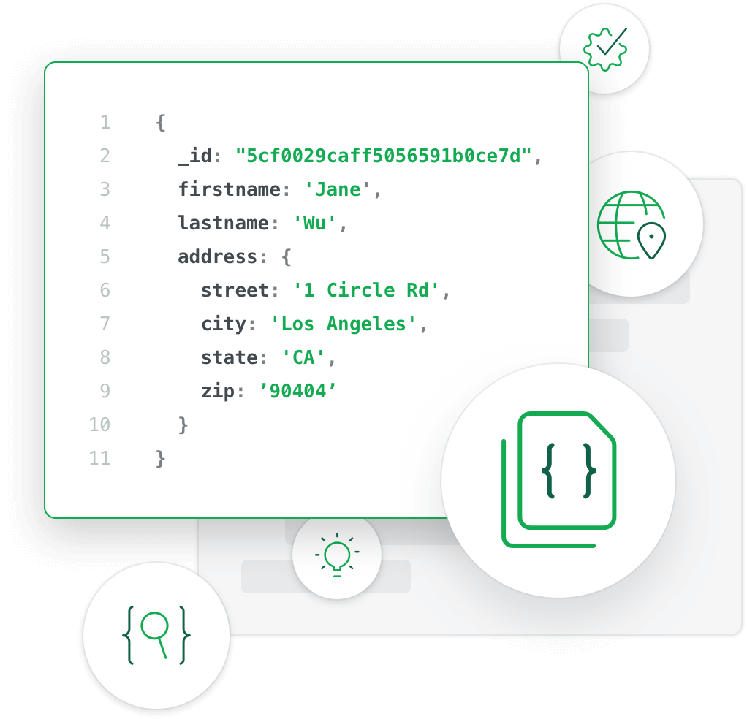
Features
Stores data in JSON-like documents (BSON)
Model maps to objects in the application code
Ad-hoc queries, indexing and real-time aggregation
Distributed database at its core
Free to use
Notes:
2. The document model maps to the objects in your application code, making data easy to work with
3. Adhoc -> Sobre la marcha
4. high availability, horizontal scaling, and geographic distribution are built in and easy to use

Slide 4




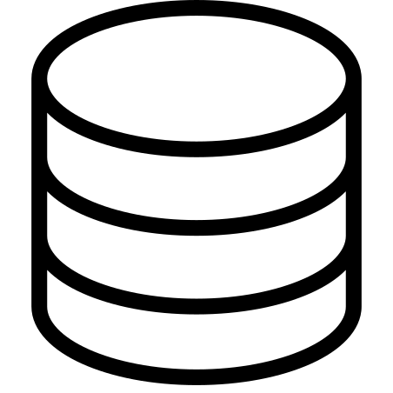
Using MongoDB
1. Installation
3. Start Client
5. Create Collection
6. Add and manage documents
2. Start Server
4. Create Database
Notes:
Program (windows) or command line (Mac linux)
Using commands
Using Mongo Shell, based on Javascript (it has several commands)
By ‘use’ command
BSON files folder, to save all the data
Using commands (insert, update, remove)

