Slide 1

Hints & Tips to Apply Clustering & Tracking Analysis
tools@bsc.es

Slide 2
Clustering

Slide 3
Steps
Apply clustering to the input traces
Setting up the environment
Running the cluster analysis
Result output files
General tips and common issues
Apply tracking to the clustered traces
Setting up the environment
Running the tracking analysis
Visualize the results with the Xtrack GUI

Slide 4
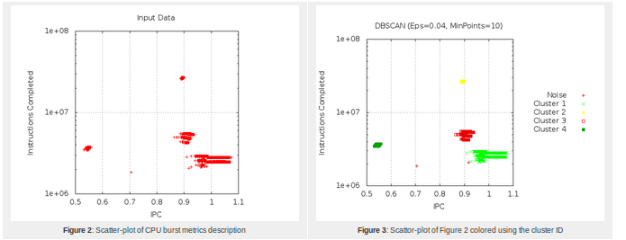
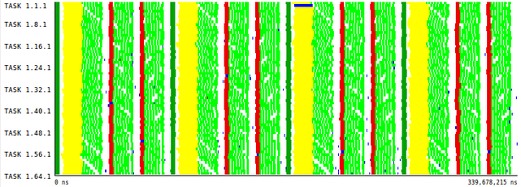
Clustering
Characterizes computing bursts that are similar and groups them into clusters
Allows to study the behavior of the clusters separately, identify patterns, etc.

Slide 5
Clustering
General information :
http://www.bsc.es/computer-sciences/performance-tools/clustering
Download the tool from:
http://www.bsc.es/computer-sciences/performance-tools/downloads
User guide & more details:
http://www.bsc.es/sites/default/files/public/computer_science/performance_tools/clusteringsuite_manual.pdf

Slide 6
Clustering – Setting up the environment
Recommended to work remotely connected to the BSC machines
Everything is configured automatically with modules
Load the tools module
The input traces must contain PAPI counters data
In the Extrae configuration (extrae.xml), activate the <counters> section
Make sure to read PAPI_TOT_INS and PAPI_TOT_CYC in all counters sets
> module load BSCTOOLS

Slide 7
Clustering – Setting up the environment
Configure the clustering analysis
Copy a configuration example to your working directory from:
$CLUSTERING_HOME/share/example/cluster.xml
Tune main cluster.xml settings
Epsilon
Radius in which a computing burst will still be considered similar
Min points
Minimum number of similar computing bursts to form a cluster
Range min/max
Allows to focus in a specific area
Duration filter
Discard very short computations

Slide 8

Clustering – Running the analysis
From command-line…
From Paraver…
Click on the “Run Application” icon in the Toolbar
Application: Clustering
Select your trace file…
Select your cluster.xml file…
Algorithm: XML defined
Press “Run”
Alternatively, right click on any timeline → Run → Clustering
In this case you may want to check…
“Use semantic window as bursts divider”
➔ The analysis will be applied to the phases that you see in the timeline
“Use semantic values as clustering dimensions”
The values of the timeline will be used as the similarity metric
Always check “Generate sequences file” → “Numbered”
> BurstClustering
-a -d cluster.xml
-i <input_trace.prv>
-o <output_trace.prv>load BSCTOOLS

Slide 9
Clustering – Output files generated
The process will generate several output files
A new trace: <trace_clustered>.prv
To visualize in Paraver, use the configuration file:
clustering/clusterID_window.cfg
An Instructions / IPC scatter plot
Open it with GNUplot
Clusters statistics
“% Total duration “ quantifies “how important” is a cluster
Cluster numeration ordered by this metric → Cluster 1 is the highest
> gnuplot <trace_clustered>.*.gnuplot
> cat <trace_clustered>.clusters_info.csv

Slide 10
Clustering – General tips and issues
How do I know whether my clustering “went well”?
There’s no “bad clustering” as long as you can extract information
Compare plot against the clustered trace. Do you see structure?
GNUplot vs. Trace viewed with clusterID_window.cfg
Is my Epsilon too high? Too small?
Lots of noise or crazy patterns → Maybe too small
You get 1-2 big clusters but you think you should see more → Too high
There’s no magic rule
Choose some parameters, run clustering and see results…
Not good? Refine parameters, repeat until satisfied

Slide 11
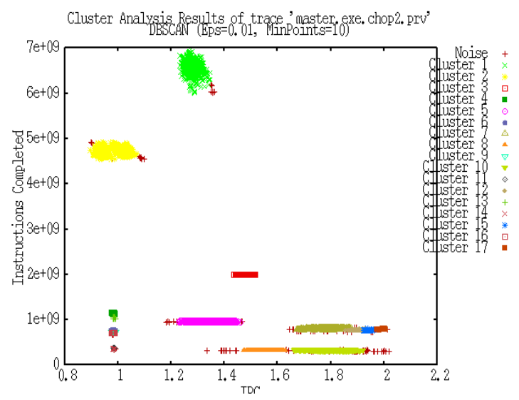
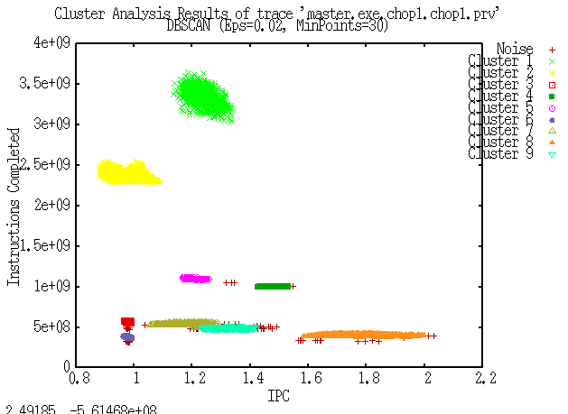
Clustering – General tips and issues (2)
Important! If you have several traces with different number of processes to do tracking later…
Be careful, the clusters “move” and maybe they end up out of the min/max ranges.
Use min/max filters in the cluster.xml to frame the same regions for each trace. Like a cameraman follows the action!
The better adjusted, the easier for the tracking tool.
Example of “bad framing”
Look at the left image, bottom region, it disappears in the right image, not good!
?

Slide 12
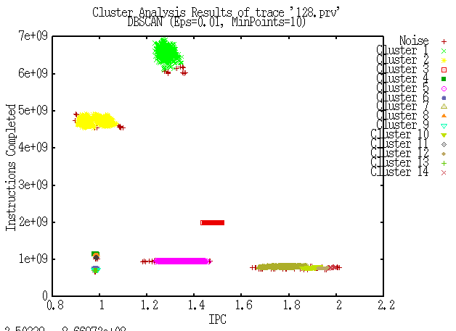
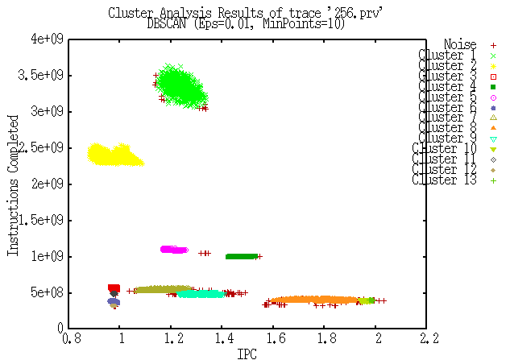
Clustering – General tips and issues (3)
After adjusting the ranges…
Same objects in both images → This is better
These two clustered traces are ready to be used with the tracking tool

Slide 13
Tracking

Slide 14
Tracking
A friendly way to quantify and visualize the evolution of the clusters among several traces
The tool has 2 parts
Recognition algorithm of “who-is-who”, based on heuristics
A visualization GUI
Available heuristics
Position (default), Callstack, SPMDiness, Density & Alignment
Examples analyzing multiple traces
Scaling number of cores (64 – 128 – 256… CPU’s)
Testing different microarchitecture features
Changing the problem size
Trying different compiler optimizations

Slide 15
Tracking – Setting up the environment
Load the tools module
Your starting point is the folder with all the files generated during clustering
E.g. You applied clustering to 2 or more traces with increasing number of cores:
64.prv, 128.prv, 256.prv…
And obtained the clustered traces:
64.clustered.prv, 128.clustered.prv, 256.clustered.prv…
> module load BSCTOOLS

Slide 16
Tracking – Running the analysis
Run the tracking analysis
Remember to pass the traces in a logical order
Tracking results: TRACKING.RESULTS.xtrack
Open with Xtrack GUI
You will also get new traces (*.clustered.tracked.prv) with new colors for the clusters
> tracking
64.clustered.prv
128.clustered.prv
256.clustered.prv
...
> xtrack TRACKING.RESULTS.xtrack

Slide 17
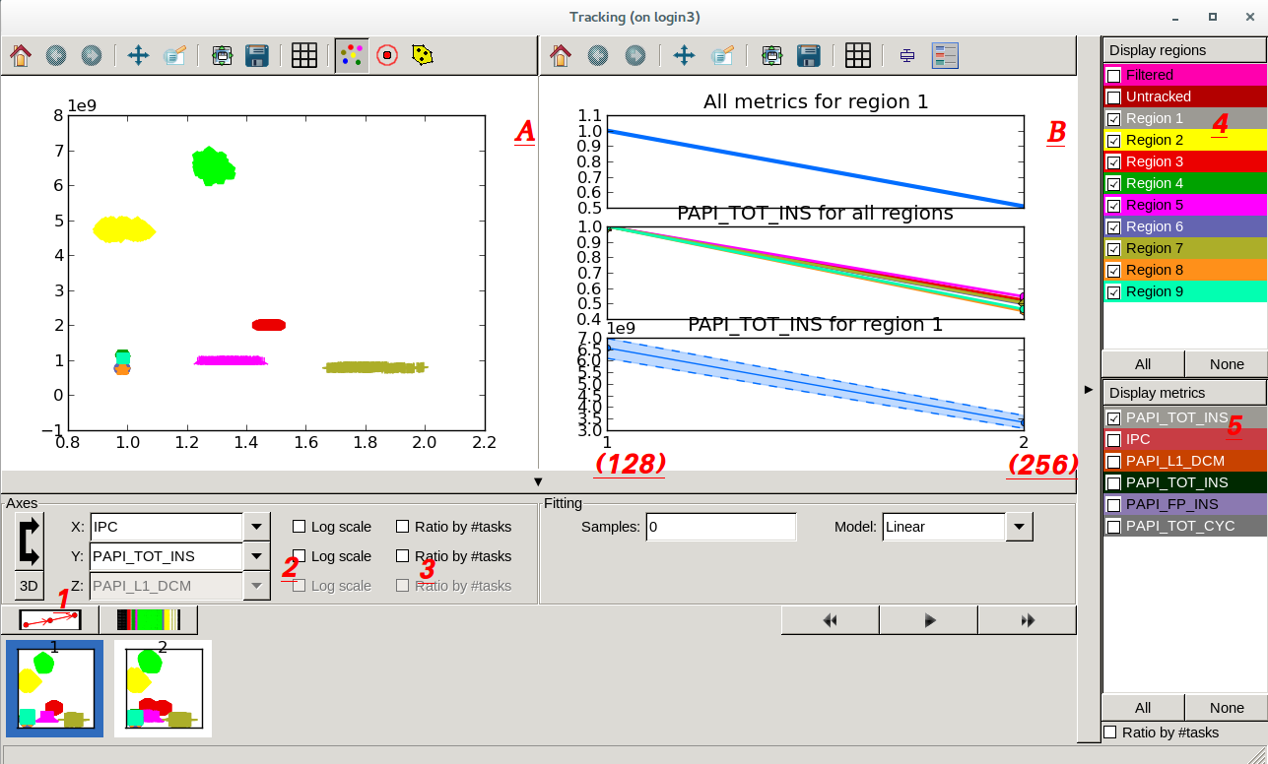
Xtrack -- GUI
Comments on next slide…

Slide 18
Xtrack – GUI (2)
Window A shows a clustering scatter plot, by default the Instructions / IPC plot.
Push button 1 (dots and arrows) → Shows the movement of the clusters along the different traces
Now push 2 → You can clearly see the movement of the clusters in the lower part of the plot
3 → Divides the numbers by number of processes. Useful to see the impact of code replication.
Window B shows correlation plots. Can be modified using right controls (4, 5)
Note that only shows a straight line because we only used two traces (128, 256 cores)
“All regions” means: all checked clusters
“For region 1” means: you clicked/selected Cluster 1 label
In this example you can see how the Total instructions were reduced to 50% for Cluster 1 (top plot)
Play around with the controls to understand better!

Slide 19
Acknowledgement
Many thanks to Constan Gómez for putting these slides, tips & tricks together!

