Slide 1





Using Oracle SQL
for Searching
Barry Chase, Information Technology
October 17, 2008
bchase@humana.com
Notes:
According to the presentation agenda this is supposed to be
“Using Oracle SQL for Searching”.... forgive me for the bait-n-switch ...
[next slide]

Slide 2
Managing Multiple Parameter Inputs via Dynamic SQL
Managing Multiple Parameter Inputs via Dynamic SQL
Using Oracle SQL
for Searching
Not Your Mama's Banana Pudding
Barry Chase, Information Technology
October 17, 2007
bchase@humana.com
Notes:
What we are really talking about is :
MANAGING MULTIPLE PARAMETER INPUTS VIA DYNAMIC SQL

Slide 3
It’s All About Me
Currently employed with Humana, Inc. as an Application Architect within Corporate Systems IT.
Approx. 10 years working experience with primary background in Oracle
1/15th second moment of fame
    Email and FTP Oracle Package Solutions using UTL_TCP published in the O’Reilly 4th edition of Oracle PL/SQL Programming book.
    Additionally provided content review for chapter on UTL_TCP usage in Oracle DB.
Notes:
About Me
Employed with Humana since October 2000. Just had my 8th year anniversary as of the 16th of this month
Roughly 10+ years exp. With primary background in Oracle, but have practical experience in linux environments, web development, php, etc.
For those that do not know, the PL/SQL Programming book was authored by Steven Fuerenstein and co-authored by Bill Pribyl.
Although not maintained as much as I would like, I do have a number of coding solutions on personal website from email and ftp, to single signon solutions. Free to the public, and more of a holding area for things I have either created or stumbled upon. For those interested, the website is within the whitepaper for this presentation.

Slide 4
Agenda
Evolution of Technology : Dynamic SQL
Scenario Overview
Solution
  Variable Parameter Inputs
  Selective Column Display
  Pagination
Future Vision
Questions
Notes:
I presume most of you are aware of Oracle's free stand alone personal edition of Oracle Application Express. If you haven't, I encourage you to download it from Oracle. It has a tremendous potential plus you get access to all those things that generally only the DBAs get to see.
At various points we will switch from presentation to live demonstration of how the presented dynamic sql execution works using Oracle Application Express.
Live demo will focus primarily on variable parameter inputs, however code supports dynamic selective column display and pagination as well
This presentation, as well as completed white paper and sample code will be made available for downloading.
Included in that white paper + demo setup, I will include application setup script for those who opt to install Oracle Application Express to their desktop or laptop... which I encourage.

Slide 5
Evolution of Technology : Dynamic SQL
Prior to Dynamic SQL availability, SQL was built and tailored specific to the processes being executed. This method incurred a number of performance issues to include but not limited to :
Excessive SQL Parsing at the Database level
Long Term Maintenance
Etc.
Dynamic SQL execution has offered the ability to build SQL on the fly using provided business rules and input parameters. A number of database features have also been made available by Oracle to enhance performance of the dynamic sql.
Bind Variables
Bulk Array Processing
Etc.
Notes:
Just a brief discussion high level of where we came from with respect to Dynamic SQL.
That being said, for the same reason that I put the efforts into the Mail Utility and FTP Utility mentioned earlier, there had to be a better way to make use of all this new technology in 10g+....
I like to know why something works the way it does, but if time is of issue, I just need to know it works, and I want it to be easy to use... implementation of complex bind variable and bulk array process scenarios, is not always easy nor time efficent to build.
I need an API !

Slide 6
Scenario Overview
Scenario : Project requires provision for client side data entry of criteria to
select desired data. Must support inclusion/exclusion logic,
must be adaptable to new conditions as the application matures.
Also include variable column display of information depending
on interface location or criteria conditions.
Objective : Provide a flexible search utility which is extensible to changing criteria and column displays.
Solution : Using REFcursors and associative arrays to build dynamic conditional logic. Providing the following key features :
Variable Parameter Input
Selective Column Return
Optimization (Pagination or Chunking)‏
This presentation is designed to cover the topics above and provide sample logic that can be easily tested and applied to your project development.
Notes:
Proposed scenario parallels web application that required essentially a 'Google-like' search feature for users to utilize in identifying key populations.
In basic we need something that could permit complex SQL to be created on the fly as well as simple, all via a common web interface.
A prototype was built in roughly a month preceding the project dev launch date, and then refined as needed during the remainder of that project.
Has sense then been employed as the backend utility for our electronic phonebook on our Corporate Intranet. Did not require any modifications to existing sourcecode.

Slide 7
Variable Parameter Input :: API Structure
Variable Parameter Input
  Instead of hardcoded api parameters or limiting to an array containing multiple values for a single parameter type, uses an associative array to build a Criteria Grid of all parameters to applied to SQL execution.
  Number of search parameter inputs become limited only by your imagination and business needs
  No bind variables required or potentially minimized greatly
  Logic to filter out potential SQL Injection routines
BEFORE
Get_data_c (
p_person_id in number
, p_company in varchar2
, p_state_id in varchar2
, p_success OUT varchar2
, p_sql OUT varchar2
, p_cur OUT c_cursor
);
AFTER
Get_data_c (
p_parameter_list in vc4000_table
, p_success OUT varchar2
, p_sql OUT varchar2
, p_cur OUT c_cursor
);
Notes:
Big thing to notice is that BEFORE, can change overtime, or require new APIs to be built which are variants of the same. The AFTER situation is a one time build which becomes a reusable component given all additional items are table driven only.
The represented API is not the actual API is provided code. However it is intended to show that we do not have to have endless parameter inputs, but instead a simple and concise set of parameters.
P_SUCCESS should always return OK, otherwise its an exception
P_SQL will return SQL built
P_CUR will return a REFCURSOR
Note : p_CUR is always populated, even if a NULL result caused by no data found or error inprocessing.

Slide 8
Variable Parameter Input
Variable Parameter input is satisfied by way of a Criteria Grid, which is passed as an associative array to the api. The grid is validated and processed to build conditional logic.
This conditional logic is then appended to the sql being built dynamically. Complex inclusion and exclusion logic is supported.
Each criteria grid array entry is a concatenated string (pipe separated) of key values, presenting a row of criteria data. Collectively, a set of these then make up conditional logic built dynamically.
Available criteria parameter name search are to be defined in our QCURSOR_SEARCH_COLUMNS table.
Notes:
Criteria Grid is essentially a set of instructions to enable the building of the conditions to be applied to the SQL
Infinite number of grid entries can exist. Grid structure lends itself to simple as well as complex SQL conditions
Ability to fold conditions one into the other to keep generated SQL small in size. More on this topic later.
Use of criteria grid does not require bind variables to address the complex sql generation, instead it leverages stored search criteria and global temp tables, and then use of analytical functions called LEAD and LAG to assist in the building of all those open/close parenthesis, and's, or's, exists, not exists, etc.

Slide 9
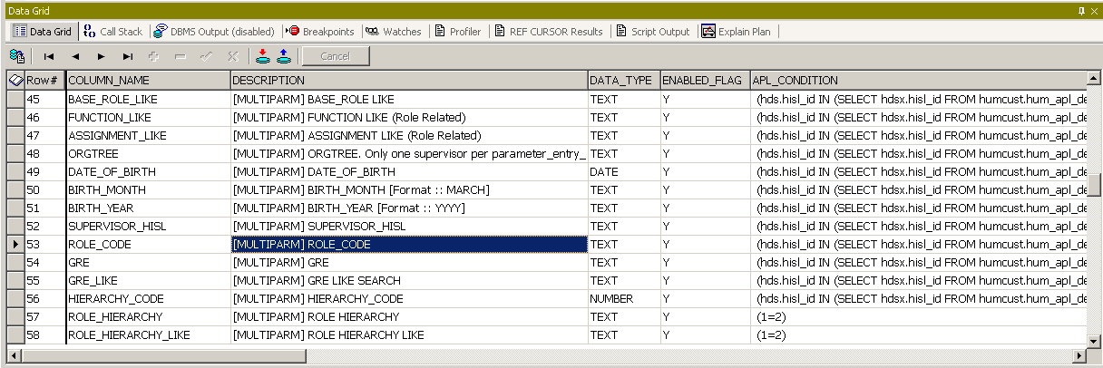
Variable Parameter Input :: Table Preview
Example stored condition :
(hds.hisl_id IN (SELECT hdsx.hisl_id FROM humcust.hum_apl_demographic_snap hdsx WHERE 1 = 1 AND EXISTS (SELECT 'x' FROM humcust.q_cursor_parms_global_temp WHERE 1 = 1 AND parameter_name = 'ROLE_CODE'|| ' [xxxparameter_entry_idxxx]' AND incl_excl_flag = 'I' AND UPPER(hdsx.ROLE_CODE) = UPPER(vdata_text))))
QCURSOR_SEARCH_COLUMNS table
(hds.employee_number IN (SELECT hdsx.employee_number FROM demo_snap hdsx WHERE 1 = 1 AND EXISTS (SELECT 'x' FROM q_cursor_parms_global_temp WHERE 1 = 1 AND parameter_name = 'BASE_ROLE'|| ' [xxxparameter_entry_idxxx]' AND incl_excl_flag = 'I' AND UPPER(hdsx.BASE_ROLE) = UPPER(vdata_text))))
Notes:
Here we have our available search conditions table. The condition is appended to our dynamic SQL by using the critiera grid as guidance, and certain string replacements to provide isolation and separation of criteria when necessary.
Need a new search condition.. just add it to the table.
It does not have to be a real column of data in the table either. For instance ORGTREE search is not a column of data but instead one of the more complex search conditions in that it returns all associates who report to identified individual using a connect by statement.
The fact that it does not have to be a column of data in the demographic snapshot table, means we have an increased level of flexibility in our search options to expose our clients to.

Slide 10
Variable Parameter Input :: Criteria Setup
Criteria Grid Elements
  PARAMETER_ENTRY_ID
    This identifies the order of the criteria in relation to each other
    This permits the ability to collapse multiple criteria grid rows into a single conditional entry as in the case of selecting for a list of employee numbers. We call this folding.
  PARAMETER_NAME
    This is similar to adding a new parameter input to an API, except that in this array format, I can manage and maintain the desired list of input parameters. Always UPPERCASE
  VDATA_TEXT
    This is the parameter varchar2 input value, similar to that of which would be passed on an API parameter input. When not provided the word NULL will be placed in this position.
  VDATA_DATE
    This is the parameter date input value, similar to that of which would be passed on an API parameter input. Format should always be represented text as YYYY/MM/DD HH24:MI:SS.
    When not provided the word NULL will be placed in this position.
  VDATA_NUMBER
    This is the parameter number input value, similar to that of which would be passed on an API parameter input. When not provided the word NULL will be placed in this position.
  INCL_EXCL_FLAG
    Identifies if this an exclusion or inclusion criteria entry and represented as an capital E or I.
  CONDITION_BLOCK_ID, CONDITION_SET_ID, CONDITION_MEMBER_ID
    These are used to help build the criteria entry into an actual SQL conditions
  CONDITION_OPERATOR
    Determines whether criteria entry falls into operator conditions of OR or AND.
Notes:
As stated a criteria grid is a string made up of key data separated by the pipe ( | ) character. This information is then built and stored into an associative array and passed to our api for SQL building and execution of the resulting SQL.
Each field position is required data.

Slide 11
Variable Parameter Input :: Simple Criteria
Criteria Grid Example
{PARAMETER_ENTRY_ID}|{PARAMETER_NAME}|{VDATA_TEXT}|{VDATA_DATE}|{VDATA_NUMBER}|{INCL_EXCL_FLAG}|{CONDITION_BLOCK_ID}|{CONDITION_SET_ID}|{CONDITION_MEMBER_ID}|{CONDITION_OPERATOR}
e.g.
l_parameter_list(1) := 1|ORGTREE|NULL|NULL|139245|I|1|1|1|OR
l_parameter_list(2) := 2|EMPLOYEE_NUMBER|NULL|NULL|139245|I|1|1|2|OR
l_parameter_list(3) := 3|BASE_ROLE|Applications Consultant|NULL|NULL|I|2|1|1|AND
..
..
and so on.

Slide 12
Variable Parameter Input :: Complex Criteria
ORGTREE of Supervisor # 45821 or ORGTREE of Supervisor # 53605 or Employee # 45821 or Employee# 53065, but do not include ORGTREE of Supervisor # 3493 who is a direct report to Supervisor 53605.
l_parameter_list(1) := 1|ORGTREE|NULL|NULL|45821|I|1|1|1|OR
l_parameter_list(2) := 2|ORGTREE|NULL|NULL|53605|I|1|1|2|OR
l_parameter_list(3) := 3|EMPLOYEE_NUMBER|NULL|NULL|45821|I|1|1|3|OR
l_parameter_list(4) := 3|EMPLOYEE_NUMBER|NULL|NULL|53065|I|1|1|3|OR
l_parameter_list(5) := 4|ORGTREE|NULL|NULL|3493|I|2|1|1|AND
Notice that our parameter_entry_id 3 (EMPLOYEE_NUMBER) is mentioned twice and both rows look identical with exception of the parameter value itself. This is an example of where we are “folding” the criteria entries into a single condition.
However, note that the array position still increments from position 3 to 4 since there can still only one entry per array index
Notes:
As said earlier... we have the potential of creating complex SQL conditions as well. One just has to think about how the grid needs to be built.
The key to building a successful criteria grid set, is the ability to visualize the conditions in criteria form.
Before we get to the visualizing piece, let me show you what this grid sample would generate SQL wise.
Next slide

Slide 13
Variable Parameter Input :: Generated SQL
AND ( ( /* ORGTREE */ ( hds.employee_number IN (
SELECT hdsx. employee_number
FROM demo_snap hdsx
WHERE 1 = 1 AND LEVEL > 1
CONNECT BY PRIOR hdsx. employee_number =
hdsx.supervisor_number
START WITH hdsx.hisl_id IN (
SELECT vdata_text
FROMq_cursor_parms_global_temp
WHERE 1 = 1
AND parameter_name =
'ORGTREE' || ' [1]'
AND incl_excl_flag = 'I' )) )‏
OR /* ORGTREE */ ( hds. employee_number IN (
SELECT hdsx. employee_number
FROM demo_snap hdsx
WHERE 1 = 1 AND LEVEL > 1
CONNECT BY PRIOR hdsx. employee_number =
hdsx.supervisor_number
START WITH hdsx. employee_number IN (
SELECT vdata_text
FROMq_cursor_parms_global_temp
WHERE 1 = 1
AND parameter_name =
'ORGTREE'
|| ' [2]'
AND incl_excl_flag =
'I' )) )‏
OR /* EMPLOYEE_NUMBER */ ( hds. employee_number IN (
SELECT hdsx. employee_number
FROM demo_snap hdsx
WHERE 1 = 1
AND EXISTS (
SELECT 'x'
FROMq_cursor_parms_global_temp
WHERE 1 = 1
AND parameter_name =
‘EMPLOYEE_NUMBER’
|| ' [3]'
AND incl_excl_flag =
'I'
AND hdsx. employee_number =
vdata_text ))‏
Notes:
The whole SQL condition is not displayed but enough to give you a concept of what ends being built.
Notice the connect by queries embedded within SQL condition statement.
Item to note here on the ORGTREE condition. In most cases this was very efficient, however the higher up the tree the supervisor was the slower it became. We have since then implemented a modified approach which works much the same but in fact goes the opposite direction... drills up from the associate to the supervisor in question, if we get a hit on the manager in question, then they report up through and to them.
Trust me.. it sounded hard to believe, but it worked a lot better. So... what I am saying is.. experiment.. remember, its just a condition within our search table. So figure something out and insert into the table.. now its available to use in your searches. Its that easy.

Slide 14
Variable Parameter Input :: Criteria Layout
As you can see you can see we build a construct that contains blocks which contain sets which contain members. Although we permit dynamic parameter selections, we enforce a series of rules around this logic.
AND (BLOCK 1
|
|__>>> SET 1
| |____>> MEMBER 1
| |____>> MEMBER 2
|
|_>>> SET 2
|
|___>> MEMBER 1
)‏
AND (BLOCK 2
|
|__>>> SET 1
| |____>> MEMBER 1
| |____>> MEMBER 2
|
|_>>> SET 2
|
|___>> MEMBER 1
|___>> MEMBER 2
)‏
Notes:
I spoke to visualizing the query. Breaking things down to the basic building blocks, we are looking at the following :
Blocks are always AND statements and thus can be leveraged as limiters of the resulting data. The more AND blocks you put in your grid, the more locked down the result set gets.
When more than 1 set is involved within a single Block, they are seen as OR statements to each other. If either is true, the condition is met.
Members on the other hand can be one of two types.... AND with the other one being OR. What is important to note is that if I have more than one member in a given SET, then they must either be AND or both must be OR, never a mix.
By default, member entries by themselves in a set, will always be an AND.
With this structure in mind, you can begin to see the variability available to us.

Slide 15
Variable Parameter Input :: Criteria Rules
The following rules permit highly flexible queries to be generated dynamically.
The VALIDATE_DEMO_PG_CRITERIA API call will be used to enforce these rules.
NON RULE VIOLATION ENCOUNTERED, BUT CAUSED FAILURE IN VALIDATION ROUTINE (e.g. Parameters invalid)
CONDITION MEMBERS ARE SEPARATED BY CONDITION OPERATORS OF 'OR' and 'AND' WHEN MORE THAN ONE CONDITION MEMBER.
WHEN ONE CONDITION MEMBER ONLY, THEN CONDITION OPERATOR SHOULD BE 'AND'.
CONDITION OPERATORS APPLY THE CONDITION SET AS A WHOLE AND USED AS A SEPARATOR BETWEEN CONDITION MEMBERS.
CONDITION SETS CAN ONLY CONTAIN ONE TYPE OF CONDITION OPERATOR. NO MIXING OF OPERATORS.
ANY GIVEN CONDITION SET CAN CONTAIN ANY NUMBER OF ONE OR MORE CONDITION MEMBERS.
Notes:
So how do we keep a bad criteria grid being built ?
Well instead of throwing caution to the wind and letting just anything through... we actually have rules.
Rules that verify we have a reasonable grid being built. We have about 13-14 rules today, but should a scenario occur that we need a new rule, we simply build that into our package code. For the most part, these rules have satisified our need for the past year. So most likely you won't need a new rule.
Whether it is a performant query execution will be a different question. The criteria grid does not replace the need for SQL tuning. You still need to tune. We tune by changing up our criteria grid placing things right.
Good example of this is where we had to move a search condition from the tail of the criteria grid, to places in the middle for each representative SET. The difference in performance was down from 20 minutes to about 1 minute. So.. don't forget to test your SQL and make sure that it performs well. Explain plans, etc.

Slide 16
Variable Parameter Input :: Criteria Rules
ANY GIVEN CONDITION BLOCK CAN CONTAIN ANY NUMBER OF ONE OR MORE CONDITION SETS.
MUST AT LEAST CONTAIN ONE CONDITION BLOCK.
CONDITIONS SETS WITHIN A BLOCK ARE ALWAYS SEPARATED BY 'OR' OPERATORS. MEANING ANY ONE OF THE CONDITION SETS CAN BE TRUE, AND DOES REQUIRE ALL CONDITION SETS TO BE TRUE TO SATISFY THE QUERY CONDITION LOGIC.
CONDITION BLOCKS ARE ALWAYS SEPARATED BY 'AND' OPERATORS. MEANING THAT EACH BLOCK MUST BE TRUE TO SATISFY QUERY CONDITION LOGIC.
ANY NUMBER OF ONE OR MORE CONDITION BLOCKS CAN BE DEFINED.
CONDITION BLOCK ID's are UNIQUE. CONDITION SET IDs ARE UNIQUE WITHIN A GIVEN CONDITION BLOCK. CONDITION MEMBER IDs ARE UNIQUE WITHIN A GIVEN CONDITION SET.
ONLY ONE ORGTREE SEARCH PER PARAMETER_ENTRY_ID.
KEYWORDS NOT AUTHORIZED IN PARAMETER VALUES (SQL INJECTION RULES)‏
- DBA_ - DBMS_SQL - GRANT - CREATE - ALTER - REVOKE - EXECUTE IMMEDIATE - SELECT
Notes:
Notice we have handling for SQL Injection identification which would then abort the API request and return a NULL set.

Slide 17
Selective Column Return
Another area of improvement is gained via creating a few, but very flexible, APIs for other systems to leverage. However, each client request clearly has different data needs that not only include what the search conditions are but also what columns of data that should be returned.
By creating master table, called QCURSOR_DATASET_COLUMN_MSTR, we can then track and deploy a variety of columns to our common api.
To ensure that each client can have their own representative set of column assignments, we leverage the use of PROCESS_DESC and SUB_PROCESS_DESC identifiers. Then populate a QCURSOR_DATASET_COLUMN_DETAIL with the columns desired for that specific feed.
Optionally, we can declare the columns desired on the fly.
Notes:
To make this API more reusable across multiple client needs, where each client wanted to see a different set of data columns, we built logic to support specific assignment of columns of data as well as on-demand column selection.
This replace previous demographic calls where always returned the same 200 demographic columns regardless of client, thus forcing the request service to ignore the other columns. Just excessive bandwidth usage which needed to be addressed... let alone the SQL generated was simple large. Now its compact and concise and to the need of the specific client.
PROCESS and SUB_PROCESS are keys to the success of this feature and has found its way into many of our foundation pieces that are used by a variety of projects and applications.

Slide 18
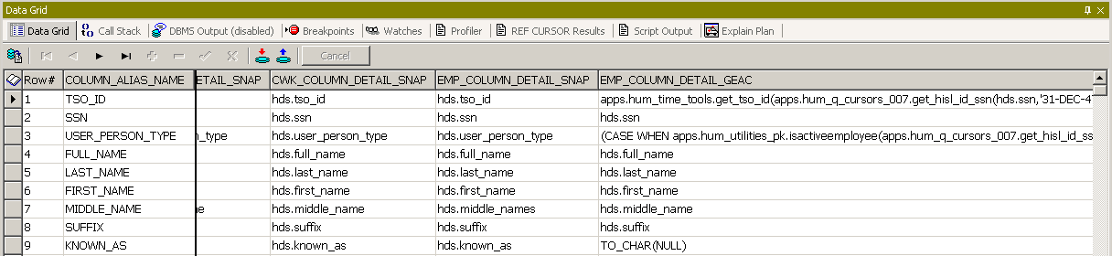
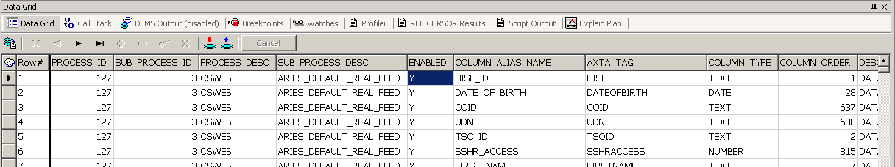
Selective Column Return : Table Preview
QCURSOR_DATASET_COLUMN_DETAIL
QCURSOR_DATASET_COLUMN_MSTR
Notes:
The master table contains the master set of available columns, wheras the detail contains the specific assignment entries. Setting a column to N for Enable flag in the detail table will turn that data column off on displays.
We can easily demonstrate that. Which takes us to a perfect time to step out to our demonstration application.

Slide 19
Optimization (Pagination/Chunking)
Final feature to the described solution is the ability to improve performance via options to grab chunks of data, page by page.
Define page/chunk size dynamically
Very few bind variables required, and same regardless of call
Collect a page/chunk at a time
Improves Web Page performance
Decreases impact of data pulls on overall system performance
Permits data-stream processing

Slide 20
Future Vision
Where do we go from here…
  Self-Service Feed Definition
  Feed Personalization
  Approval Cycle
  Setup Migration
  ??

Slide 21


