Slide 1
Git Flow Training

Slide 2
Goals
Learn to:
Use Bitbucket to change to the correct settings
Understand the MDE branching model
Create a feature branch and make a pull request for it.

Slide 3
Bitbucket Checklist
Repository Permissions
Add your users and set their access levels.
Branch Permissions
Prevent deletion/rewriting history/merging without pull requests on production branches
Add exemptions where necessary.
Default Reviewers
To add code reviewers for certain branches
Pull request settings
Require at least one successful build (Jenkins Only)
Requires at least one approver

Slide 4
Branching
master
This is the default branch that git creates when a new repo is made. It is the equivalent of the production branch.
develop
This is the branch we make our pull requests to.
feature/
This is the branch that you create and maintain.
You can freely push to this branch.
Make a pull request to merge this branch into develop.
master and develop cannot be pushed to.
Notes:
Branches should be short lived.
Prefixes:
The “feature/” is what you place in front of your branch name to let git/Bitbucket know that branch type it is.
Ex. git branch feature/login
hotfix/ is another prefix we will use.
release/ and bugfix/ the remaining two types of prefixes that Bitbucket recognizes.

Slide 5
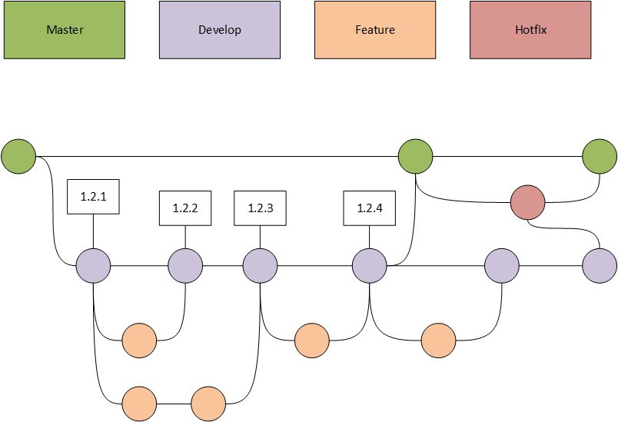
MDE model for large releases
Notes:
Make your pull requests to Develop.
The dev team in this model will merge develop into master when they have a release prepared.
Goal of this model is for continuous delivery.

Slide 6
Branching Process
Setup Branch
Pull Request
Work and Stage

Slide 7
Setup Branch
Pull changes
Make sure you are using the latest code
Create branch
Create your branch with the correct prefix
Prefixes are “feature/ or hotfix/”
Checkout Branch
This branch will only be local to your computer until you push to the remote repository.
Fix any merge conflicts
Notes:
1: Check for changes:
git fetch
2: To update your repo:
git pull
3: To create your branch:
git branch feature/<branchname>
4: To switch branches:
git checkout feature/<branchname>
To create and switch in one command:
git checkout –b feature/<branchname>
To delete:
git branch –d feature/<branchname>
To see all branches:
git branch

Slide 8
Work and Stage
Add changes
Commit changes
Push branch to the remote repository
Notes:
1: git add .
2: git commit
3: git push
Anything not staged will not be committed.
The commit message:
git commit –m “For a short message on your change”
Sometimes you need more to a commit message than one line. If that’s the case:
git commit
Which will open your default text editor. On line 1 enter a one line summary. On line 3 enter the full description.
The push:
Things to make sure of:
a.) You’re on the right branch – master or develop won’t let you push to them.
b.) You have the latest code – another pull request could have gone in before you finished your feature.
c.) You have no merge conflicts in your code – fix your issues before you push.
To push a branch that doesn’t exist on the remote repository:
git push –u origin master <branchname>

Slide 9
Pull request
Bitbucket
Log on to the remote repository and select create pull request.
Pull Request
Select your branch as the source and merge into master. Add reviewers and create.
Clean up
Delete your branch once the pull request has been accepted.
Update Pull Request
Make the necessary changes the reviewer required.
Notes:
Pull Request:
Our reviewers will be the 5 mentors (Carlos, Chris, Jing, Luan, and Shuvo).
Make your pull requests as small as possible. Large requests are difficult for the reviewers to check everything.
Give a more descriptive explanation about what the pull request is changing to help the reviewers know what to check.
Once you hit create, the reviewers will get an email notification about the pull request.
Updating Pull Requests:
If a reviewer requires a change to the pull request before the merge all you have to do is make the change and then push.
Pull requests stays open and you can continuously push to them.

Slide 10
Pull Request Reviewers
Receive PR
Checkout PR branch
Run tests and code quality checks
Notify requester of fixes required
Wait for next push
Merge PR when no fixes
needed
Notes:
Syntax notice:
PR means pull request.
Reviewers:
Good practice to respond within a day of receiving the pull request.
You will receive an email from Bitbucket.
Make sure delete the source branch once you’re ready to merge.
The code should work completely when it gets merged. If code doesn’t work when every one else does a pull they’re code breaks too.

Slide 11
Useful Quick Links
MDE tutorials:
Git Tutorial Series
Commit messages:
How to write Git commit messages
Pull requests:
Pull Request Guidelines
Unwritten Guide
README.md:
SSA Git Repo Guidelines
18f Open Source Style Guide
Bitbucket Markdown
.gitignore:
.gitignore

