Slide 1
EE368 Face detection
Joon Hyung Shim, Jinkyu Yang, and Inseong Kim

Slide 2
Introduction
Face detection : important part of face recognition
Variations of image appearance
  pose (front, non-front)
  occlusion
  Image orientation
  illuminating condition
  facial expression.
Methods
  color segmentation
  image segmentation
  template matching methods.

Slide 3
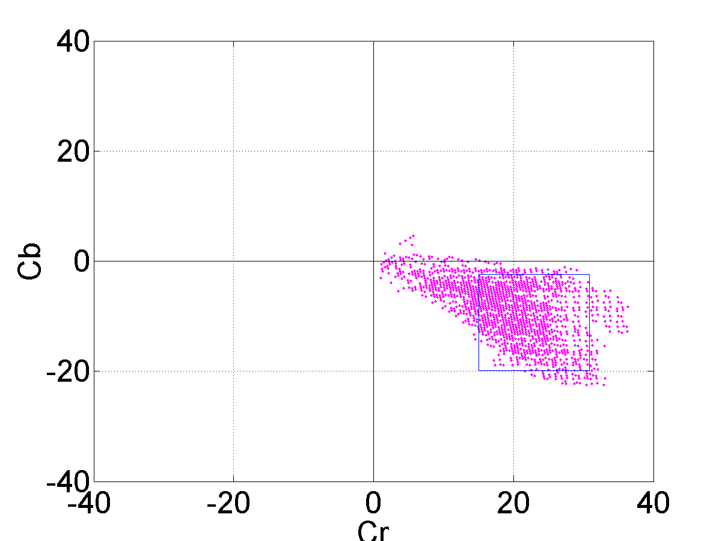
Color Segmentation
RGB components → YCbCr components
    Y = 0.299R + 0.587G + 0.114B
    Cb = -0.169R - 0.332G + 0.500B
    Cr = 0.500R - 0.419G - 0.081B
Skin window : from mean, deviation of Cb, Cr components.
Skin pixel of YCbCr color space

Slide 4
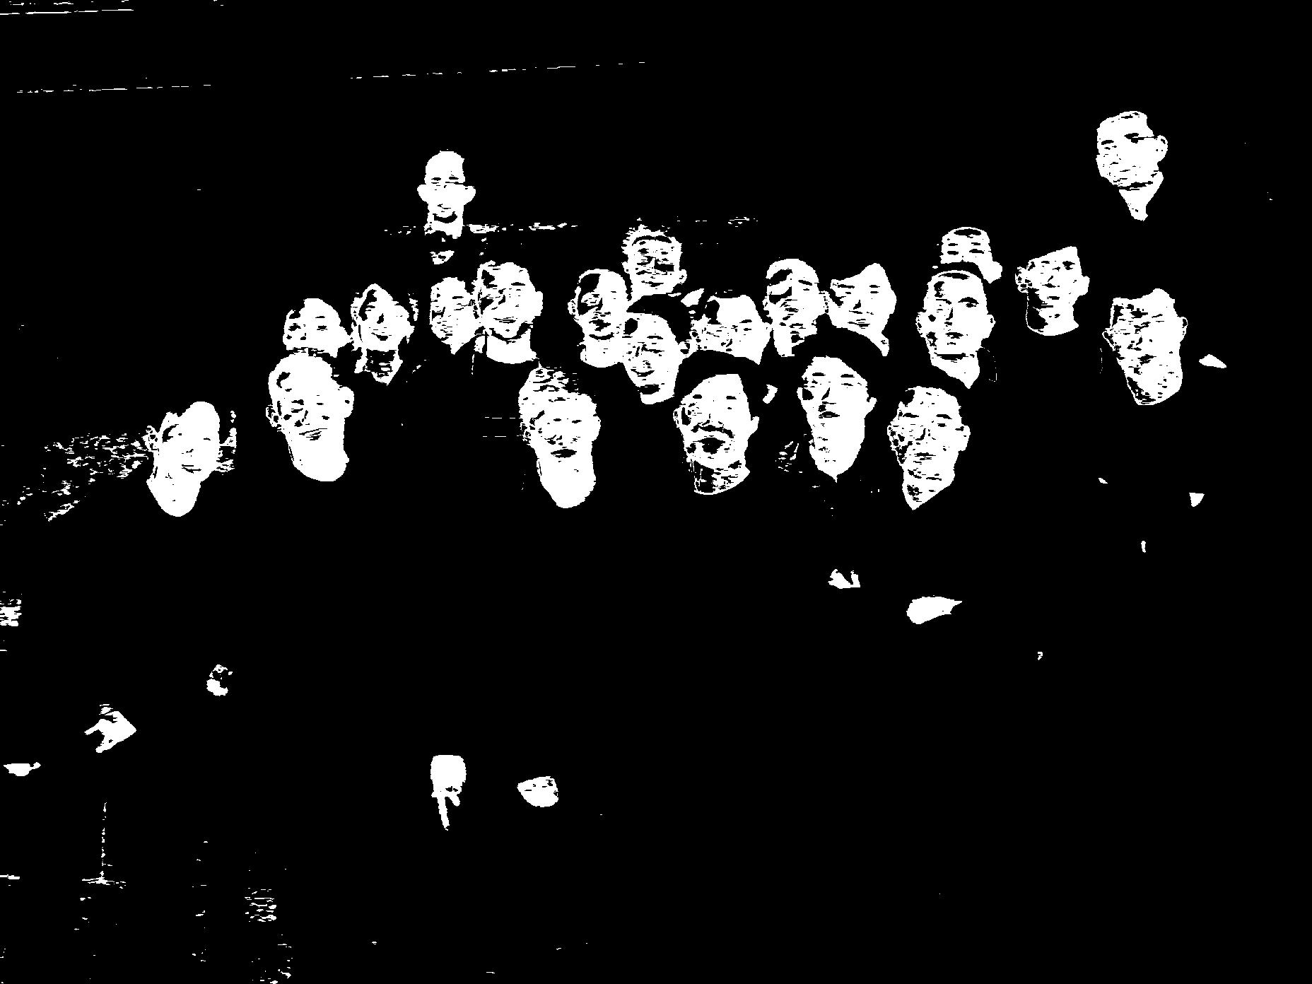
Color segmentation result of a training image

Slide 5
Image Segmentation
Separate the image blobs into individual regions
  Fill up black isolated holes, remove white isolated region
  Separate some integrated regions into individual faces
    Roberts cross edge detection algorithm
      Highlights regions(edge) → black line → erode
  Previous images are integrated into one binary image
  Small black and white areas are removed.

Slide 6
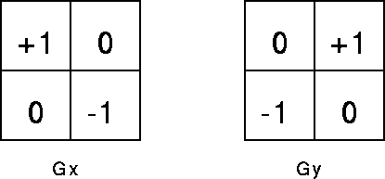
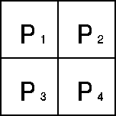
Roberts cross edge detection
Roberts Cross convolution masks
gradient magnitude : |G | = ( G_{x}² + G_{y}² ) ^{½} or |G | = |G_{x} | + |G_{y} |
Angle of orientation : θ = arctan (G_{y} /G_{x} ) - 3π/4
Pseudo-convolution operator
magnitude : |G | = |P₁ – P₄ | + |P₂ – P₃ |
Pseudo-Convolution masks

Slide 7
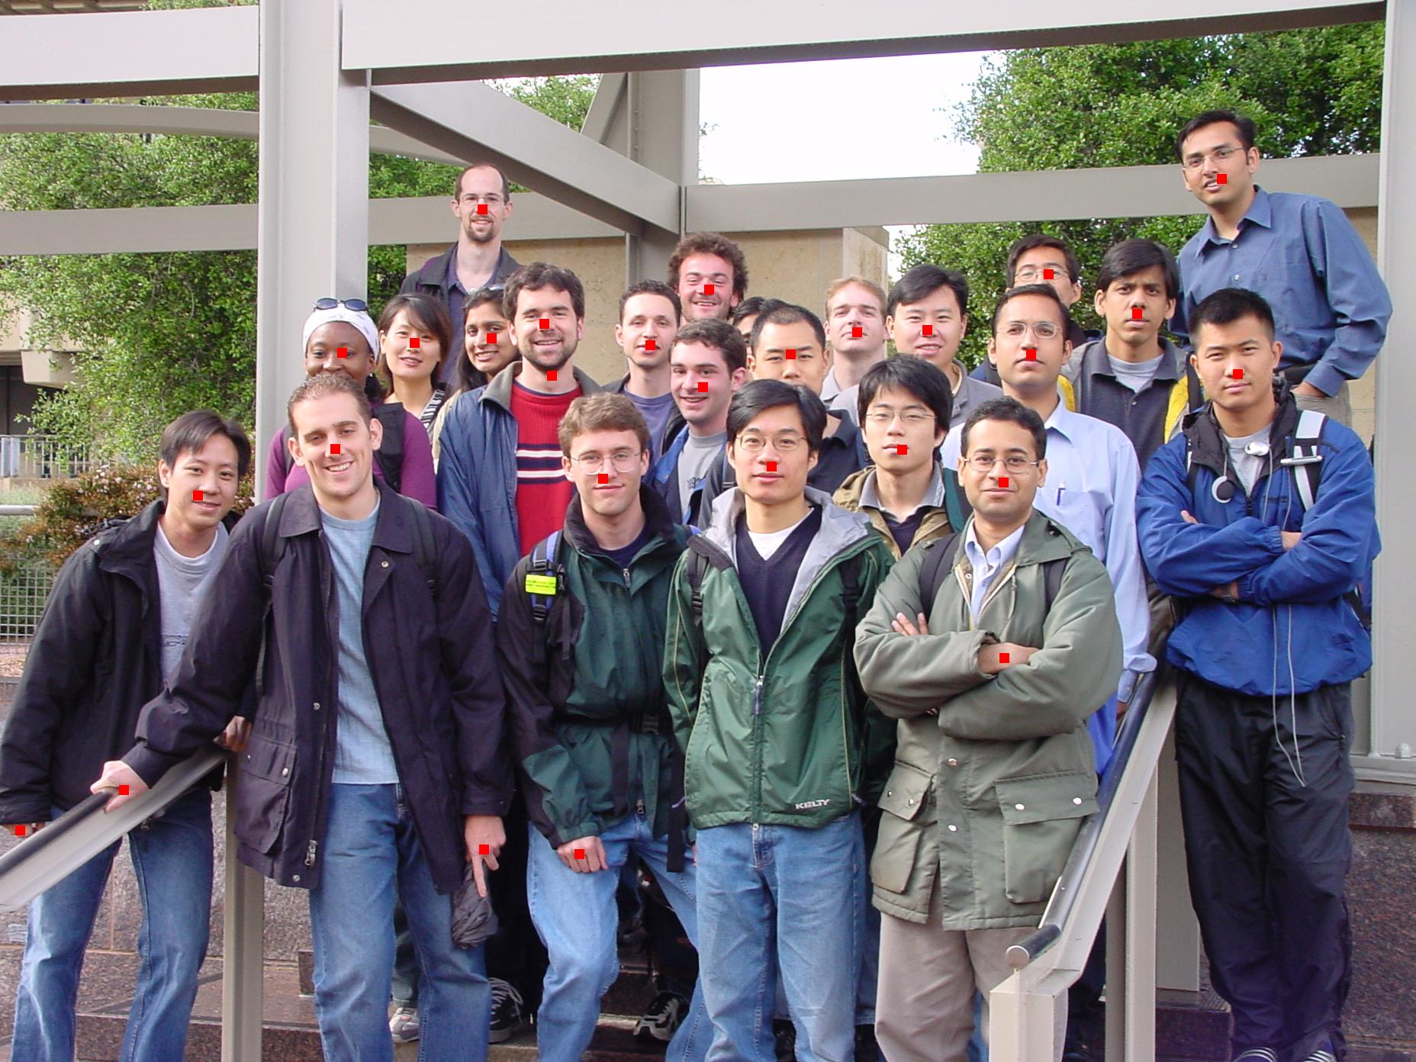
Preliminary face detection with red marks

Slide 8
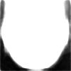
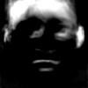
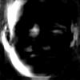
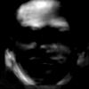
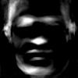
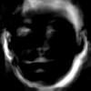
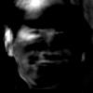
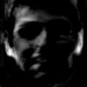
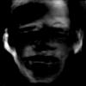
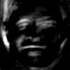
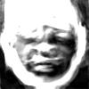
Image Matching
Eigenimage Generation
  10 eigenimages using 106 test
  Average image using eigenimages
Building Eigenimage Database
    30 → 220 pixel-width square image with 10-pixel gap

Slide 9
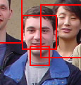
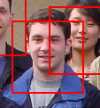
Image Matching (cont.)
Test Image Selection : box-merge algorithm
  Merging of Adjacent Boxes
Correlation : image matching algorithm
  Normalized test image : gray , average brightness of skin color
Distance compensation
->

Slide 10
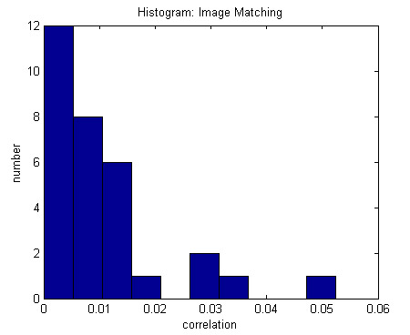
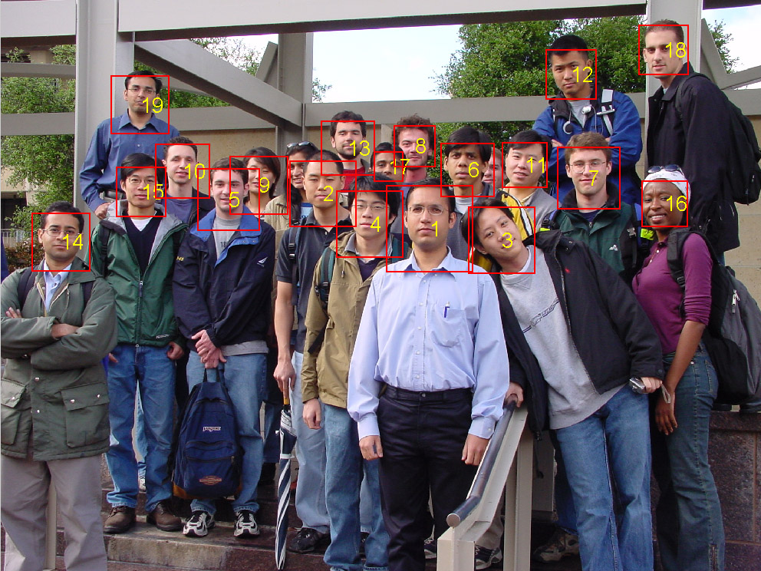
Image Matching (cont.)
Filtering using Statistical Information : non-face removal
  Histogram : Imaging matching
Correlation Ranking after Geographical Consideration

Slide 11
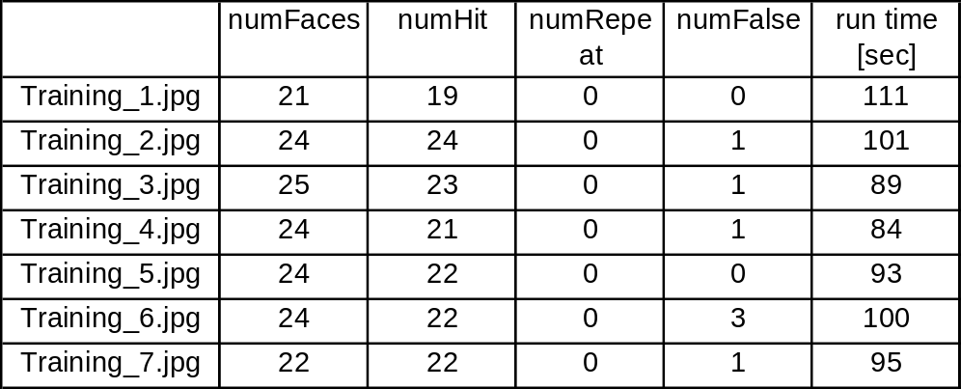
Results
  Face Detection Results using 7 Training Images
Right hit rate : 93.3 %
Repeat rate : 0 %
False hit rate : 4.2 %
The average run time : 96 seconds.

Slide 12
Conclusion
Color segmentation
  Rectangular window must be in actual distribution of skin color
Image segmentation
  Unnecessary noises in edge integration
  Roberts cross operator : small-hole removal
  Sobel cross filter, prewitt filter
  Threshold : discriminate face edges from other edge lines effectively
Skin-colored areas : unnecessary squares → one face
  Eigenimage matching
  Statistical approach
Sophisticated algorithm for general applications

Slide 13
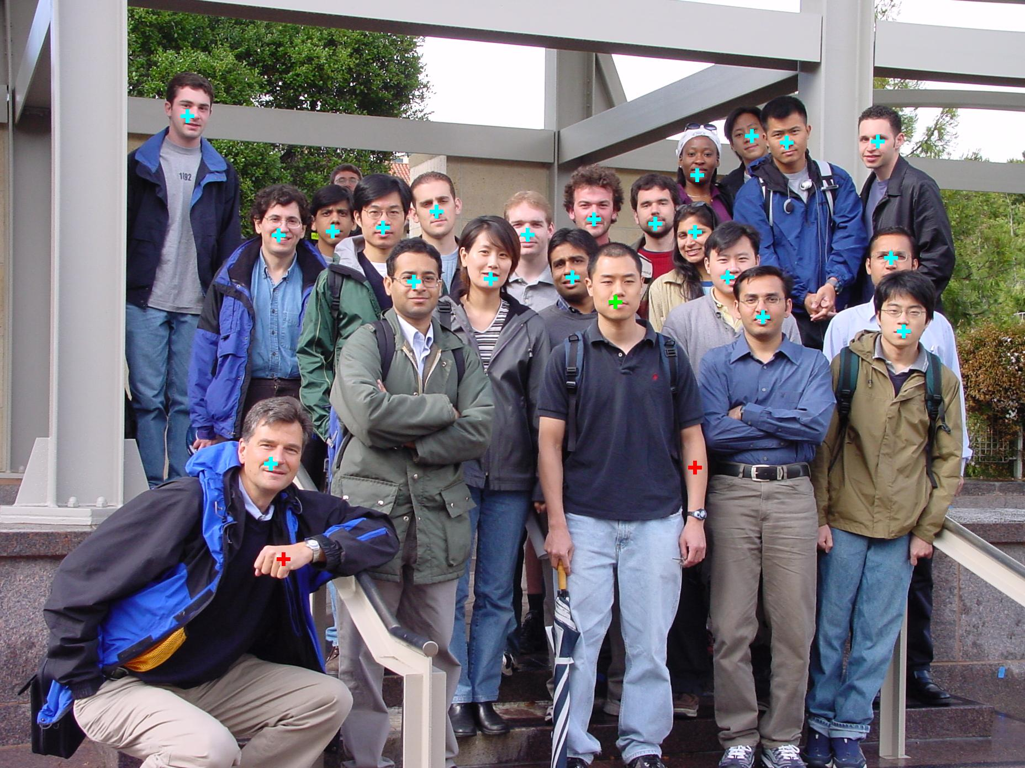

Slide 14
