Slide 1
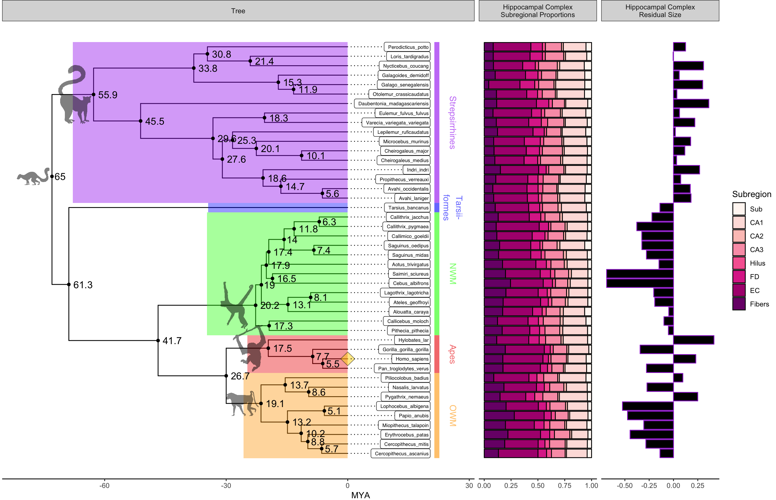
Ancestral State
65 MYA
SCZ, Fibers, FD, CA3, CA1
Haplorrhine Shifts
61.3 MYA
↓ retroHP_res\n ↑ CA2_res
Anthropoid Shifts
41.7 MYA
↑ Hilus_res
Pan-Homo Shifts
Catarrhine Shifts
Homo Shift

