Slide 1

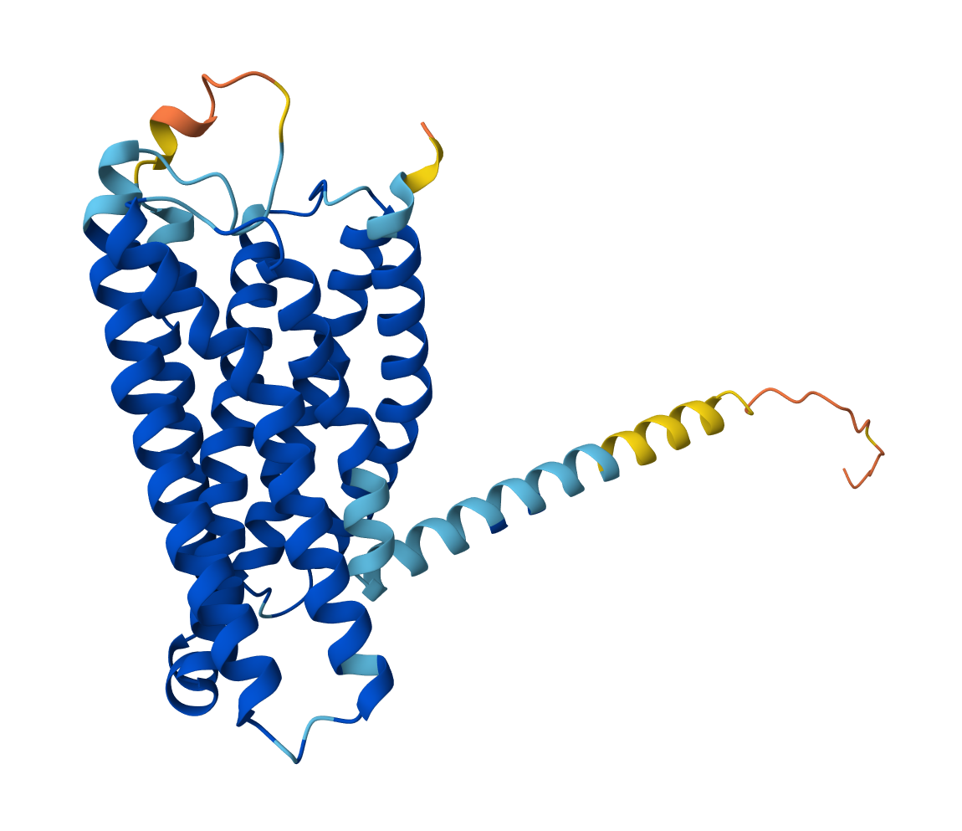
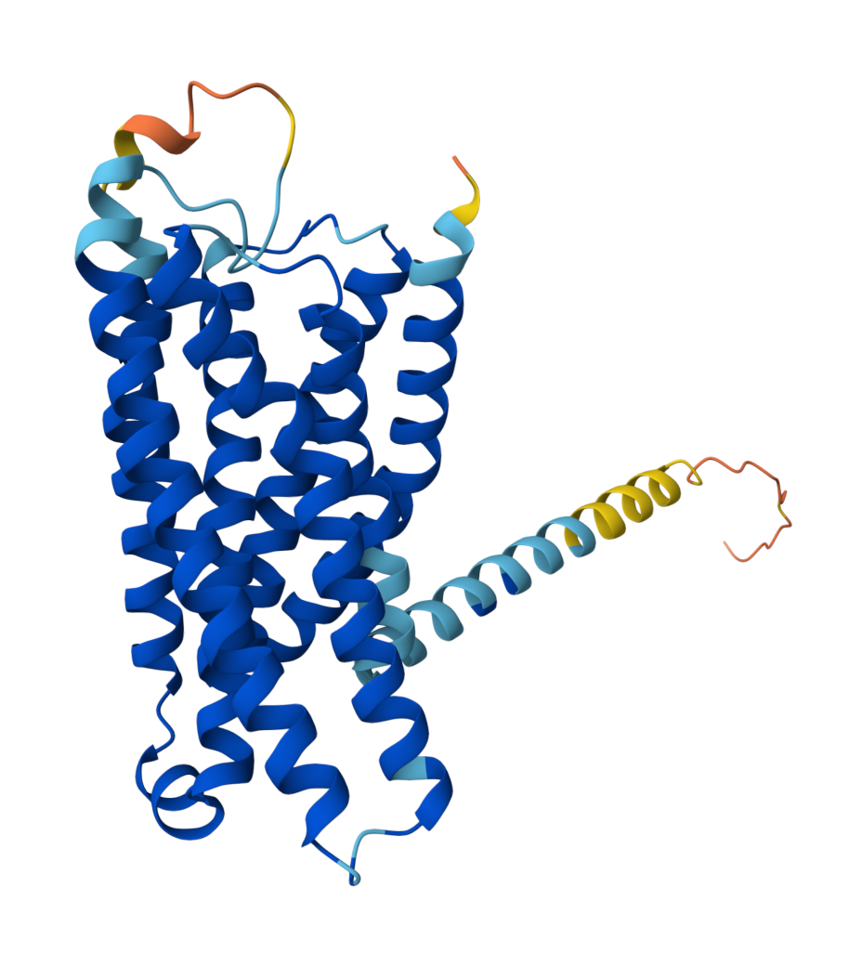
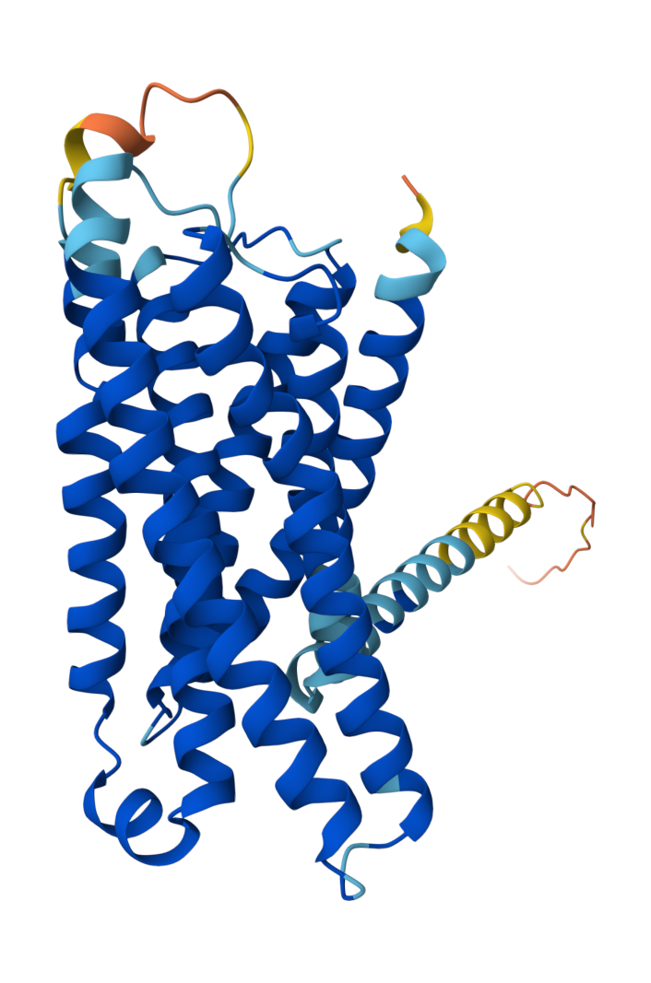

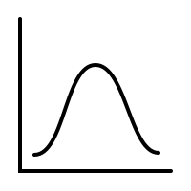
Wildtype
Sequences
(WT)
AlphaFold
Personalized Structures
Reference Genome
M
T
I
L
F
L
T
W
V
I
Personalized Genomes
M
T
I
L
L
T
W
V
I
-
. . .
M
T
I
L
F
L
T
W
G
I
M
T
I
L
F
L
V
W
Q
I
Protein Language Model
+
WT
Predictions
Personalized
VEPs
REF
Clinical
Variant
4L>P
Δ
=
MUT
Predictions
Mutated
Sequences
(MUT)
Reference Genome
VEP Distribution
M
T
I
P
F
L
T
W
V
I
Personalized Genomes
M
T
I
P
L
T
W
V
I
-
. . .
M
T
I
P
F
L
T
W
G
I
M
T
I
P
F
L
V
W
Q
I
Notes:
We took a different approach.
Instead of just computing VEP on a single reference sequence, we repeated the VEP procedure on personalized genomes from thousands of individuals to a build distribution of VEPs, and see where the reference falls within that distribution.

Slide 2
Wildtype
Sequences
(WT)
Reference
ATG | GCT | TTT | CAG | AAA | GGC | …
Personalized
Genomes
ATG | GTT | TTT | CAG | AAA | GGC | …
ATG | GCT | TCT | CAG | AAA | GGA | …
ATG | GCT | TTT | C -G | AAA | GGC | …
ATG | GCA | TTT | CAG | AA - | GGC | …
. . .
…
…
Sequence Model
WT
Predictions
Clinical Variant
c.9T>G
Δ
MUT
Predictions
Mutated
Sequences
(MUT)
Reference
ATG | GCT | TTG | CAG | AAA | GGC | …
Personalized
Genomes
ATG | GTT | TTG | CAG | AAA | GGC | …
ATG | GCT | TCG | CAG | AAA | GGA | …
ATG | GCT | TTG | C -G | AAA | GGC | …
ATG | GCA | TTG | CAG | AA - | GGC | …
VEP_{ref}
…
…
VEP Distribution
Notes:
We took a different approach.
Instead of just computing VEP on a single reference sequence, we repeated the VEP procedure on personalized genomes from thousands of individuals to a build distribution of VEPs, and see where the reference falls within that distribution.

Slide 3
Wildtype
Sequences
(WT)
Reference
ATG | GCT | TTT | CAG | AAA | GGC | …
Personalized
Genomes
ATG | GTT | TTT | CAG | AAA | GGC | …
ATG | GCT | TTT | C -G | AAA | GGC | …
ATG | GCA | TTT | CAG | AA - | GGC | …
VEP_{ref}
…
…
Sequence Model
c.9T>G
Mutated
Sequences
(MUT)
Reference
ATG | GCT | TTG | CAG | AAA | GGC | …
VEP Distribution
Personalized
Genomes
ATG | GTT | TTG | CAG | AAA | GGC | …
ATG | GCT | TTG | C -G | AAA | GGC | …
ATG | GCA | TTG | CAG | AA - | GGC | …
…
…
Notes:
We took a different approach.
Instead of just computing VEP on a single reference sequence, we repeated the VEP procedure on personalized genomes from thousands of individuals to a build distribution of VEPs, and see where the reference falls within that distribution.

Slide 4
Missense Variants
Splicing Variants
UTR Variants
ATG | GCT | TTG | CAG | AAA | GGC
M | A | L | Q | K | G

Slide 5
Missense Variants
ATG | GCT | TTG | CAG | AAA | GGC
M | A | L | Q | K | G
Splicing Variants
UTR Variants

