Slide 1
Multiprocessing and Threading
Boris Schnider (Msc in Prof. Waterhouse group)

Slide 2
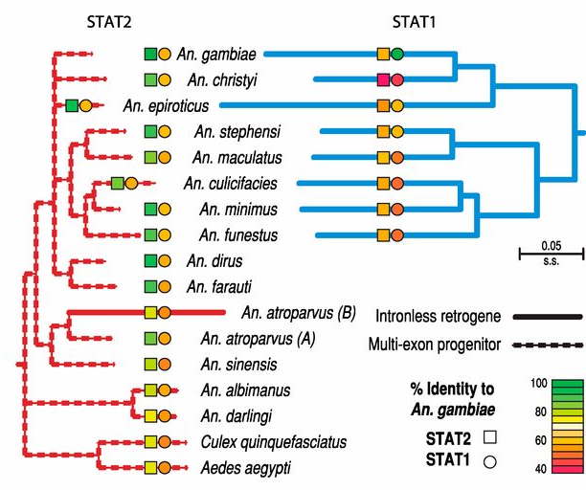

Master's Project
Computational characterization of STAT binding sites in mosquito genomes
Notes:
STAT is a developmental and immune TF found to have duplicated in a sub-clade of Anopheles
We want to study the consequences of its duplication on its regulatory network, thus compare between species with 1 or 2 STAT

Slide 3


Master's Project: Current Pipeline
Jaspar STAT92E motif profile
Search motifs in A. gambiae with:
Matrix2meme
+
TomTom motif comparison
Remove unrelevant motifs
Taken from www.meme-suite.org
Remove lowly represented hits
Clusters Fimo hits:
MAFFT + Build count matrix
Taken from www.cd-hit.org

Slide 4
Master's Project: Time Issues
1st cycle: ~ 2 min
2nd cycle: + 40 min
3rd cycle: ???
STAT92E Profile
x 20
Putative Profiles
…
x 20?
Motif search is slow → How to speed up?

Slide 5
Multiprocessing and Multithreading
1st cycle: ~ 2 min
2nd cycle: + 10 min
3rd cycle: + 120 min
4x faster
Notes:
Could have made on cluster but wanted to do it in python for oop => modularity and scalability, to eventually make a software from it (easy-to-code graphical interfaces and complete libraries)

Slide 6
Multiprocessing
Main memory
CPU 1
CPU 2
Input
Output
CPU 3
CPU n
Notes:
Multiprocessing is the concept of allocating tasks between the different central processing units of a computer, so in my case, of executing multiple processes in parallel running on separate cores.

Slide 7
Multithreading
Thread = unit of scheduling and execution
Share resources of same core
Responsiveness to user input while executing task
CPU 1
Instruction queue
Thread 0
Thread 1
Execution pipeline
Thread 2
Thread 3
Notes:
- Concept of attributing tasks to threads, which is a unit of scheduling and execution, whereas a process is a unit of resources
- A thread is a component of a process
- Multiple threads share the resources of a same core
- (sometimes say that a core has 2 threads because some of the units constituting the core are duplicated)
- Main advantage of multithreading is that it allows the application to remain responsive to the user input while executing tasks in the background.
- It is useful when the code or program is input/output-bound, which means when you spend a significant amount of time waiting for an input or output, because you can parallelise the waitings

Slide 8
Python Modules
Multiprocessing:
multiprocessing
Multithreading:
multiprocessing
threading
thread
Notes:
- Diverse modules available for mp and mt, that are the most commonly seen on the forums.
- I chose multiprocessing and threading because they're well documented, easy to use, but still flexible and because it easily allows to use pool of processes.
- The Pool class can be used to manage a fixed number of workers for simple cases where the work to be done can be broken up and distributed between workers independently.
The return values from the jobs are collected and returned as a list.

Slide 9
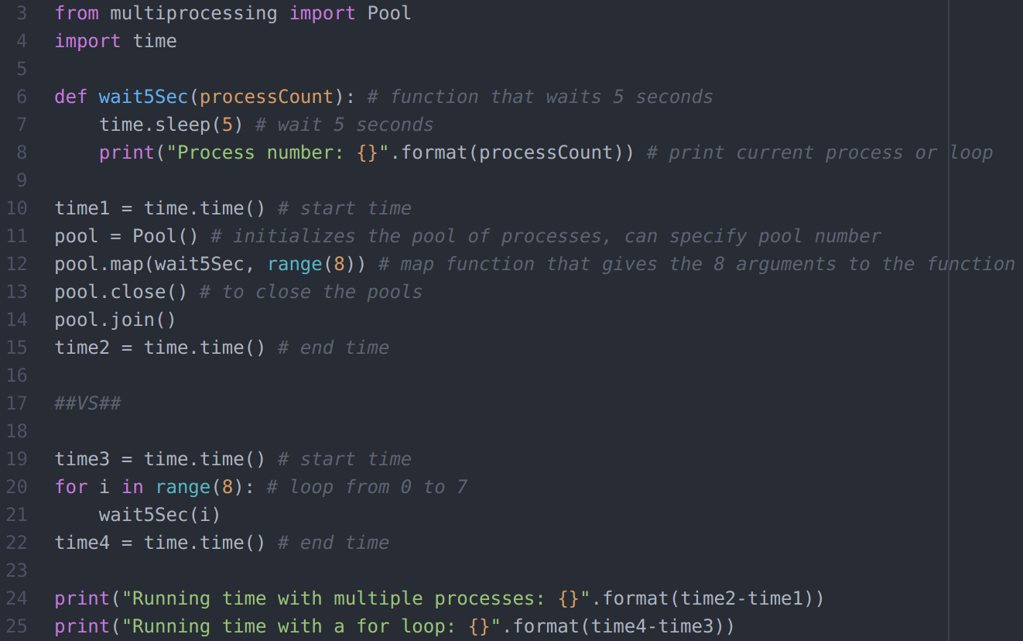
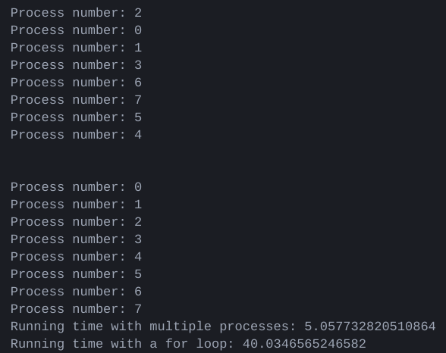
Multiprocessing Example
Notes:
Simple example to show how multiprocessing works
- Explain code briefly
- Processes not in same order, because parallelization. 8x faster because 8 cores

Slide 10
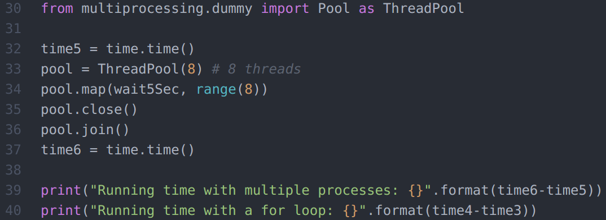
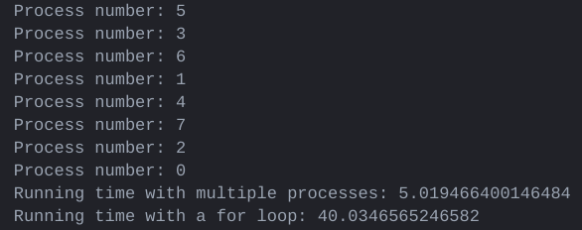
Multithreading Example
Notes:
Simple example to show how multithreading works
- Explain code briefly
- Threads not in same order, because parallelization of wating time. Note that here the word process can be ambiguous and should be called thread instead
- 8x faster because 8 threads

Slide 11
CPU-bound Process
Time to run task determined by speed of processor
High processor utilization
→ Improving code increases performance
Restrict threads
In contrast to I/O-bound processes
Notes:
- A CPU-bound process is, as the name says, a process that requires important CPU utilization.
- In such a process, the speed of processor determines the time to run task
- So if you improve the code, you'll increase the performance
- Restrict the number of threads (due to resource limitation)
- Often contrasted with input/output-bound processes

Slide 12
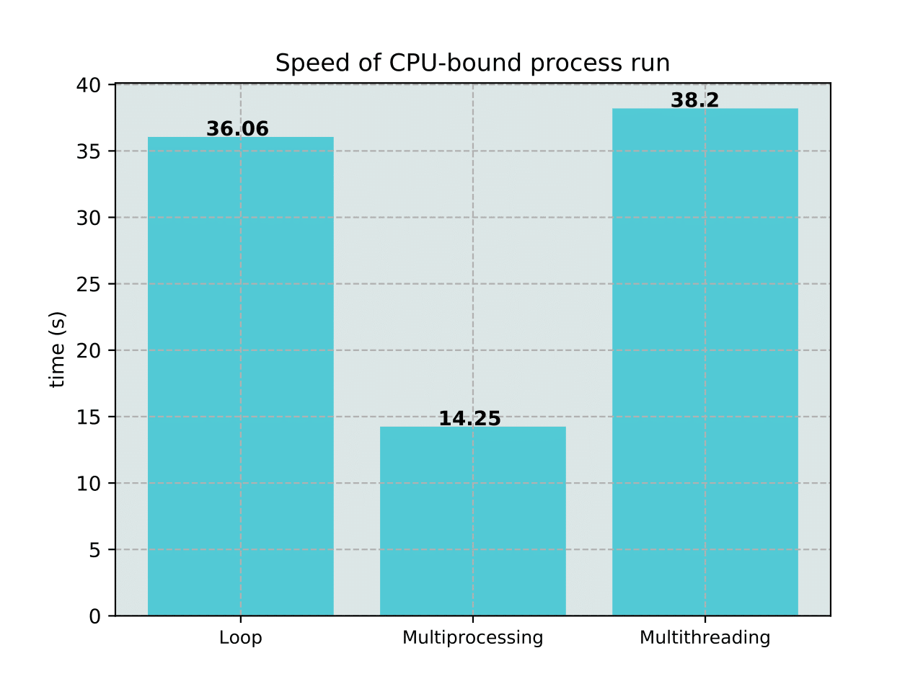
Speed Comparison: CPU-bound Processes
Notes:
- The speed comparisons are made by making repeated simulations, in this case 500.
- Here I generated all possible DNA sequences of a length of 10 and then applied a base probability for each position and selected the sequences with the highest score, score based on these frequencies
- Just aiming at being a CPU-bound resource demanding process.
- Describe.
- We see that for a CPU-bound process, only multiprocessing is really useful, as threads actually share the same resources.

Slide 13
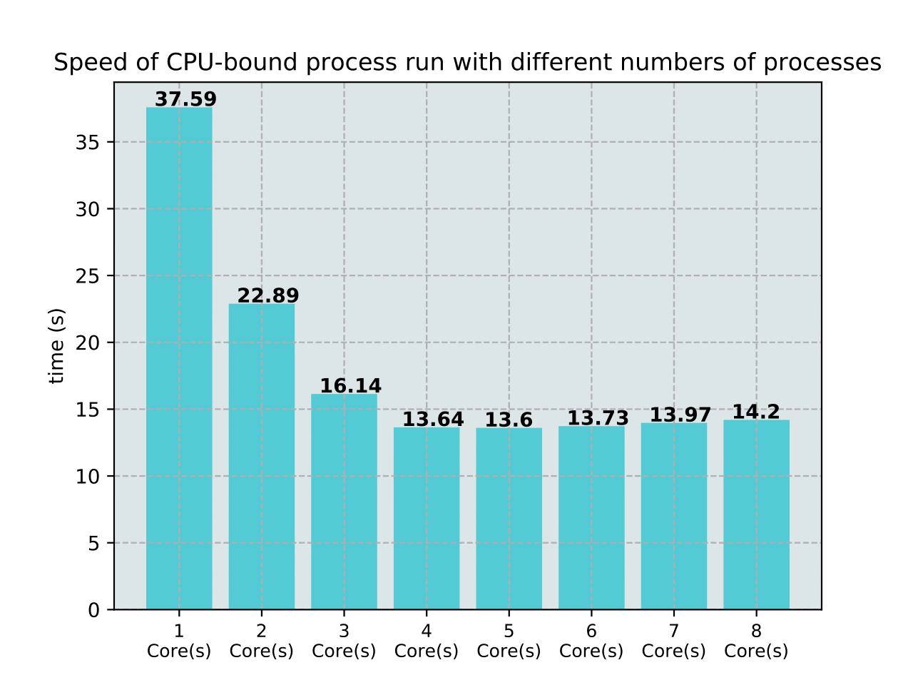
Speed Comparison: CPU Number
Notes:
- As expected, increasing the number of cores increases the speed of the process. However, the increase in speed seem to reach a plateau, which could be due to the use of the cores for other processes by the computer or the use of a number of processes that is not multiple of the number of cores, which means that at the end, a few cores will have to finish the jobs and thus remake a cycle . Internal limitations probably too.

Slide 14
What is a I/O-bound Process?
Computation time determined by period spent waiting for input/output
Case when more time spent requesting data than processing them
CPU and memory separated in computer
→ data transfer rate limit computation speed
CPUs get faster but not the data transfer
Notes:
- In an I/O-bound process, the computation time is mainly determined by the period spent waiting for an input/output.
- It is the case when the rate at which data are processed is higher than the rate at which they are requested.
- The processor and memory are separated, so data must be transferred between them
--> the data transfer rate between the processor and memory is actually limiting the computation speed.
- We say that the computer become more and more I/O-bound because the CPU gets faster but not the data transfer, which means that the CPU has to wait for the data

Slide 15
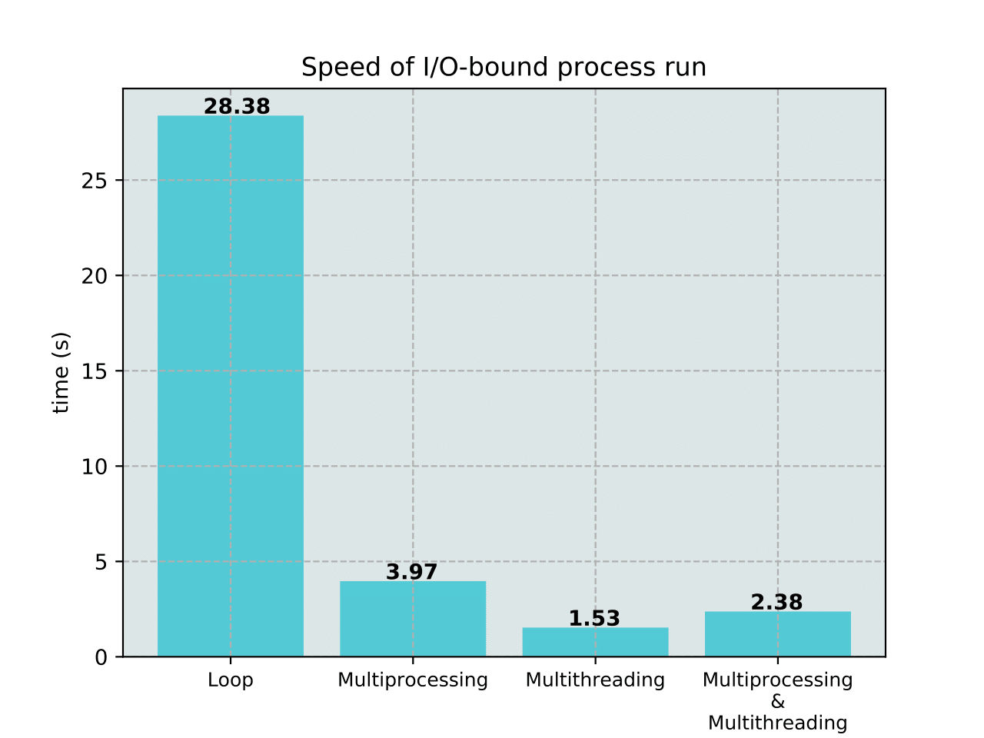
Speed Comparison: I/O-bound Processes
Notes:
- So I made another speed comparison. This time, the process was simple, I had a list of 20 web sites and I just accessed them with urllib module and stored the html text into a text file
We see that here the multithreading becomes useful as it allows to parallelize the 20 request/waiting time, and thus, to reach an even faster data retrieving than the multiprocessing, since we have less cores available to parallelize.
Note also that spawning threads is faster than spawning processes
I combined both also here, just to show that it is possible, in each core to allocate tasks to multiple threads. It is, however, slower, probably because generating 2 sets of pools than generating just a pool of threads and because spawning processes is a little bit slower than spawning threads.
(spawn = load and execute a new child process)

Slide 16
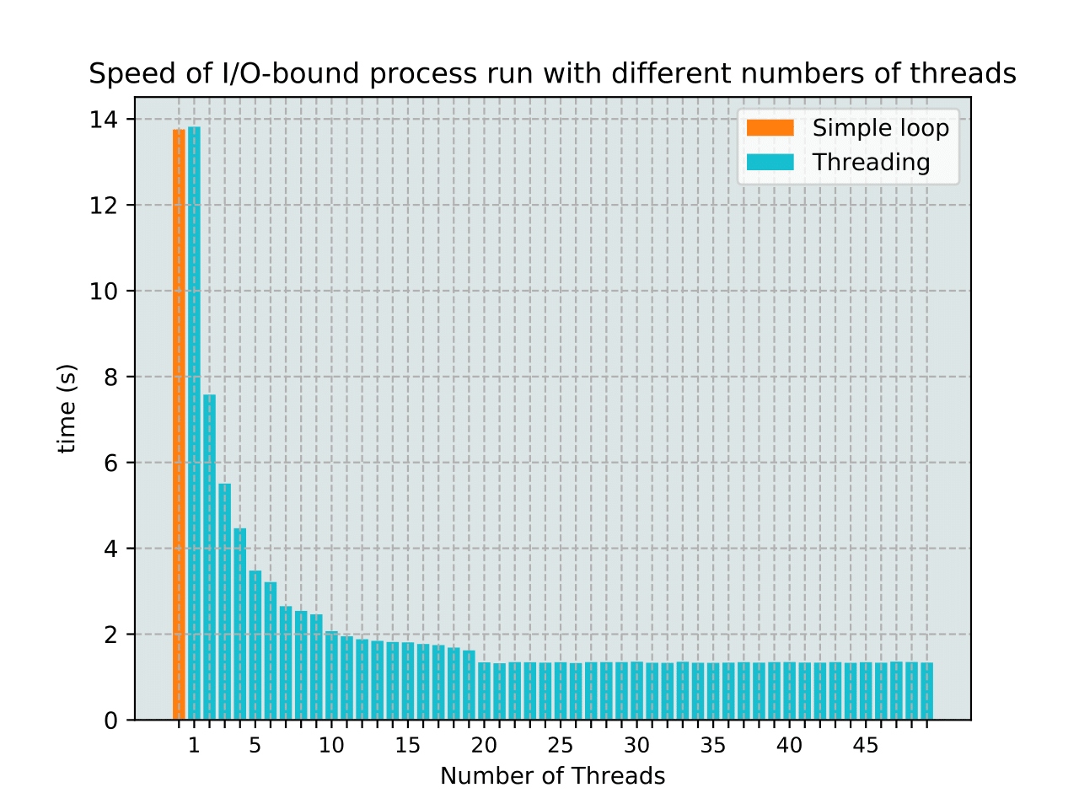
Speed Comparison: Thread Number
Notes:
- Then I compared the speed of the same process with different number of threads.
- We can see that up to a certain number of threads, the computation speeds increases dramatically, to finally become stable

Slide 17
Python Multiprocessing and the GIL
GIL = Global Interpreter Lock
Why threading not efficient for CPU-bound processes in Python?
→ presence of the GIL
Lock that protects access to CPython objects
I/O, image processing, NumPy operations happen outside the GIL
Separated process have separated memory → gets around GIL
Notes:
- The gil stands for …
- It is the cause why we observed unefficient threading
- It is a lock that protects the access to CPython objects. It prevents multiple threads from executing python bytecodes at once.
- it is necessary because python's memory management is not thread-safe, so to prevent 2 threads to write to the same memory space at the same time as they share the same memory
- Only the thread that acquired the lock can operate in python
- Some processes such as I/O-bound, image processing and some NumPy operations happen outside the GIL.
- Multiprocessing modules gets around the GIL limitation as separated processes have separated memory
(CPython is a type of python implementation that uses the GIL, ex: Jython doesn't)

Slide 18
Pros
Multiprocessing:
Separate memory space → no GIL
Take advantage of multiple CPUs
Processes are killable
Easy to code
Multithreading:
Lightweight
Shared memory (easy to communicate between the threads)
Useful for I/O-bound processes
Will work for modules that properly release the GIL
Notes:
The following are for CPython implementation
- …
- … to split a process into parallel processes and make it faster
-… processes easy to kill
-… the module is easy to use
- The use of threads has a low memory footprint
- …
- …
- …
… means that the bullet point is clear enough and doesn't need to be detailed

Slide 19
Cons
Multiprocessing:
Larger memory footprint
Communication between processes more complicated
Multithreading:
Subject to the GIL → not useful for CPU-bound processes
Not safely killable
Notes:
Threads are not safely killable, because they may have the GIL and thus, if killed with the GIL, it leads to deadlock, which is a state in which all the other threads opened are waiting indefinitey for another thread action.

Slide 20
Take Home Message
Multiprocessing → different memory space
Multithreading → same memory space → GIL limitation
Multiprocessing allows to speed up CPU-bound processes dramatically
Multithreading allows to speed up I/O-bound processes dramatically
Notes:
- …
- …
- ...
- …
- Both can be combined to optimize CPU-bound and I/O-bound processes handling
- ...

Slide 21



Thanks
PhD Student, Evolutionary patterns to function
Postdoc, Data integration and function
PI
Notes:
I would like to thank Livio, Maarten and Rob for the help in the project and the frequent useful suggestions

Slide 22
Question?
Annotated code, plots and simulations available on my github:
https://github.com/bschnide

Slide 23
Plan
Master's project title, group and general principle
Master's project aims
All general steps (in one slide)
Current pipeline
Time issues associated with the pipeline => multiprocessing and multithreading
Could have made on cluster but wanted to do it in python for oop => modularity and scalability, to eventually make a software from it (easy-to-code graphical interfaces and complete libraries)
What is multiprocessing, figure
What is multithreading, figure (threads share resources of a same core) (sometimes say that a core has 2 threads because some of the units constituting the core are duplicated) (temporal threading vs simultaneous)
Diverse modules available for each, I chose multiprocessing and threading (well documented, easy to use, but still flexible) (cite other modules)

Slide 24
Plan
Simple example use of multiprocessing (code) (mention pools of processes but make sure to understand)
Simple example use of multithreading (code)
What is a CPU-bound process?
Multiprocessing use on CPU-bound processes (use the timeit module that allows to repeat multiple time, make many times and heavy process for the time to be reliable) vs multithreading vs none (use same process each time)(make plot nb of seconds) (Explain that not using both because threading does not boost speed so does not make sense), Conclude on the use of each on CPU-bound processes.
Multiprocessing use on CPU-bound processes, repeat with diff nb of cores and timeit to find optimum which is supposed to be the max
What is a I/O-bound process?
Multiprocessing vs multithreading vs both vs none on I/O-bound processes (timeit + plot) (explain that using both to show that it is possible and it speeds the part that processes the data)
Multithreading use on I/O-bound processes, repeat with diff nb of threads, find optimum which is supposed to be the max => why using more threads than available processes works?

Slide 25
Plan
Why multiprocessing more advantageous in this case? => GIL, explain the GIL.
Advantages of each
Inconvenients of each: Introduce error challenges with multiprocessing and threading, how to deal with it, emphasize the importance of oop to have modularity to make the code easy to reuse in any context and the danger it represents when the code that is supposed to be modulable has breeches and thus, raises errors not raised with other data. Problem communicate between processes. Using time to set the threads that may be not worth it.
Conclude on time spare thanks to multiprocessing and threading, briefly say now cython to improve some scripts
Thanks group

Slide 26
Master's Project: Aims
1 - Identify putative STAT binding sites in Anopheles genus
2 - Identify putative target genes and compare them with orthologs
3 - Compare STAT binding sites and target genes identified among Anopheles genus

Slide 27
Master's Project: Approaches
1 – Motif search based on orthologous sequences and previous knowledge
2 – Search and identify genes close to putative binding sites and compare with orthologs
3 – Anopheles multiple sequence alignment, conservation study, loss and maintenance rates
Notes:
- The first part will be to search for STAT in Anopheline mosquito genomes, by searching for the orthologous D. Melanogaster STAT92E binding motif, which is well characterized, thanks to ChIP-seq data. The potential sites can then be compared with orthologous sites experimentally validated.
- The second part will be to search and identify the genes close to the putative binding sites. By looking at their distance, orientation and by comparing these parameters and the presence of the binding site with orthologous sequences, we hope to identify STAT target genes
- The third step will consist in aligning all the whole genomes of the species of the genus and make a binding site and target gene conservation analysis, including loss and maintenance rate calculation. At the end we hope to be able to cluster them in STAT1 and STAT2 groups based on the conservation analysis data.

