Slide 1
SILVEC · BIOLOGICS
HYPOTHESIS · TRIAL · 002
THE / QUESTION · TRANSMISSION-DEAD VIRIONS
A capsid question, answered behind the capsid.
Nine substitutions in p61, two in p65 — the chaperones that build the aphid-facing virion tail — keep CTV assembling and moving inside the plant while making it unreadable to T. citricida. The phenotype exists in nature; the trial asks if design can copy it.
PREPARED FOR THE SILVEC TEAM
HARPER ET AL. 2016 · KILLINY ET AL. 2016 · GENBANK KC517488 / AY170468
Notes:
Verdict: the target is CTV's minor-CP tail complex, not the coat. Eleven substitutions, published evidence in one direction.

Slide 2
SILVEC · BIOLOGICS
02 / 26
“
What mutation(s) to a capsid still makes a functional virion with respect to self-assembly and internal plant movement, but would make it incompatible to an insect vector — disabling plant-to-plant movement?
As a first trial, do this for Citrus tristeza virus, to deactivate aphid transmission.
— THE QUESTION · AS POSED · SEPTEMBER 2026
01 / THE HYPOTHESIS
02 / THE EVIDENCE
03 / THE CONDITIONS
04 / THE PLAN
SILVEC BIOLOGICS · CONFIDENTIAL
Notes:
The question as posed. Note the capsid presumption — slide 7 is where that gets corrected.

Slide 3
SILVEC · BIOLOGICS
03 / 26
01
PART ONE OF FOUR
The hypothesis.
What a transmission-dead CTV looks like genetically, why the major coat protein is the wrong target, and what Silvec's own capsid-free platform already knows about this problem.
Notes:
Part one: the hypothesis itself.

Slide 4
SILVEC · BIOLOGICS
04 / 26
THE / ANSWER
Specific — eleven substitutions, two proteins.
The question as posed has a precise answer, and it is not a coat-protein mutation. In CTV the aphid reads the virion's minor-coat-protein tail, and the transmission difference between two near-identical isolates is already mapped to two genes.
WHAT'S ALREADY SHOWN
WHAT TO CHANGE
WHAT DECIDES IT
The phenotype exists
in nature.
p61 and p65,
together or not at all.
One experiment
settles it.
Greenhouse T36: systemic infection, full titer, 0.6% aphid transmission. Field isolate FS577: same strain lineage, 24%. The capsid proteins are essentially identical.
Nine substitutions in p61 and two in p65, moved as a pair — alone each gives 2–4% transmission, together 18%. p27 and p25 stay wild type: the coat is not the interface.
Harper et al. ran the swap in the healing direction. The inverse — T36 alleles silencing a transmissible backbone — is the real knockout, and it has never been run. If it fails, the hypothesis dies cheap.
ONE CAVEAT · GAIN-OF-TRANSMISSION IS PROVEN; THE LOSS-OF-TRANSMISSION KNOCKOUT IS NOT — SEE SLIDE 10
Notes:
Three panels: what nature already showed, what to change, and the one experiment that decides it.

Slide 5
SILVEC · BIOLOGICS
05 / 26
WHAT / WE CAN SEE ALREADY
Six findings already on the record.
All of it drawn from two published papers and two GenBank accessions — no lab work. Together they define the trial.
0.6%
17.9%
11
transmission of the T36 clone
restored by two genes, not one
residues distinguish the pair
One plant in 172 infected via T. citricida — under a protocol where field isolate FS577 scored 24%.
FS577 p65+p61 into the T36 clone. Either alone gave 2–4%; the pair matched field rates at unchanged titer.
Nine in p61, two in p65 — the chaperones that build the CPm tail. Minor coat protein p27 is identical between the isolates.
0
35.7%
1
changes needed in the capsid itself
T36 transmission from mixed infections
existence proof in a sister family
p25 and p27 stay wild type in trial 1. The 'capsid mutation' is two chaperone genes gating the virion's aphid handle.
Co-infecting genotypes complement each other. Single-genotype trees are the only valid assay design.
A LIYV minor-CP mutant moved systemically in plants but was never whitefly-transmitted. The split is real — and general.
TWO PAPERS · TWO ACCESSIONS · NO LAB WORK
EVERY NUMBER HERE IS A CLAIM THE TRIAL HAS TO HOLD
Notes:
Six numbers from the record. The 35.7% complementation result is why every assay is single-genotype.

Slide 6
SILVEC · BIOLOGICS
06 / 26
THE / THREE JOBS
What testing the hypothesis actually means.
Three concrete jobs, in sequence. They carry different risk and different value — and only the first is a commitment.
01
Run the knockout.
Move the T36 alleles of p61 and p65, as a pair, into a transmissible infectious clone — FS577 or T68. Confirm systemic infection at parental titer, then score aphid transmission. Harper proved the gain; this proves the loss.
02
Resolve the eleven residues.
The paired swap proves the gate exists but not which residues hold it. A staged panel — blocks, then singles — turns one knockout into a design rule for the whole family.
03
Prove the principle Silvec ships.
CYVaV has no capsid at all — vector-incompatible by architecture. A designed transmission-dead CTV is the same biocontainment logic, engineered point by point into a virus that does have one.
JOB 01 IS THE GATE · JOB 03 IS WHY SILVEC SHOULD CARE
Notes:
Three jobs: knockout, residue map, platform principle. Only the first is committed.

Slide 7
SILVEC · BIOLOGICS
07 / 26
WHY / THIS PROBLEM
The instinct in the question is the right one.
The question presumes the capsid is the target — right by complex, wrong by protein. CTV's transmission interface is the virion's minor-coat-protein assembly, not its major coat.
WHY NOT THE MAJOR COAT PROTEIN
WHY THE TAIL IS THE TARGET
p25: the body, and the decoy.
p27 / CPm, placed by two chaperones.
p25 coats ~95% of the RNA and doubles as the silencing suppressor. Mutating its surface risks assembly and titer — and the aphid never reads it: free p25 does not compete virion binding.
p27 coats ~630 nt at the 5′ end; p65 (HSP70h) and p61 assemble it there. Free p27, p61 and p65 all compete virion binding at the aphid cibarium — that is the docking site.
Silvec's own platform is the extreme case of this rule: CYVaV is a non-encapsidated RNA — no capsid, no virion, no insect phase by default. This trial asks whether closterovirus genetics can engineer the same property into a capsidated virus, eleven substitutions at a time.
Notes:
The aphid reads the tail: p27 placed by p65 and p61. Free p25 does not compete binding at the cibarium.

Slide 8
SILVEC · BIOLOGICS
08 / 26
02
The evidence.
The swap series that proves one direction, the binding assays that name the interface, the literature that does not transfer — and what the numbers say about trial size.
PART TWO OF FOUR
Notes:
Part two: the evidence.

Slide 9
SILVEC · BIOLOGICS
09 / 26
TIER 1 / PREREQUISITES
Five conditions. Four already in hand.
What any first virology trial must clear before it deserves greenhouse space. This hypothesis meets more of them than most topics could.
CONDITION
WHY IT MATTERS
STATUS
Infectious clones exist
Gain-of-function swaps were already demonstrated on this exact backbone. The inverse is standard subcloning.
IN HAND
947R (AY170468) · FS577 (KC517488)
One published assay
The Harper protocol is documented end-to-end, with positive and negative baselines on the same numbers.
IN HAND
24 H ACQUISITION · 10 APHIDS · 8-WK ELISA
A defined host and vector
One host species, one aphid species. No host-range ambiguity contaminating the readout.
IN HAND
C. MACROPHYLLA · T. CITRICIDA
A titer control
Titer separates movement loss from docking loss — the two phenotypes this trial must keep apart.
IN HAND
RT-QPCR + ELISA ON SOURCE FLUSH
A transmissible backbone clone
The knockout needs a recipient that transmits. CTV field-isolate clones exist; access must be confirmed.
TO CONFIRM
FS577 OR T68 INFECTIOUS CLONE
THE FIFTH ROW IS THE WHOLE TRIAL — AND IT IS ANSWERABLE THIS MONTH
Notes:
Four of five prerequisites in hand; the fifth is access to a transmissible backbone clone.

Slide 10
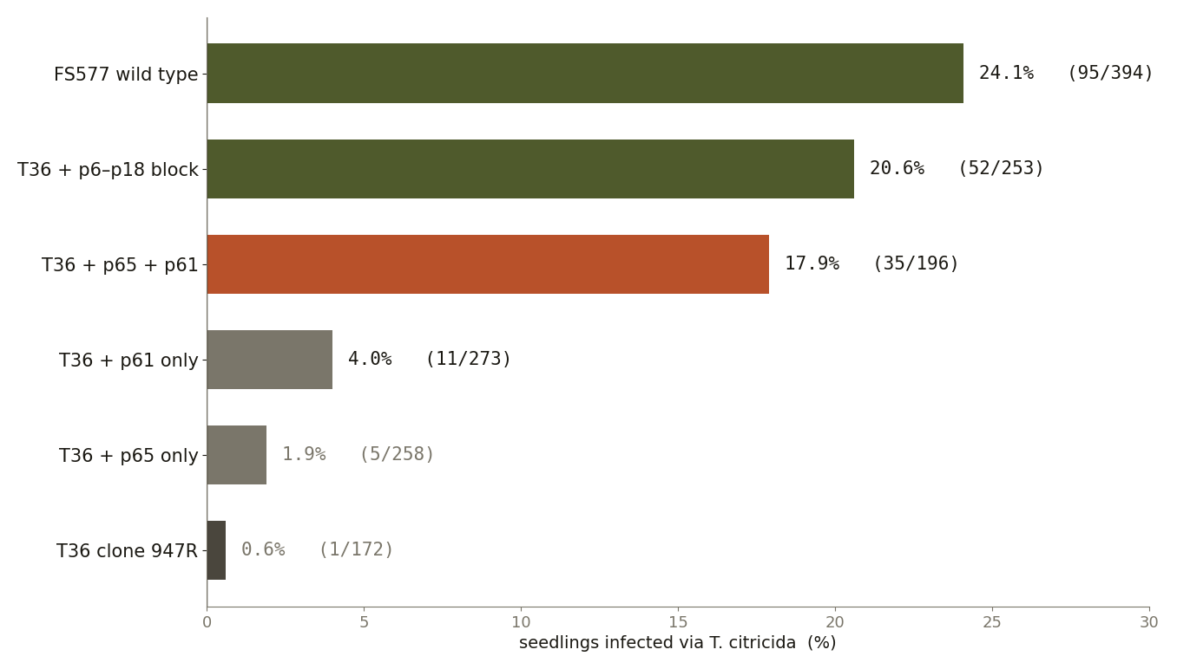
SILVEC · BIOLOGICS
10 / 26
THE / INCUMBENT
The forward direction is already published.
Good news and a constraint at once. It proves the biology is real — and sets the bar the knockout has to clear.
THE PUBLISHED RESULTS
T36 + FS577 p65+p61 → 17.9%:
the pair, or nearly nothing.
Single genes: 1.9% (p65), 4.0% (p61). Both together: 17.9%. Wild-type FS577: 24.1%. Every construct infected C. macrophylla systemically, at indistinguishable titer.
· All hybrids moved systemically and titred like the parent — assembly and in-plant movement were untouched.
· The experiment never ran in reverse: nobody has asked T36's alleles to silence a transmissible strain.
FIG. 01 / APHID TRANSMISSION BY CONSTRUCT · HARPER ET AL. 2016
THE INVERSE SWAP — T36 ALLELES INTO FS577 — IS THE WHOLE PROPOSAL
Notes:
Harper 2016: the pair reaches 17.9% vs 0.6% baseline at unchanged titer. Inverse never run.

Slide 11
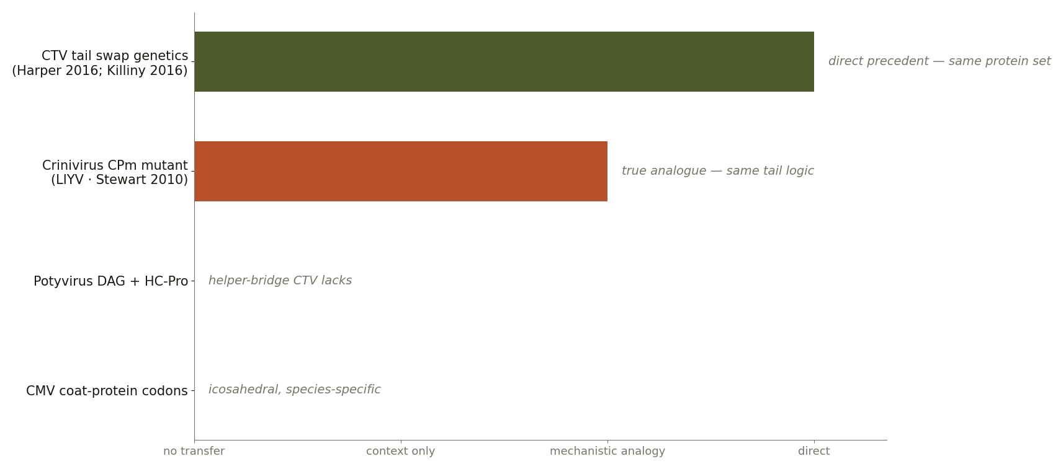
SILVEC · BIOLOGICS
11 / 26
THE / ANALOGY TRAP
How this gets argued down for the wrong reason.
Plant-virus transmission motifs are well studied and completely virus-specific. The famous textbook cases share no architecture with CTV.
FAMILY, NOT MOTIF
· Potyviruses: the CP DAG motif plus HC-Pro — a helper-bridge mechanism CTV does not possess.
· CMV: aphid-species-specific coat codons on an icosahedral particle with no tail at all.
· LIYV: the one true analogue — a minor-CP mutant, systemic in plant, dead to its whitefly. Same tail logic, different genus.
The fix. Judge this hypothesis only on closterovirus evidence: CTV swap genetics (Harper 2016), foregut binding (Killiny 2016), tail-assembly genetics (Satyanarayana 2004). Everything else is context, never precedent.
A MOTIF THAT WORKS IN ONE FAMILY SAYS NOTHING ABOUT CTV
FIG. 02 / WHICH LITERATURE ACTUALLY TRANSFERS TO CTV
Notes:
Potyvirus/CMV motifs do not transfer. LIYV is the one real analogue.

Slide 12
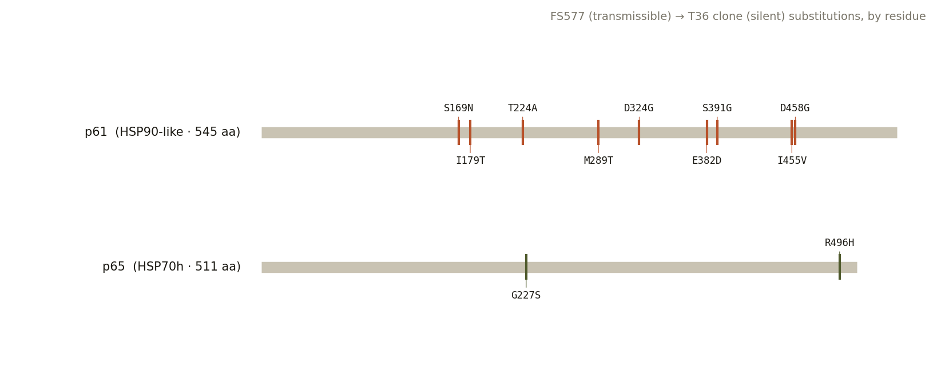
SILVEC · BIOLOGICS
12 / 26
SIZING / THE HEADROOM
Be honest about what isn't known.
The published series gates transmission but resolves none of the eleven residues individually — and one cofactor was never tested.
9 + 2
RESIDUES, UNRESOLVED
The pair is proven necessary; nothing says which of the nine p61 and two p65 substitutions carry the effect. That map is the scientific deliverable.
p33
THE KNOWN THIRD FACTOR
T68's p33 also raises T36 transmission (Shilts 2020). Trial 1 ignores it — Harper hit near-field rates without it — unless residual signal says otherwise.
FIG. 03 / THE ELEVEN SUBSTITUTIONS ON p61 AND p65
AY170468 NUMBERING · KC517488 × AY170468
Notes:
Eleven residues unresolved; p33 is the known third factor, deferred unless residual signal appears.

Slide 13
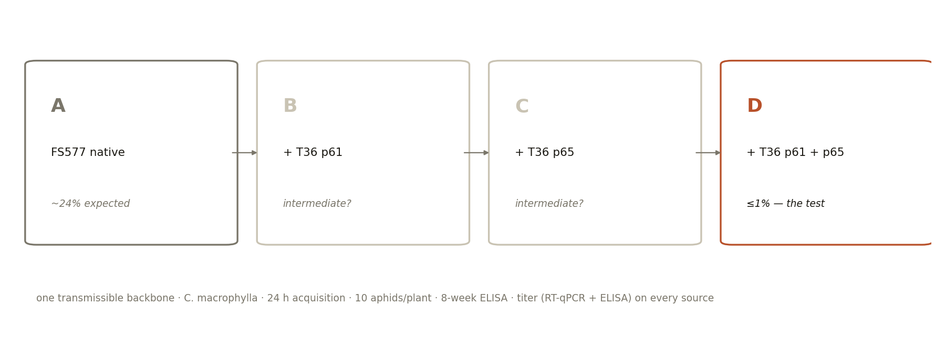
SILVEC · BIOLOGICS
13 / 26
SIZING / THE TRIAL
Four clones decide the question.
Same backbone, same host, same aphid colony, same protocol. The only variable is which T36 alleles ride along.
THE MINIMUM
Two clones to kill the hypothesis.
FS577 native versus FS577 + T36 p61+p65. If the swap does not silence, stop: the phenotype is backbone-dependent and the cheap version of the hypothesis is wrong.
THE FULL DESIGN
Four clones, ~1,000 plants.
Parent, +p61, +p65, +both — split arms resolve which gene does what. Roughly 250 plants per arm distinguishes 20% from 1%; Harper's own runs were 172–394 per construct.
FIG. 04 / FOUR-CONSTRUCT DESIGN ON ONE BACKBONE
Notes:
Two clones kill the hypothesis; four resolve it. ~250 plants per arm matches Harper's own power.

Slide 14
SILVEC · BIOLOGICS
14 / 26
PART THREE OF FOUR
The conditions.
03
What would make the result decisive, what would sink it, what separates trustworthy aphid data from noise — and the four answers that settle go or no-go.
Notes:
Part three: the conditions.

Slide 15
SILVEC · BIOLOGICS
15 / 26
TIER 2 / AMPLIFIERS
What would make it a great trial.
None of these is required for the knockout. Each one raises the value of the same lab work.
RAISES THE VALUE
RAISES THE VALUE
A residue map
A second backbone
Eleven substitutions tested in blocks and singly converts one knockout into a transferable design rule for any closterovirus transmission module.
T68 shares the tail architecture but not the genotype. Reproducing the silencing there separates a universal mechanism from an isolate quirk — a rule, not a result.
SHORTENS THE LOOP
COSTS NOTHING
The cibarium binding assay
The platform parallel
Fluorescent virions on dissected aphid foreguts, competed with free p27, p61 and p65 (Killiny 2016). Days instead of eight weeks — and it separates 'never docks' from 'docks but won't transmit'.
CYVaV already runs without an insect phase. Every CTV result lands beside a Silvec product embodying the same logic — a biocontainment story written in data.
THE FIRST TWO MAKE A RULE · THE THIRD COMPRESSES THE LOOP FROM WEEKS TO DAYS
Notes:
Amplifiers: residue map, second backbone, days-scale binding screen, the CYVaV platform parallel.

Slide 16
SILVEC · BIOLOGICS
16 / 26
TIER 3 / DISQUALIFIERS
What would make it the wrong trial.
One failure mode is fatal and detectable in the first assay. The other two would keep the science sound but shrink the claim.
FATAL
The swap doesn't silence the backbone.
If FS577 carrying T36's p61+p65 still transmits, gating depends on something these eleven residues don't supply. Two clones were all it cost to find out.
CHECK FIRST · THE FIRST EIGHT-WEEK READOUT
WEAKENS
Mixed infections rescue transmission.
T36 alone transmits at 0.5%; co-infected with other genotypes, up to 35.7%. Field claims rest on single-genotype conditions — and real groves are mixed.
ASSAY SINGLE INFECTIONS ONLY · KNOWN BEFORE THE FIRST CLONE
WEAKENS
Titer falls along with transmission.
If silenced constructs also lose titer or movement, you've built an assembly defect, not a vector defect — the premise is that the two are separable.
RT-QPCR ON SOURCE TISSUE DISCRIMINATES THIS
IF THE FATAL CASE HOLDS, THE FALLBACK IS THE PHASE-2 p27 MAP — NOT ABANDONMENT
Notes:
Fatal: no silencing. Weakens: mixed-infection rescue; titer loss. Both known before cloning starts.

Slide 17
SILVEC · BIOLOGICS
17 / 26
DATA / REQUIREMENTS
What makes a transmission number count.
Applies to any vector-competence work, not only this trial. Six rules, all learnable from Harper's own two papers.
01
Single-genotype source trees
Complementation between co-infecting genotypes moves T36 transmission 30-fold. One clone per tree; purity verified by sequencing.
02
The same assay, the same way
24 h acquisition, 10 aphids per plant, 24 h inoculation, ELISA at 8 weeks. The protocol exists so results are comparable.
03
Titer on every source plant
Transmission is only interpretable against source titer. ELISA plus RT-qPCR on the flush the aphids actually fed on.
04
Denominators, not adjectives
'35 of 196' carries its confidence interval inside it. 'About a fifth' does not. Keep positives and n for every batch.
05
Blinded scoring
Whoever reads the ELISA does not know which clone is on the bench. A 1% effect at the assay floor needs protection from expectation.
06
One row per plant, machine-readable
Clone, titer, aphid batch, acquisition date, OD, Ct. Fifty clean rows beat five hundred narrated ones.
Notes:
Six data rules for a credible transmission number.

Slide 18
SILVEC · BIOLOGICS
18 / 26
DATA / ANTI-PATTERNS
What makes a transmission number lie.
Two categories. Missing data announces itself; biased data produces a result that looks real — the dangerous kind.
MAKES IT UNUSABLE
MAKES IT MISLEADING
Hard blockers
Silent degraders
· Rates without denominators. 'Poorly transmitted' is not a number.
· Mixed isolates passing as one genotype. Quasispecies clouds make every swap ambiguous.
· Non-clonal starting material. Greenhouse T36 populations drift by construction.
· Undocumented aphid colonies. T. citricida competence varies by colony and lineage.
· Greenhouse drift read as biology. T36 lost transmission exactly this way: decades of graft-only passage.
· Titer drift between source plants. Transmission scales with titer; unmeasured, it reads as genotype.
· Scoring from mixed-symptom trees. The 35.7% complementation result is precisely this trap.
· Host swaps. A macrophylla rate says nothing about sweet orange.
THE BIGGEST RISK IS QUIET: A DRIFTED OR COMPLEMENTED CLONE MASQUERADING AS A RESULT
Notes:
Hard blockers announce themselves; silent degraders — drift, unmeasured titer, mixed trees — do not.

Slide 19
SILVEC · BIOLOGICS
19 / 26
THE / DECISION
Four answers, three outcomes.
Each answer changes what happens next. The first one changes it absolutely.
QUESTION
IF YES
IF NO
Q1
Does T36 p61+p65 silence the transmissible backbone?
The hypothesis stands. Build the map.
Backbone-dependent. Stop, or redesign.
Q2
Are titer and systemic movement preserved in the knockout?
The two phenotypes are separable — the premise holds.
An assembly defect, not a vector defect.
Q3
Do single-gene swaps silence partially?
A graded gate — the residue map has headroom.
All-or-nothing: the pair is the minimal edit.
Q4
Does the binding assay track transmission?
A days-scale screen for every future variant.
Failure is downstream of docking — different biology.
GO
Strong case
GO
Proof of principle
NO
Change target
Q1 YES, Q2 YES
Q1 YES, Q2 BORDERLINE
Q1 NO
Proceed to the residue map and the second backbone. The design rule is real.
Publishable and defensible — but the platform claim narrows to what the titer data supports.
Move to the phase-2 p27 map via the binding assay — or reframe as a T36-mechanism study with p33 in play.
Notes:
Q1 is the gate. Q3 sizes the design space. Q4 buys the fast screen.

Slide 20
SILVEC · BIOLOGICS
20 / 26
04
The plan.
A staged trial with the gate at the first aphid readout, what a residue map would unlock, how the work runs week by week, and what it will not claim.
PART FOUR OF FOUR
Notes:
Part four: the plan.

Slide 21
SILVEC · BIOLOGICS
21 / 26
IF / GO
A staged plan, gated at the first assay.
Two weeks of sequence work come before any greenhouse space is committed.
STAGE 0
Align and design.
Re-derive the eleven substitutions from the GenBank CDS translations — never a supplement — and freeze the four constructs in writing.
2 WEEKS
PROCEED IF: ALIGNMENT CONFIRMED, BACKBONE CLONE IN HAND
STAGE 1
Build and verify.
Assemble A–D on the transmissible backbone; full-length sequence every clone; agroinoculate C. macrophylla and confirm systemic infection at parental titer.
4–8 WEEKS
THE ONLY THING GREENHOUSE SPACE BUYS BEFORE THIS IS SEEDLINGS
STAGE 2
Transmit — blinded.
24 h acquisition on titred flush, 10 T. citricida per plant, ELISA at 8 weeks, clone identity masked from scorers. ~250 plants per arm.
8 WEEKS
FAIL IF TITER DROPS OR TRANSMISSION STAYS ABOVE 5%
STAGE 3
Optional: add the binding screen.
Fluorescent-virion cibarium competitive binding, Killiny protocol. If it tracks transmission, every later iteration takes days, not weeks.
DAYS
CHEAP TO FIND OUT, HIGH LEVERAGE IF IT WORKS
JUDGE AGAINST PRE-REGISTERED CRITERIA — NOT AGAINST A POST-HOC STORY
Notes:
Stage 0 is two weeks of alignment and design; nothing living is touched before it passes.

Slide 22
SILVEC · BIOLOGICS
22 / 26
HOW / FAR THIS GOES
Five levels. The first is a season away.
Each level needs the one below it working. Levels 01 and 02 are the trial; the rest is what the trial unlocks.
LEVEL
WHAT IT DOES
NEEDS
01
Confirm the knockout.
T36 p61+p65 into a transmissible backbone; titer and transmission scored.
The four clones.
CONFIRM · 0–3 MONTHS
02
Map the necessary residues.
Block and single swaps say which of the eleven carry the effect.
Level 01, plus the panel.
MAP · 3–6 MONTHS
03
Engineer a clean CPm point mutant.
A true capsid mutation — the original question — aimed by a now-known interface.
Level 02, plus the binding assay.
DESIGN · 6–12 MONTHS
04
Transfer across closteroviruses.
The same tail logic in BYV-type and crinivirus systems: generality, not just CTV.
Level 03, plus a second system.
TRANSFER · 9–18 MONTHS
05
Codify biocontainment by design.
A documented design rule — virions that can't ride vectors — beside CYVaV's capsid-free architecture.
Everything above, and scepticism.
PLATFORM · 18 MONTHS +
ONLY LEVELS 01 AND 02 SHOULD BE COMMITTED TO NOW · 03 TO 05 ARE THE REASON TO START, NOT A PROMISE
Notes:
Commit only to levels 01-02. The rest is the reason to start, not a promise.

Slide 23
SILVEC · BIOLOGICS
23 / 26
THE / WORKING MODEL
How this runs, week by week.
Credibility rests on two choices: fail criteria registered before cloning, and clone identity masked from everyone reading an ELISA.
WEEKS 0–2
WEEKS 2–10
WEEKS 10–18
WEEKS 18–20
Align and design.
Clone and verify.
Transmit — blinded.
Score and decide.
Re-derive the substitutions from GenBank, freeze the construct list, register the fail criteria. Your effort: one scientist, a few hours.
Synthesis and assembly of A–D, full-length sequencing, agroinoculation. No aphid work before systemic infection and titer are confirmed.
The published Harper protocol, run with clone identity sealed. Expectation cannot steer a 1% readout.
Outcomes against the registered criteria, not against hope. Deliverable: go on the residue map — or a clean, explained null.
EVERYTHING IS DELIVERED AS CONSTRUCTS, SEQUENCES AND DATA SILVEC KEEPS — STOP AFTER STAGE 0 AND THE ALIGNMENT IS STILL YOURS
Notes:
Blinding and pre-registration are what make a positive result reportable.

Slide 24
SILVEC · BIOLOGICS
24 / 26
OPEN / QUESTIONS
What we need, and what nobody knows yet.
The left column is answerable this week from the team's own records. The right is what the trial exists to find out.
ANSWERABLE FROM YOUR RECORDS
ANSWERABLE ONLY BY THE TRIAL
Questions for the team
Scientific unknowns
→ Is a transmissible infectious clone (FS577 or T68) accessible?
→ Which T. citricida colony is on hand, and its historical baseline?
→ What containment does CTV construct work already run under?
→ Who in-house has closterovirus cloning or CTV assay experience?
→ What does a 250-plant, 8-week C. macrophylla cohort actually cost?
· Do the eleven residues act additively or epistatically?
· Do the two p65 substitutions suffice without any of p61's nine?
· Does the knockout fail at docking, or downstream of it?
· Does silencing reproduce on a second backbone (T68)?
· Can a single p27 substitution replicate the whole effect?
THE LEFT COLUMN IS THE AGENDA FOR THE SESSION
THE RIGHT IS THE REASON TO RUN THE TRIAL
Notes:
Left column: one scientist, this week. Right column: the reason to run the trial.

Slide 25
SILVEC · BIOLOGICS
25 / 26
SETTING / EXPECTATIONS
What this will not do.
Worth stating plainly at the outset. A first engineered-virus trial fails more often from overclaiming than from underperforming.
LIMITS
WHAT YOU KEEP EITHER WAY
It will not…
The durable asset
· Cure tristeza in the field. Co-infecting transmissible strains complement the knockout — 35.7% is the demonstration.
· Authorize release. This is the design of a laboratory experiment; nothing here proposes environmental deployment.
· Map the interface on its own. The knockout is on/off; the residue map needs the staged panel.
· Transfer untested. Family rules do not cross; CYVaV has no capsid.
→ An exact p61/p65 substitution map of the T36↔FS577 pair, with accessions, in writing.
→ Four sequence-verified constructs on one backbone — reusable for reversion, complementation and binding studies.
→ A blinded, pre-registered aphid assay Silvec can rerun for any future variant or product claim.
Basis and limits. Transmission rates and plant counts from Harper et al. 2016 (Arch Virol 161:3555); complementation from Harper et al. 2018 (Arch Virol 163:3373); binding from Killiny et al. 2016 (AEM 82:6294); tail assembly from Satyanarayana et al. 2004 (PNAS 101:799); sequences GenBank KC517488 and AY170468.
Notes:
Stating the limits is what makes the positive claims credible. No release is proposed.

Slide 26
SILVEC · BIOLOGICS
26 / 26
THE / ROAD
Eighteen weeks to a verdict.
Nothing expensive is committed before the gate: sequence-verified clones infecting C. macrophylla at parental titer.
THIS WEEK
WEEKS 1–8
THE GATE
WEEKS 8–16
WEEKS 16–18
Confirm.
Build.
Infect.
Transmit.
Score.
Backbone-clone access, aphid colony, containment — the three inputs that gate everything else.
Four clones on the transmissible backbone. The substitution map re-derived from GenBank, not from citation.
Full-length sequence plus systemic infection at parental titer — or the project stops here, cheaply.
Blinded aphid assay to the Harper protocol; titer measured on every source plant.
Against the registered criteria: below 5% at parental titer goes to the residue map; anything else is an explained null.
START WITH THE ALIGNMENT →
SILVEC BIOLOGICS · TRANSMISSION-DEAD CTV HYPOTHESIS · 2026 · CONFIDENTIAL
Notes:
The ask: confirm the three inputs, then two weeks of alignment before anything is built.

