Slide 1

AFFILIATE MARKETING

Slide 2
What is Affiliate Marketing?
Affiliate marketing is a performance-based digital marketing model where a person (affiliate) promotes a company’s product or service and earns a commission for every sale, lead, or action generated through their referral link.
Definition
Affiliate marketing is a system where individuals earn commission by promoting other companies’ products using a unique tracking link

Slide 3
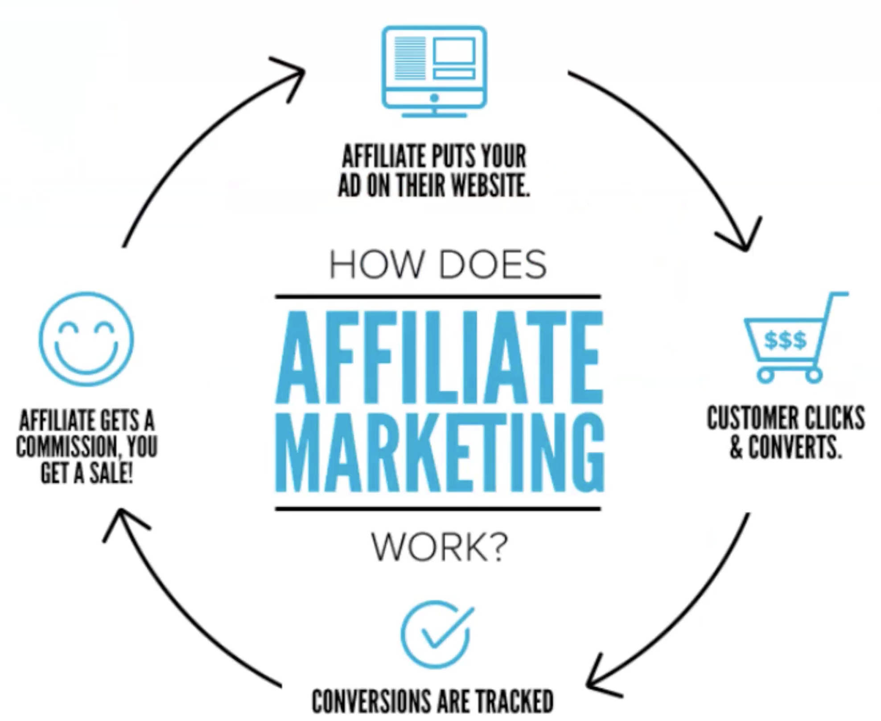

Slide 4
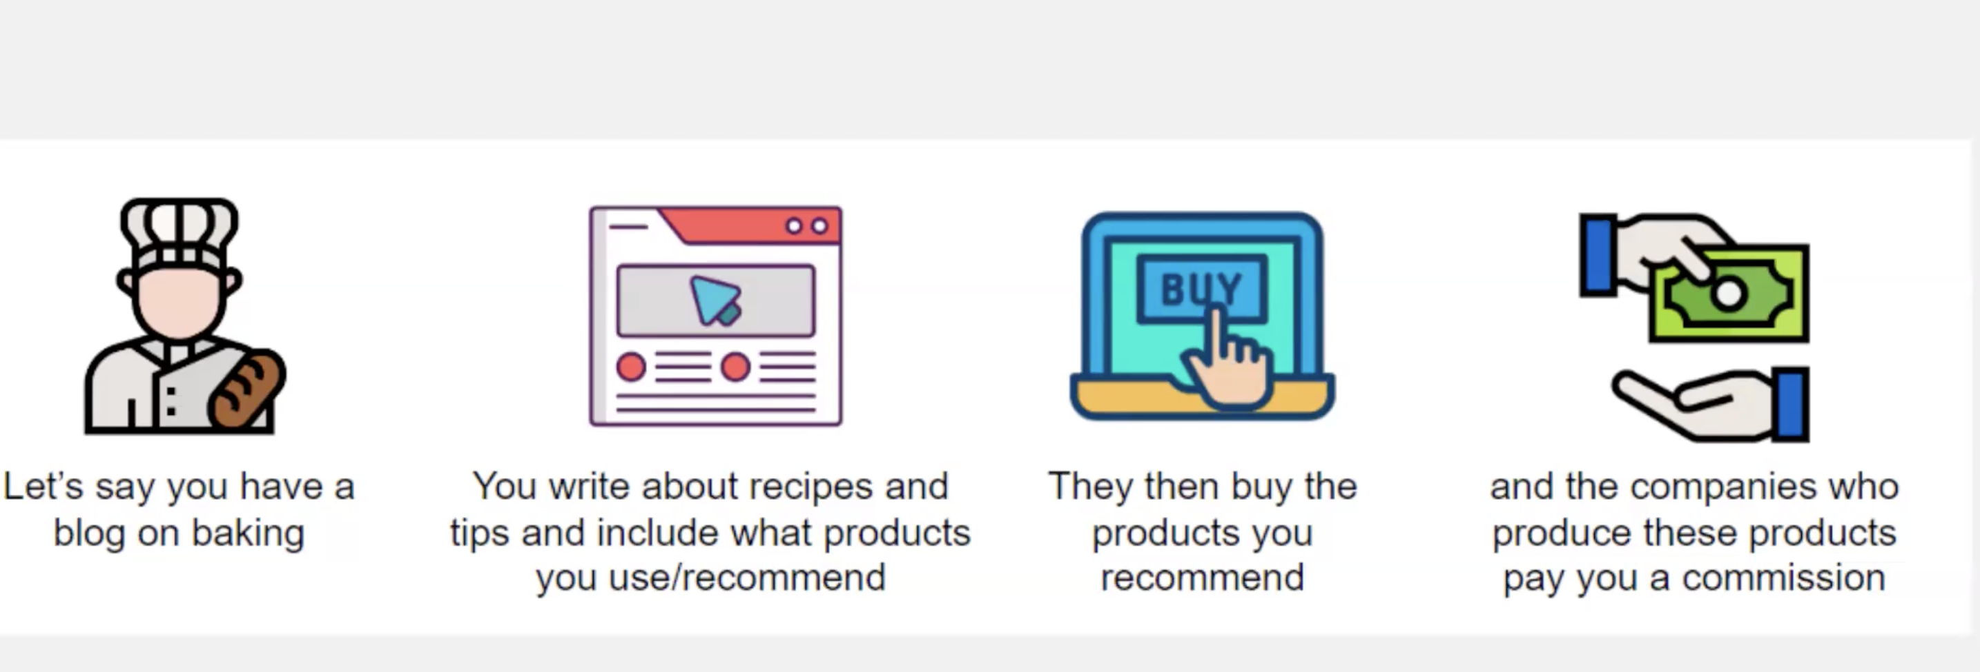
Example

Slide 5
https://www.livemint.com/gadgets-and-appliances/top-10-7-kg-washing-machines-under-rs-20-000-for-smart-laundry-in-2025-11762413127458.html
https://www.amazon.in/dp/B08ZJHJ5DJ
https://www.youtube.com/watch?v=tmYu4fSsJmM-Reviews Dekho

Slide 6
How Affiliate Marketing Works
A company launches an affiliate program
An affiliate joins the program
The affiliate receives a unique referral link
The affiliate promotes the product via:
  Blog
  YouTube
  Instagram
  Website
  Display /Banner Ads-Eg.Makemytrip
When someone clicks the link and makes a purchase → the affiliate earns commission

Slide 7
Key Players in Affiliate Marketing
Merchant – The brand selling the product
Affiliate – The promoter
Customer – The buyer
Affiliate Network – Platform connecting brands and affiliates

Slide 8
Popular Affiliate Platforms
Amazon Associates
Flipkart Affiliate
Meesho
Shopify
E-Bay Partner Network
Udemy
Nyka
Myntra

Slide 9
Types of Affiliate Commission Models
CPS (Cost Per Sale) – Earn per sale (most common)
CPL (Cost Per Lead) – Earn per signup
CPC (Cost Per Click) – Earn per click

Slide 10
Why Affiliate Marketing is Popular
Low investment
No need to create your own product
Work from anywhere
Passive income potential
Example
If you promote a ₹2,000 product with 10% commission:
One sale = ₹200 earnings
50 sales = ₹10,000 earnings

Slide 11
Basic Difference
Basis | Affiliate Marketing | Dropshipping
What you do | Promote someone else’s product | Sell products through your own store
Inventory | No | No (supplier ships directly)
Customer ownership | No | Yes
Profit type | Commission | Profit margin (Selling price – Cost price)

Slide 12
How They Work
Affiliate Marketing
You promote products using a referral link.
Customer buys from the brand’s website.
You earn a commission.
Example platforms:
Amazon Associates
Flipkart Affiliate
You do not handle:
Payments
Delivery
Returns
Customer complaints

Slide 13
Dropshipping
You create your own online store.
Customer buys from your store.
You forward the order to a supplier.
Supplier ships directly to the customer.
You keep the profit margin.
Common tools:
Shopify
AliExpress
You handle:
Customer service
Refunds
Branding
Marketing

Slide 14
Profit Example
Affiliate
Product price = ₹2,000
Commission = 10%
You earn = ₹200 per sale
Dropshipping
Product cost = ₹1,200
Selling price = ₹2,000
Profit = ₹800 per sale

