Slide 1

E-COMMERCE BUSINESS MODELS

Slide 2

TYPES OF BUSINESS MODELS
In order to find the right ecommerce model for your business, you need to define two things.
Firstly, you will have to define who you will sell to and then define how you will position what you have to sell. Then, figure out your ecommerce business plan. This will define how you will attract customers and how they will engage with your product.
Secondly, figure out your delivery framework by assessing what will work best for your ecommerce business.

Slide 3

Types of Ecommerce Business Models
1. Business-to-Business (B2B)
2. Business-to-Consumer (B2C)
3. Consumer-to-Consumer (C2C)
4. Consumer-to-Business (C2B)
5. Business to Government (B2G)
6. Business to Business to Consumer (B2B2C)
7. Direct-to-Consumer (D2C)
8. Hybrid

Slide 4

Other Models
1. Selling your products to customers
Selling your products directly to customers helps you cut costs by eliminating middlemen.
The direct-to-customer model is a great way for online stores to build a loyal relationships with customers, and you can easily customize your customer experience.
2. Selling "White label" products
White labeling is a business model and strategy that involves branding a third-party product and selling it as your product.
White labeling is common in the health and fashion industry.
An example is a cosmetic brand that buys a particular type of body cream from a third-party brand and sells it under its name. The image and design of the cosmetic brand will be presented on the product, depicting their ownership.

Slide 5
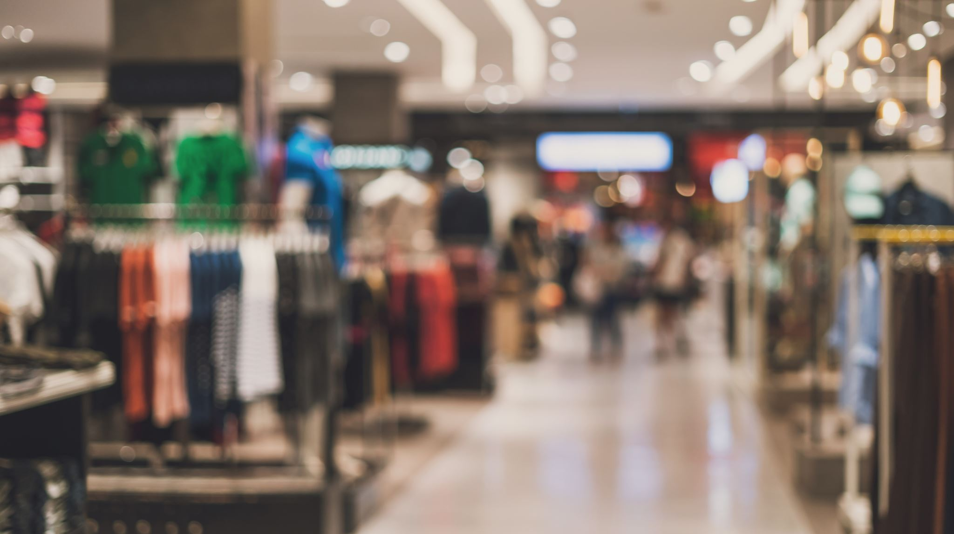
3.Wholesaling
Wholesaling is an ecommerce model and strategy that involves selling goods in large quantities to businesses at a discounted price. This model is common to manufacturers and online retailers.
Venturing into wholesaling requires huge capital and a large inventory. However, the model has high risks and thin profit margins. Many B2B brands and a few B2C companies apply this business strategy.

Slide 6

4.Dropshipping
Want to sell products without holding inventory?
Dropshipping is an ecommerce revenue model that allows you to market and sell items by acting as an intermediary between a buyer and a supplier. You eliminate the costs of holding inventory, warehousing, and shipping.
You can set up an ecommerce website and display products of different brands with your own added price. When a buyer places an order, you notify the supplier who handles the tracking and delivery of the product, then you gain a commission from the price.
You are only responsible for running ads and getting traffic to your ecommerce site.

Slide 7
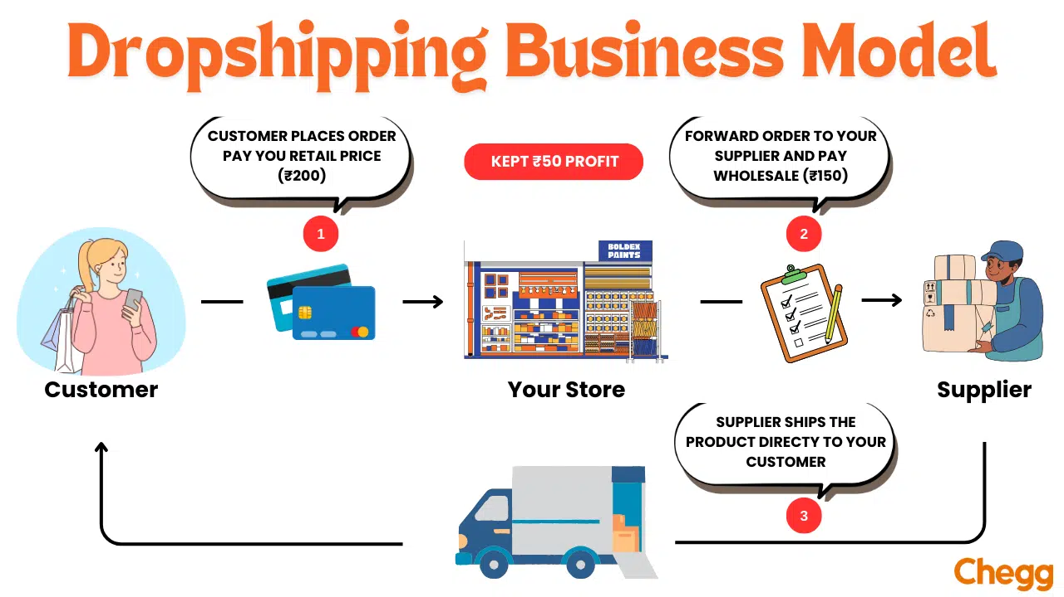

Slide 8
Let’s compare dropshipping in India to traditional retail:
Aspect | Traditional Retail | Dropshipping
Inventory | Store buys and stores products | No inventory needed
Upfront Costs | High (buying inventory) | Low (website setup)
Shipping | Store handles shipping | Supplier ships directly
Location | Physical store needed | Can operate from anywhere
Product Range | Limited by storage space | Wide range possible
Risk | Risk Higher (unsold inventory) | Lower (no inventory risk)

Slide 9
Types of Business Models for Drop shipping in India
1. Business-to-Consumer (B2C) Dropshipping
Think of it like an online shop where you can buy clothes, gadgets, or health products.
Examples: Online fashion retailers, electronics stores, or health products websites.
Advantages:
  Direct customer engagement.
  Greater control over branding and marketing.
2. Business-to-Business (B2B) Dropshipping
In this model, one business sells products to another business, often in bulk. It’s like a wholesaler supplying goods to a retail store, helping businesses stock up without holding inventory themselves.
Examples: Wholesale supply companies or platforms targeting retailers.
Advantages:
  Potential for larger order sizes.
  Building long-term relationships with other businesses.

Slide 10
3. Print-on-Demand Dropshipping
Print-on-demand lets you create custom-designed products, like T-shirts or mugs, that are only made when someone orders them. You don’t keep stock; instead, every order is printed fresh just for the buyer.
Examples: Custom apparel stores, personalized gift shops.
Advantages:
  Unique product offerings that can greatly differentiate a brand.
  No need for upfront inventory investment.
4. Niche Dropshipping
Niche dropshipping focuses on a specific type of product or customer group, like eco-friendly items or pet supplies. This helps you stand out and attract customers who are passionate about those particular products.
Examples: Eco-friendly products, pet supplies, or handmade crafts.
Advantages:
  Less competition compared to general stores.
  Ability to build a loyal customer base.
5. Global Dropshipping
Global dropshipping involves selling products from international suppliers to customers in India or other countries. You get access to a huge variety of products, often at lower prices.
Examples: E-commerce stores that source products from China, the US, or Europe.
Advantages:
  Access to a wider variety of products.
  Potentially lower prices depending on global suppliers.

Slide 11
6. Local Dropshipping
In local dropshipping, businesses work with nearby suppliers to sell products within a specific region. This means faster shipping times and supporting local merchants and products.
Examples: Regional fashion boutiques or local handmade crafts.
Advantages:
  Faster shipping times due to proximity.
  Support for local businesses and products.
7. Crowdfunding Dropshipping
Crowdfunding dropshipping uses platforms like Kickstarter to see if people want a product before you start selling. It helps you test ideas with potential customers and gather funds before production.
Examples: Innovative gadgets or unique products introduced on platforms like Kickstarter or Indiegogo.
Advantages:
  Validating market interest before investing in inventory.
  Building a community around a product.

Slide 12
8. Subscription-Based Dropshipping
Subscription-based dropshipping allows customers to receive products regularly. It creates a steady income stream and helps keep customers coming back for more.
Examples: Monthly beauty boxes, snack subscriptions, or health supplements.
Advantages:
  Predictable revenue stream.
  Opportunity for strong customer retention.

Slide 13
5. Selling by subscriptions
A subscription-based ecommerce revenue model enables customers to buy and subscribe to a service or product for a defined period - usually lasting for a month or year.
Most software companies adopt the subscription e-business model, including Website builders, Payroll software, Accounting solutions, and many others. The model is not limited to Tech giants only, as ecommerce giants like Netflix, Blue Apron, Amazon Prime, and ButcherBox also use the model.
However, the business model doesn't apply to every business line; it works well if you're in the fashion, food, pet products, movie, or beauty industry.
6. Using a freemium model
Freemium is an ecommerce business marketing strategy that involves making some product or service features accessible to users for free while charging a premium price for the additional features.
The model is mostly used by Social media enterprises like Hootsuite, Music providers like Spotify, and Software companies that make games and mobile applications.
For instance, Spotify offers users a basic plan with few features and lots of restrictions. However, the premium plan allows users to enjoy all features and stream unlimitedly.

Slide 14
1. Business-to-Business (B2B)
If your products or services are geared toward meeting the needs of businesses, setting up a B2B strategy is your best bet. In this model, a business sells its product or service to another business.
Networking and reaching out is a bigger part of this strategy. A big advertising budget is not of much help. The most important challenge you would face is convincing established businesses that your products/services fit their processes.
The advantage of this business model is that order sizes are usually large, and repeat orders are very common if you maintain the quality of your products and services. Microsoft is an example of a great B2B model.

Slide 15
2. Business-to-Consumer (B2C)
B2C businesses sell directly to consumers. Whether you purchase clothing, household items, or entertainment from an online store, it is part of a B2C transaction.
Choose this model if you sell to individuals. B2C purchases are faster than B2B, especially for cheaper items. So, B2C companies spend less on marketing but have lower order values and fewer repeat customers than B2B companies.

Slide 16
3. Consumer-to-Consumer (C2C)
B2B and B2C business concepts are well-known, but Customer-to-Customer (C2C) is unique to ecommerce. In the C2C model, consumers connect to buy and sell goods or services. Platforms like Craigslist and eBay earn money from transaction or listing fees.
These platforms allow their users to trade, buy, sell, and rent products and services. The platforms receive a small commission on every transaction. This business model is complex and requires careful planning to be successful.

Slide 17
4.Consumer-to-Business (C2B)
C2B businesses let individuals sell goods or services to companies, similar to freelancers working for businesses.
This model, popularized by platforms for freelancers, involves individuals providing services or tasks to commercial clients. In simple terms, it’s like a sole proprietor serving larger companies.
In this model, consumers can set their prices, and businesses compete to meet their needs directly. Reverse auction websites, freelance marketplaces, and affiliate marketing are part of this business model. Again, this model requires planning due to the legal complexities involved.

Slide 18
5. Business to Government (B2G)
Business to Government (B2G) is a type of online business where a company sells its products to government organizations. To participate in B2G, you need to bid on government contracts.
Governments often have requests for proposals, and ecommerce businesses can bid on government projects. Typically, government agencies won’t place orders directly on your ecommerce store.
However, some local government agencies may be an exception depending on their needs.

Slide 19
6. Business to Business to Consumer (B2B2C)
When a business sells products to another business, and that business then sells to consumers online, this is called B2B2C ecommerce.
There are three parties involved in this type of ecommerce business model. You will need to partner with another business and sell its products. You will offer the partner a commission for each sale.
Ecommerce store owners choose this business model to acquire new customers. Customers may be familiar with the partner’s products but cannot order from them online due to obstacles like location or shipping costs.
This ecommerce business model is best for new ecommerce store owners who want to expand their customer base.

Slide 20
7. Direct-to-Consumer (D2C)
The direct-to-consumer (D2C) model involves selling products straight to consumers, bypassing wholesalers or third-party retailers like Amazon. It simplifies the shopping process for customers by eliminating the need to choose between competing brands.
8. Hybrid
Hybrid models mix different business types—B2B, B2C, and D2C—to offer more flexibility in the ecommerce market. This means businesses can use different strategies to reach customers in various ways.
For instance, a company might sell directly to consumers (B2C) and also provide services to other businesses (B2B). Alternatively, it could use D2C to control its brand while working with wholesalers. Amazon is a great example again, combining B2C retail with B2B services.

