Slide 1
Q Commerce

Slide 2
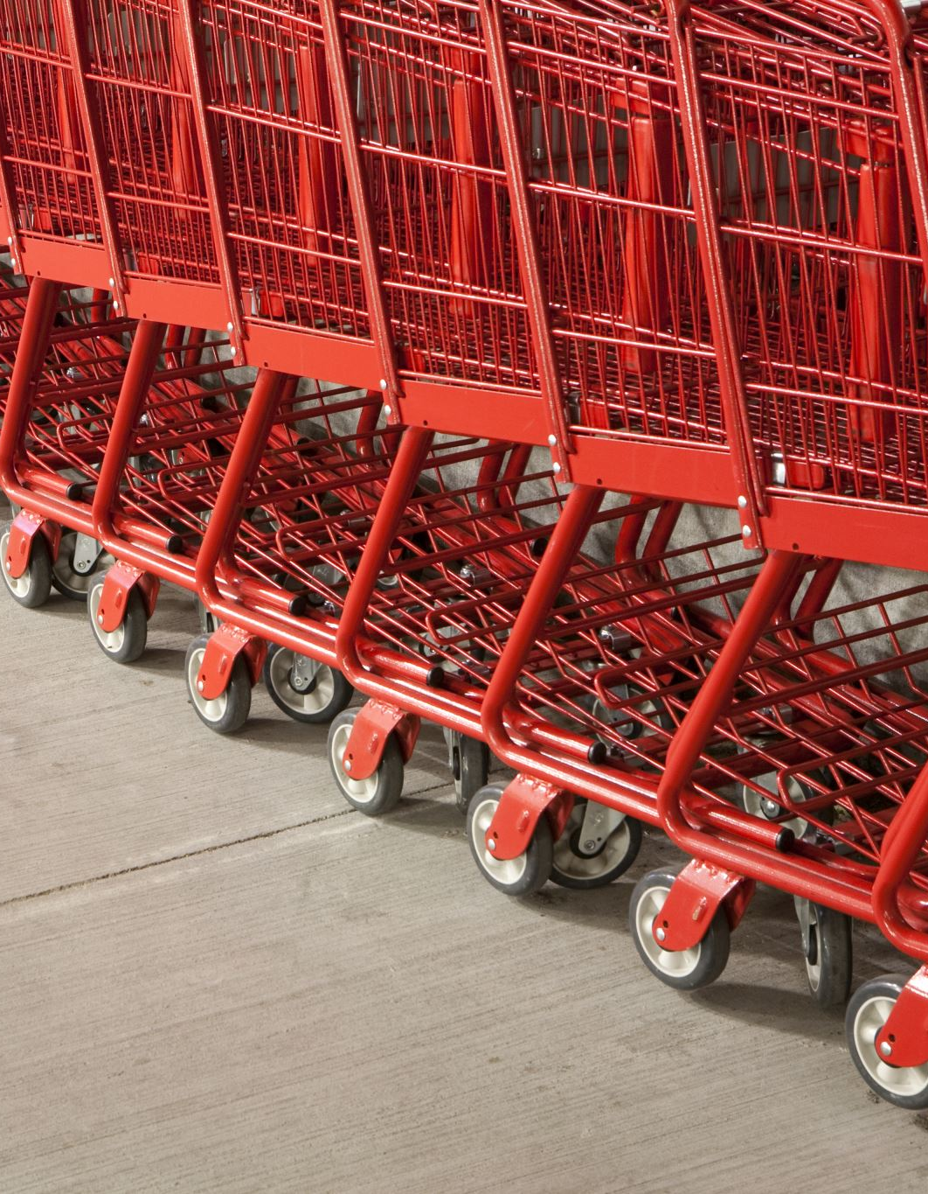
What is Quick Commerce (Q-Commerce)?
Definition :
Quick Commerce is a subset of e-commerce focused on ultra-fast delivery (10–20 minutes) of daily-need, high-frequency products using hyperlocal infrastructure and data-driven logistics.
Examples (India):
Blinkit (Zomato)
Zepto
Swiggy Instamart
Dunzo Daily

Slide 3
Evolution: From E-Commerce to Q-Commerce
MBA Insight:
Phase | Delivery Time | Model | Key Learning
Traditional E-commerce | 3–7 days | Central warehouses | Scale over speed
Same-day commerce | 24 hours | Regional hubs | Faster fulfillment
Hyperlocal commerce | 1–2 hours | Local stores + riders | Proximity matters
Q-Commerce | 10–20 minutes | Dark stores + micro-clusters | Speed is the product

Slide 4
Dark Stores – The Backbone of Q-Commerce
A small warehouse (1,500–3,000 sq ft) designed only for order picking, not customer walk-ins.
Key Characteristics:
Located within 1–3 km of customers
Limited SKUs (2,000–4,000 vs 20,000+ in supermarkets)
Optimized for speed, not display
Why Dark Stores Matter :
Lower last-mile delivery cost
Predictable demand
Higher inventory turnover

Slide 5
Cluster Operations
Cluster = A micro-market
Each cluster includes:
1 dark store
10–30 delivery partners
2–3 km delivery radius
Real-time demand forecasting
Operational Flow:
Customer places order
Algorithm assigns nearest dark store
Picker packs order (2–4 minutes)
Rider delivers (8–12 minutes)

Slide 6
Hyperlocal Logistics – The Real Differentiator-Hyperlocal logistics is the system of delivering goods within a very small geographic radius (1–3 km) using data, algorithms, and micro-infrastructure to minimize time and cost per order.
Core Elements:
GPS-based rider allocation
Route optimization
Inventory prediction (AI/ML)
Time-slot heat mapping-When & where demand spikes
Why hyperlocal wins:
Lower fuel cost
Faster turnaround
Higher rider utilization

Slide 7
How a Home Chef or Small Business Can Partner with Q-Commerce / E-Commerce
Business Models Available for Small Sellers
Model 1: Marketplace Listing (Most Common)
Platforms:
Swiggy, Zomato
Amazon Local Shops
ONDC
You handle: cooking/production
Platform handles: discovery, delivery, payments
Best for home chefs
High commission (15–30%)

Slide 8
Model 2: Dark Store Supplier / Local Vendor
You supply:
Fresh meals
Baked goods
Ready-to-eat items
Platform stocks or lists your products in nearby dark stores.
Predictable volume
Quality & compliance strict

Slide 9
Model 3: Hyperlocal Brand Partner (Advanced)
Your brand gets featured
Platform uses your kitchen/store as a fulfillment point
Brand building
Requires scale & consistency

Slide 10
Step-by-Step: Home Chef → Q-Commerce Partner
Step 1: Legal & Compliance (Non-Negotiable)
FSSAI registration
GST (if applicable)
Standard packaging & labeling
Step 2: Choose Platform
Meals: Swiggy/Zomato
Packaged food: Blinkit / Amazon / ONDC
Local discovery: WhatsApp + ONDC
Step 3: Menu & SKU Design
Q-Commerce favors fast-moving, repeat items, not elaborate menus.
Example:
3–5 signature dishes
Limited daily quantity
Easy-to-pack items

Slide 11
Pricing Strategy
Platform commission: 20–30%
Packaging cost
Delivery charge
Rule of thumb:
Price 25–35% higher than offline selling

Slide 12
How Small Retailers Can Join Hyperlocal Ecosystem
Options:
Register as “Local Seller” on Amazon
Partner via ONDC apps
Act as last-mile fulfillment partner
Convert store into micro dark store
Remember
Small stores don’t lose relevance — they become infrastructure.

Slide 13
Risks & Challenges (Important to Teach)
Thin margins
High customer expectations
Platform dependency
Demand unpredictability
Class Discussion Question:
“Is Q-Commerce a logistics company, a retail company, or a data company?”

Slide 14
Q-Commerce companies operate like retail companies on the surface, logistics companies in execution, and data companies in decision-making.

Slide 15
What Does “Unit Economics” Mean?
Unit Economics = Profitability of ONE unit of business
In Q-Commerce, the “unit” is one customer order.
Why Unit Economics is Critical in Q-Commerce
Q-Commerce operates on:
Low order values
High delivery costs
Extreme speed expectations
Even ₹20 loss per order, multiplied by 1 million orders/month, becomes unsustainable.
That’s why investors focus on unit economics before scale.

Slide 16
Contribution Margin per Order
Revenue per Order–Variable Costs per Order=Contribution Margin If contribution margin is:
Positive → scalable
Negative → growth burns cash

Slide 17
Example 1: Positive Contribution Margin (Scalable Model)
Scenario
A Q-Commerce platform delivers groceries in 15 minutes.
Revenue per Order
Average order value (AOV): ₹450
Delivery fee: ₹20
Total Revenue = ₹470

Slide 18
Variable Costs per Order
Cost Component | ₹
Cost of goods sold (COGS) | 300
Picking & packing | 25
Last-mile delivery | 70
Payment & tech ops | 15
Total Variable Cost | ₹410
Contribution Margin
470−410=₹60
✔ Each order contributes ₹60 toward covering fixed costs
✔ Once fixed costs are covered → profits start

Slide 19
Example 2: Negative Contribution Margin (Cash-Burn Model)
Scenario
Same platform uses heavy discounts to gain users.
Revenue per Order
AOV after discount: ₹380
Delivery fee: ₹0
Total Revenue = ₹380

Slide 20
Variable Costs per Order
Contribution Margin
380−415=−₹35
Every order loses ₹35
More orders = more losses
Negative contribution margin means scale accelerates cash burn.
Cost Component | ₹
COGS | 300
Picking & packing | 25
Last-mile delivery | 75
Tech ops | 15
Total Variable Cost | ₹415

Slide 21
Fixed Costs (NOT in Unit Economics, but Important)
Dark store rent
Corporate salaries
Marketing spends
Technology development
These are covered only after contribution margin turns positive at scale.

Slide 22
Why Q-Commerce Struggles Initially
Early-stage Q-Commerce:
Low AOV
High discounts
Idle riders
Poor demand predictability
Result:
Negative unit economics
Strategic losses to build habit & frequency

Slide 23
How Q-Commerce Improves Unit Economics
1. Increase Basket Size
Bundles
Minimum order value
2. Private Labels
Margins jump from 8–10% → 25–40%
3. Order Density
More orders per rider per hour
4. Smarter Clustering
Shorter delivery distances
5. Ads as Revenue
Platforms become media companies

Slide 24
Q-Commerce is like running a restaurant where customers sit at home, and the kitchen must reach them in 10 minutes profit depends on how many plates a waiter can serve per hour.”

