Slide 1
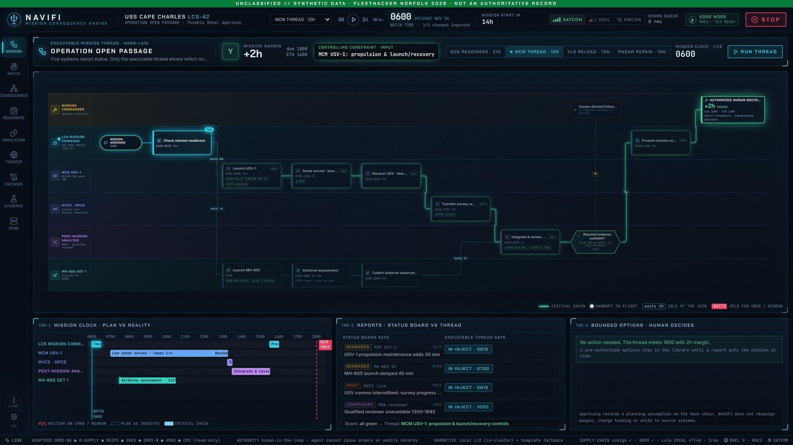
FLEETHACKER NORFOLK 2026
NAVIFI
A mission consequence engine for the watch floor
Know before it breaks the mission.
We built it this week: the app, the engine under it, and a real cluster to run it on. This deck is what we did, what we hit, and where it stands.
TUESDAY
WEDNESDAY
THURSDAY
Engine and watch floor
The mission thread
Live on our own cluster
Consequence graph, Monte Carlo, hash-chained decision log, evidence pack, three scenarios
Executable MCM thread, auto-laid threads, Connor's standalone mission engine, the video
RHEL 9, RKE2 and UDS Core stood up on AWS; NAVIFI deployed from a git commit
Notes:
NAVIFI is a mission consequence engine for the watch floor: when status reports land, it shows which one actually controls the mission, what it costs, and which bounded options recover it.
We built it this week. Tuesday was the engine and the watch floor. Wednesday was the executable mission thread; Connor also wrote a standalone mission engine, and we built the video. Wednesday night into Thursday we stood up a real cluster on AWS, on the same stack a ship would run, and deployed NAVIFI to it.
Everything you will see uses synthetic data, and a human makes every decision.

Slide 2


WHO WE ARE
A two-day sprint
Questions, or a mission you want to see run through it? Email either of us.
Bryce Schumacher
Connor Barnsley
Built the NAVIFI app: the watch floor, the mission thread, the decision log and the evidence screens. Stood up the lab cluster on AWS.
Built the standalone mission engine: the dependency graph, Monte Carlo, the decision ledger, and naval and airlift mission packs, with 48 tests.
bschumacher@uncomn.com
cbarnsley@uncomn.com
NAVIFI · FleetHacker Norfolk 2026
Notes:
We're Bryce and Connor, and the two of us built this in a two-day sprint.
Bryce built the NAVIFI app, the watch floor, mission thread, decision log and evidence screens, and stood up the lab cluster it runs on. Connor built the standalone mission engine: the dependency graph, Monte Carlo, the decision ledger and the naval and airlift mission packs.
If you have questions, or a mission you want to see run through it, our emails are on the slide.

Slide 3
FIRST, THREE TERMS
MBSE, mission engineering and mission readiness
Engineers model systems and missions. Ships report readiness. Today a Sailor joins the two by hand.
MBSE
Mission engineering
Mission readiness
Model-based systems engineering
Start from the mission, not the platform
Can we do it, and when?
Design a system as one connected model instead of a stack of documents. Requirements, parts, interfaces and behavior link to each other, so a change shows where it lands.
Break a mission into a thread of tasks, systems, people and timing, and engineer across all of them so the mission works, not just each system.
Whether a unit can do its assigned missions, now and when they are needed. The Navy reports it in DRRS-N against mission essential tasks, rated Y, Q or N.
ANSWERS
ANSWERS
ANSWERS
How is this system built, and what does it need to work?
What has to happen, in what order, for this mission to succeed?
Will this mission happen on time, and if not, why?
WHERE IT LIVES
WHERE IT LIVES
WHERE IT LIVES
Design and acquisition, usually in SysML
Planning and analysis; the DoD Mission Engineering Guide
DRRS-N, CASREPs, supply status, the watchbill
IN OUR DEMO
IN OUR DEMO
IN OUR DEMO
What USV-1, the MH-60S and the analyst each need: parts, maintenance, a qualified person
Operation Open Passage: USV sonar and a helo survey in parallel, an analyst reviews both, report by 1800
MCM rated N: 1 h 15 m short, held up by the analyst's watch
Notes:
Three terms before the demo, because NAVIFI sits where they meet.
MBSE, model-based systems engineering, designs a system as one connected model instead of a stack of documents, so you can see what each system needs to work: parts, maintenance, a qualified person.
Mission engineering starts from the mission instead of the platform. It breaks a mission into a thread of tasks, systems, people and timing, and engineers across all of them. In our demo that is Operation Open Passage: a USV and a helo survey the channel in parallel, an analyst reviews both, and the report is due at 1800.
Mission readiness is whether a unit can do its missions, now and when they are needed. The Navy reports it in DRRS-N against mission essential tasks as Y, Q or N. Today a Sailor joins these by hand: the mission thread lives in a plan, readiness is reported system by system, and the whiteboard connects them.

Slide 4
THE DIGITAL THREAD
How mission engineering threads into readiness
Each link points to the next, so a status change finds the mission it hits, and the answer traces back.
BUILT DOWN THE THREAD
1 · MISSION
2 · MISSION THREAD
3 · SYSTEMS AND PEOPLE
4 · LIVE RECORDS
5 · READINESS
Mine assessment
Six lanes of tasks
Its dependencies
Today's status
MCM: N, −1 h 15 m
Thimble Shoal approach, due to the commander by 1800
Survey, review and report, with every handoff and its timing
USV-1, the MH-60S and the analyst, and the parts, upkeep or quals each needs
CASREP, supply ETA and watchbill, read-only, as they change
Controlled by OS1 Vega, with bounded options to recover
From the tasking
From mission engineering
From the system models
From the ship
Y, Q or N, as DRRS-N rates it
Traced back: every answer points to the task, the system and the record behind it
TODAY
WITH NAVIFI
The thread is a plan or a slide. Readiness is reported system by system. The watch joins them on a whiteboard, by hand, every time a report lands.
The thread runs. Records attach to its nodes as they change, and readiness is computed per mission: Y, Q or N, the margin, and what controls it.
Not yet: we write the thread and the system dependencies by hand. Reading them from the engineering model is the next link.
Notes:
This is how mission engineering threads into readiness, and it is the idea the rest of the demo runs on.
Start with the mission: a mine assessment of the Thimble Shoal approach, due by 1800. Mission engineering turns it into a thread: six lanes of tasks and handoffs with their timing. The system models say what each piece needs: USV-1, the MH-60S and the analyst each need parts, maintenance or a qualified person. The ship's own records say where those stand right now. Put together, readiness comes out per mission: MCM is N, an hour and fifteen minutes short, controlled by OS1 Vega's watch.
And it traces back. Every answer points to the task, the system and the record behind it.
Today that thread is broken: the mission plan sits in a model or a slide, readiness is reported system by system, and a Sailor joins them on a whiteboard. NAVIFI makes the thread run.
What is not done yet: we write the thread and the dependencies by hand. Reading them straight from the engineering model is the next link.

Slide 5
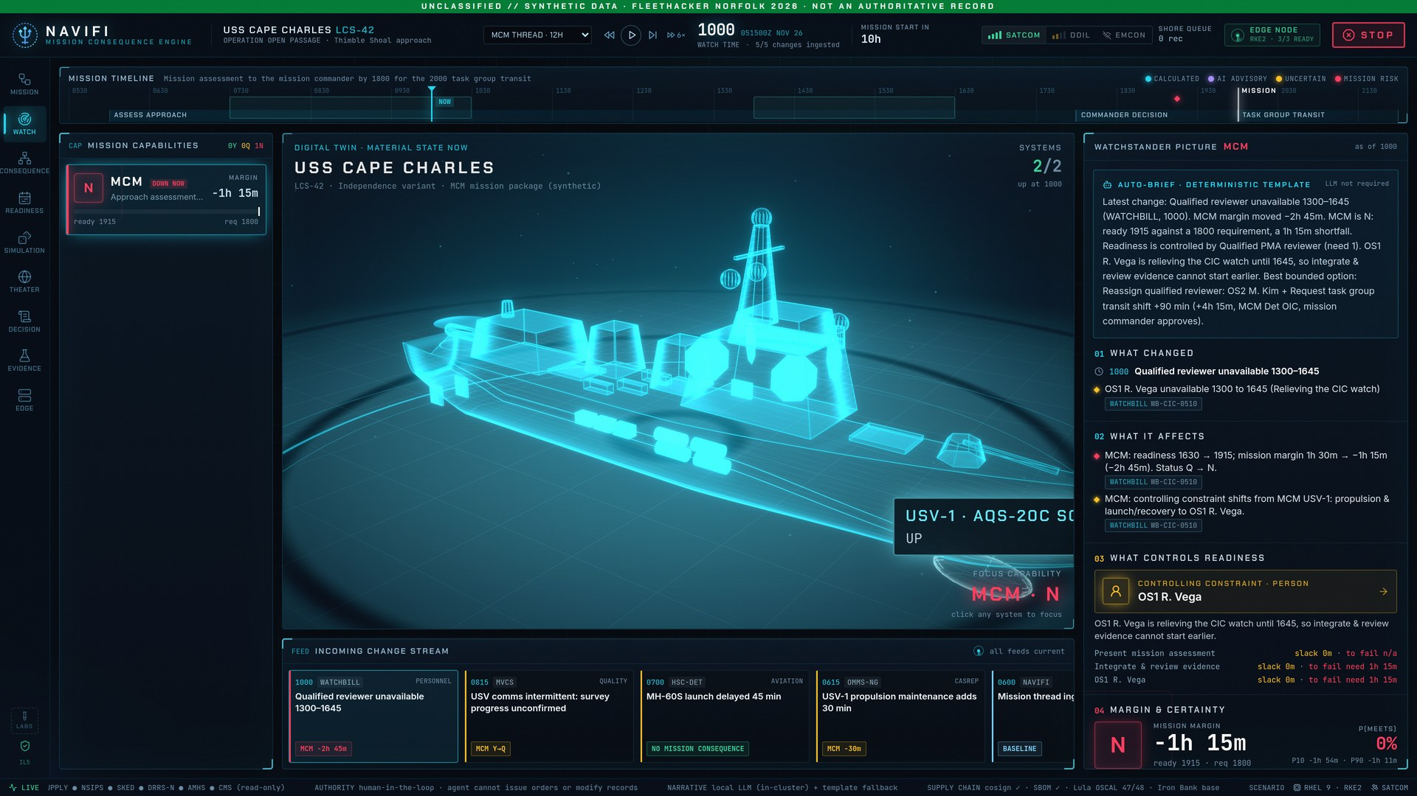
WHERE WE STARTED
Four reports land. Which one breaks the mission?
Today a Sailor answers that by hand. We wanted the watch to see it on one screen.
How it gets answered today
Pull the CASREP
30–60 min
per change, by our own tabletop estimate. Not measured fleet data.
Call supply
Check the watchbill
Redo the whiteboard
What we built instead
NAVIFI reads the records of eight systems, read-only, and recomputes the mission in milliseconds.
Every number links back to the record it came from. Nothing is typed twice or written back.
OMMS-NG
R-SUPPLY
NSIPS
SKED
DRRS-N
WATCHBILL
MVCS
AMHS
Eight systems in one picture. Synthetic records for now.
Notes:
We started from one question: when four status reports land at once, which one actually breaks the mission?
Today the Sailor is the integration layer: pull the CASREP, call supply, check the watchbill, redo the whiteboard. Our own tabletop estimate is 30 to 60 minutes per change; that is our estimate, not fleet data.
NAVIFI reads the records of eight systems read-only (OMMS-NG, R-Supply, NSIPS, SKED, DRRS-N, the watchbill, MVCS and AMHS; synthetic for now), puts them in one picture, and recomputes in milliseconds. Every number links to its source record, and nothing is written back.

Slide 6
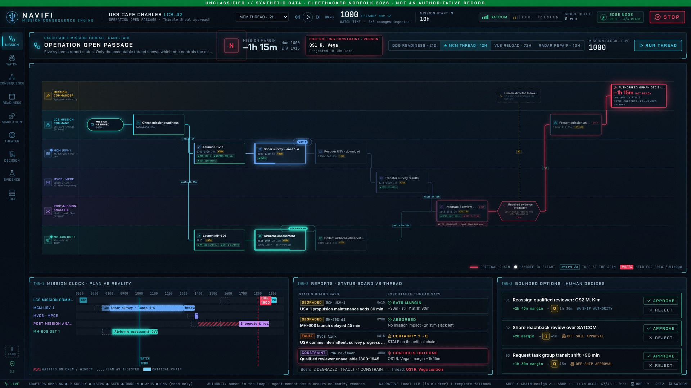
WHAT WE BUILT
We made the mission itself executable
Operation Open Passage: mine countermeasures for USS CAPE CHARLES (LCS-42), synthetic data
1
Six swimlanes, one thread
Mission commander to the MH-60S detachment, recomputed on every status report.
2
Four reports in. One controls.
At 1000 it points at the analyst's review window, not the degraded USV or helo: −1h 15m, not ready.
3
Fixes simulated, not guessed
Three bounded options run on the same thread. Reassigning a qualified reviewer gets to +1h 30m.
The live app at 1000, mid-mission
Notes:
We took the mine countermeasures mission for USS Cape Charles and made it an executable thread: six swimlanes from the mission commander to the MH-60S detachment, recomputed on every status report.
At 1000 four reports are in. The engine shows that the one controlling the end time is the PMA reviewer's 1300 to 1645 absence, not the degraded USV or helo: minus 1 hour 15, not ready.
The bounded options are simulated on the same thread. Reassigning a qualified reviewer recovers to plus 1 hour 30.

Slide 7
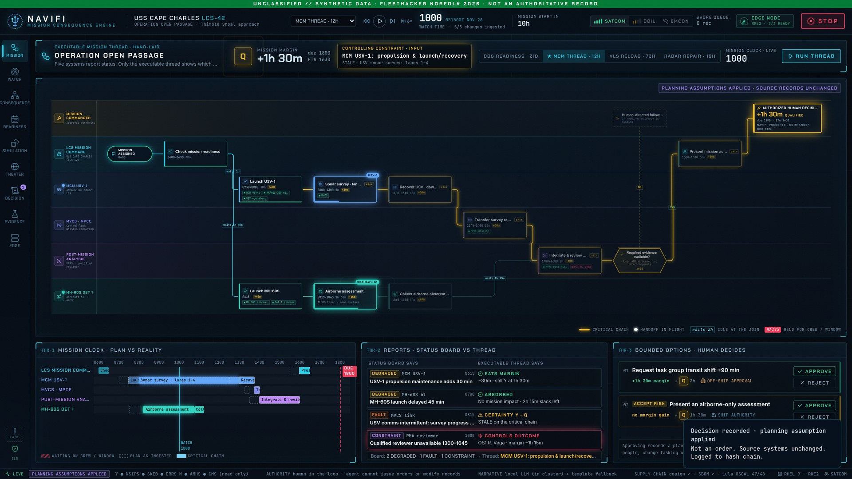
WHO DECIDES
The AI explains. A person decides.
We kept the AI out of the math on purpose.
Deterministic engine
Same inputs, same answer, every time.
The AI only narrates
Switch the language model off and the answer is identical.
Approve, reject or STOP
Approving applies a planning assumption, never an order. Source records stay untouched.
Every decision on a hash chain
Tamper with the log and verification catches it, then restores from the edge copy.
After a person approved one option: −1h 15m became +1h 30m, and the decision went on the log
Notes:
We kept the AI out of the math on purpose. The engine is deterministic: same inputs, same answer. The language model only explains the answer, and with it switched off the answer is identical.
The watchstander approves, rejects or hits STOP. Approving applies a planning assumption, never an order, and the source records stay unchanged. Every decision goes on a hash-chained log; tamper with it and verification catches it, then restores from the edge copy.

Slide 8
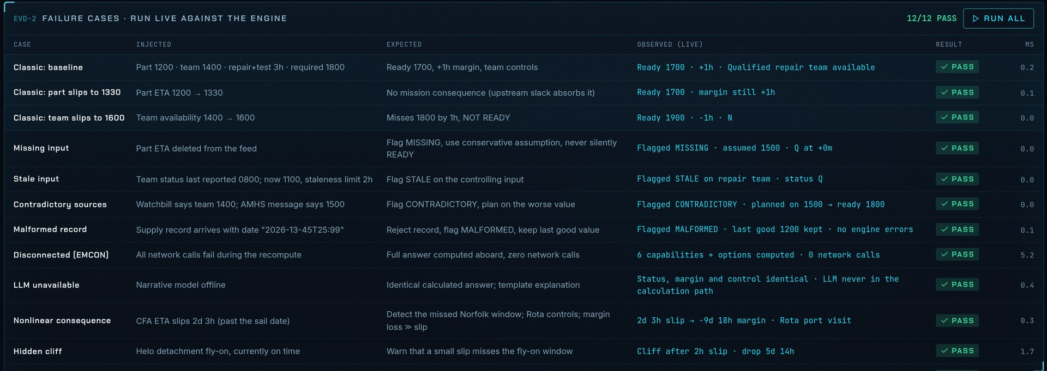
THEN WE TRIED TO BREAK IT
Twelve ways a real watch could trip it up
We wrote the failure cases down, and the app runs every one of them live against the engine.
Bad data
Missing input
Stale input
Contradictory sources
Malformed record
Bad conditions
Disconnected (EMCON)
LLM unavailable
Hard problems
Nonlinear consequence
Hidden cliff
No single fix works
The failure-case table in the app, all twelve passing
Known answers
Classic baseline
Part slips to 1330
We wrote down what it does not do yet, too
Durations are planner estimates, delays are treated as independent, and the picture is one ship. Those limits are on the evidence screen next to the results.
Team slips to 1600
12
failure cases, run live
39
app tests
48
tests on Connor's engine
Notes:
Then we tried to break it. We wrote twelve failure cases a real watch would hit: missing, stale, contradictory and malformed data; losing the link in EMCON; the language model being unavailable; and hard problems like a nonlinear consequence, a hidden cliff, and a case where no single fix works. The app runs every one live against the engine.
Behind that are 39 app tests, and Connor's new standalone engine has 48 of its own.
We also wrote down what it does not do yet: durations are planner estimates, delays are treated as independent, and it is a single-ship picture. Those limits sit on the evidence screen next to the results.

Slide 9
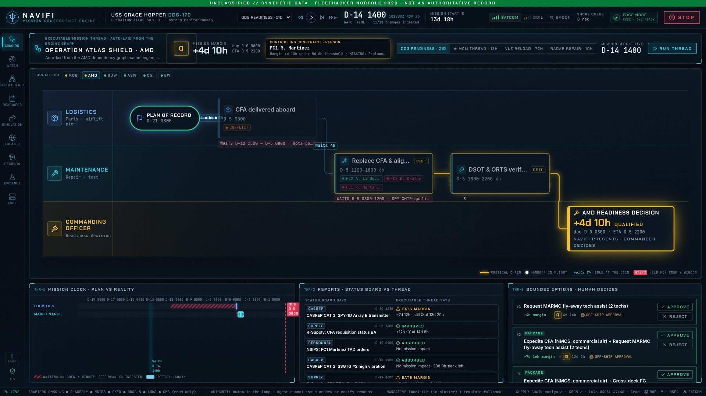
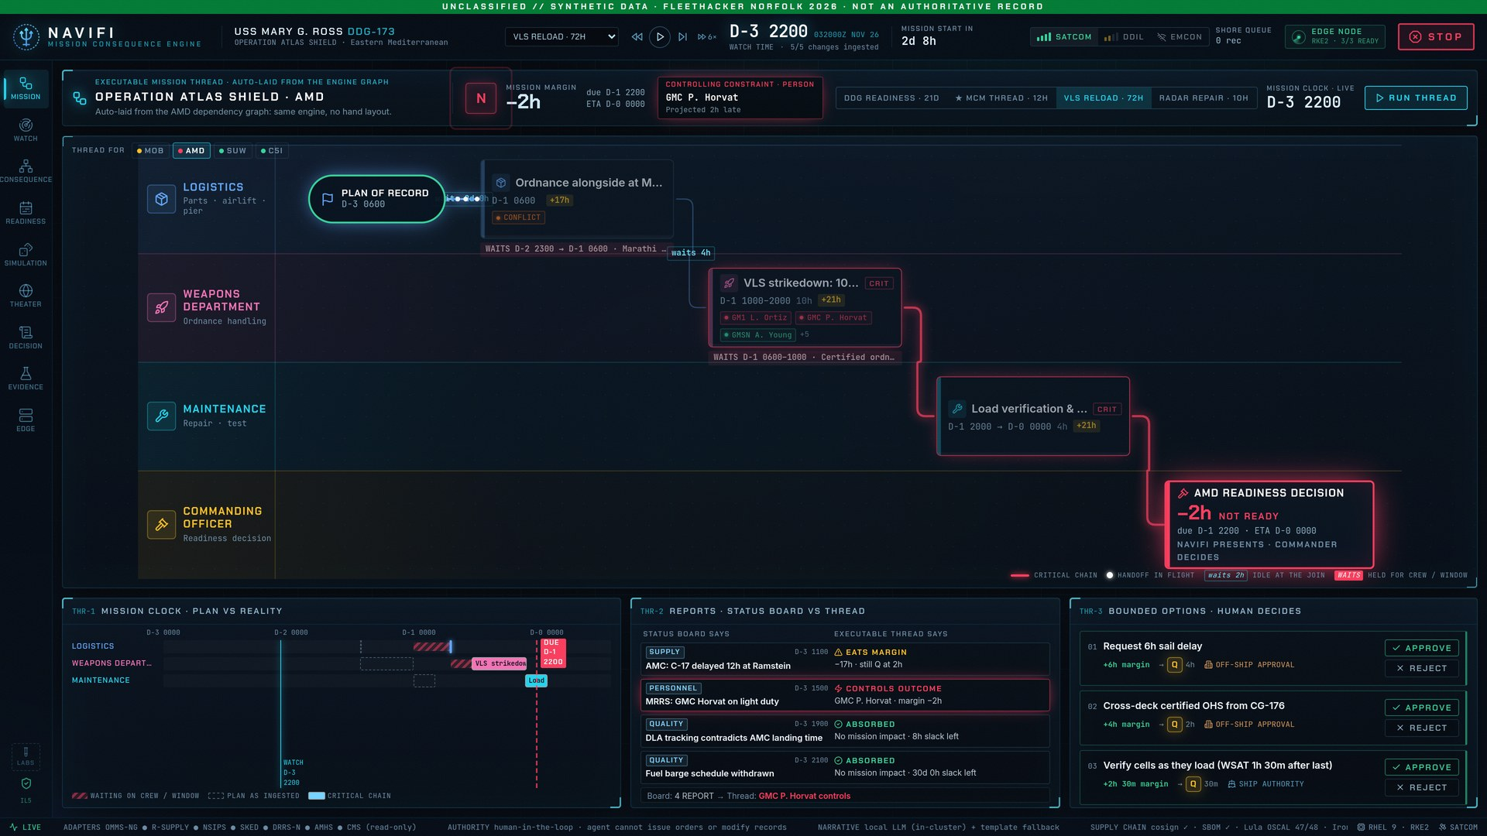
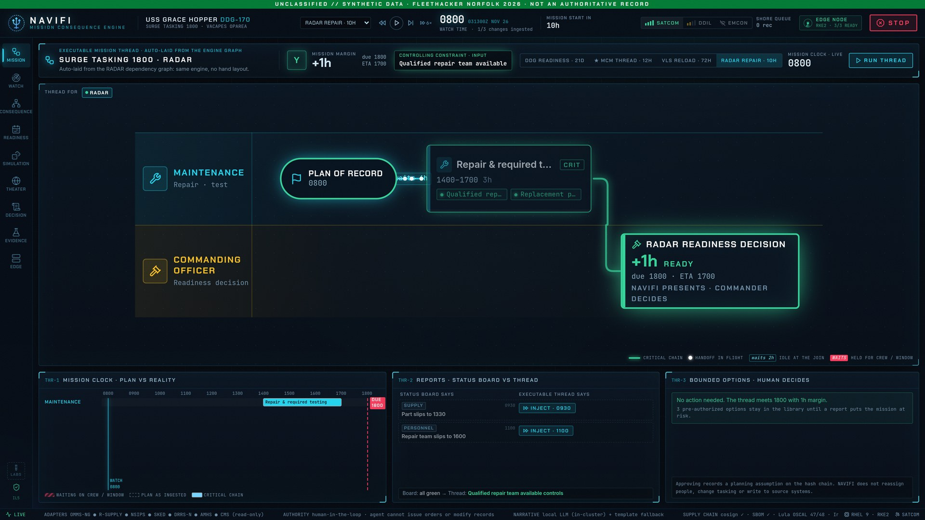
ONE ENGINE
Then we pointed it at three more missions
We laid out the MCM thread by hand. The same engine laid out the rest from their dependency graphs.
4
mission threads
2
ship classes
LCS-42
Mine countermeasures · 12 h · hand-laid
DDG-170
Air and missile defense · 21 days
3
hulls
0
engine rewrites
Threads, interfaces and deployment profiles are configuration, so a new ship class is data work, not code.
DDG-173
VLS reload · 72 h
DDG-170
Radar repair · 10 h
Notes:
We laid out the mine countermeasures thread by hand. Then we pointed the same engine at three more missions and it laid them out from their dependency graphs: air and missile defense over 21 days, a VLS reload over 72 hours, and a radar repair over 10 hours. Four threads, two ship classes, three hulls, and no changes to the engine.
Mission threads, system interfaces and deployment profiles are configuration, so adding a ship class is data work.

Slide 10
NAVIFI · INFRASTRUCTURE
Built this week: a full Kubernetes platform on AWS
From terraform apply to a hardened cluster serving NAVIFI at navifi.uds.demo.uncomn.ai, all from code in the repo
1 TERRAFORM
2 FIRST BOOT
3 RKE2
4 UDS CORE
5 NAVIFI
Provision AWS
Harden the host
Install Kubernetes
Install the platform
Deploy the app
Node, firewall, IAM role, load balancer rules, TLS certificate and DNS
RHEL 9 with SELinux enforcing. SSM agent instead of SSH, no key pair
Single-node RKE2 v1.36 with SELinux, plus the kernel setup Istio needs
Zarf init, then UDS Core 1.14: policy, mTLS, SSO, logs, metrics, backups
Any git commit: build, test, package with Zarf, roll out into the cluster
27 resources, one apply
user-data.sh
install-rke2.sh
install-core.sh, signed
deploy.sh, SBOM per build
Where it runs
Real problems we solved on the way
All in code
AWS us-east-1, inside the existing lab VPC
EC2 m7i.2xlarge: 8 vCPU, 32 GiB
RHEL 9 with SELinux enforcing
Behind an AWS load balancer with TLS
navifi.uds.demo.uncomn.ai
SELinux locked a 2nd registry pod out of its volume
→ pinned the registry to one replica
RKE2 1.36's Gateway API CRDs blocked UDS Core
→ turned RKE2's bundled ingress off
MinIO stopped publishing public images
→ moved to the Chainguard build
Tight storage rules cut Loki off from the API
→ added explicit Kubernetes API rules
27
AWS resources from one Terraform apply
4
scripts from first boot to live app
3
Zarf and UDS packages, platform to app
Rebuild it from infra/README.md
Notes:
This week we built the platform under NAVIFI as well as the app: a real Kubernetes cluster in AWS, running the same stack we plan to run aboard ship.
Five steps, all in the repo. Terraform creates the node, its firewall, IAM role, load balancer rules, TLS certificate and DNS: 27 resources in one apply. First boot hardens the RHEL 9 host with SELinux enforcing and no SSH; we get in through AWS Systems Manager. A script installs RKE2 Kubernetes. Another installs Defense Unicorns' UDS Core through Zarf, with the platform packages signature-verified. The last one takes any git commit, builds and tests it, packages it with Zarf and rolls it out.
It runs in AWS us-east-1 on one m7i.2xlarge with 8 vCPUs and 32 GiB, inside the existing lab network, behind the lab's load balancer, at navifi.uds.demo.uncomn.ai.
It was not a copy-paste install. We hit and fixed real problems: SELinux locking a second registry pod out of its storage, RKE2's newest release shipping CRDs that blocked UDS Core, MinIO pulling its public images, and our own tighter network rules cutting Loki off from the Kubernetes API.

Slide 11
NAVIFI · LAB CLUSTER ON AWS
One hardened node running the ship's stack
RHEL 9 · RKE2 Kubernetes · Defense Unicorns UDS Core · Zarf live at navifi.uds.demo.uncomn.ai
AWS EC2 · RHEL 9 · SELinux enforcing
RKE2 Kubernetes v1.36 · 8 vCPU · 32 GiB
Locked down by default
Load balancer
TLS via AWS ACM
NAVIFI: public
Admin tools: operator IPs only
Users
any browser
› SSM sessions only, logged in CloudTrail
› Only NAVIFI is public; admin tools return 404
› Default-deny network policy and mTLS
Istio ingress gateways tenant · admin
NAVIFI
app + audit volume
Zarf registry
Commit to live in one command
The node's firewall admits only this load balancer
MinIO storage
› Typecheck and tests gate every image build
› Zarf packages it with an SBOM, air-gap style
› Every commit gets its own image tag
UDS Core 1.14 wraps every workload
Pepr admission policy
Istio ambient mTLS
App network policies
Keycloak sign-in
Mirrors the shipboard deploy
Operator
AWS IAM
SSM session · no SSH, no keys
Falco runtime alerts
Vector + Loki logs
› Same RHEL 9, RKE2, UDS Core and Zarf
› Lab only: TLS at the load balancer, sign-in off
› Ship adds DISA STIG, FIPS and Keycloak SSO
Prometheus + Grafana
Velero backups
8 vCPU · 32 GiB
the whole platform on one node
0
node ports open to the internet
Signed
Sigstore-verified, SBOM per build
1 command
from any git commit to live
Notes:
NAVIFI runs on the same stack it will use aboard ship: RHEL 9 with SELinux enforcing, RKE2 Kubernetes, and Defense Unicorns' UDS Core, all packaged with Zarf. Here it is one EC2 node behind an AWS load balancer.
Traffic: the load balancer terminates TLS and serves only navifi.uds.demo.uncomn.ai to the public. Grafana, Keycloak and the UDS portal answer 404 unless the request comes from an operator IP. The node accepts traffic only from the load balancer, and there is no SSH: operators get in through AWS Systems Manager, authenticated by IAM and logged in CloudTrail.
Inside the cluster, UDS Core wraps NAVIFI like every other workload: Pepr admission policies, Istio ambient mTLS, deny-by-default network policies generated from the app's Package, Falco runtime detection, and central logs and metrics.
Delivery: one command takes any git commit, runs typecheck and tests in the image build, wraps the image in a Zarf package with an SBOM, and deploys it through the in-cluster registry, the same way the air-gapped ship bundle works. The lab differs only where an AWS demo needs it: TLS at the load balancer and sign-in off so the demo opens without an account. The ship build adds DISA STIG, FIPS and Keycloak SSO.

Slide 12
NAVIFI · THEORETICAL SHIPBOARD DEPLOYMENT
The same stack aboard, built for DDIL
RHEL 9 · RKE2 Kubernetes · Defense Unicorns UDS Core · Zarf same as the lab
Amber: changes from the lab
Ship rack · RHEL 9 · SELinux enforcing
RKE2 v1.36 · STIG, FIPS, CIS · 3 nodes
Locked down aboard
Ship's LAN
Runs with no shore link
Admin tools: ship IT only
Watchstanders
CAC, ship terminal
› Installed whole; nothing downloads at sea
› CAC sign-in through Keycloak
› Default-deny network policy and mTLS
Istio ingress gateways TLS ends here
NAVIFI
app + audit volume
Zarf registry
Works with the link down
Uses the link when it has one; nothing leaves in EMCON
AI narrator, optional
› SATCOM: audit goes ashore in batches
› DDIL: one entry at a time, local model
› EMCON: nothing leaves, everything works
UDS Core Iron Bank images
Pepr admission policy
Istio ambient mTLS
App network policies
Keycloak CAC sign-in
What changes from the lab
Pier side
builds the bundle
UDS bundle · sneakernet or DDIL
Falco runtime alerts
Vector + Loki logs
› One air-gapped bundle, not a git build
› TLS at the Istio gateway, no load balancer
› DISA STIG, FIPS, CIS and Iron Bank images
Prometheus + Grafana
Velero backups
1 bundle
Zarf init, UDS Core and NAVIFI
0
downloads at sea, model included
Signed
Sigstore-verified, SBOM per build
3 link states
SATCOM, DDIL and EMCON
Notes:
This is the same picture aboard ship. It is the design, not something we have deployed on a hull. Everything in amber is what changes from the lab cluster on the previous slide; everything else is the same software we ran this week.
It is built for DDIL: installed air-gapped, then it runs whatever the link is doing. Watchstanders reach NAVIFI over the ship's LAN with a CAC, through Keycloak. It needs no shore link to run, and there is no load balancer: TLS ends at the Istio gateway. When there is a link, the decision log goes ashore; in EMCON nothing leaves at all.
The rack runs RHEL 9 with the DISA STIG and FIPS mode, and RKE2 with the CIS profile across three edge nodes. UDS Core uses Iron Bank images. The optional AI narrator runs in the cluster, so it works with the link down too.
Delivery: pier side, connected, we build one UDS bundle carrying Zarf init, UDS Core and NAVIFI, with the model weights inside. It goes aboard by sneakernet or over a degraded link, and nothing is downloaded at sea.
With the link up, the audit log forwards ashore in batches over SATCOM. In DDIL it trickles one entry at a time and uses a local model or template text. In EMCON nothing leaves the ship, and the engine, map, simulation and audit all keep working.

Slide 13
WHERE WE ARE
What's real, what isn't yet, and what's next
Three days in. Here is the straight version.
Real today
Not real yet
Next
› Runs on the ship's stack, live on AWS
› Four mission threads on one engine
› Twelve failure cases and a hash-chained decision log
› Any git commit to live in one command
› All data is synthetic
› Durations are planner estimates, not fleet history
› Correlated delays (one cause, many slips) aren't modeled
› One ship at a time; squadron roll-up is a prototype
› Wire Connor's new mission engine into the app
› 30 days: read-only exports from one DDG; three watch teams try it against today's process
› 60 days: workflow authoring, and UDS on an RKE2 edge node (we did a version of this one this week)
› 90 days: three hulls plus a squadron roll-up
Synthetic data only. A human decides.
Notes:
Straight version, three days in.
Real today: it runs on the ship's stack and is live on AWS; four mission threads run on one engine; twelve failure cases run live; every decision goes on a hash-chained log; and any commit goes live in one command.
Not real yet: all data is synthetic, durations are planner estimates, correlated delays are not modeled, and it is one ship at a time; the squadron roll-up is a prototype.
Next: wire Connor's new mission engine into the app. Then the plan in the app: in 30 days, read-only exports from one DDG and three watch teams trying it against today's process; in 60, workflow authoring and UDS on an RKE2 edge node, which we did a version of this week; in 90, three hulls and a squadron roll-up.

Slide 14
APPENDIX
More detail, if you want it
Each one goes a level deeper on something from the main deck.
A1
A2
A3
Nothing typed twice
What it gives back to the watch
Built for the person on watch
Where the data comes from, and what happens when it is bad
Our before and after for one change landing mid-watch
The screen, the words, the STOP button, and EMCON
A4
A5
A6
Slack is not margin
Four things broke on the way to AWS
Beyond the surface fleet
The one idea under the engine
What we hit standing up the cluster, and the fixes
Connor's engine: other ships, other domains
Notes:
The appendix goes one level deeper on six things from the main deck. Jump to whichever one comes up.

Slide 15
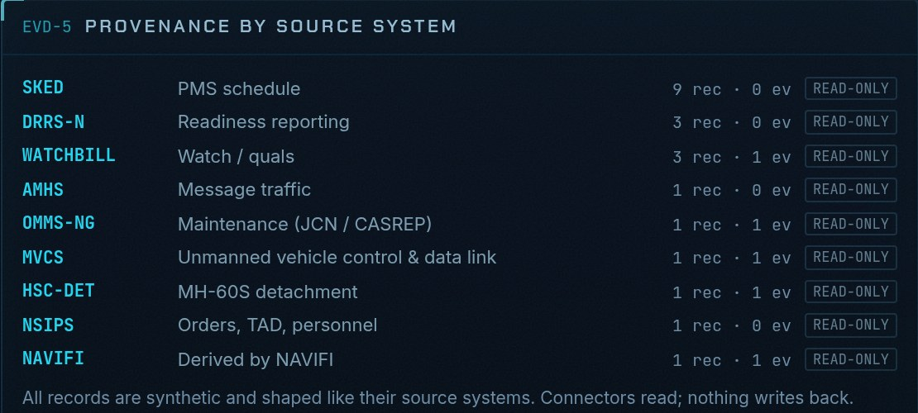
APPENDIX A1 · WHERE THE DATA COMES FROM
Nothing typed twice
NAVIFI reads the records the ship already keeps. Nobody re-enters a status to make the picture move.
Read-only connectors
OMMS-NG maintenance
Bad data gets flagged, not retyped
R-SUPPLY parts and ETAs
Missing
plans on a conservative value and says so
NSIPS personnel
Change event
Time-stamped, with its source record attached
Mission recomputed
in milliseconds, every number linked to its record
Stale
flagged on the input that controls
WATCHBILL watches and quals
Contradictory
plans on the worse value, shows both
SKED PMS schedule
DRRS-N readiness
Malformed
rejected; the last good value is kept
MVCS unmanned vehicles
Connectors only read. NAVIFI never writes back to a system of record.
AMHS message traffic
The paperwork comes from the code
The provenance panel: how many records each system supplied, all read-only.
› SBOM and signature on every image build
› 48 NIST 800-53 controls in an OSCAL file generated from the code
› CI fails if that file drifts from the code
Notes:
Where the data comes from. NAVIFI reads the records the ship already keeps, through read-only connectors shaped like OMMS-NG, R-Supply, NSIPS, the watchbill and the rest. Each change arrives as a time-stamped event with its source record attached, and the mission is recomputed in milliseconds. Nobody types a status twice, and NAVIFI never writes back.
Bad data is the normal case, so the engine flags it instead of asking a Sailor to reconcile it: missing values get a conservative assumption, stale ones are flagged on the input that controls, contradictions plan on the worse value, and malformed records are rejected.
The accreditation paperwork comes from the code too: an SBOM and signature on every build, and an OSCAL file mapping 48 NIST 800-53 controls that CI regenerates and checks. All records here are synthetic.

Slide 16
APPENDIX A2 · BEFORE AND AFTER
What it gives back to the watch
Our tabletop comparison for one change landing mid-watch. Not measured fleet data yet.
AFTER A CHANGE LANDS
TODAY
WITH NAVIFI
HOW
Time to a defensible answer
30–60 min
Milliseconds
Recomputed the moment the report lands
Systems consulted
5–7, plus calls
One screen
Every number links to its source record
Nonlinear effects caught
Often missed
2 of 2
A missed sail window and a helo fly-on cliff
Data problems surfaced
When they bite
4 of 4
Missing, stale, contradictory, malformed
Decision record
Notebook or email
Hash-chained log
Who decided what, on which facts, and when
How we would make it real In the first 30 days: sanitized, read-only exports from one DDG, and three watch teams run this same comparison against today's process.
Notes:
This is what we think it gives back to the watch, for one change landing mid-watch. The 'today' column is our own tabletop estimate, not measured fleet data, and we say so in the app too.
Today a defensible answer takes 30 to 60 minutes of pulling the CASREP, calling supply, checking the watchbill and redoing the whiteboard. With NAVIFI it is recomputed in milliseconds when the report lands, on one screen, and every number links back to its record. The nonlinear effects and the bad data in our test cases are all caught, and every decision lands on a hash-chained log instead of a notebook.
To make it real, the first 30 days are read-only exports from one DDG and three watch teams running this same comparison against today's process.

Slide 17
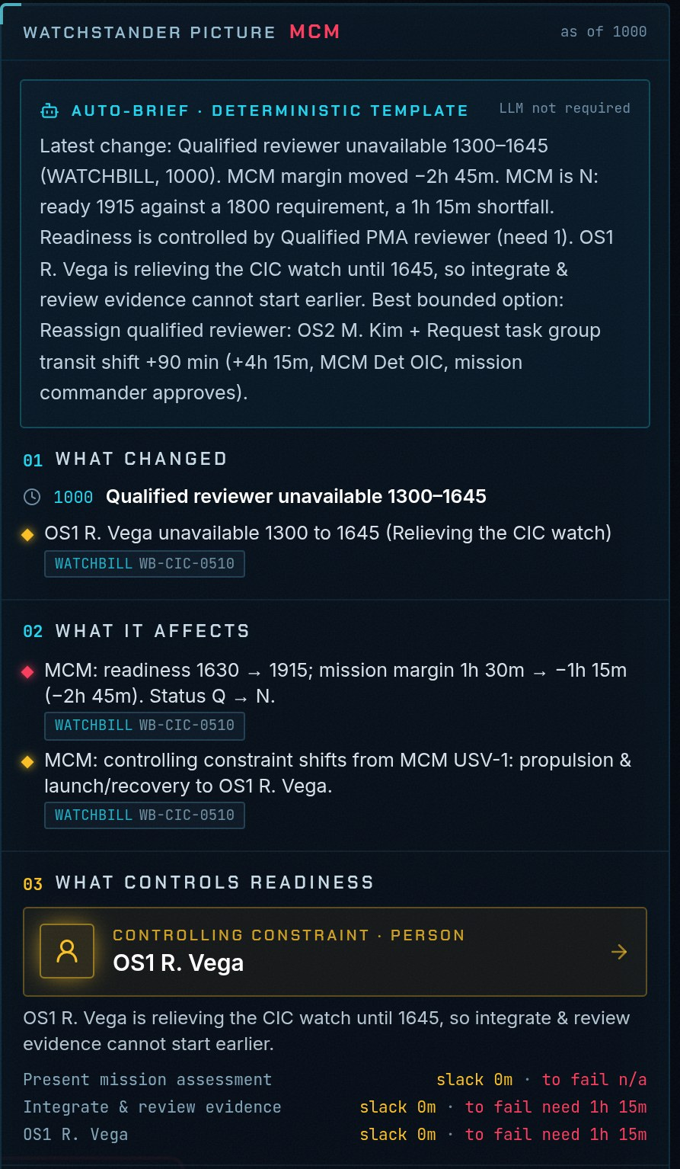
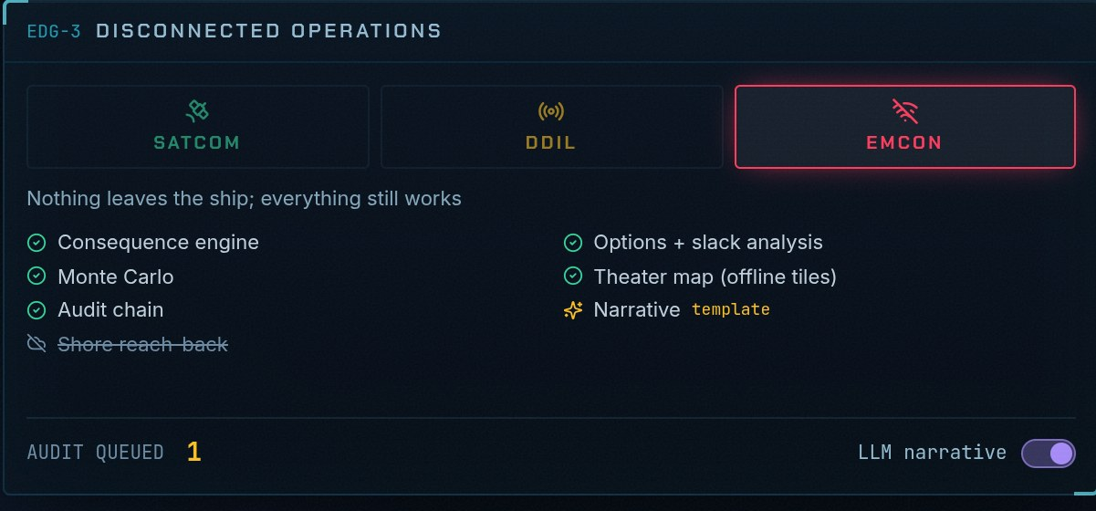
APPENDIX A3 · THE SAILOR AT THE CONSOLE
Built for the person on watch
One screen, plain words, and it keeps working when the ship goes quiet.
1
Five answers, always in this order
Is it up now? Will it be up when needed? What controls it? How much margin? What are the options?
2
Plain words first
A written brief on top, numbers underneath. AI text is violet and labelled; with no model it falls back to a template.
Flip to EMCON: nothing leaves the ship, and everything still works.
3
One button to stop it
STOP halts every recommendation at once, and the stop itself is logged.
What we haven't done yet
Put it in front of a real watch team. That is the first thing in the 30-day plan.
4
Hands stay on the keyboard
1–9 jump between screens, Space plays the change stream, Shift+R resets the session.
The written brief on the watch floor
Notes:
Built for the person on watch. The watch floor gives five answers, always in the same order: is it up now, will it be up when needed, what controls it, how much margin is left, and what the options are.
Plain words come first: a written brief on top and the numbers underneath. Anything the AI wrote is violet and labelled, and with no model available it falls back to a template, so the answer never changes. One STOP button halts every recommendation, and the stop is logged. Everything is reachable from the keyboard.
Flip the ship to EMCON and nothing leaves, but the engine, map, simulation and audit all keep working.
What we have not done is put it in front of a real watch team. That is the first thing in the 30-day plan.

Slide 18
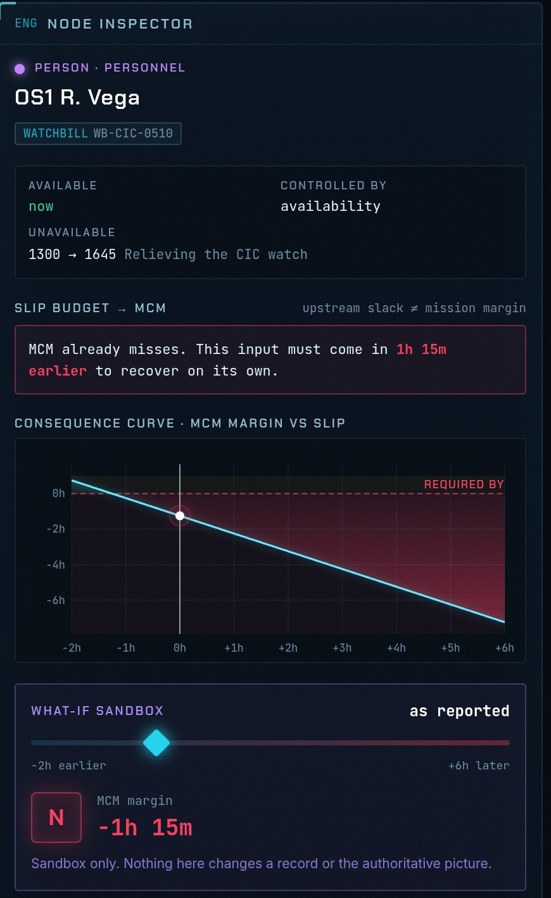
APPENDIX A4 · THE IDEA UNDER THE ENGINE
Slack is not margin
The late part gets the attention. The input that controls the mission often isn't the late one.
A radar repair: part due 1200, qualified team free at 1400, a 3-hour job, needed by 1800.
Ready at 1700 with 1 hour of margin. The team controls, not the part.
HOW FAR EACH ONE CAN SLIP
The part
no effect
eats margin
fails
The team
eats margin
mission fails
+0 h
+1 h
+2 h
+3 h
+4 h
Slack
Margin
Exact, not estimated
How far an input slips before anything changes. The part: 2 hours. The team: none.
How far the mission can slip before it fails. Here 1 hour, and the team sets it.
Readiness rules only move one way, so bisection finds both numbers exactly for every input.
The same check in the app: OS1 Vega on the mine countermeasures thread
Notes:
This is the one idea under the engine: slack is not margin.
A radar repair. The part is due at 1200, the qualified team is free at 1400, the job takes three hours, and it is needed by 1800. It is ready at 1700, an hour of margin, and the team controls, not the part.
So the part can slip two hours and nothing changes; after that it eats the hour of margin; past three hours the mission fails. The team has no slack at all: one hour late and the mission fails. Everyone chases the late part, and the thing that actually controls is somewhere else.
Every readiness rule only moves one way, so a later input never makes the mission earlier, and bisection finds both numbers exactly for every input. On the right is the same check in the app, on the mine countermeasures thread.

Slide 19
APPENDIX A5 · WHAT WE HIT
Four things broke on the way to AWS
Each fix is in the scripts now, so the next node will not hit them.
WED 21:58
WED 22:07
WED 23:03
THU 01:11
MinIO's public images were gone
The registry kept failing
UDS Core wouldn't install
Logs and backups lost the API
WHY
MinIO stopped publishing the images the storage chart pulled.
WHY
A second registry pod shared the volume, and SELinux relabels it for the newest pod, locking the older one out.
WHY
RKE2 1.36 ships Gateway API CRDs in its Traefik chart, and they blocked UDS Core's own.
WHY
Narrowing Loki and Velero to MinIO also removed the rule that let them reach the Kubernetes API.
FIX
Pull the Chainguard build that uds-k3d uses.
FIX
Pin the Zarf registry to one replica.
FIX
Set ingress-controller to none, which skips both charts.
FIX
Add an explicit Kubernetes API rule for the pods that need it.
4 fixes
each one now in the scripts
10 of 10
UDS packages ready
45 pods
running and ready, none unhealthy
27
AWS resources from Terraform
Notes:
Four things broke while we stood up the cluster, in the order we hit them on Wednesday night.
MinIO's public images were gone, so we pull the Chainguard build that uds-k3d uses. The registry kept failing because a second pod shared its volume and SELinux relabels the volume for the newest pod, so we pinned it to one replica. UDS Core would not install because RKE2 1.36 ships its own Gateway API CRDs, so we turned RKE2's ingress off entirely. And when we narrowed Loki and Velero's network access down to MinIO, they lost the Kubernetes API, so they now get an explicit rule for it.
Each fix is committed in the install scripts. As of Thursday morning, all ten UDS packages are ready and 45 pods are running with none unhealthy.

Slide 20
APPENDIX A6 · OTHER SHIPS, OTHER DOMAINS
Beyond the surface fleet
Connor's engine keeps the core general and puts the domain knowledge in packs.
Mission engine core
Timelines, stock levels, the controlling chain, slack vs margin, options, Monte Carlo, hash-chained decisions
In the NAVIFI app today
› Four mission threads on one engine
› Two ship classes, three hulls
› A fleet picture prototype: 38 hulls, 12 missions, 140+ packages timed by the engine
Naval pack
Strike group, logistics force, maintenance, C2
Airlift pack
Flight legs, ground time, checklist items
The next domain
A new pack of factor tables and routines, not an engine rewrite
Operation STEEL TIDE
7 hulls: a carrier, a cruiser, three DDGs, an oiler and a T-AKE
REACH 417
A C-17A on three legs, Dover to Diego Garcia
NAVIFI classic
The app's radar repair case passes unchanged on this engine
Not yet
The app still runs its own engine. Wiring Connor's in is the next job; his engine's 48 tests run on their own today.
› Packs work together: the naval pack calls the airlift pack to check the carrier onboard delivery flight.
› Crews are tracked by qualification (AMD, strike, FC, ET), so who can cover a task is part of the math.
Notes:
Beyond the surface fleet. Connor's new engine keeps the core general, with timelines, stock levels, the controlling chain, slack versus margin, options, Monte Carlo and the decision log, and puts domain knowledge in packs.
There are two packs today. The naval pack runs Operation STEEL TIDE, seven hulls across a strike group and its logistics force. The airlift pack runs REACH 417, a C-17 on three legs from Dover to Diego Garcia. They work together: the naval pack calls the airlift pack to check the carrier onboard delivery flight. Crews are tracked by qualification, so who can cover a task is part of the math. A new domain is a new pack, not an engine rewrite, and the app's original radar repair case passes unchanged on it.
In the app today there are four mission threads on one engine and a 38-hull fleet picture prototype. The app still runs its own engine; wiring Connor's in is the next job. All scenario data is synthetic.

