Slide 1
CSE360 Auto Project
The thing that pretty much everyone is doing
Notes:
Ben

Slide 2
Team Members
Ahmed Moussa
Benjamin Clayton
Coakley Rathbun
Lloyd Allen
Robert Glickman
Notes:
Ben

Slide 3
Process Model
Iterative and Incremental
Functional products after short time
Room for low-cost maintenance
Notes:
Ben

Slide 4
Gantt Chart 1: Past
Gantt Chart goes here
Notes:
Robert

Slide 5
Gantt Chart 2: Future
Notes:
Robert

Slide 6
Risk Analysis
Risk Assessment Summary
Probability of Risk Occurance | High |  |  | -Inaccurate Project Timeline | -Incorrect Specification | -Scheduling Conflicts
 | Medium-High | -Overlapping of Artifact creation/Duplication of work |  | -Requirements Change | -Lack of GUI programming experience
 | Medium |  |  |  |  | -Lack of direction from customer
 | Low-Medium
 | Low | -Tool availability |  |  | -Project Member(s) Leaving
 |  | Low | Low-Medium | Medium | Medium-High | High
 |  | Consequence of Risk Impact
Risk Analysis
Notes:
Robert

Slide 7
Requirements Overall
Add the must haves for the main project
Notes:
Lloyd

Slide 8
Requirements Current Iteration
For the first iteration, implementing only the most basic of capabilities in the “Drive” feature:
Car’s speed and acceleration
Car’s location
Trip duration
Fuel level and construction
Notes:
Ahmed

Slide 9
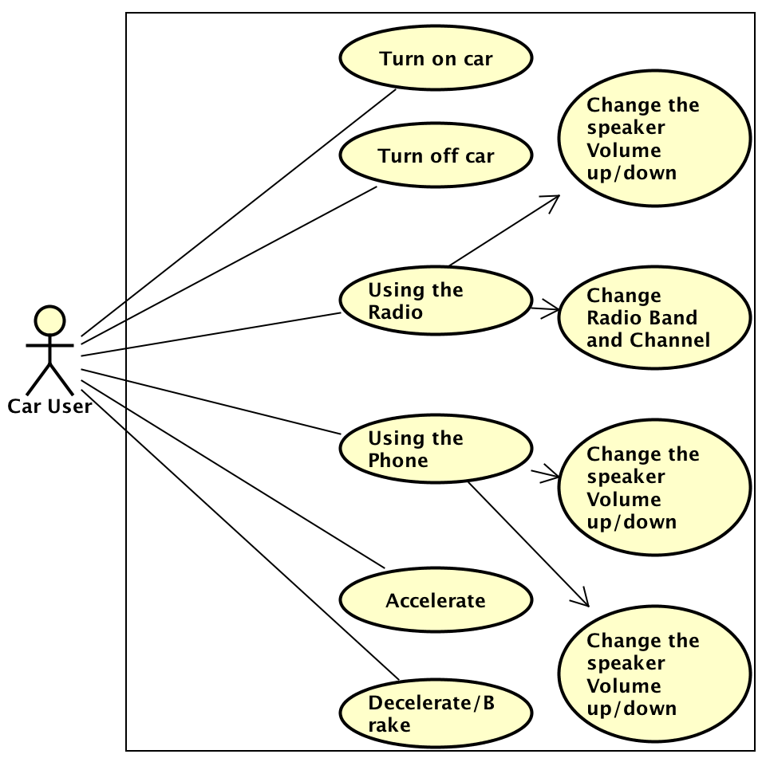
Use Case Diagram
Notes:
Coakley

Slide 10
Use Case: Turning Car Off
Use Cases: Turning Car Off
Goal in Context: To turn off the car
Preconditons: The car is on and has a speed value of zero
Trigger: The user wants to turn off the car
Scenario:
The user presses the off button. The car turns off.
Exceptions: None
Priorities: Essential must be implemented
When Available: First iteration
Frequency of Use: Once during a session
Channel to actor: Through GUI
Secondary Actors: None
Channels to secondary actors: None
Open Issue: None
Notes:
Coakley

Slide 11
Use Case: Accelerate
Primary Actor: User
Goal in Context: To make the car go faster.
Preconditions: The car must be on
Trigger: The user wants the car to accelerate.
Scenario:
The users selects a speed at which the car accelerates until the maximum speed is reached. The car’s current acceleration and speed will be displayed.
The user selects a speed that he/she wants the car to reach the car will accelerate at a rate until that speed is reached. The car’s current acceleration and speed will be displayed.
The rate of fuel consumption is directly related to the acceleration of the vehicle.
Exceptions:
If the desired speed is reached the car will not accelerate anymore keeping the speed at that value.
If the max speed is reached the car will not accelerate anymore keeping the speed at that value.
Priority: Essential must be implemented
Frequency of Use: Whenever the user wants to go faster.
When Available: First Iteration
Channel to actor: Through GUI
Secondary Actors: None
Channels to secondary actors: None
Open Issue: None
Notes:
Coakley

Slide 12
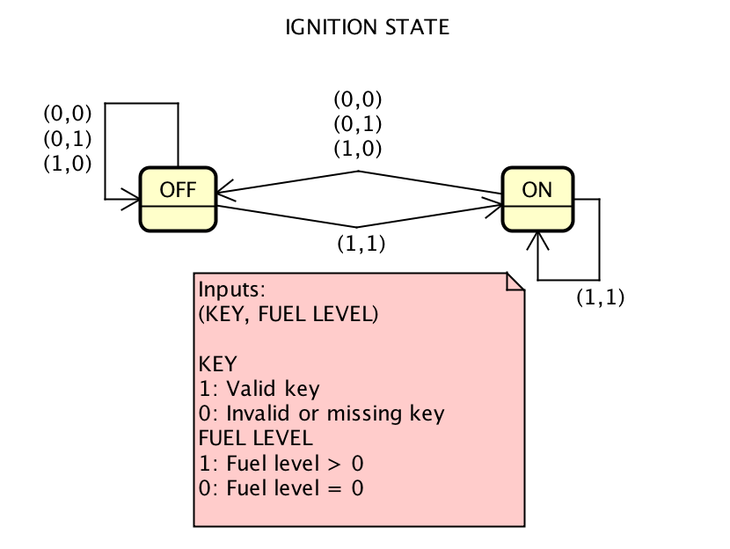
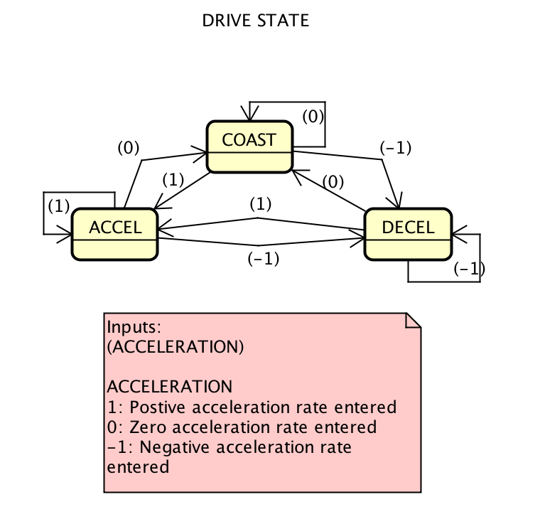
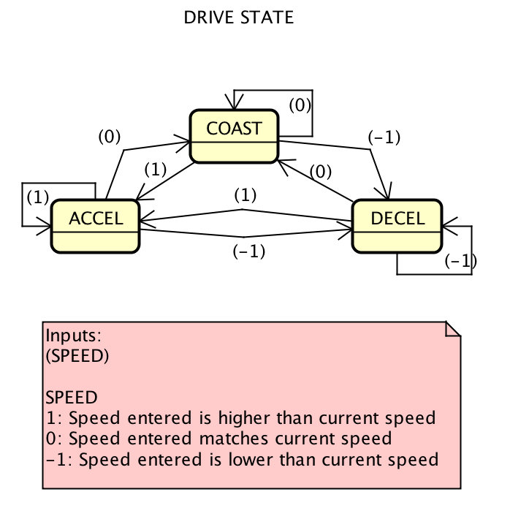
State Machine
Notes:
Lloyd

Slide 13
Design GUI
Speed (mph) | Fuel (%) | State (Drive/Park) | Odometer (miles)
Radio | Main Panel (Info Displayed is based on context menu) |  |  | User Manual
Phone |  |  |  | Map
STOP | Control Panel (Speed & Acceleration)
Speed (mph) Fuel (%) State (Drive/Park) Odometer (miles) Radio Main Panel (Info Displayed is based on context menu) User Manual Phone Map STOP Control Panel (Speed & Acceleration)
Notes:
Ben

Slide 14
Closing Remarks
Notes:
Current State of the project
(iterating through our first increment)
What we plan for the future
(Continue incremements)

Slide 15
Questions?

