Slide 1
CSE360 Auto Project
The thing that pretty much everyone is doing

Slide 2
Team Members
Ahmed Moussa
Benjamin Clayton
Coakley Rathbun
Lloyd Allen
Robert Glickman

Slide 3
Problem Overview
Ahmed, you got this

Slide 4
Process Model
Iterative and Incremental
Functional products after short time
Room for low-cost maintenance

Slide 5
Planning
Gantt Chart goes here

Slide 6
Risk Analysis
Risk Assessment Summary
Probability of Risk Occurance | High |  |  | -Inaccurate Project Timeline | -Incorrect Specification | -Scheduling Conflicts
 | Medium-High | -Overlapping of Artifact creation/Duplication of work |  | -Requirements Change | -Lack of GUI programming experience
 | Medium |  |  |  |  | -Lack of direction from customer
 | Low-Medium
 | Low | -Tool availability |  |  | -Project Member(s) Leaving
 |  | Low | Low-Medium | Medium | Medium-High | High
 |  | Consequence of Risk Impact
Risk Analysis

Slide 7
Requirements Overall

Slide 8
Requirements Current Iteration

Slide 9
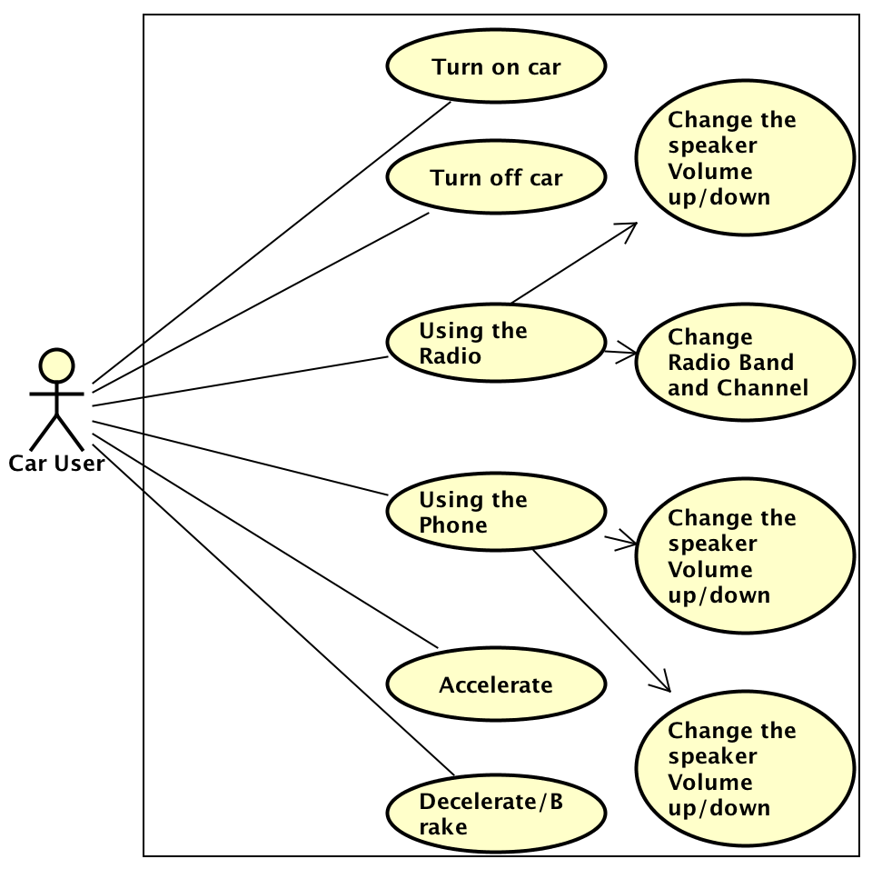
Use Case Diagram

Slide 10
State Machine

Slide 11
Use Case Specifications
Use Case Specifications

Slide 12
Design 1
Consumption of fuel as a function of acceleration plus a constant
Use files to log data sets
Cap car speed
Acceleration is capped and is based off the delta between current and desired speed

Slide 13
Closing Remarks
Questions?
Rotten tomatoes?
Moral conundrums?

