Slide 1

MONSOON MALABAR(®)
MOBILE APPS CUM DIGITAL STORE BUILDER, SOCIAL COMMERCE, E COMMERCE AGGREGATOR AND NEIGHBOURHOOD STORE TO BRING YOUR BUSINESS ONLINE AND ESTABLISH

Slide 2

Presentation Video

Slide 3
Storyline
In covid pandemic situation I thought about to help creating online business can reduce social congestion which help to decrease spread of disease. I searched for reliable, stable and cheap way to create a platform that bring business online. Then I created this platform myself as I am in programming field for more than 10 years.

Slide 4
Introduction
Hi, welcome to Monsoon Malabar!!
Having website and mobile apps are essential for the identity and uniqueness of any business.
Today, we would like to show you how to bring your business online with mobile apps and a digital store or any business website without knowing how to program.
First, go to monsoonmalabar.com and register an account.
You can add your products or services one by one by clicking the add item button.
After adding your items, you can also edit or delete your items.
Now you need to update your settings.
Click the add blog post button if you need to add blog posts.
After updating your settings and adding all items, click the publish button to publish the app. Voila! Your app is ready.
You can download android, ios and windows store applications for your business by clicking download app button at bottom side of the dashboard page.

Slide 5
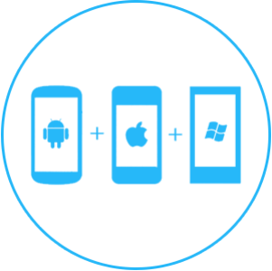



Customers can reach digital store or business website by following ways.
One, through the mobile apps, you share with your customers directly, on social media or any other means.
Two, through the digital store or business website link that you share with your customers directly, on social media or any other means.
Three, by searching from the monsoon Malabar home page.
Four, we have setup an app called progressive web app(PWA) on seller’s store. Buyers visiting seller’s store can easily install this app on their mobile or computer.
A buyer who reaches in a seller’s store can easily switch to our main site by clicking nearby store button located top of seller’s store and can search for nearby store from main site. Then buyer can go to nearby store and switch back to main site using the method described above. Hence the flow of buyers through our platform will be very easy and efficient.

Slide 6



We address the following four primary social pains(PROBLEMS)
One, social congestion in a pandemic like covid is an accelerating factor. Our platform decreases social congestion by allowing buyers to stay at their residences and purchase online.
Two, Creating mobile apps and a digital store or any business website for non-technical business persons to establish their business is challenging and consumes a lot of money and time. Our platform makes this process free and easy with a few clicks.
Three, busy people don’t have time to go to shops directly and buy items. They can choose items online and purchase them from their residence through our platform.
Four, lack of employment is a problem in society. We think every person across the globe has something to sell. Our platform gives
jobs to each seller and the delivery person across the globe.
Also, building and maintaining physical store is costly and tedious task. With our platform a seller can easily create online store for free.
Transgenders and women who are even housewives, can start a store and apps to sell products or services and become entrepreneur easily and for free.
Hence we believe our platform is a scalable business with high potential for employment or wealth creation.
Since our platform act as direct interface between producer and consumer, we can effectively avoid the price manipulation in the market.

Slide 7


In summary, this platform serves four primary purposes
One, provides a digital store or any business website to the seller.
Two, provides mobile apps and computer apps to the seller.
Three, serves as a neighbourhood store because customers can search their nearby businesses through the Monsoon Malabar home page.
Four, serves as an e-commerce aggregator since we display products category-wise from all of our sellers across the globe.
We also have other social utility services like Order taking app(used for taking orders from customers visiting the offline store), Dictionary app, Notepad editor, Image editor, Chat app, Discussion forums, Entertainment services, Kids corner etc. We are working to expand these utility services by adding matrimony service, home stay booking service, higher education guide service, bus timing chart service, job updates service etc. Hence we believe that our app is a social commerce also.
With these purposes, we believe that this platform is an innovative, developed, improved and one-stop solution which act as a super hub for several needs.

Slide 8
Conclusion
Buyers can search and add items to their cart.
There is a button to order via WhatsApp(Cash On Delivery or use methods like UPI to get payment), email(COD or Methods like UPI) or prepayment if enabled from the dashboard.
You can ship items to customers through any courier when you receive an order. Or you can give it directly to your customer if the customer is near you.
You and your customers can use the app in your native language by selecting the appropriate language in the language dropdown option. Our platform is translated into all possible languages across the globe.
Since our platform can act as a direct interface between producer and consumer, we can effectively avoid price manipulation in the market.
All services in our platform are free of cost except the custom domain option and premium themes, which is optional, and you can choose if you need.
If you forgot your password, click on the forgot password button on the login page. Then write your registered email and click the Send password reset link button. You will get a password reset link in your registered email address. You can click the reset link and create a new password.

Slide 9
Mobile App
Our main website is a PWA(Progressive Web App). So users can easily install app on android and ios mobiles.
We released an android app which has got about 1000 downloads, but we are more focusing on PWA since its more easy and occupy less space in mobile.
Our client’s website also a PWA. So their users also can install app on ios and android. There is also an extra option to create ios, android, microsoft and facebook meta app.

Slide 10
Competitors
Advantage over Competitors
Shopify
Dukaan etc.
We use github pages to host clients app. So we don’t require no server resources and its cost to run client’s apps.
We don't spend any money to create or maintain our business till now. We are using free resources and I created this platform. We use github pages to host clients app and none of the other service we are giving consumes money. Our servers are used only when seller create and update site. So our server expenses are very minimal and thus we can give our service at very competitive price.
We translate our platform and client app to every possible language. So any seller across the globe can join and start business.

Slide 11
USP & UVP
In this online era, business owners can easily build online store and mobile apps with few clicks using our mobile-first platform. We are using github pages to serve our client's store and app, hence our servers require very limited amount of resource usage. So we can provide our service at a very competitive price.
We also give nearby store search feature hence end users can search nearby store, also they can switch back to main platform and search for another nearby store easily and effectively.
We have aggregation service which provide product/service wise search with filters like category place, price etc and sorting
We also have social utilities apps which help users to retain in our platform.

Slide 12
USP & UVP(continues)
Easy to use(Avoids the fear of complexity)
Free/Cost effective( Avoids fear of loss of money)
Efficient
Mobile-first
No-code platform(Avoids the headache of programming)
SaaS
Social Commerce
Ecommerce Aggregator
Neighbourhood Store
App builder(Easily fulfill seller’s app requirement)
Ecommerce website builder(Easily fulfill seller’s web app requirement)
Gender equality
Support forum(Avoids the fear of lack of support)
Avoid price manipulation in the market
Scalable business with high potential for employment or wealth creation
Innovative, developed, improved and one-stop solution which act as a super hub for several needs

Slide 13
Traction
Early traction will be through digital marketing like facebook ads, google ads and email marketing.
We also do in-person canvassing of the sellers present online by going to places like ‘buy and sell’ facebook groups etc.
We think we can acquire 5000 to 10000 customers through this method in 6 months to 1 year.
After that we use usual media for marketing and sales.
We expect maximum expansion across the globe since most of our services are free.
We translate our platform and client app to every possible language. So any seller across the globe can join and start business.

Slide 14
Profit
We expect profit from domain addon, donation price from sellers, premium themes sales and business advice service to clients.
We expect at least 2000 domain sales, 1000 donations and 1000 premium themes sales first year.
350×20000 = 7000000 indian rupees profit from domain addon
100×10000 = 1000000 indian rupees from donations
1000×10000 = 10000000 indian rupees from premium themes
Total expected expenses are hosting fee (10000)+advertisement(1500000)=151000
Expected profit = 1849000
We can also introduce yearly subscription and business advice service to client and increase our revenue if required in future.
We can also consider local and global ads in our aggregation service in future if required.
We expect more sales from first generation countries as we translate our platform and client’s app to maximum possible languages.

Slide 15
Projected turnover
Item | First year | Second year
Domain addon(A) | 350×20000=7000000 | 350×30000=10500000
Donations(B) | 100×10000=1000000 | 100×30000=3000000
Premium themes(C) | 1000×100000=10000000 | 1000×150000=150000000
Hosting(D) | 10000 | 15000
Advertisement(E) | 1500000 | 1500000
Profit(A+B+C)-(D+E) | 10649000 | 162085000

Slide 16
Break Even Analysis
Selling price per unit | ₹1450
Cost of sales per unit(COGS) - Mainly advertisement cost | ₹500
Profit per unit | ₹950
Other expenses(not (COGS) | ₹0
Number of unit sales needed to break even | 1

Slide 17
Startup Valuation
Investment | ₹50,00,000
Investors equity | 10%
Pre money valuation | ₹4,50,00,000
Post money valuation | ₹5,00,00,000

Slide 18
Market fit
Now a days everyone initiated to go online and doing things which make the task easy. This tendency will increase in future. So online business like ours can be a good fit in market. At present ecommerce aggregators will impose more service charge and new sellers don't get any attention among experienced sellers. More than that sellers has to complete lots of steps like GST registration, joining fee, listing fee etc. With our platform sellers can easily create indipendant apps and list in aggregation service. Every seller wish to create mobile app and website for their business. But it is time consuming and a non programming businessman can't create it. If they approach IT company they charge huge and that too in a subscription model. We give most of our services free and easy with some clicks. We translated our platform and client's app so we can have users from across the globe.

Slide 19
Validation
Since most of our services are free and easy to use, we can easily reach most of the sellers across the globe and famous.
Seller want their business needs to be unique. So they will try to buy our domain addon and premium themes,
If we get most of the market, clients will approach us for business advice like where will they get most customers to start their business. We can earn money from that.
Since we are mostly free, customers tends to provide donations also.
We expect most of the sales from first generation countries, that’s why we translate our platform and client’s app to maximum possible languages.

Slide 20
Exit
Next funding round
Acquisition
IPO

Slide 21
Innovations in this project
Creating mobile apps and a digital store or any business website for non-technical business persons to establish their business is challenging and consumes a lot of money and time. Our platform makes this process free and easy with a few clicks.
Transgenders and women who are even housewives, can start a store and apps to sell products or services and become entrepreneur easily and for free.
Building and maintaining physical store is costly and tedious task. With our platform a seller can easily create online store for free.
Busy people don’t have time to go to shops directly and buy items. They can choose items online and purchase them from their residence through our platform.
social congestion in a pandemic like covid is an accelerating factor. Our platform decreases social congestion by allowing buyers to stay at their residences and purchase online.
Lack of employment is a problem in society. We think every person across the globe has something to sell. Our platform gives jobs to each seller and the delivery person across the globe.
Our platform is also an e-commerce aggregator, social commerce and neighbourhood store.

Slide 22

Behind the scenes
Justine Chacko
FOUNDER, DIRECTOR & CEO
Justine a qualified graduate in pharmacy. He has more interest in programing field and hence he learned coding and has robust experience in the tech industry having worked in this domain for the past 15 years. He conceptualized & executed the idea on his own working.
Holds 49% share

Slide 23
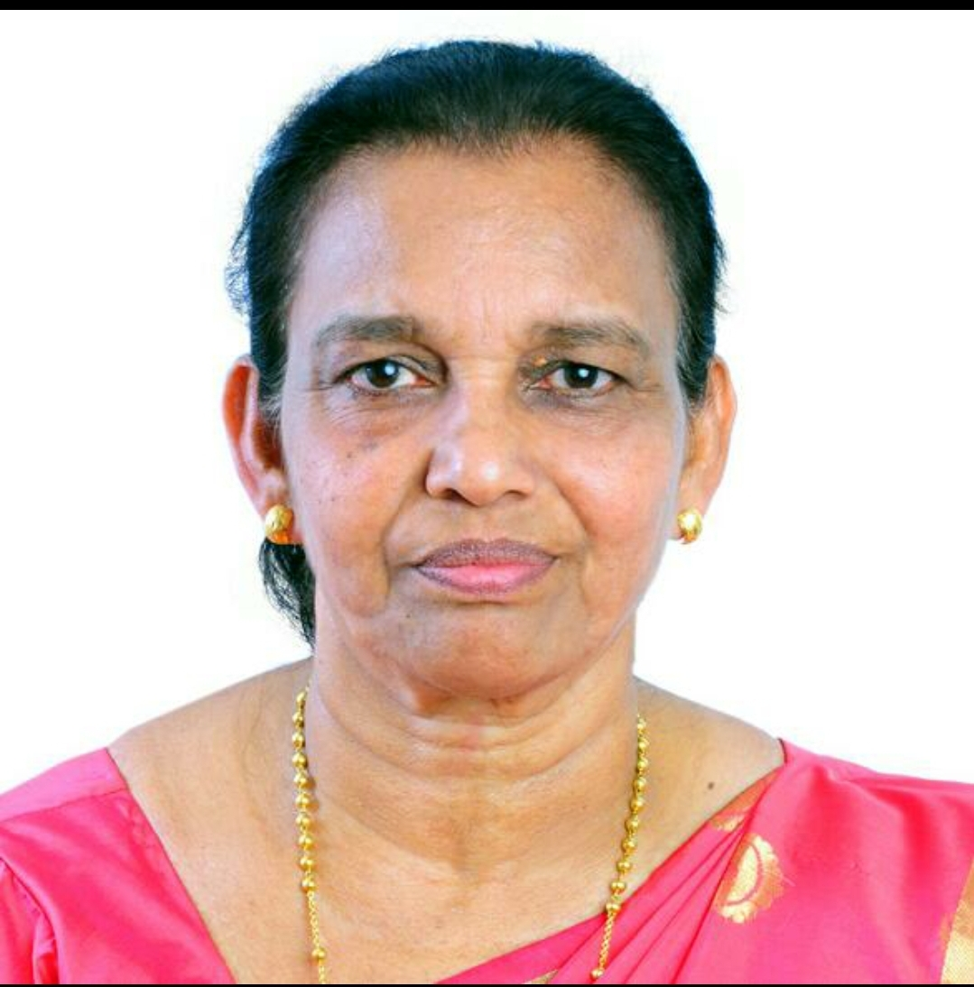
Behind the scenes
Pennamma Chacko
DIRECTOR
Holds 51% share

Slide 24
Roadmap
Add premium themes
Aggregation service(Beta stage)
Add more social utilities

Slide 25
Intellectual Property
Registered trademark

Slide 26
Thank you
Have a good day!!

