Slide 1

Lending Club Case Study
Group Members:
Rohit Chhabra
Deepthi BS

Slide 2
General Info
Consumer Finance Company is the largest online loan marketplace, facilitating personal loans, business loans , and financing of medical procedure
Borrowers can eaisly acess lower rate of interest rate loans through a fast online interface.
The objective is to analyse how consumer attributes and loan attributes influence the tendency of default

Slide 3
Analysis Approach
Data Cleaning
Removing the null values columns, unnecessary variables and the rows.
Conclusion
Analyzing all plots and observations for reducing the loss of business by detecting columns which contribute to loan defaulters.
Data Understanding
Working with the Data Dictionary and getting knowledge of all the columns and their domain specific uses
Bivariate Analysis
Analyzing the two variables behavior like term and loan status with respect to loan amount.
Univariate Analysis
Analyzing columns, plotting the distributions plot respectively.
Segmented Univariate Analysis
Analyzing the continuous data columns with respect to the categorical column

Slide 4
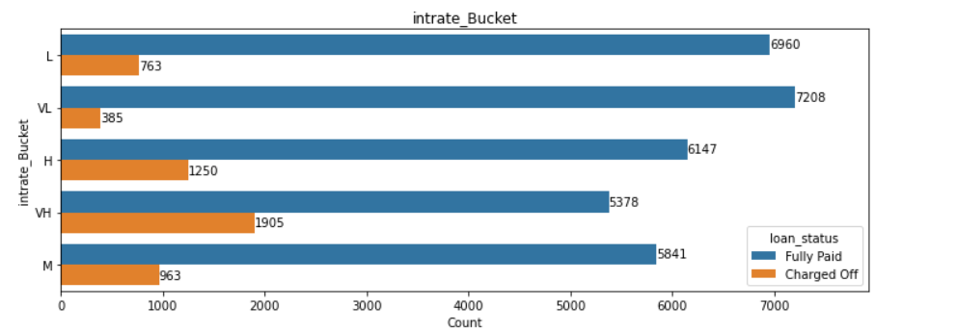
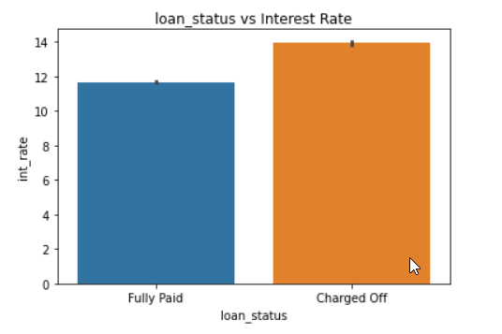
Analysis with Interest Rate
There is 26% chances of loan default where the interest rate is very high(VH) : Fig1
When the loan interest rate is high there is high chance of loan getting defaulted. : Fig2

Slide 5
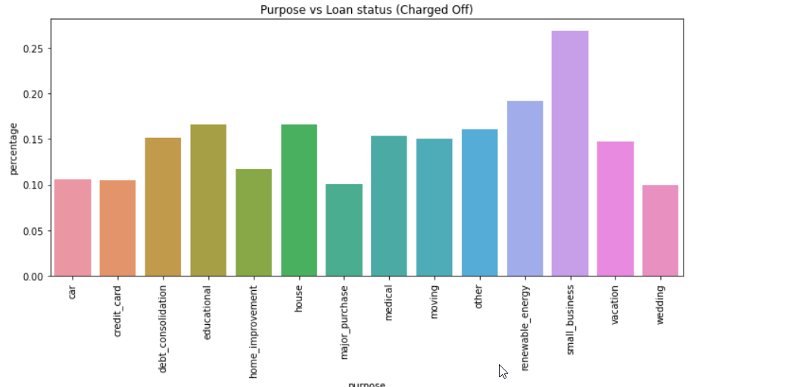
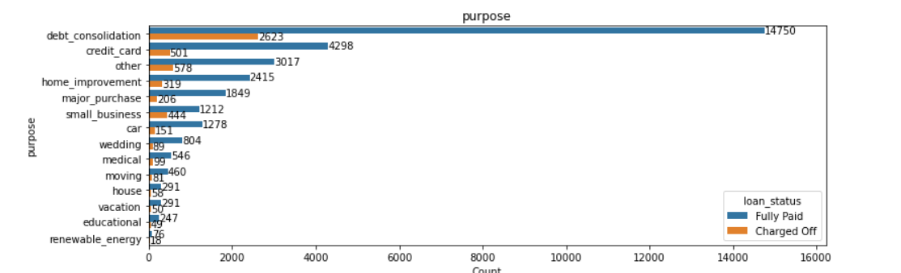
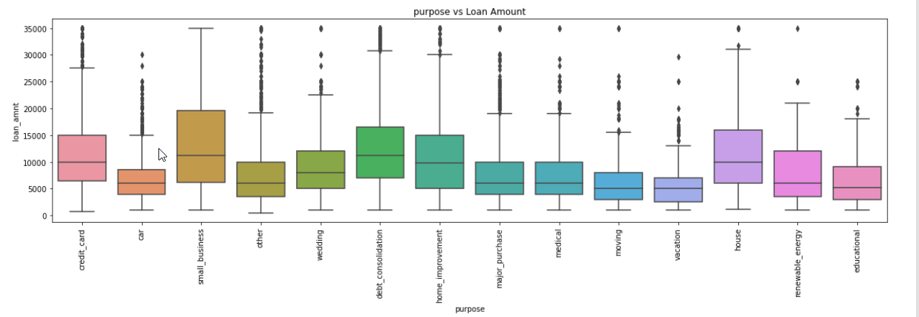
Analysis with category provide by the borrower
Borrower’s who took loans for small business purpose have defaulted more.
Percentage of default case in small business case is more as 26%

Slide 6
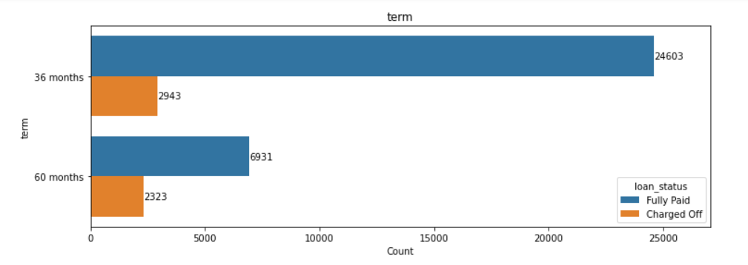
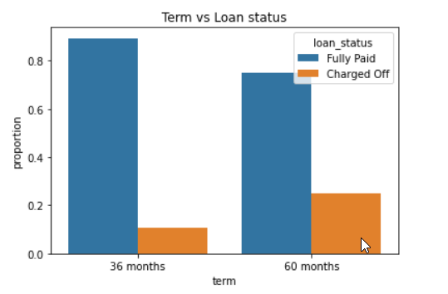
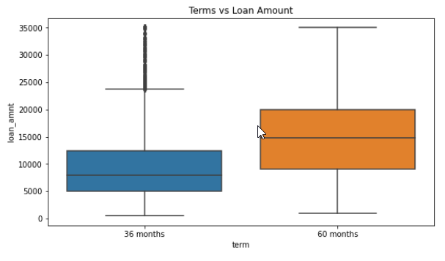
Analysis with Term
There are only two loan terms 36 and 60 months. Around 75% borrowers took loans with 36 months term.
The charged off borrowers are around 15% and fully paid is
around 85% in the given data set.
Basically control required on loan where the term is 60 months

Slide 7
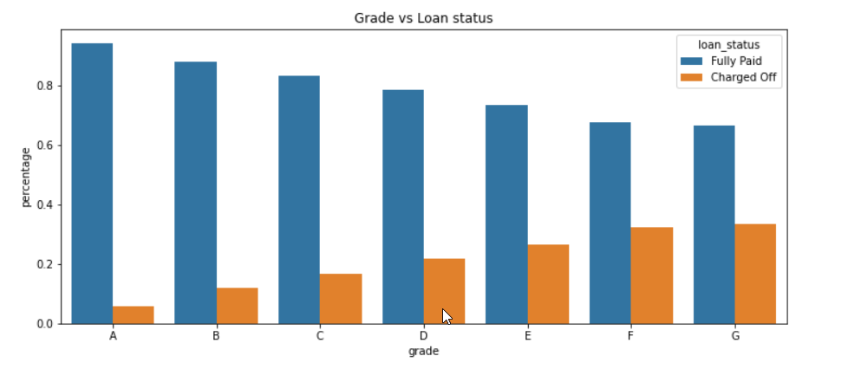
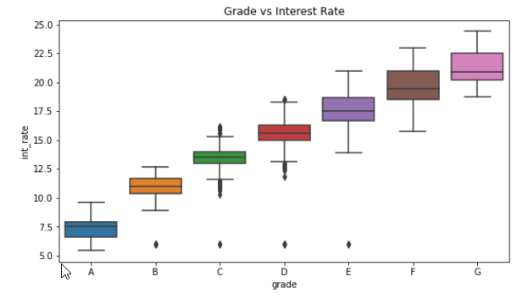
Analysis with Grades
The Lower grades(E,F,G) have higher chances of defaulting the loan than Higher ones(A,B)
Also the Lower grades are getting loans for higher interest rates which might be the cause for loan default.

Slide 8
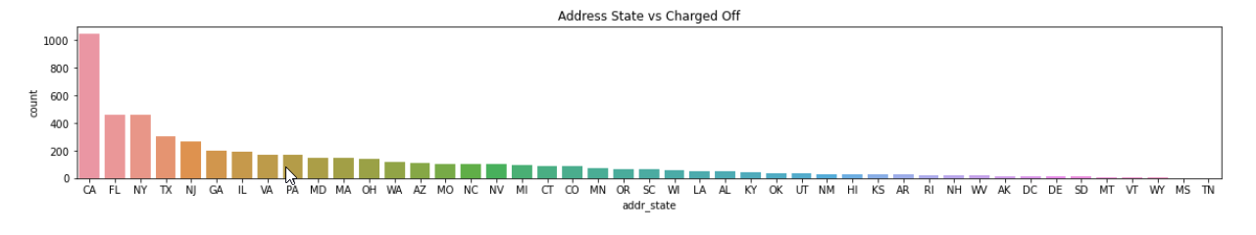
Analysis with State
The loans which are given for CA, FL and TX state’s borrowers are defaulted more than other states.

Slide 9
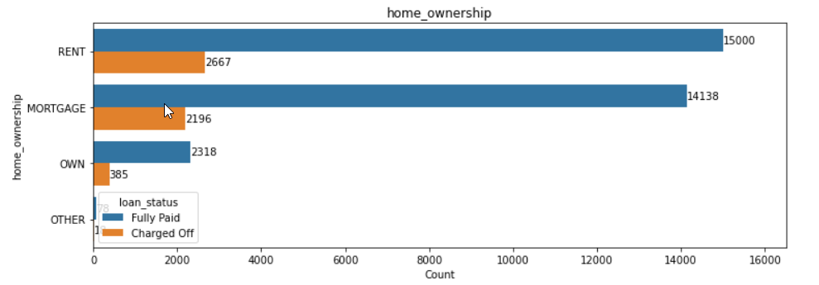
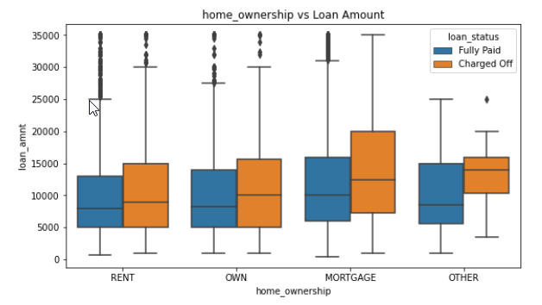
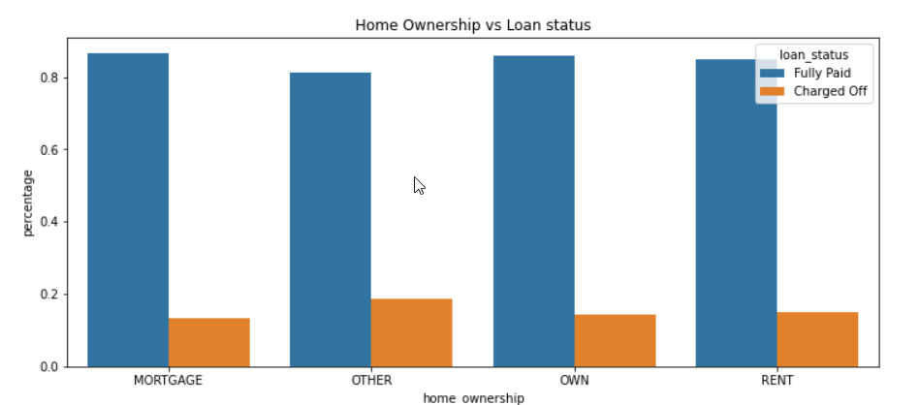
Analysis with Home Ownership
There is around 20% chance of loan default in each home ownership category.
From the 2nd plot we can see the people with higher loan amounts in mortgage home ownership has high default rate than others.

Slide 10
Conclusion
Consumer Finance Company should reduce the high interest loans for 60 months tenure, they are prone to loan default.
Grades are good metric for detecting defaulters. Consumer Finance Company should examine more information from borrowers before issuing loans to Low grade (G to A).
Consumer Finance Company should control their number of loan issues to borrowers who are from CA, FL and NY to make profits.
Small business loans are defaulted more. Consumer Finance Company should stop/reduce issuing the loans to them.
Borrowers with mortgage home ownership are taking higher loans and defaulting the approved loans. Consumer Finance Company should stop giving loans to this category when loan amount requested is more.

