Slide 1
SQM and
Plans for Summer Faculty

Slide 2
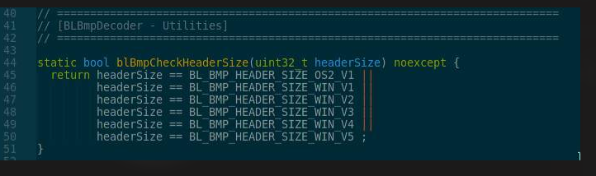
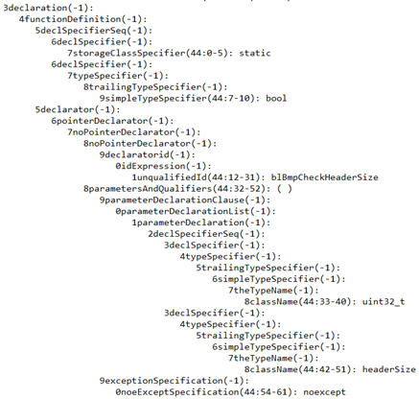
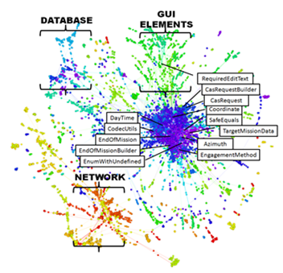

3declaration(-1): 4functionDefinition(-1): 5declSpecifierSeq(-1): 6declSpecifier(-1): 7storageClassSpecifier(44:0-5): static 6declSpecifier(-1): 7typeSpecifier(-1): 8trailingTypeSpecifier(-1): 9simpleTypeSpecifier(44:7-10): bool 5declarator(-1): 6pointerDeclarator(-1): 7noPointerDeclarator(-1): 8noPointerDeclarator(-1): 9declaratorid(-1): 0idExpression(-1): 1unqualifiedId(44:12-31): blBmpCheckHeaderSize 8parametersAndQualifiers(44:32-52): ( ) 9parameterDeclarationClause(-1): 0parameterDeclarationList(-1): 1parameterDeclaration(-1): 2declSpecifierSeq(-1): 3declSpecifier(-1): 4typeSpecifier(-1): 5trailingTypeSpecifier(-1): 6simpleTypeSpecifier(-1): 7theTypeName(-1): 8className(44:33-40): uint32_t 3declSpecifier(-1): 4typeSpecifier(-1): 5trailingTypeSpecifier(-1): 6simpleTypeSpecifier(-1): 7theTypeName(-1): 8className(44:42-51): headerSize 9exceptionSpecification(-1): 0noeExceptSpecification(44:54-61): noexcept 5functionBody(-1): 6compoundStatement(44-51): { } 7statementSeq(-1): 8statement(-1): 9jumpStatement(45-50): return ; 0expression(-1): 1assignmentExpression(-1): 2conditionalExpression(-1): 3logicalOrExpression(45-49): || || || || || 4logicalAndExpression(-1): 5inclusiveOrExpression(-1): 6exclusiveOrExpression(-1): 7andExpression(-1): 8equalityExpression(45:20-21): == 9relationalExpression(-1): 0shiftExpression(-1): 1additiveExpression(-1): 2multiplicativeExpression(-1): 3pointerMemberExpression(-1): 4castExpression(-1): 5unaryExpression(-1): 6postfixExpression(-1): 7primaryExpression(-1): 8idExpression(-1): 9unqualifiedId(45:9-18): headerSize 9relationalExpression(-1): 0shiftExpression(-1): 1additiveExpression(-1): 2multiplicativeExpression(-1): 3pointerMemberExpression(-1): 4castExpression(-1): 5unaryExpression(-1): 6postfixExpression(-1): 7primaryExpression(-1): 8idExpression(-1): 9unqualifiedId(45:23-47): BL_BMP_HEADER_SIZE_OS2_V1 4logicalAndExpression(-1): 5inclusiveOrExpression(-1): 6exclusiveOrExpression(-1): 7andExpression(-1): 8equalityExpression(46:20-21): == 9relationalExpression(-1): 0shiftExpression(-1): 1additiveExpression(-1): 2multiplicativeExpression(-1): 3pointerMemberExpression(-1): 4castExpression(-1): 5unaryExpression(-1): 6postfixExpression(-1): 7primaryExpression(-1): 8idExpression(-1): 9unqualifiedId(46:9-18): headerSize 9relationalExpression(-1): 0shiftExpression(-1): 1additiveExpression(-1): 2multiplicativeExpression(-1): 3pointerMemberExpression(-1): 4castExpression(-1): 5unaryExpression(-1): 6postfixExpression(-1): 7primaryExpression(-1): 8idExpression(-1): 9unqualifiedId(46:23-47): BL_BMP_HEADER_SIZE_WIN_V1 4logicalAndExpression(-1): 5inclusiveOrExpression(-1): 6exclusiveOrExpression(-1): 7andExpression(-1): 8equalityExpression(47:20-21): == 9relationalExpression(-1): 0shiftExpression(-1): 1additiveExpression(-1): 2multiplicativeExpression(-1): 3pointerMemberExpression(-1): 4castExpression(-1): 5unaryExpression(-1): 6postfixExpression(-1): 7primaryExpression(-1): 8idExpression(-1): 9unqualifiedId(47:9-18): headerSize 9relationalExpression(-1): 0shiftExpression(-1): 1additiveExpression(-1): 2multiplicativeExpression(-1): 3pointerMemberExpression(-1): 4castExpression(-1): 5unaryExpression(-1): 6postfixExpression(-1): 7primaryExpression(-1): 8idExpression(-1): 9unqualifiedId(47:23-47): BL_BMP_HEADER_SIZE_WIN_V2 4logicalAndExpression(-1): 5inclusiveOrExpression(-1): 6exclusiveOrExpression(-1): 7andExpression(-1): 8equalityExpression(48:20-21): == 9relationalExpression(-1): 0shiftExpression(-1): 1additiveExpression(-1): 2multiplicativeExpression(-1): 3pointerMemberExpression(-1): 4castExpression(-1): 5unaryExpression(-1): 6postfixExpression(-1): 7primaryExpression(-1): 8idExpression(-1): 9unqualifiedId(48:9-18): headerSize 9relationalExpression(-1): 0shiftExpression(-1): 1additiveExpression(-1): 2multiplicativeExpression(-1): 3pointerMemberExpression(-1): 4castExpression(-1): 5unaryExpression(-1): 6postfixExpression(-1): 7primaryExpression(-1): 8idExpression(-1): 9unqualifiedId(48:23-47): BL_BMP_HEADER_SIZE_WIN_V3 4logicalAndExpression(-1): 5inclusiveOrExpression(-1): 6exclusiveOrExpression(-1): 7andExpression(-1): 8equalityExpression(49:20-21): == 9relationalExpression(-1): 0shiftExpression(-1): 1additiveExpression(-1): 2multiplicativeExpression(-1): 3pointerMemberExpression(-1): 4castExpression(-1): 5unaryExpression(-1): 6postfixExpression(-1): 7primaryExpression(-1): 8idExpression(-1): 9unqualifiedId(49:9-18): headerSize 9relationalExpression(-1): 0shiftExpression(-1): 1additiveExpression(-1): 2multiplicativeExpression(-1): 3pointerMemberExpression(-1): 4castExpression(-1): 5unaryExpression(-1): 6postfixExpression(-1): 7primaryExpression(-1): 8idExpression(-1): 9unqualifiedId(49:23-47): BL_BMP_HEADER_SIZE_WIN_V4 4logicalAndExpression(-1): 5inclusiveOrExpression(-1): 6exclusiveOrExpression(-1): 7andExpression(-1): 8equalityExpression(50:20-21): == 9relationalExpression(-1): 0shiftExpression(-1): 1additiveExpression(-1): 2multiplicativeExpression(-1): 3pointerMemberExpression(-1): 4castExpression(-1): 5unaryExpression(-1): 6postfixExpression(-1): 7primaryExpression(-1): 8idExpression(-1): 9unqualifiedId(50:9-18): headerSize 9relationalExpression(-1): 0shiftExpression(-1): 1additiveExpression(-1): 2multiplicativeExpression(-1): 3pointerMemberExpression(-1): 4castExpression(-1): 5unaryExpression(-1): 6postfixExpression(-1): 7primaryExpression(-1): 8idExpression(-1): 9unqualifiedId(50:23-47): BL_BMP_HEADER_SIZE_WIN_V5
This is where SQM starts
And what it produces.
Which looks a lot like Ultron

Slide 3
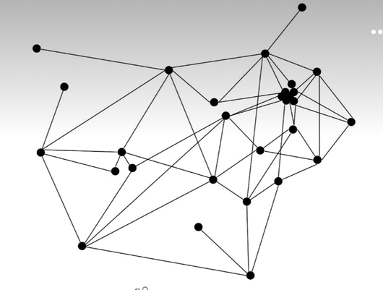
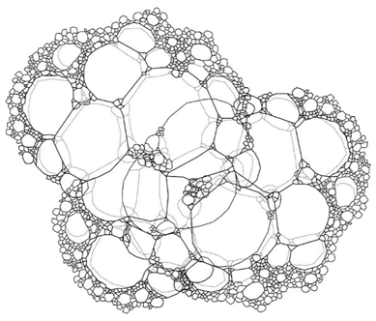
There are lots of mathematical theories about the way graphs are built, identifying ways that the graph may be decomposed.
There are technique that use unusual methods like bubble tension values to further examine the structure of the graph.
I want to know about those and use them where appropriate.

Slide 4
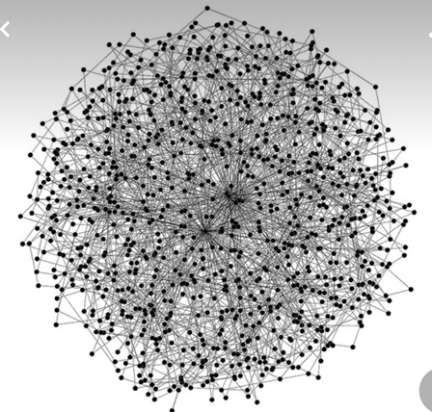
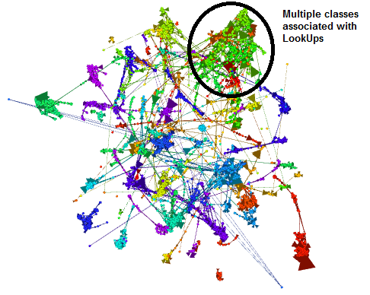
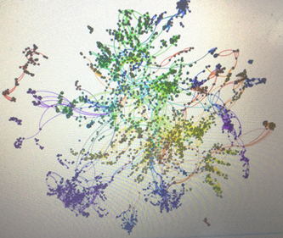
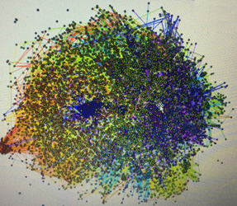
The goal of SQM is to understand the code and I am working metrics that will be code specific, but the wild world of math seems to have some useful tools that just look at the graph.
How might those tools apply to SQM?
Could we use those tools to further our understanding of the code?

Slide 5
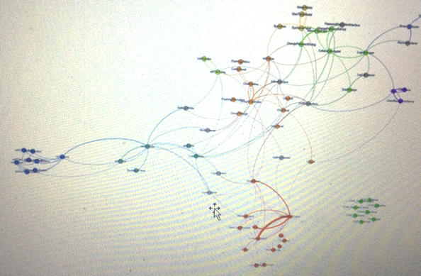
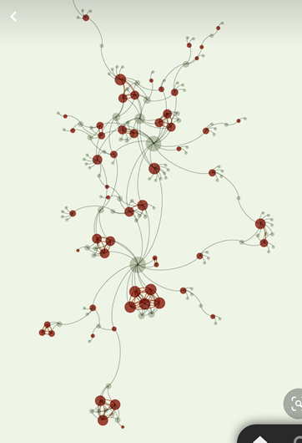
Sometimes the completeness and complexity of the graph is a barrier to understanding, but in the detailed form it is quite elegant.
Again, the mathematical tools might be used to identify areas of interest.

Slide 6
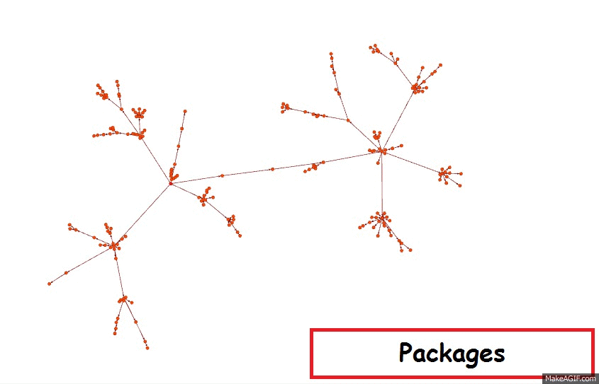
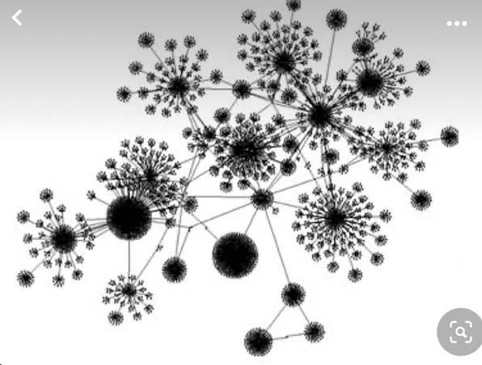
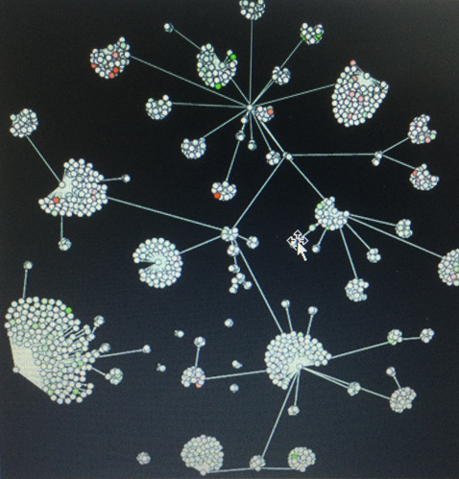
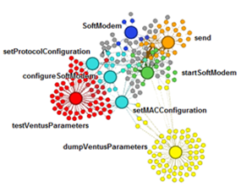
Even simple structural hierarchies that exist in the code may have hidden information.
From a graph perspective, what might this mean?
Is there a graph-based knowledge point that would have significance in the world of code?

