Slide 1
CSC 200 Lecture 11
Errors and Security

Slide 2
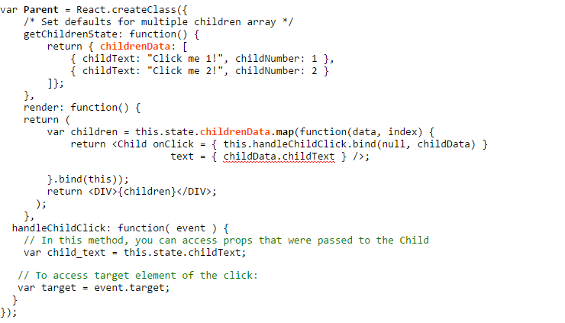
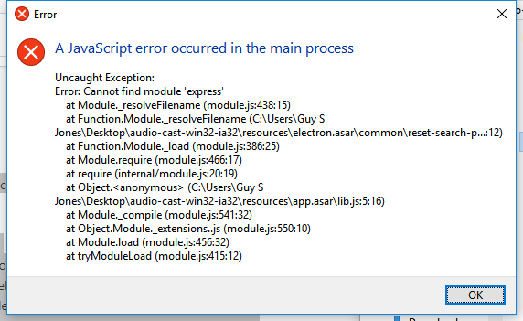
What if you make an error?
If your code has a problem it throws an exception.
An exception is raised by the code and bubbles up the call stack.
You can read an exception which will tell you
What happened
Where it happened
How you go there.

Slide 3
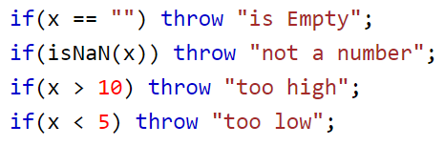
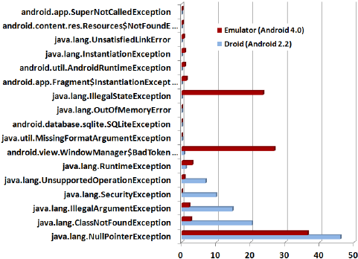
Throwing an Exception
In Javascript an exception is just a text message indicating what went wrong.
You can throw any exception you want.
In other languages exceptions are objects with names indicating what went wrong.
It is important to throw the right kind of exception.
throw “Why did Brian do this to me?”

Slide 4
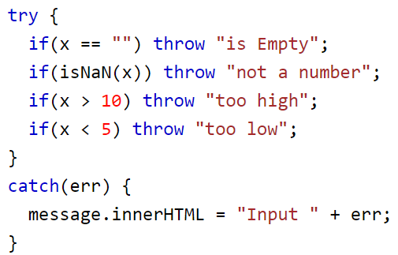

Try and Catch
If you think code may create an error surround it with a try block.
Any error which bubbles up into that try bock will be caught.
After a try is a catch. Catch allows you to:
Read the exception message.
Decide what to do next.
Recover from the error.

Slide 5
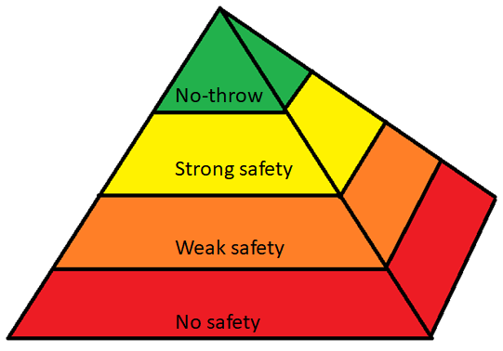
Error-Safe Code
Good error handling takes three steps.
Look for ways your code could break.
Put in checks for errors.
Put in try-catch to handle and recover.
Practice makes perfect.
No-throw guarantee – The user sees no effects of an error
Strong exception safety – The user action either works or not. Always a valid state.
Weak safety – The system will not crash, but it may not be valid anymore.
No exception safety - Anything could happen.

Slide 6
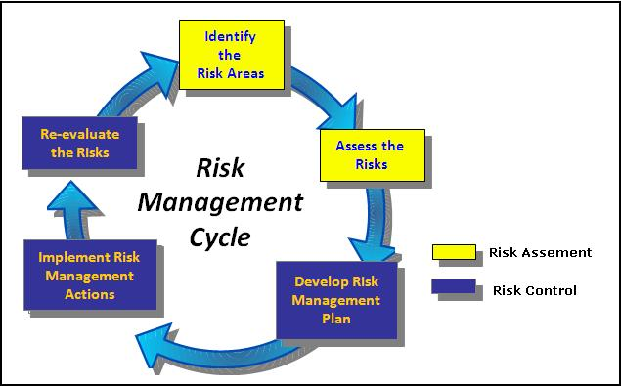
Cyber Security Risk Management
Vulnerability – Something which could go wrong.
Impact – The effect if it goes wrong.
Mitigation – Reducing the vulnerability or impact.
Re-evaluate regularly.

Slide 7
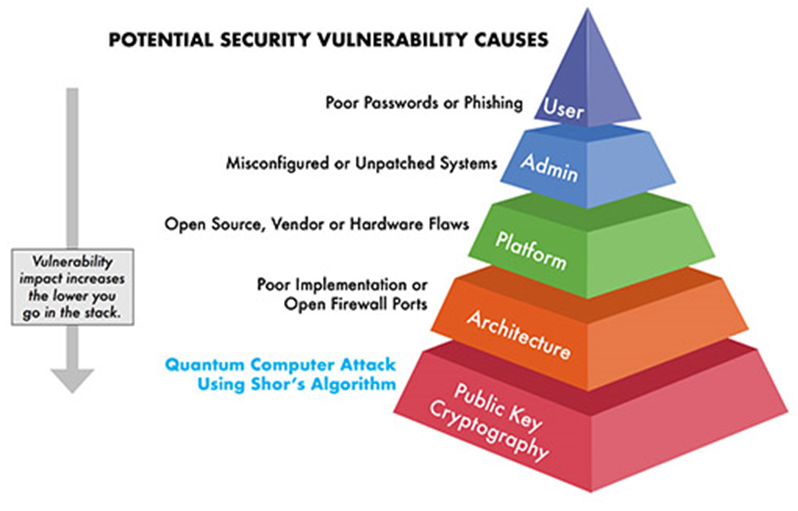
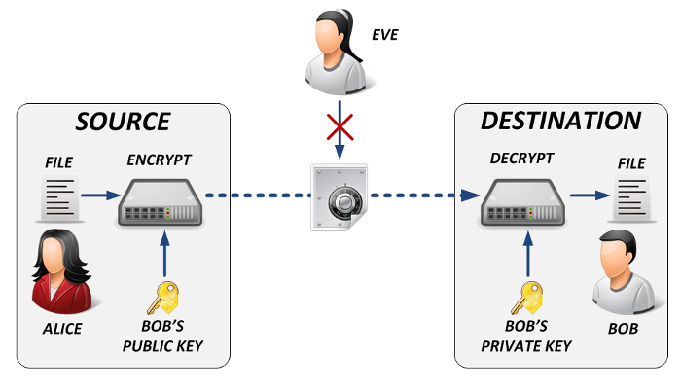
Vulnerability Pyramid
Public Key Cryptography assigns each person a key to sign things.
Impossible to “spoof”.
Impossible to deny.
Impossible to fake.
Sort of…
Birthday attack
Social engineering
“Cryptographically hard”

Slide 8

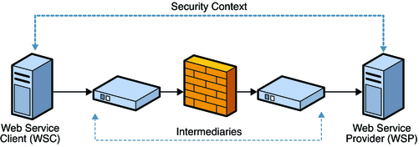
Vulnerability Pyramid
Network architectures, protocols and hardware architectures are built to be secure.
Verify identity
Allow access
Assign privilege
Someone should not be able to get high-level access.
Heartbleed

Slide 9
Vulnerability Pyramid
Once you have a system, you have to monitor its components.
Hardware and software have recalls, too.
Does the hardware have a known vulnerability?
Does the software have a known vulnerability?
Zero day vulnerability
Introduced
Fixed
Discovered
Announced
Hacker activity
Risk
Time

Slide 10
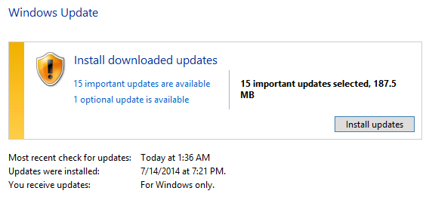
Vulnerability Pyramid
System Admins are supposed to maintain the security of the system.
Is it available?
Is it working as expected?
Is the security up-to-date?
Failing to patch/fix a system is an admin problem.
Heartbleed again
https://www.slashgear.com/over-300k-websites-still-havent-patched-for-heartbleed-23334762/
https://blog.malwarebytes.com/exploits-and-vulnerabilities/2019/09/everything-you-need-to-know-about-the-heartbleed-vulnerability/

Slide 11
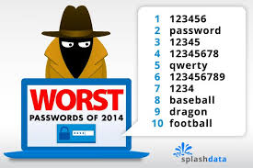
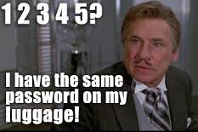
Vulnerability Pyramid
The best system can be penetrated if someone gets your password.
Bad passwords are easy to guess.
Bad passwords are written down.
Bad passwords can be socially engineered.
January 21, 2011 – Son’s birthday
11 21 01 – backward ≠ sneaky.

Slide 12
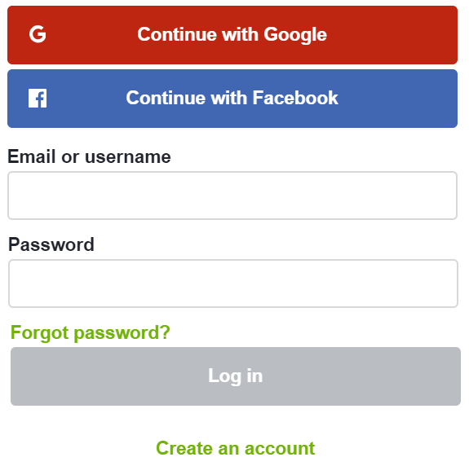
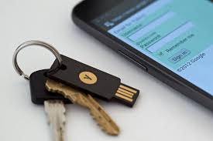
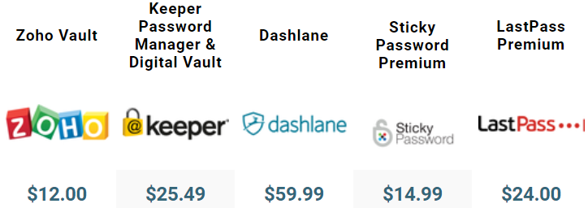
Why Bad Passwords?
They are:
Hard to create
Hard to change often
Hard to keep track
Technology solutions are coming out to solve these problems.
Login with Google/Facebook
Physical security token
Password management services

Slide 13
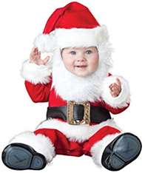
Good Passwords
I recommend two ways to secure a password.
Use a key word which offers easy complexity
All passwords are equally vulnerable.
Change it regularly.
Use a glyph
Memorize a phrase related to the glyph.
Select word
Change to L33+ speak
Pair with “first thing”
Family of passwords
Change it once a year
Fiddle
F1dd!3
FacebookF1dd!3
SchoolF1dd!3
CableF1dd!3
Create a glyph as a hint
Post it anywhere
Memorize a phrase
L33+ speak it
Hint: Santa Baby
Password: Sl1p@S@b!3Und3rTh3Tr33

Slide 14
Personal Security Questions
What super-risky activities do you engage in?
Porn
“Free” games/movies/music
Foreign country sites
What information do you put on your computer and the web?
Assume it can be seen
Assume it can be taken elsewhere
Obfuscate My birthday: January 1, 1980 +/- 1 year

Slide 15
Personal Security Questions
Who are you talking to?
Do you know this person in real life?
How do you know it is the same person?
What does this person want from you?
What are they asking you to give them?
How much of your data is online?
Personal information: SSN, DOB, Family, Contact
Events: birthdays, trips, deaths

Slide 16
For the Exam / Homework
Explain Try-Throw-Catch
Add these features to some example code.
Explain the vulnerability pyramid
Give or explain examples.
Explain personal security issues.
Give or explain examples.

