Slide 1
CSC 200 Class 1
Syllabus
HTML, CSS, JavaScript

Slide 2
Syllabus Review – Bad News
No late work
No extra credit
Three graded assignments each week
Pre-Lecture Asynchronous Assignment
Lecture/Lab
Homework
Three tests @ 20pts each
Capstone programming project @ 15 points
90+ A
80-89 B
70-79 C
60-69 D

Slide 3
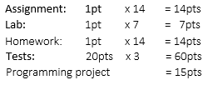

Syllabus Review – Good News
Integrated extra credit
Group work policy
StackOverflow / W3Schools
Nevertheless, you are responsible for your own mastery of the material. 75% of your final grade will depend on projects and the exam which are assigned individually. It is impossible to get a passing grade in this course by copying the work of someone else.

Slide 4
Syllabus Review – Other
Disabilities
Contact options
Office hours after class
Online asynchronous Tuesdays
By email
By arrangement (skype?)
bdillon@rappahannock.edu

Slide 5
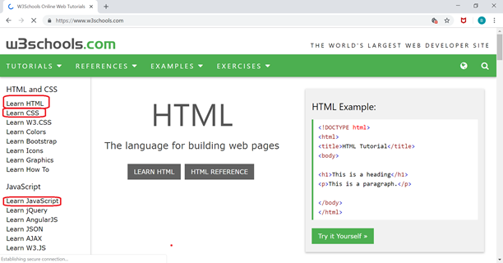
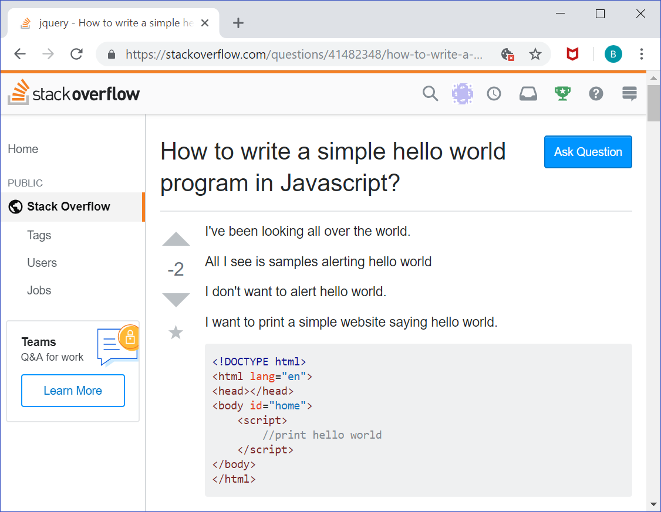
Resources
This course has no required textbook.
There are two websites which you may and should use.
w3schools.com
stackoverflow.com
I recommend that you get a stackoverflow account so you can ask questions.

Slide 6
HTML

Slide 7

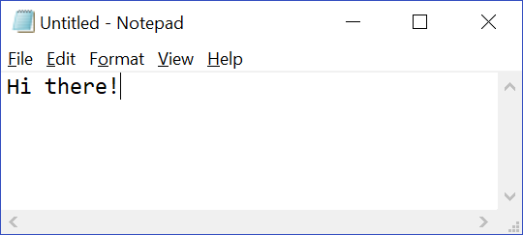
Text Editor
To program you will need a text editor.
Windows is installed on each of your computers and it comes with notebook.
If you have a preference, use that editor.
Set up your editor with the font/size you want.

Slide 8
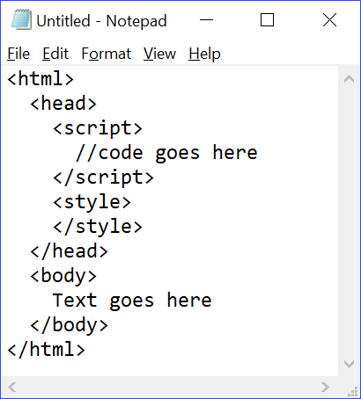
HTML
Hyper Text Markup Language
(More than) Writing (that codes itself) as language
Use whitespace appropriately!
There is a fixed structure that you should use for all HTML documents.
This is not required; it is a convention.
Following the convention helps everyone read you program.
Just learn it.
Note there is a head and a body.

Slide 9
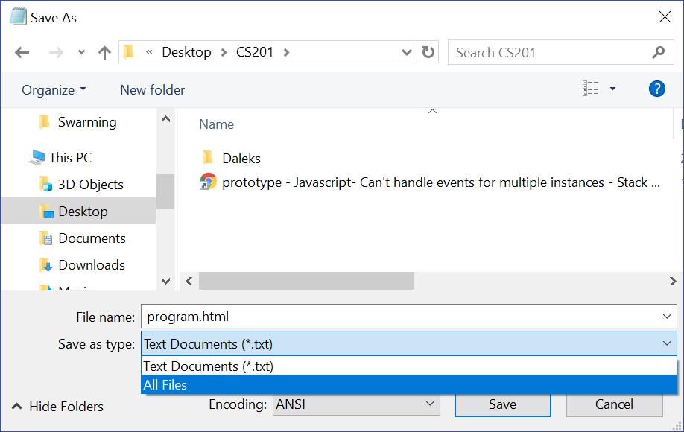

Saving the File
Save the text file with a .html extension.
Be sure to select the All Files type.
You should see the file saved on your computer.
Note that the icon matches your default browser

Slide 10
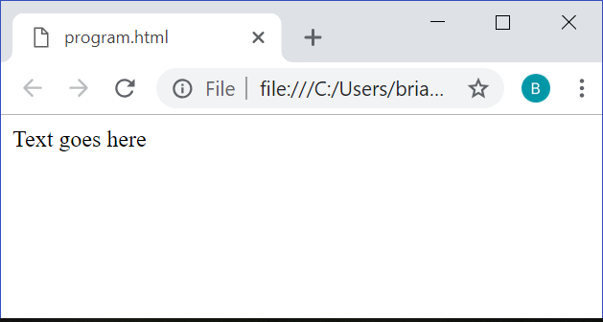
Using a Browser
Open the file using a web browser.
HTML files should work in any browser.
There are some differences between browsers.
Historically these differences were a problem for web developers.
HTML5 definitions eliminate most of these differences.
The browser is smart and will make up for some of your simple mistakes.
That does not mean the page will look the way you expected.

Slide 11
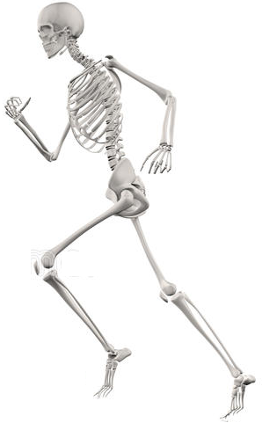
Why HTML?
HTML provides bones for a web page.
Basic structure
Pieces to move/work
Basic form
A tag-based programming language
Tags are usually binary <open></close>
Useful tags include:
- p Paragraph
h# Headlines (h1, h2, h3, etc)
img Images
a Links

Slide 12
Anatomy of a Tag
Each tag has a fixed name
Use recognized HTML tags
Each tag has several attributes
Attributes have default values, so you don’t HAVE to include them.
If you do include them, you can set the values as you like.
In HTML5 many of the style-related attributes became deprecated.
<tag attribute=“value” other=“value2”>
InnerHTML
</tag>
<tag attribute=“value” other=“value2”>
<p>More stuff</p>
</tag>
Deprecated – No longer recognized as the best practice; liable to be removed at any time.

Slide 13
Tag, Class, Name, ID
A tag can be identified by four key attributes
Tag – There can be many instances of the same tag.
Class – Many tags may have the same class.
Name – Many tags can share the same name
ID – Only one tag can have each ID.
<p class=“left” id=“first” name=“talk”>
I am some text in a paragraph.
</p>
<p class=“right” name=“talk”>
So am I.
</p>
<div class=“left” name=“talk”>
But not all text is in a paragraph
</div>
<h1 class=“right” name=“talk”>
So what?
</h1>
<p class=“left” name=“talk”>
I don’t know. Stop yelling!
</p>

Slide 14
Take Another Look
Find the open/close tags.
See how each pare of tags is indented?
Does that help you read?
Body is best used for pure HTML
Head will be used for script and style code.

Slide 15
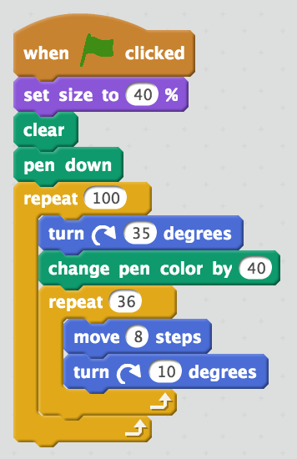
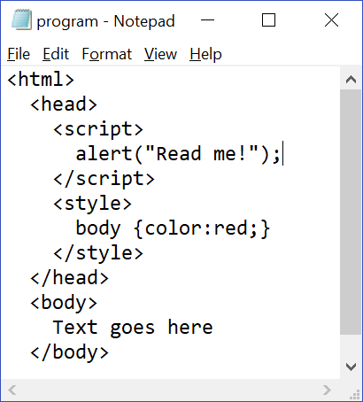
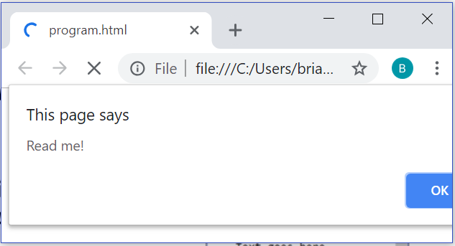
Javascript
Javascript is a popular programming language.
All over the web
Used in Scratch
JavaScript ≠ Java
Not very user-friendly
It is best placed in the head although you could place them anywhere.

Slide 16
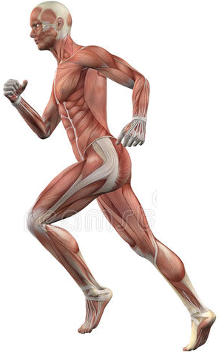
Why JavaScript?
JavaScript provides muscles for a web page.
Move things
Change things
Connect things
JavaScript uses fields and functions.
Fields contain data – var myName = “Brian”
Functions do things with data – alert(myName)

Slide 17
Document Object Model
In JavaScript you can use the get functions to find all the tags.
document.getElementsByTagName
document.getElementsByClass
doucment.getElementsByName
document.getElementById
You can work with groups of related tags OR one specific tag.
<p class=“left” id=“first” name=“talk”>
I am some text in a paragraph.
</p>
<p class=“right” name=“talk”>
So am I.
</p>
<div class=“left” name=“talk”>
But not all text is in a paragraph
</div>
<h1 class=“right” name=“talk”>
So what?
</h1>
<p class=“left” name=“talk”>
I don’t know. Stop yelling!
</p>

Slide 18
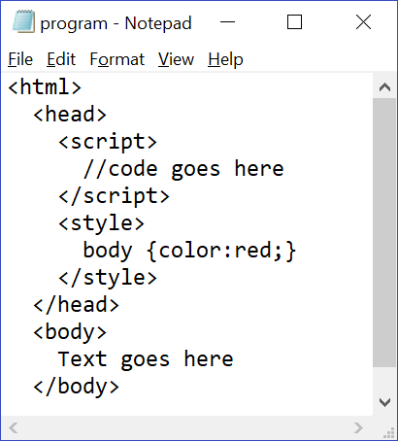
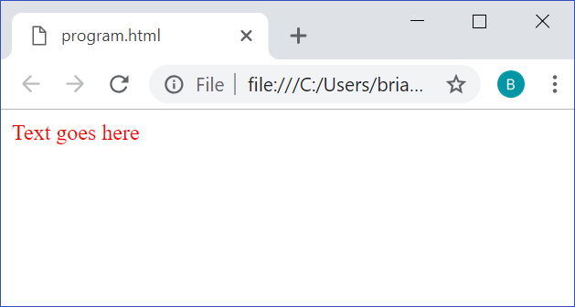
CSS
Cascading Style Sheets
Style adds all sorts of formatting and view attributes beyond the basic HTML.
A lot of attributes were moved to CSS for clarity.
Separating the two is a great idea.
They are best placed in the head although you could place them anywhere.

Slide 19
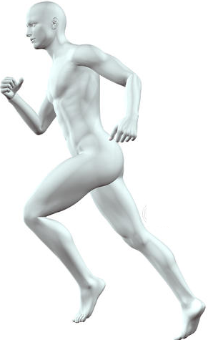
Why CSS?
Cascading Style Sheets provide skin for a web page.
How things look
How things are arranged on the page
Use of classes, ids, names, and tag types
CSS uses a fixed set of attributes and values
p {color:blue; font-weight:bold; width:500px;}
Tag
Attribute
Value
Attribute
Value
Attribute
Value

Slide 20
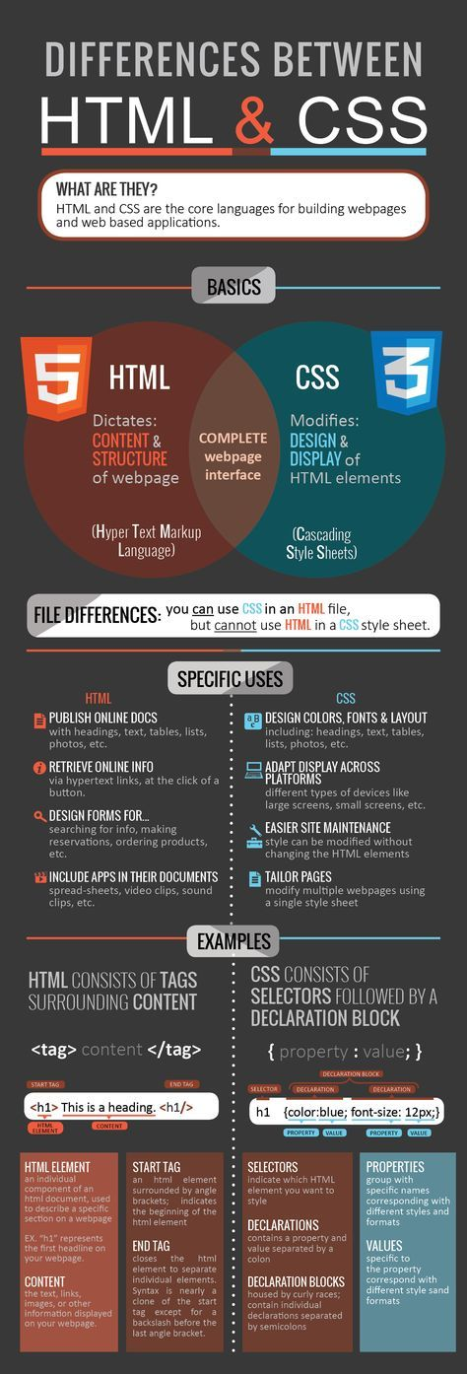

Slide 21
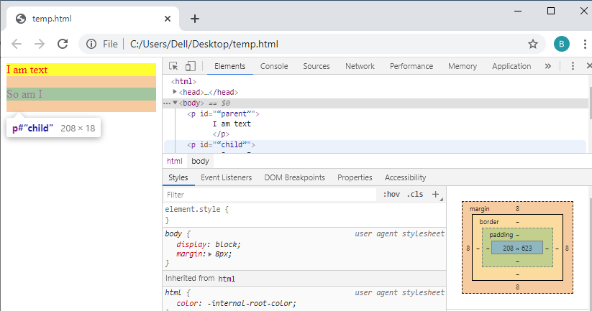
Style Cascade
CSS allows styles to be applied from one element to all its children.
Style applied to the parent cascades to the children.
There are ways to look at such relationships in the browser through the developer tools.
<p id=“parent”>
I am text
<p id=“child”>
So am I
</p>
</p>
P
P

Slide 22
Style Specificity
Styles can also be applied to tags based on their identifying attributes.
Tag name p {color:red;}
Class p.left {color:blue;}
Name p[name=“talk”] {color:gray;}
ID p#first {color:black;}
You can also stack these selectors in many different ways.
<p class=“left” id=“first” name=“talk”>
I am some text in a paragraph.
</p>
<p class=“right” name=“talk”>
So am I.
</p>
<div class=“left” name=“talk”>
But not all text is in a paragraph
</div>
<h1 class=“right” name=“talk”>
So what?
</h1>
<p class=“left” name=“talk”>
I don’t know. Stop yelling!
</p>

