Slide 1
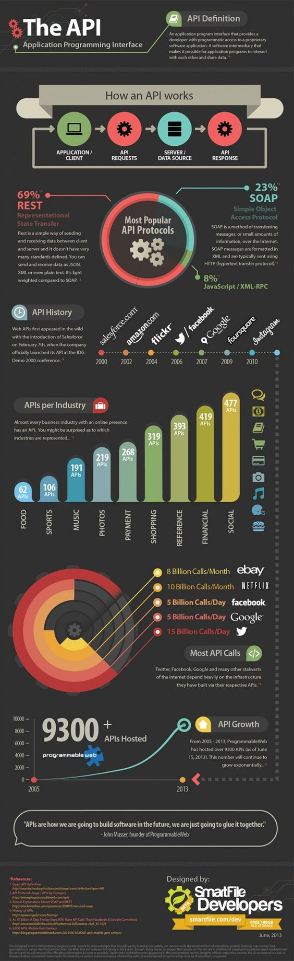
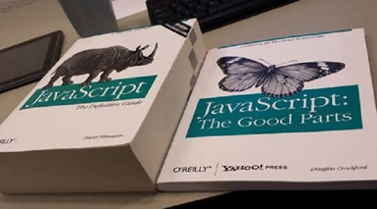
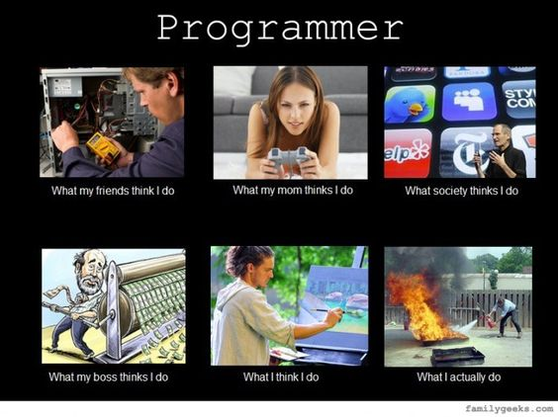
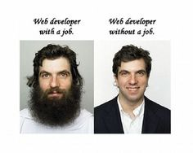
CSC 200 Lecture 7
Computer Architecture

Slide 2
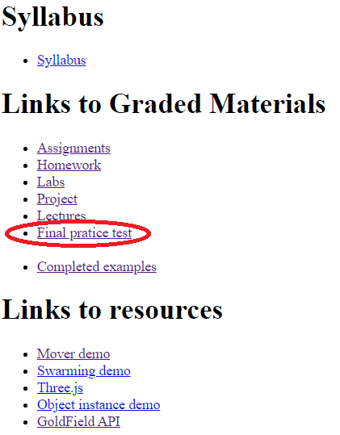
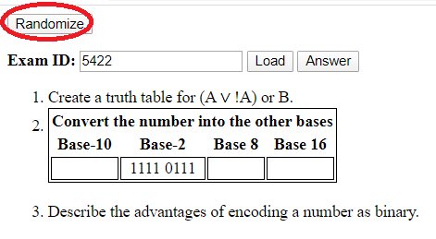
Practice for the Final
I have posted a practice test on the class web page that will help you work on the academic subjects.
It is randomly generated and you can take it as many times as you like.
You can also get the answers to see how you did.
https://bsdillon.github.io/cs200_Spring2020/finalp.html

Slide 3
Really Excellent News
I know that the pace of assignments has been a little high.
Do I teach programming first?
Do I teach academics first?
Do I mix them?
There are no assignments for spring break but….
You are allowed to (re)submit any and all assignments/homework/labs due before March 6 for full credit.
Many things that you had a problem with at the beginning should be that much easier now.
I am willing to have office hours during the week by appointment.

Slide 4
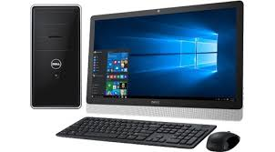
Computer Architecture
The computer’s architecture has not changed significantly since it was original considered in the early 1900s.
Input
Output
Processor
Memory
We have developed new forms of each, but the basic purpose of each component remains the same.

Slide 5
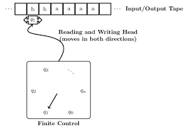
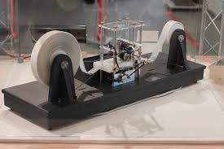
Turing Machine
Just prior to the outbreak of WWII, Alan Turing developed the concept of a computing machine.
Input/output tape
Movable reader
Program
This conceptual model defines the smallest set of components necessary to build a computer.
https://en.wikipedia.org/wiki/Turing_machine

Slide 6
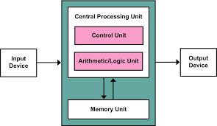
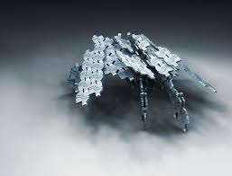

Von Neumann Architecture
In the 1940s, as an outgrowth of WWII and the Atom Bomb, physicist John von Neumann developed the architecture which is with us today.
Von Neumann’s architecture was an improvement on Turing’s concept.
Internal program/data storage.
Von Neumann also gave birth to many concepts in AI.
https://en.wikipedia.org/wiki/Von_Neumann_architecture

Slide 7
Main Parts
Processor &
Memory
On any computer you can identify the main components although you may need a screwdriver.
Input
Input is needed to direct the computer to some action. Otherwise it runs entirely unsupervised.
Output
Output is needed to monitor what the computer is doing. Otherwise whatever it computes is useless.
Output
Input

Slide 8
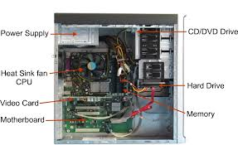
Main Parts (2)
Processor
The Central Processing Unit (CPU) does all the thinking for the machine.
Memory
Memory stores the program and data for running the program.

Slide 9
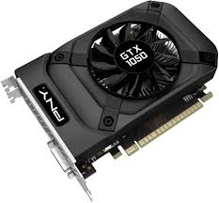
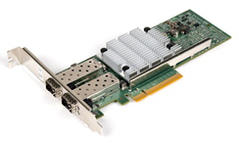
Other Processors & Memory
The CPU resides on the motherboard. The motherboard has slots for additional components.
Network Interface Card
The NIC allows the computer to connect to the network and communicate with other computers.
Video/Graphics Card
The video card configures the data for the display.
Most Graphics Processing Units (GPUs) have specialized capabilities for massive graphics calculations.

Slide 10
Memory – Size and Distance
Memory comes in various sizes and distances.
Registers are on the CPU.
Cache is also on the CPU with more space.
Random Access Memory is much larger, but off the chip so it takes longer to access.
Main memory is HUGE, but also much further away.
Access Time
<1ns
Registers
On CPU
10ns
Cache
30ns
RAM
100ns
Hard Drive

Slide 11
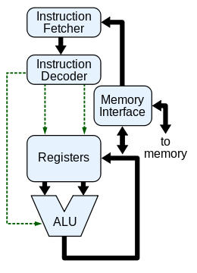
The CPU
The CPU has an interface with memory to read/write data and get program instructions.
Data is stored temporarily in registers.
32-bit registers make a 32-bit machine.
64-bit registers make a 64-bit machine.
The Arithmetic and Logic Unit (ALU) does all the math/logic.
The chip also has a set of microcode instructions which translate program instructions into a set of specific math/logic steps.

Slide 12
What you need for the final
Understand and be able to describe the following:
Input
Output
Processor
Memory
NIC
Graphics card

