Slide 1
CSC 200 Lecture 8
Computing Stack

Slide 2

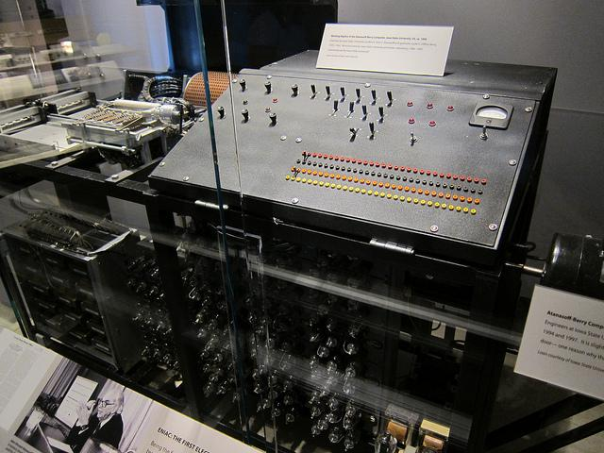
A long long time ago…
In the 1940s, applications were written to run on a specific machines.
Each machine had its own language
Very few machines
Limited developer options
If you bought/built a new computer, your program was useless.
Some computers could load a different programming language AND the application, but it took most of the memory.
Application
Physical Hardware

Slide 3
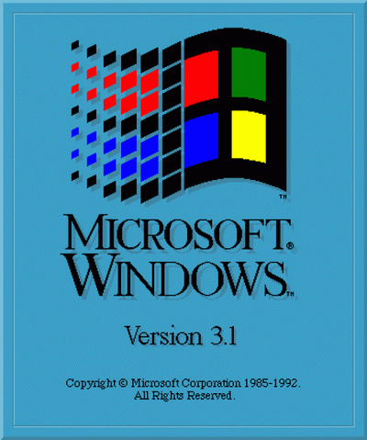


Operating System
In the 1950s people began to create systems which operated the hardware and managed the application.
The operating system took up memory, but it created an abstraction layer separating the application from the hardware.
Now an application written for an operating system would run on any hardware.
Variations in operating systems still created enormous divisions in the computing world.
Application
Operating System
Physical Hardware
https://www.youtube.com/watch?v=0eEG5LVXdKo
https://sites.google.com/site/optsytms/history-of-operating-systems

Slide 4






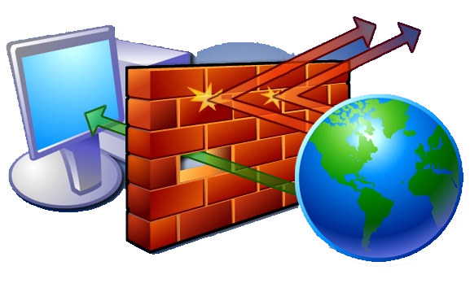

Operating System Innovations
There were many new concepts developed as part of an OS:
Multi-tasking
Scheduling
Threading
Drivers
Services
Daemons
Permissions
Firewalls

Slide 5
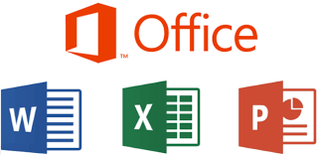
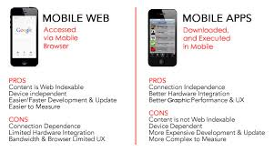
App vs Application
Originally, an application was defined as a more complete set of algorithms and capabilities in one software package.
MS Word
Web-based technologies eroded the need for monolithic applications.
Mobile devices replaced the concept of an application with the “app”
Lightweight, single purpose, small cost
Under the hood most “applications” are now deploying with “app” concepts.

Slide 6
Virtual Machines
Still, operating systems were tied to the hardware.
One OS = one machine
Early solutions featured virtual machines hosted inside another OS.
Modern virtual machines provide another layer of abstraction between OS and hardware.
Many OS = one machine
OS image can move to another machine.
New OS copies can be created at will.
App
App
App
OS
OS
OS
VM
VM
VM
Hypervisor
Physical Hardware

Slide 7
Containers and Dockers
Still the application was dependent on the OS.
Bitter PC vs Mac wars.
Recently (2010) containers were introduced to provide yet another abstraction layer.
Now all the services, drivers, etc. inherent in the OS can be ported with the application.
App
App
App
App
App
App
Con
Con
Con
Con
Con
Con
OS
D
D
D
OS
OS
VM
VM
VM
Hypervisor
Physical Hardware
https://www.youtube.com/watch?v=0eEG5LVXdKo

Slide 8
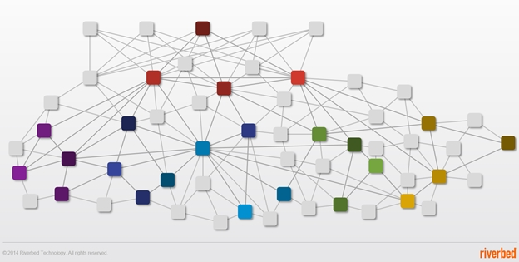
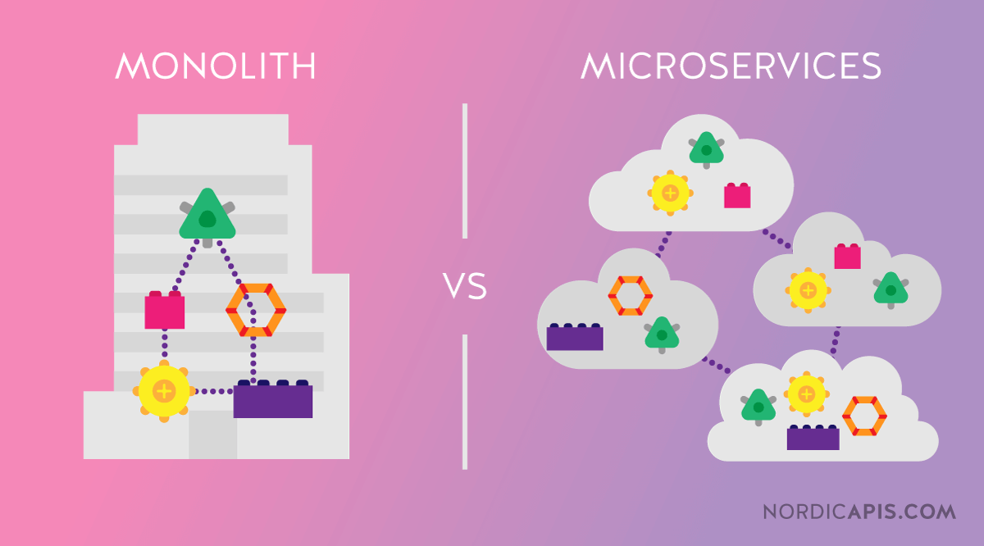
Microservices
Starting with service-oriented architecture, programmers began developing modular, networked code.
Less difficult to build/test
Reusable by many clients
The modern concept of a microservice avoids creating large applications instead of simple services.
Perfect one capability
Join them together for complexity

Slide 9
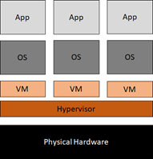
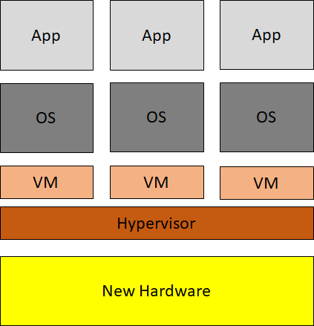
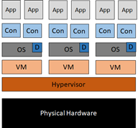
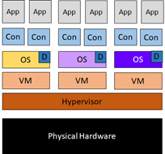
Why We Care
The development of virtual machines made it easy to port a machine image from one set of hardware to another.
No changes were required in the OS. No new drivers. No new patches.
The development of containers made it easy to port an application from one OS to another.
No changes were required in the OS. No new libraries. No new services.

Slide 10


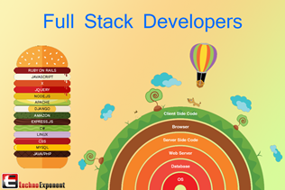
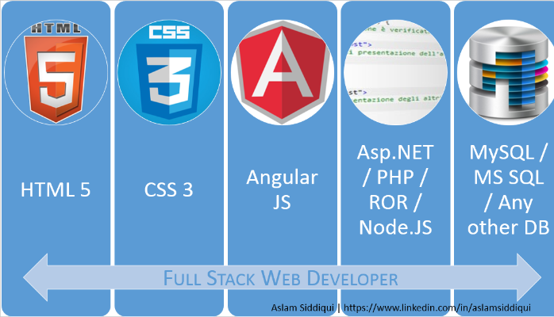
Computer Stack
For developers, the “stack” contains all the layers of software, interfaces, and libraries which are needed to create your application.
What devices will run it?
Do they all look the same?
What happens in the front and back ends?
How do you handle the middleware between layers?
How do the development and operational stack differ?
Languages: JavaScript, PHP, HTML, CSS, MySQL
Applications: Mobile, Web, Desktop
APIs: Google Maps, Database

Slide 11
For the Exam / Homework
Know the purpose of:
Operating systems
Virtual Machines
Containers
Be able to define an abstraction layer.
Contrast and compare:
Application and app
Desktop, web and mobile development

Slide 12
Practice Test
Before lab time, I’m going to give you a practice test question. This isn’t worth points, but it will help you to anticipate the March 19 test.
We’ll spend 10 minutes on this.

Slide 13
Please program the following
Write a function f1 that takes two parameters and returns the absolute difference between them.
e.g. x=1 y=7 absolute difference is 6
e.g. x=7 y=1 absolute difference is 6
Hint: Use an if before doing the subtraction.

