Slide 1
CSC 200 Lecture 14
Languages

Slide 2
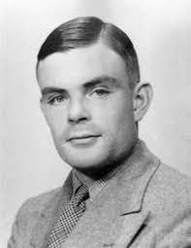
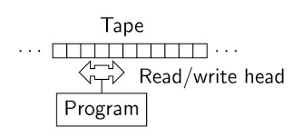
Turing Complete
Alan Turing was discussed in lecture 2.
His concept for a fully-functional programming languages has a few basic capabilities.
Write values
Read values
Move to an instruction
Execute the instruction
Any language which does all these things is said to be Turing Complete.

Slide 3
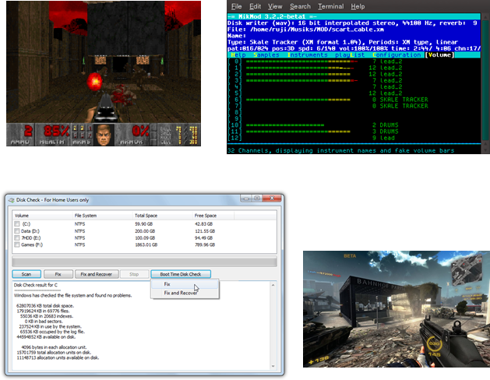
Turing Complete (2)
The effect of being Turing Complete is that a language can do all the things any other language can.
Even though they look very different, each of these languages can do the same things.
If some of the fancy capabilities look out of reach for the more primitive languages, remember that those languages were used to build the fancy capabilities.
It just takes time and effort.

Slide 4
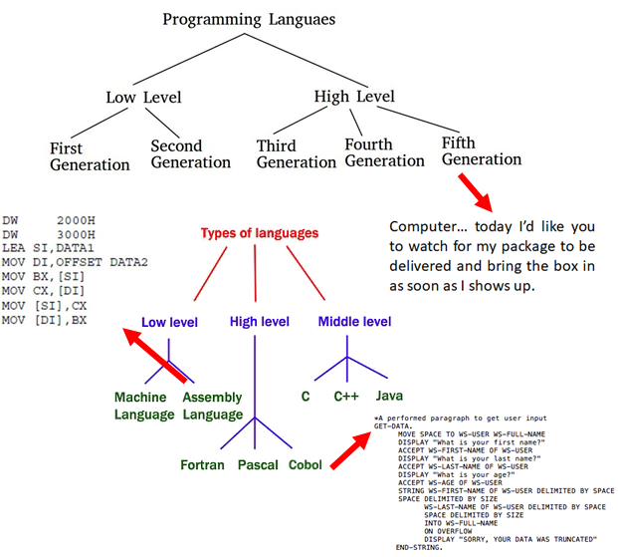
Language Levels
Five levels of programming languages have been hypothesized.
The levels are based on how close they are to humans or machines.
Low level languages are very close to machines.
Higher levels are more like humans.
The fifth level would be a language like English which could be compiled into a program.

Slide 5
Language Paradigms
Anyone can create their own programming language.
As a consequence it is hard to strictly classify languages.
Very different languages can also have identical characteristics.

Slide 6
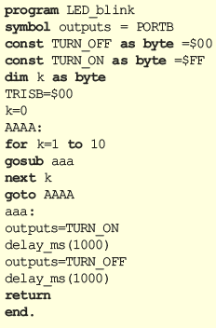
Procedural Languages
A language is said to be procedural when it gives a set of steps which are followed from start to finish with little extraneous structure.
This group is more notable for what is not included, rather than what is.

Slide 7
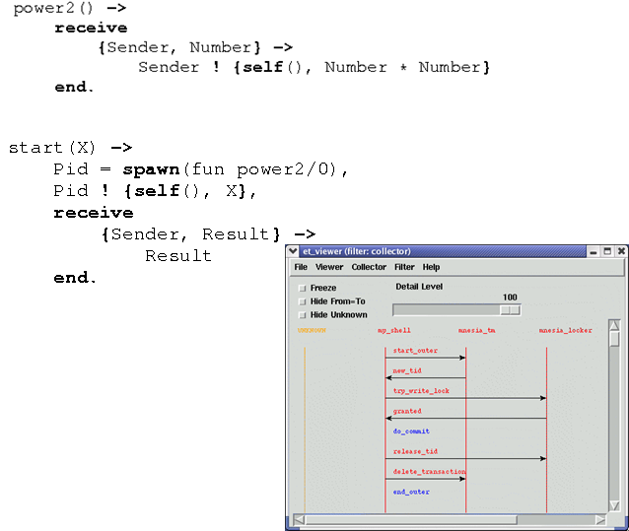
Functional Languages
Some languages define units of procedural code as functions.
Functions are first-class citizens in functional languages.
Functions are components that can be aggregated to create complex behavior.
Functions can be reused for completely different behaviors.

Slide 8
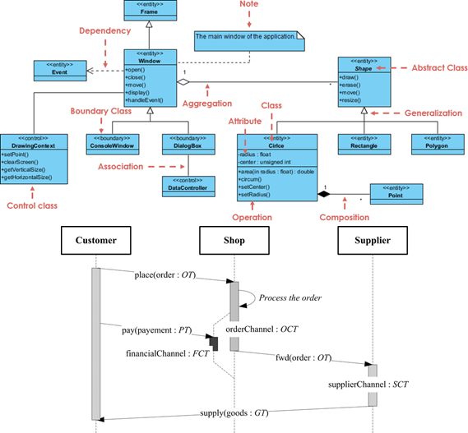
Object Oriented Languages
Other languages defined a bundle of fields and functions as a program unit.
Objects have their own birth, life, and death as first class objects in these languages.
Objects can be reused and composed to create more complex programs.

Slide 9

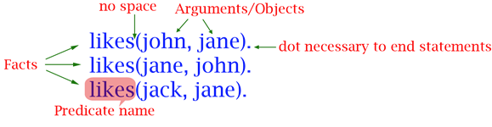
Logical Languages
Program
Logical languages use rules rather than commands.
A rule can tell you how two or more things relate.
Facts can be entered which show concrete examples of rules.
Logical languages search for matching patterns.
By asking a question, the program can tell you what answers match the question.
Facts
Query
Friends(jack,Y).
no bindings for Y.
Friends(jane,Y).
john
Look for a y that matches this rule
No value matches that rule. Likes(jack,jane), but there is no likes(jane,jack).
John can be y because likes(jane,john) and likes(john, jane).

Slide 10
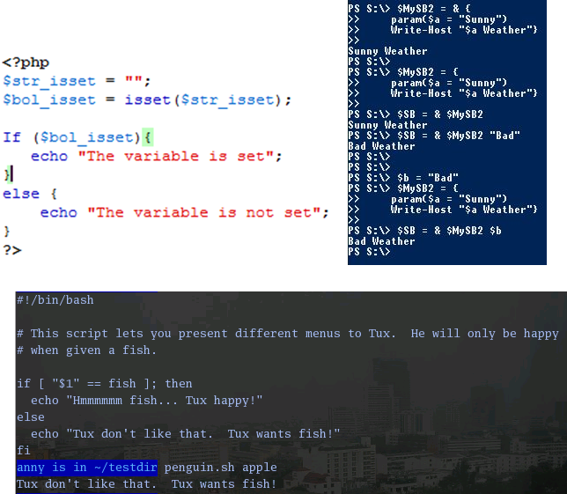
Scripting Languages
Many languages are designated as “scripts”.
“Other” languages are used for applications.
Are any of these uses applications?
What difference is there, if any?

Slide 11
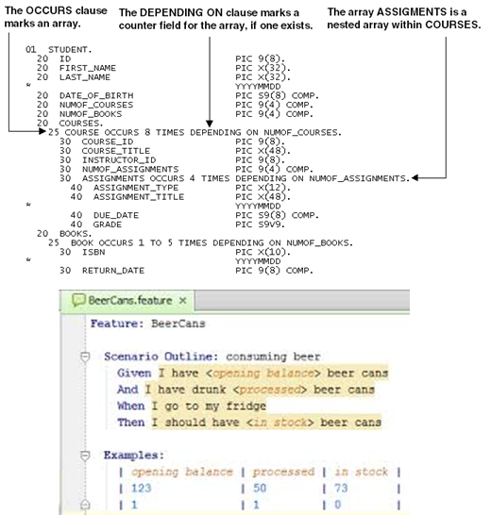
Business Languages
Some languages are created to be used by business people.
These people don’t want to learn to program. They want to meet some other goal.
These languages have simpler syntax, closer to spoken English.
Sometimes they are integrated into other business tools with immediate impact on business.

Slide 12
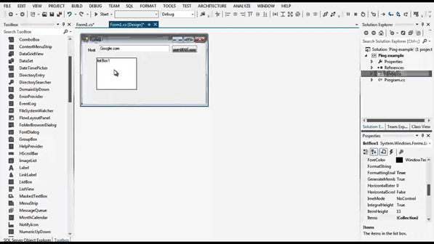
Visual Languages
When a language is used to define an interface or most of the language focuses on interface events, it might be called visual.
Many “non-visual” languages use auxiliary tools to make GUIs
All visual languages have the same power as any other language.
How many programs don’t have a GUI? How else can you build a GUI?

Slide 13
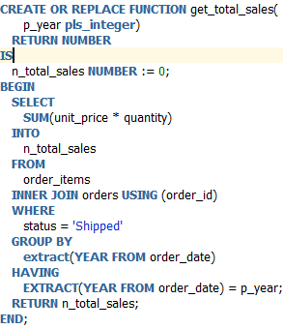
Purpose-Built Languages
Some languages are narrowly defined for a specific purpose.
There are many such languages which may be looked down on because they are not Turing Complete.
Is HTML a language?
Is it Turing Complete?
Does it do the job for which it was built?
Does it have a defined grammar/syntax?

Slide 14
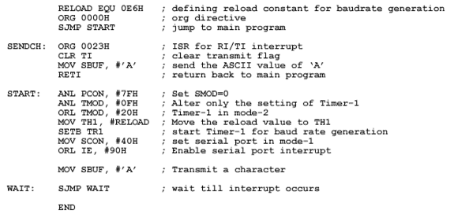
Assembler
Assembler is very like the programs you read in lecture 2.
Data is read/written from registers.
Commands are simple math or logic operations.
Things can be done in Assembler which are perfectly optimized for a given need.
There is no compilation for Assembler.

Slide 15
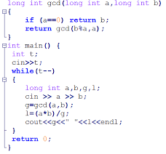
C/C++
C is a procedural language which evolved.
Over time it took on Structs which contain fields as a unit.
Eventually these became objects and Objective-C or C++ was born.
C/C++ share syntax and libraries. They are still the most popular programming language.

Slide 16
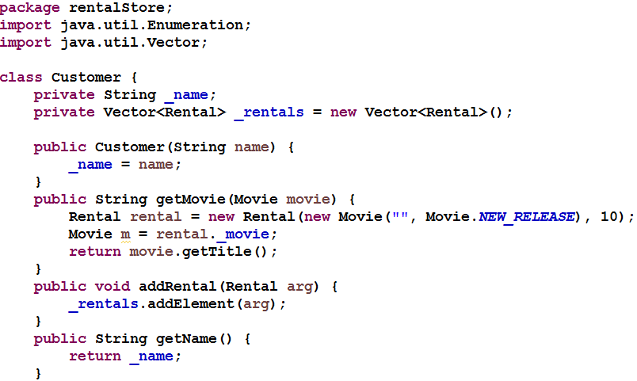
Java
Java got its start using C++ syntax.
Unlike C/C++, Java is not compiled—it is interpreted.
A program in C/C++ must be rewritten for each machine type.
The same program written in Java can be used on any machine.
Now many other means can be used to make a program portable e.g. web interface.

Slide 17
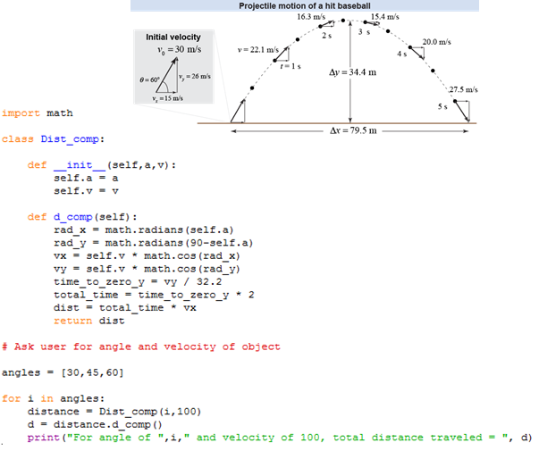
Python
Python abandoned the C/C++ syntax in favor of a white-space structure.
Python is extremely good at working with files, text, and collections of data.
Recent research has shown it is much easier to learn than other languages.
Python is quickly becoming the language of choice for colleges e.g. UMW.

Slide 18
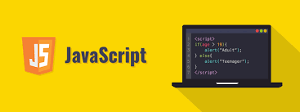
JavaScript
Javascript was built to program for the Netscape web browser.
It has become the default scripting language for all web interfaces.
Multiple libraries have been built to enhance or extend JavaScript.
As you have seen, there are problems with the language, but it does work.

Slide 19
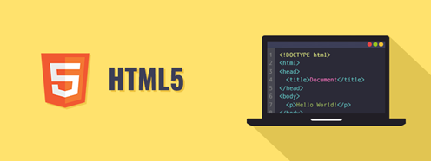
HTML
HTML was built to a single purpose, which it does well.
HTML has been normalized and revised many times to enable the growth of web-based programming and resolve problems.
Some languages (i.e. Angular) claim to do HTML’s job the way it “should” have been.
HTML will never go away as long as legacy pages exist and things can be built on HTML.

Slide 20

SQL
SQL is another purpose-built language for dealing with data.
It has two simple math operations:
Select something that looks like this.
Show only the parts I want to see.
That simple algebra works powerfully on most databases today.
R = {a1, a2, a3,… an}
T1 = σ_{a1=3}(R)
T2 = π_{a1,a2,a7}(T1)

Slide 21
For the Exam / Homework
Explain the main types of languages:
Procedural
Functional
Object-Oriented
Logical
Place JavaScript in context with other languages.
Why is it built the way it is?
How is it like/unlike other languages?
Give examples of different languages used at different layers of the stack.
See lecture 8 for some examples.

