Slide 1
CSC 200 Lecture 13
Algorithms, Efficiency
Standard Libraries

Slide 2
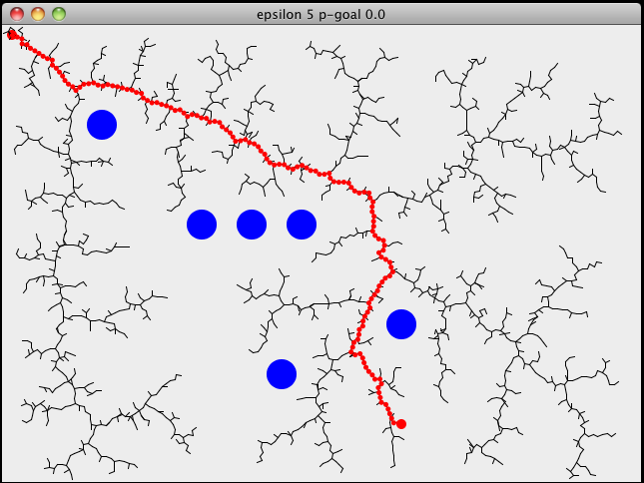
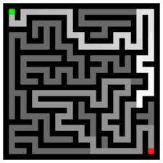
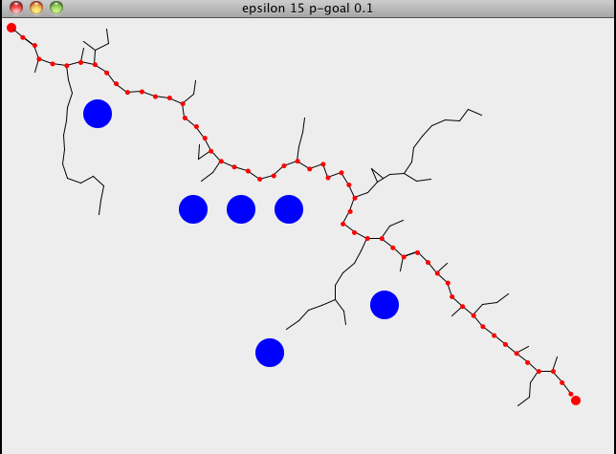
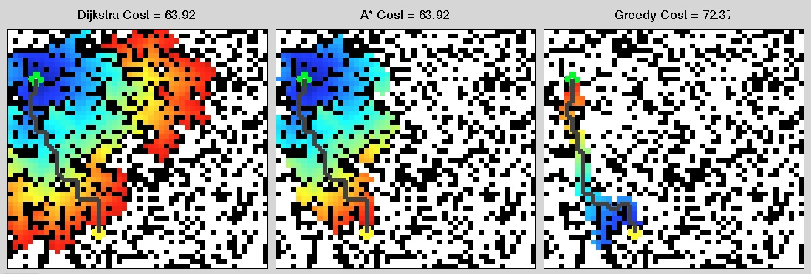
Algorithm
An algorithm is any program which does a job.
This definition can be WIDELY interpreted.
Generally we talk about algorithms in terms of how fast they do the job and how much memory they take.

Slide 3

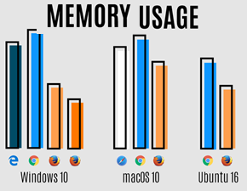
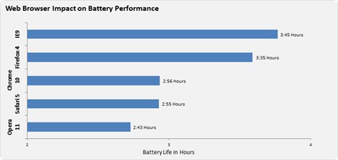
Efficiency
Once upon a time computers were slow and had little memory.
Algorithm design was all about doing things faster and with less memory.
Current requirements add battery efficiency for mobile environments.
Bottom line: can you do the same job with less time, memory, or battery power?

Slide 4
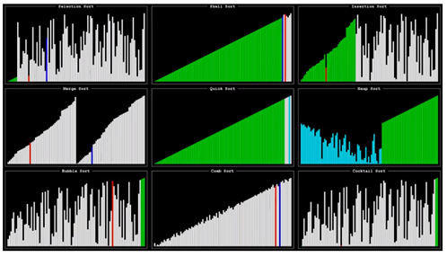
Efficiency (2)
One traditional example is sorting algorithms.
Given a set of cards, how quickly can you put them into order?
We count how many steps are needed to get the job done.
Some algorithms work well for a few cards, but they won’t work for larger card sets.
There are various algorithms and lots of places where you can watch races between algorithms.
https://www.youtube.com/watch?v=ZZuD6iUe3Pc

Slide 5
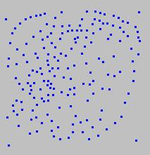
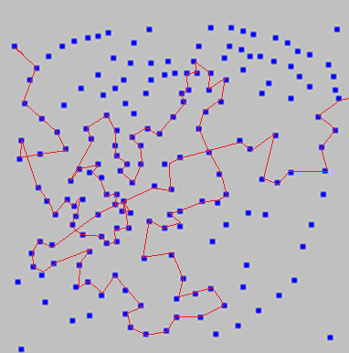
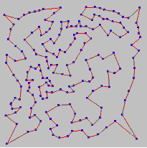
Correctness
Another criteria for an algorithm is correctness.
Deterministic algorithms always get the right answer.
Heuristic algorithms get a good* answer.
In some cases we can accept a bit of error. We can predict the rate of error and we can adjust for it.
In other cases, only the best answer will do.
Well known Traveling Salesman Problem with no perfect solution.
*For some measures of “good”

Slide 6
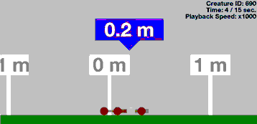
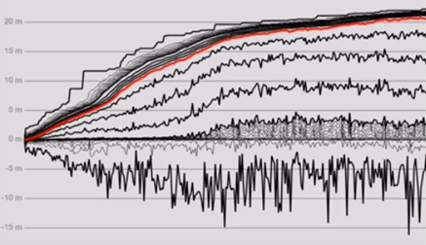
Genetic Algorithm
One powerful algorithm for “unsolvable” problems is based on biology.
Start with a set of random solutions.
Pick the best ones.
Try minor variations and combinations.
Repeat.
If a single random mutation doesn’t work, that doesn’t affect the outcome.
https://www.youtube.com/watch?v=GOFws_hhZs8

Slide 7
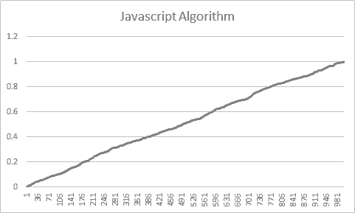
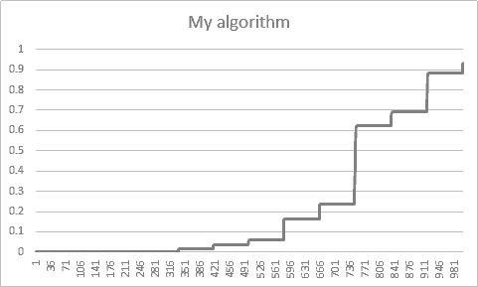
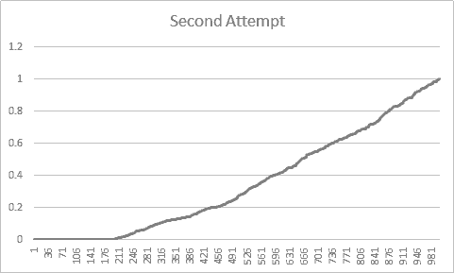
Standard Algorithms
1000 “Randomly Generated numbers
There are lots of very smart people who have developed efficient algorithms for you to use.
Languages like JavaScript add such algorithms to their standard libraries.
While you MAY create your own algorithms, you probably won’t do it as efficiently or as correctly.
A good random number generator should select values which are evenly distributed over the whole range.
My second attempt used a block-chain technique reintroducing random time, but it still favored zero.
My algorithm found a cycle of numbers which repeated.
This caused most numbers to favor specific values.

Slide 8



Breaking Down A Problem
The key to creating an algorithm is breaking down the problem.
Your practice in programming has already introduced you to this.
Think about the “big” steps.
Figure out how to solve each one.
Repeat as necessary.

Slide 9
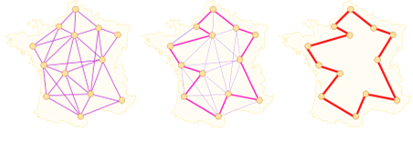
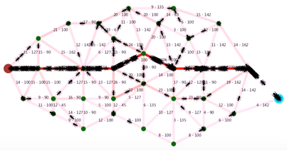
Ant Algorithms
Ants don’t communicate intention with each other. They don’t plan. Yet they can make amazing things and accomplish coordinated tasks.
Chemical trails
Random walk
Many individuals
This is also an example of agent-based AI.
Simple rules=>Complex behaviors
All paths are open
Paths are “strengthened” by each passer
The remaining paths are the shortest.
https://www.youtube.com/watch?v=eVKAIufSrHs

Slide 10
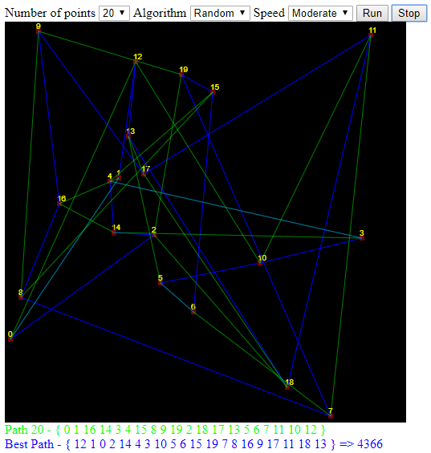
Traveling Salesman Problem
To demonstrate some of these concepts I built a TSP tool. There are three algorithms.
Random – Try anything
Brute Force – Try everything
Genetic – Try what has worked
Greedy – Try what looks best
Each of these has pros and cons.
Split into groups and discuss.
http://bsdillon.github.io/cs200_Spring2020/Lecture/Algorithm.html

Slide 11
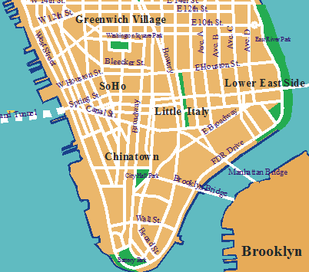
Another Algorithm
This is a map of Manhattan.
How would you plan a route from west 14th St to the East River Park?
Remember the goal is not to find a route, but develop a plan to find a route.
What factors are you considering?
Distance?
Traffic?

Slide 12
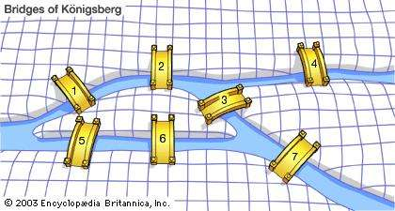
Learning from History
This is Koneigsberg. It is famous for its seven bridges.
A famous mathematician, Euler, asked a question: Is it possible to cross every bridge exactly one time in a single trip?
Talk amongst yourselves to answer this question.
Focus on HOW to answer the question, not just yes/no.

Slide 13
Learning from History
3
Impossible!
Euler realized that any land with an odd number of bridges had a problem.
That extra bridge could be
The start of the path.
The end of the path.
Unreachable.
This means that any graph which can support and Euler path can have no more than two odd nodes.
5
3
3
Apply this algorithm here

Slide 14
Learning from History
Impossible! I spent hours on this as a teenager because someone told me it was possible.
Euler realized that any land with an odd number of bridges had a problem.
That extra bridge could be
The start of the path.
The end of the path.
Unreachable.
This means that any graph which can support and Euler path can have no more than two odd nodes.
4
5
4
5
5
9

Slide 15
For the Exam / Homework
Given a problem, explain how you would solve the problem.
Break your solution into a set of steps which can be taken one at a time.
Given a solution which is missing some steps, fill in the steps.
Given a pair of algorithms, explain which one is more efficient.
Explain why algorithm efficiency is important with respect to memory, power, and speed.

