Slide 1
CSC 200 Class 2
Field, Functions, Events

Slide 2
Fields
A computer program has a fixed amount of memory.
That memory is divided into fields, sometimes called variables.
You can think of each field as a box with a name and some contents.
Allocated memory space
Identifier
Value
39
Age
var Age = 39;

Slide 3


Fields – Memory Space
In many programs the size of a field if fixed. The size depends on the type of value it will hold.
Different numbers have different sizes. Some data holds lots of pieces.
JavaScript tries to assess the type of a field dynamically. Sometimes this causes problems.
Truck
Grape

Slide 4
Fields - Identifier
You can create any identifier you like.
You have complete freedom here.
Some rules
Letters, numbers, and ‘_’ only
Letter or ‘_’ first
Unique
Some conventions
Make it a descriptive name
Name a thing (noun)
UPPER CASE FOR CONSTANTS ONLY
Start with lower case
Only one upper case letter
Be consistent
Not an Identifier
4+4 that’s math
12men that could be a number
Proper Identifiers
lower, UPPER
onlyLetters
name1, name2, name3
_with_underscores
PI
camelCase
PascalCase
neverHTML
useHtml

Slide 5
Fields - Value
The value in a field changes over time.
Declaration – it exists but it is undefined
Definition – you put something into it
Assignment – you put something else.
Reading a piece of code often comes down to your ability to trace the changes in a field.
Age
undefined
Age
18
Age
21

Slide 6
Reading Code
Let’s look at an example of how a field changes over time.
After line
0
1
2
3
4
5
6
7
8
9
10
11
12
13
14
days
undefined
0
31
59
90
120
151
181
212
243
273
304
334
365
365
0
1
2
3
4
5
6
7
8
9
10
11
12
13
14
var days;
days = 0;
days += 31; //January
days += 28; //February
days += 31; //March
days += 30; //April
days += 31; //May
days += 30; //June
days += 31; //July
days += 31; //August
days += 30; //September
days += 31; //October
days += 30; //November
days += 31; //December
alert(days);
HAND EXECUTION!

Slide 7
What can go wrong?
There are three errors that tend to happen more often than others.
Read before write – If you try to read the value before you have put one in, the result is undefined.
Wrong type – If you think it’s a number but JavaScript thinks it is text.
Name mismatch – If you don’t write the identifier exactly right JavaScript won’t understand.
var days;//undefined
alert(days);//still undefined
Days = 30;
var age = userInput.value;//“18”
age+=10;//“1810”
var PI = 3.14;
alert(“What is PI? “+Pi);//Pi, not PI

Slide 8
Functions
Functions, sometimes called methods, are bits of code.
A function can be called over and over by different pieces of code.
Making that bit of code into a function prevents you from having to repeat it every time you need it.
function add(p1, p2)
{
return p1+p2;
}
function warning(reason)
{
alert(“Warning: “+reason);
}
var x = 7;
warning(add(x,1));
warning(add(x,2));
warning(add(x,3));
warning(add(x,4));
warning(add(x,5));

Slide 9
Anatomy of a Function
Functions always start with the keyword ‘function’.
Each function has a unique identifier.
Pick a verb phrase
Functions have a list of parameters
There might be zero parameters
Parameters also have identifiers
The function may do something or it may calculate something.
The function may return some value.
function identifier(parameter1, parameter2)
{
//all the code
return x;
}

Slide 10
Parameters and Scope
When you call a function, the parameters are set from the values you put in the call.
This call passes:
The value of x into parameter p1.
The value 1 into parameter p2.
Once the program goes to the function the scope changes.
There is no x, only p1.
Scope changes for each call.
Scope ends with the function
When the value returns it is put into x.
function add(p1, p2)
{
return p1+p2;
}
var x = 7;
x = add(x,1);

Slide 11

Events
Events are functions that the system calls for you.
Events interrupt the normal program to do something else.
You can write ANY code into an event.
You can call a function that starts a series of other calls.
This kind of function is an event handler.
<img src=“button.png” onclick=“makeSale()” />
function makeSale()
{
getShoppingCart();
getPaymentInformation();
finalizeSale();
}

Slide 12
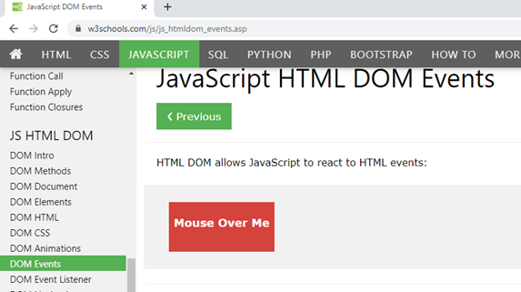
The Document Object Model
Every HTML tag in the page is an object with a set of members: fields, functions, and events.
The DOM defines these properties and w3schools is a great resource to learn what is available.
You can find a list of all

Slide 13
So What?
ALL of programming is the ability to use fields, functions, and events.
What data do you need to get the job done?
Have you put the right data in those fields?
What things do you need to do?
What data do you need to pass to those functions?
What data do you want back?
What events will prompt these actions?
How will you trigger those events?

Slide 14

One Example
I want to adjust the background color to be lighter/darker.
I want to use a slider to get it done.
The DOM says all <input> tags have a value field and an onchange event.
I will create an event handler function to:
Take that value as a parameter
Get the panel by ID
Use that number to change the color of the panel.
Can you read this?
https://bsdillon.github.io/cs200_Spring2020/Lecture/slider.html

Slide 15


Lab #2
Lab#2 will let you use all these things.
Create two buttons
They have click events.
They can pass a parameter to the event handler.
Use the event handler to change a field.
Read the field to draw the ball.
var whoHasTheBall;

