Slide 1
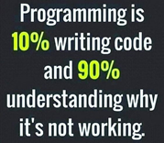
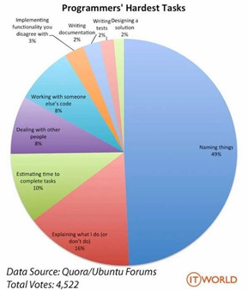
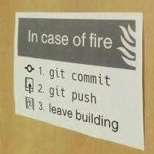
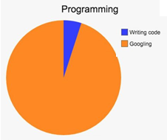
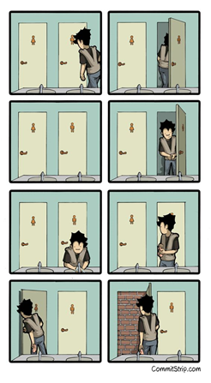

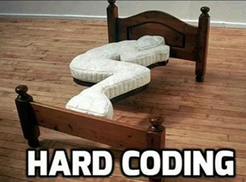
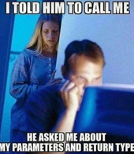
CSC 200 Lecture 3
GUI Geometry
Control Structure
Programming Practices

Slide 2
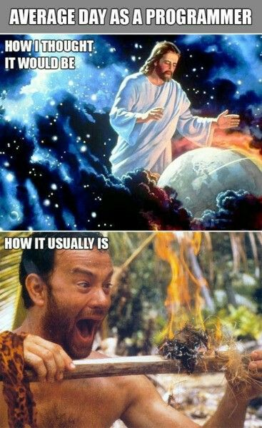

Slide 3
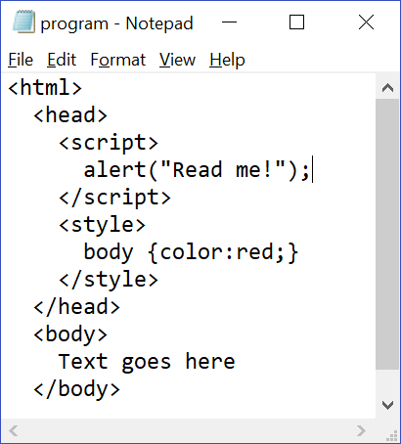
Before We Start
PLEASE memorize the basic structure of a web page.
Helps you find things
Help you build things
Differentiate code from style from HTML.
Get in the habit or reading the code as human sentences.
Have you seen the browser put up with something you did wrong?

Slide 4
Cartesian Geometry
Let’s remind you of a couple of things.
Cartesian plane is the cross of an X and Y axis.
Four quadrants based on positive/negative regions of each axis
Quadrant I has positive x and positive y
Origin is (0,0) for both.
Y=10
II
I
X=10
III
IV

Slide 5

Computer Screen Physical Operation
When TV was first invented it consisted of:
An electron beam
A phosphorescent screen
Magnetic “aim” of beam
This is why TVs had deep screens.
The beam can be aimed in two dimensions: across and down.
As the beam moved down the screen it scanned back and forth.

Slide 6
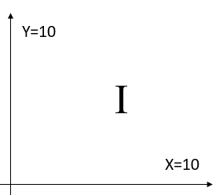
Computer Screen Geometry
Because screens functioned in this way, there are naturally two dimensions to the screen:
X goes across the screen.
Y goes down the screen.
Pixels are given coordinates in terms of these dimensions.
(0,0) ends up in the upper left corner.
(maxX,maxY) ends up in the lower right corner.
The computer screen is an inverted first quadrant.
Scan – x across
(0,0)
Rows – y down
(10,10)

Slide 7
Computer Screen Tradition
Modern LCD screens don’t use scanning beams.
Each pixel has a wire that connects it.
Wires are laid in an (x,y) grid.
Positions are completely arbitrary.
The same inverted quadrant I is still used because the tradition has existed for so long.
Scan – x across
(0,0)
Rows – y down
(33,12)

Slide 8
So what?
Suppose that you have two points on the screen and you draw a line between the them.
Is the slope of this line positive or negative?
If this were anywhere on the Cartesian plane, it would be positive.
On a computer it’s negative.
(x2,y2)
(x1,y1)

Slide 9
So what?
m = (y1-y2)/(x1-x2)
m = (100-42)/(10-100)
m = 58/-90 ≈ -2/3
If you testing to see if point#1 is “above” point#2 what would you do?
(100,42)
(10,100)

Slide 10
Draw a Clock Hand
If you were going to draw a clock hand you need two points.
Center of the clock
End of the hand
At some angle θ
Use sine and cosine to find Δx and Δy.
X_{H}=X_{C} + Δx
Y_{H}=Y_{C} – Δy
(X_{H},Y_{H})
θ
Δy
(X_{C},Y_{C})
Δx

Slide 11
Today’s Lab
Get familiar with the screen geometry
What are the x and y bounds on the screen?
Is an object inside those bounds?
What happens when it “hits” the bounds?
Physics of a “bounce”.

Slide 12
Variable Scope

Slide 13
Scope
Curly braces { } define the scope of a function, loop, or block of code.
Fields defined within a block only exist within that block
JS “hoists” variables up to the function.
Use ‘let’ instead of ‘var’ to define something only for local scope.
var x=1;
function reveal(x)
{
alert(x);
}
reveal(x);
reveal(4);
Scope of reveal’s x
Scope of global x
ALERT
1
ALERT
4

Slide 14
Calling a Function
From anywhere else in the code you can call a function defined elsewhere.
From the calling function you cannot change the name.
Note that the parameters x and y become val1 and val2 once you enter Larger’s scope.
The names of the parameters do not need to match.
Use the name defined in the function only.
function Elsewhere(x, y)
{
var max = Larger(x, y);
var min = Smaller(x, y);
return max – min;
}
function Larger(val1, val2)
//there is no x or y here

Slide 15
Control Structure

Slide 16
Applying Jumps
Programs execute each step in order. This is called control flow.
Control structures will use logic to jump to a different line.
The simplest version is if/then/else.
The If condition can either be true or false.
There is a Then part which you jump to when the condition is true.
There is an Else part which you jump to when the condition is false.
You can chain these together with ‘else if’
if( condition1 )
{
//true
}
else if( condition2 )
{
//true
}
else
{
//false
}
//false

Slide 17
Loops
Start Counting
Check count
Other control structures create loops.
For loops happen for a fixed number of times.
While loops happen until something changes
Count method
for(let i=0;i<max;i++)
{
//loop
}
while(!empty)
{
//loop
}

Slide 18
Arrays

Slide 19
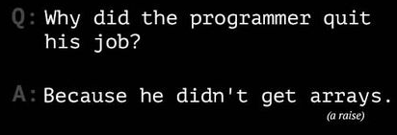
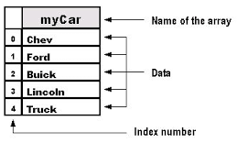
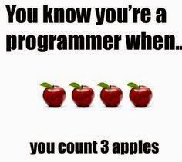
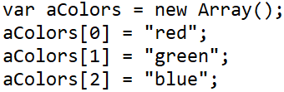

Arrays
Arrays are the most basic data structure.
An array has n data slots.
Each data slot has an index.
You can check the length of the array.
You can access any slot by the index.
You can insert, remove, or change data in any slot.
Don’t read a slot you haven’t added.

Slide 20
Timers

Slide 21
Timing Methods
Javascript uses timeout and interval to define timing within a program.
Timeout happens once.
Interval happens repeatedly.
In both cases you have to define an object which calls a function.
Await is a new capability which can use a timeout in a function.
Func1()
TOFunc()
Creates
Calls
Timeout
Func2()
IFunc()
Creates
Calls
Calls
Calls
Calls
Interval
Interval
Interval
Interval
https://stackoverflow.com/questions/951021/what-is-the-javascript-version-of-sleep
https://www.w3schools.com/js/tryit.asp?filename=tryjs_setinterval2

Slide 22
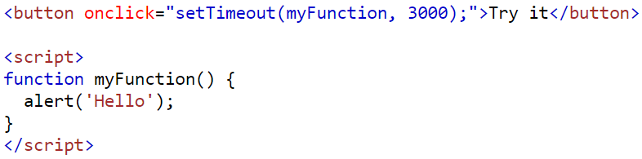
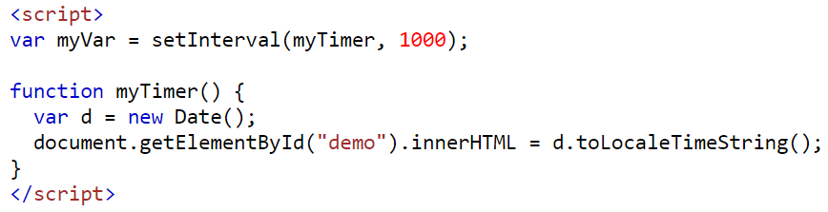
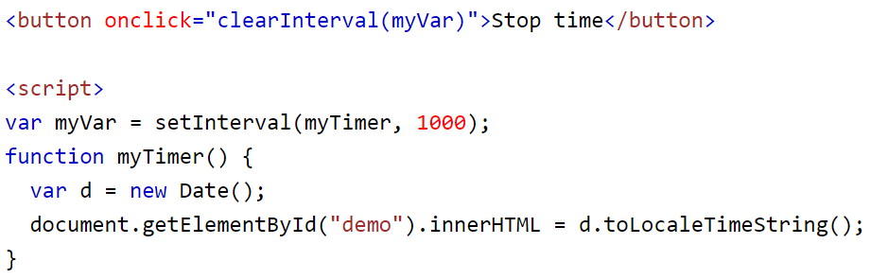
Timing Methods (2)
In a timeout, the object only works once.
In an interval, the object exists and continues to call.
Both objects can be saved and cleared.
https://stackoverflow.com/questions/951021/what-is-the-javascript-version-of-sleep
https://www.w3schools.com/js/tryit.asp?filename=tryjs_setinterval2

