Slide 1
CSC 200 Lecture 4
Objects

Slide 2
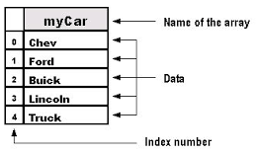
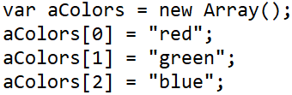

Arrays
Arrays are the most basic data structure.
An array has n data slots.
Each data slot has an index.
You can check the length of the array.
You can access any slot by the index.
You can insert, remove, or change data in any slot.
Don’t read a slot you haven’t added.

