Slide 1





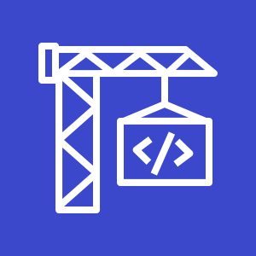



Deployment
AWS Cloud
Static
Web Content
3
Amazon S3 code deploy bucket
1
2
Template
Git push
Git webhook
4
GitHub
webapp repository
Git users
AWS CodePipeline
AWS CodeBuild
5
AWS CloudFormation
Change set
Stack

Slide 2



System elements
AWS Cloud
Groups
Arrows
Product icons
Show the connection between multiple products or resources
Describe a flow of information or connect different parts of a diagram
Represents an AWS product or service
Resource icons
General resource icons
Represents an AWS product resource
Apply to multiple products or categories

Slide 3





System elements
Group icon
AWS Cloud
Layered groups
Availability Zone 1
Availability Zone 2
VPC
Product icon
NAT Gateway
Amazon EC2 Auto Scaling
NAT Gateway
Auto Scaling group
Instance
Instance
Auto Scaling group
Resource icon
Instance
Instance

Slide 4









Groups
1/3
AWS Cloud
AWS Cloud
Region
Availability Zone
Security group
Auto Scaling group
VPC
Private subnet
Public subnet
Server contents
Corporate data center
Elastic Beanstalk container
EC2 instance contents
Spot Fleet
AWS Step Functions workflow
Generic group
Generic group

Slide 5
Arrows
2/3

Slide 6
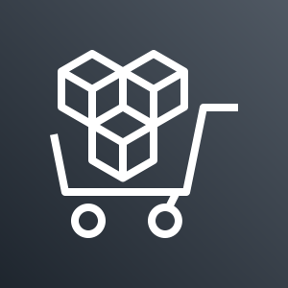
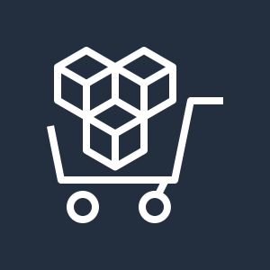

















General icons
3/3
AWS Marketplace
AWS Marketplace
Client
Disk
Forums
Generic database
Internet
Internet alt1
Internet alt2
Mobile client
Multimedia
Office building
SAML token
SSL padlock
Tape storage
Traditional server
User
Users
Toolkit
SDK

Slide 7











Compute
3/5
AWS Elastic Beanstalk
AWS Lambda
Amazon Elastic Container Service for Kubernetes
Amazon Lightsail
AWS Elastic Beanstalk
AWS Lambda
Amazon Elastic Container Service for Kubernetes
Amazon Lightsail
Deployment
Lambda function
Application

Slide 8
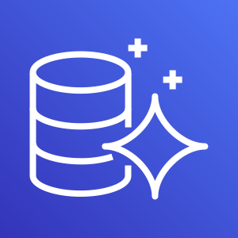
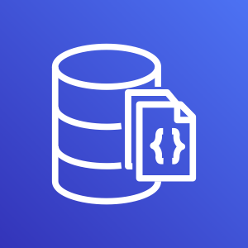

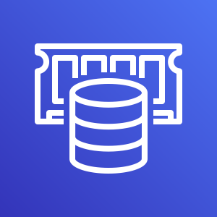













Database
1/3
Amazon Aurora
Amazon DocumentDB (with MongoDB compatibility)
Amazon DynamoDB
Amazon ElastiCache
Amazon Aurora
Amazon DocumentDB (with MongoDB compatibility)
Amazon DynamoDB
Amazon ElastiCache
Attribute
Items
Cache node
Item
Table
ElastiCache for Redis
ElastiCache for Memcached
Attributes
Global secondary index

Slide 9

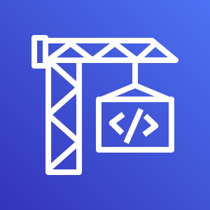
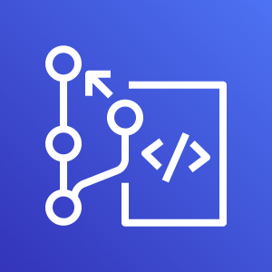




Developer Tools
1/3
AWS Cloud9
AWS CodeBuild
AWS CodeCommit
AWS CodeDeploy
AWS Cloud9
AWS CodeBuild
AWS CodeCommit
AWS CodeDeploy

Slide 10


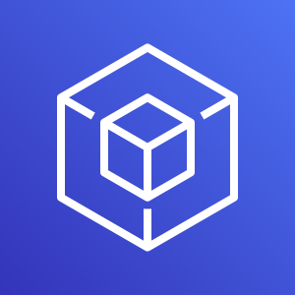




Developer Tools
2/3
AWS CodePipeline
AWS CodeStar
AWS Command Line Interface
AWS Tools and SDKs
AWS CodePipeline
AWS CodeStar
AWS Command Line Interface
AWS Tools and SDKs

Slide 11











Management & Governance
1/5
Amazon CloudWatch
AWS Auto Scaling
AWS CloudFormation
AWS CloudTrail
Amazon CloudWatch
AWS Auto Scaling
AWS CloudFormation
AWS CloudTrail
Alarm
Rule
Change set
Stack
Event
(event-based)
Event (time-based)
Template

Slide 12








Management & Governance
2/5
AWS Command Line Interface
AWS Config
AWS License Manager
AWS Managed Services
AWS Command Line Interface
AWS Config
AWS License Manager
AWS Managed Services

Slide 13
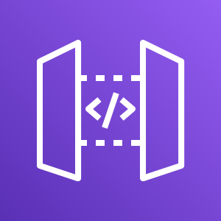











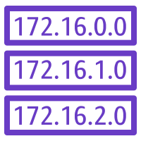

Networking & Content Delivery
1/4
Amazon API Gateway
Amazon CloudFront
Amazon Route 53
AWS PrivateLink
Amazon API Gateway
Amazon CloudFront
Amazon Route 53
AWS PrivateLink
Endpoint
Download distribution
Hosted zone
Edge location
Route table
Streaming distribution

Slide 14

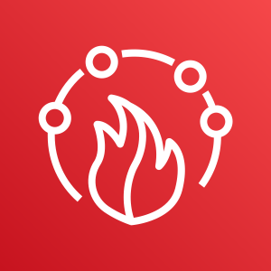














Security, Identity and Compliance
3/5
AWS Directory Service
AWS Firewall Manager
AWS Identity and Access Management (IAM)
AWS Directory Service
AWS Firewall Manager
AWS Identity and Access Management (IAM)
Add-on
MFA token
Encrypted data
Long-term security credential
AWS STS
Permissions
Data encryption key
Temporary security credential
AWS STS (alternate)
Role

Slide 15













Storage
2/3
Amazon FSx for Windows File Server
Amazon Simple Storage Service (S3)
Amazon S3 Glacier
AWS Snowball
Amazon FSx for Windows File Server
Amazon Simple Storage Service (S3)
Amazon S3 Glacier
AWS Snowball
Object
Bucket
Vault
Archive
Snowball import-export
Bucket with objects

Slide 16
Example:
Git to S3 Webhooks
AWS Cloud
Amazon S3 SSH Key bucket
Git push
Third-party Git repository
Git webhook
Git users
AWS KMS key
AWS Lambda
AWS Lambda
Amazon S3 output bucket

Slide 17

Example:
Chef Automate Architecture on AWS
AWS Cloud
Availability Zone
VPC
Internet gateway
Public subnet
Knife is used to upload cookbooks
Knife is used to bootstrap and communicate with nodes
Chef-client processes run-list
1
Chef Automate
3
2
Chef workstation (local Chef repo)
Chef node
10.0.0.0/19
10.0.0.0/16

