Slide 1
AWS Serverless Web App

Slide 2





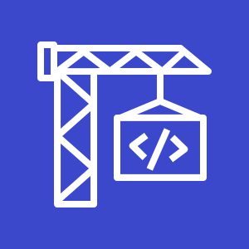




Deployment
AWS Cloud
Static
Web Content
3
Amazon S3 code deploy bucket
1
2
Template
Git push
Git webhook
4
GitHub
webapp repository
Git users
AWS CodePipeline
AWS CodeBuild
5
AWS CloudFormation
Change set
Stack
CloudFormation Service Role

Slide 3










Runtime
Backend
AWS Cloud
Static Content
D,A,CH
us-east-1
eu-central-1
2
3
Amazon CloudFront
Static
Web Content
Certificate
1
Amazon Route 53
Hosted zone
eu-central-1
Web Clients
Dynamic Content
4
5
6
Amazon API Gateway
AWS Lambda
Amazon DynamoDB

Slide 4

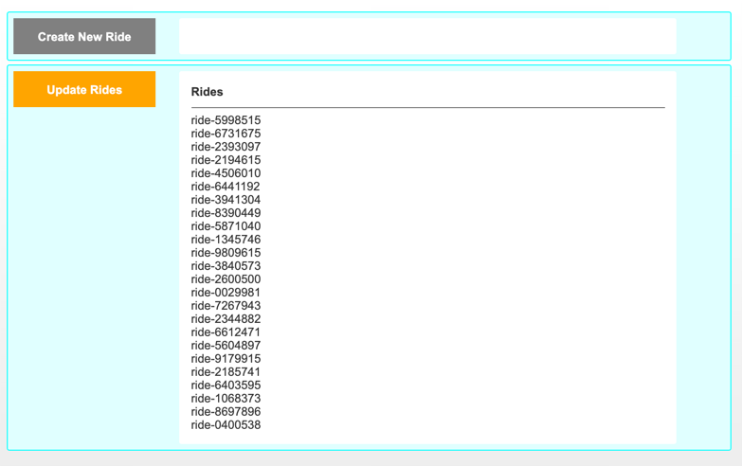

Runtime
Frontend
1
AWS Cloud
GET
Static HTML
POST
Create New Ride
GET
Fetch Rides
every 60secs
3
2
Downloaded Rides
2
4
GET Response
LocalStorage
Web Client
Displayed Rides
5
Delta Calculation
SessionStorage

Slide 5
Todos
API Gateway via CloudFront
GET with 15s TTL
connect via subdomain api.kmeson.com
Separate web content and CloudFormation template pipelines
Separate git repos
different update frequencies
AWS CodeBuild generates costs
Only template needs CodeBuild
Create pipelines via separate CloudFormation templates
HTTPS for everything
Include www.kmeson.com as alias for CloudFront

Slide 6
AWS Icons

Slide 7





System elements
Group icon
AWS Cloud
Layered groups
Availability Zone 1
Availability Zone 2
VPC
Product icon
NAT Gateway
Amazon EC2 Auto Scaling
NAT Gateway
Auto Scaling group
Instance
Instance
Auto Scaling group
Resource icon
Instance
Instance

Slide 8









Groups
1/3
AWS Cloud
AWS Cloud
Region
Availability Zone
Security group
Auto Scaling group
VPC
Private subnet
Public subnet
Server contents
Corporate data center
Elastic Beanstalk container
EC2 instance contents
Spot Fleet
AWS Step Functions workflow
Generic group
Generic group

Slide 9
Arrows
2/3

Slide 10
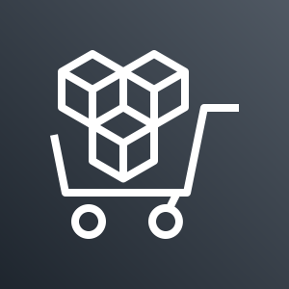
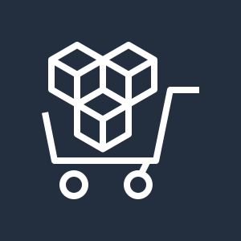













General icons
3/3
AWS Marketplace
AWS Marketplace
Client
Disk
Forums
Generic database
Internet
Internet alt1
Internet alt2
Mobile client
Multimedia
Office building
SAML token
SSL padlock
Tape storage
Traditional server
User
Users
Toolkit
SDK

Slide 11










Compute
3/5
AWS Elastic Beanstalk
AWS Lambda
Amazon Elastic Container Service for Kubernetes
Amazon Lightsail
AWS Elastic Beanstalk
AWS Lambda
Amazon Elastic Container Service for Kubernetes
Amazon Lightsail
Deployment
Lambda function
Application

Slide 12

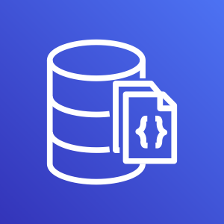

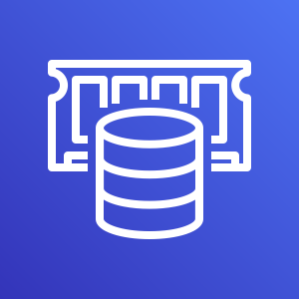

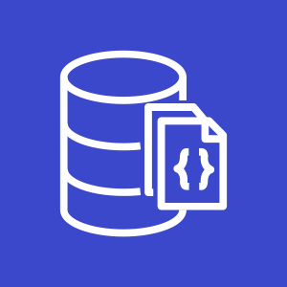
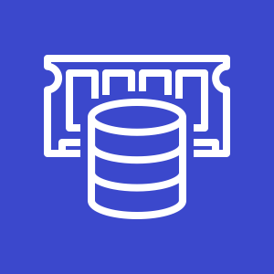









Database
1/3
Amazon Aurora
Amazon DocumentDB (with MongoDB compatibility)
Amazon DynamoDB
Amazon ElastiCache
Amazon Aurora
Amazon DocumentDB (with MongoDB compatibility)
Amazon DynamoDB
Amazon ElastiCache
Attribute
Items
Cache node
Item
Table
ElastiCache for Redis
ElastiCache for Memcached
Attributes
Global secondary index

Slide 13

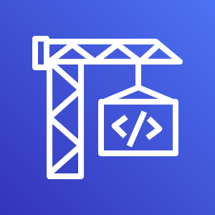





Developer Tools
1/3
AWS Cloud9
AWS CodeBuild
AWS CodeCommit
AWS CodeDeploy
AWS Cloud9
AWS CodeBuild
AWS CodeCommit
AWS CodeDeploy

Slide 14


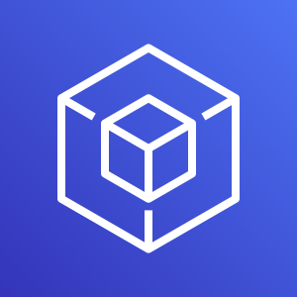



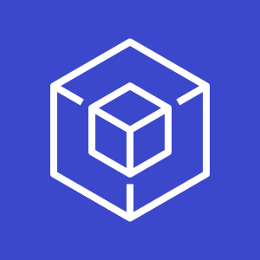
Developer Tools
2/3
AWS CodePipeline
AWS CodeStar
AWS Command Line Interface
AWS Tools and SDKs
AWS CodePipeline
AWS CodeStar
AWS Command Line Interface
AWS Tools and SDKs

Slide 15











Management & Governance
1/5
Amazon CloudWatch
AWS Auto Scaling
AWS CloudFormation
AWS CloudTrail
Amazon CloudWatch
AWS Auto Scaling
AWS CloudFormation
AWS CloudTrail
Alarm
Rule
Change set
Stack
Event
(event-based)
Event (time-based)
Template

Slide 16








Management & Governance
2/5
AWS Command Line Interface
AWS Config
AWS License Manager
AWS Managed Services
AWS Command Line Interface
AWS Config
AWS License Manager
AWS Managed Services

Slide 17








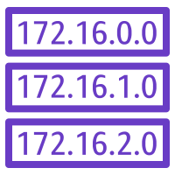

Networking & Content Delivery
1/4
Amazon API Gateway
Amazon CloudFront
Amazon Route 53
AWS PrivateLink
Amazon API Gateway
Amazon CloudFront
Amazon Route 53
AWS PrivateLink
Endpoint
Download distribution
Hosted zone
Edge location
Route table
Streaming distribution

Slide 18















Security, Identity and Compliance
3/5
AWS Directory Service
AWS Firewall Manager
AWS Identity and Access Management (IAM)
AWS Directory Service
AWS Firewall Manager
AWS Identity and Access Management (IAM)
Add-on
MFA token
Encrypted data
Long-term security credential
AWS STS
Permissions
Data encryption key
Temporary security credential
AWS STS (alternate)
Role

Slide 19













Storage
2/3
Amazon FSx for Windows File Server
Amazon Simple Storage Service (S3)
Amazon S3 Glacier
AWS Snowball
Amazon FSx for Windows File Server
Amazon Simple Storage Service (S3)
Amazon S3 Glacier
AWS Snowball
Object
Bucket
Vault
Archive
Snowball import-export
Bucket with objects

Slide 20
Example:
Git to S3 Webhooks
AWS Cloud
Amazon S3 SSH Key bucket
Git push
Third-party Git repository
Git webhook
Git users
AWS KMS key
AWS Lambda
AWS Lambda
Amazon S3 output bucket

Slide 21

Example:
Chef Automate Architecture on AWS
AWS Cloud
Availability Zone
VPC
Internet gateway
Public subnet
Knife is used to upload cookbooks
Knife is used to bootstrap and communicate with nodes
Chef-client processes run-list
1
Chef Automate
3
2
Chef workstation (local Chef repo)
Chef node
10.0.0.0/19
10.0.0.0/16

