Slide 1
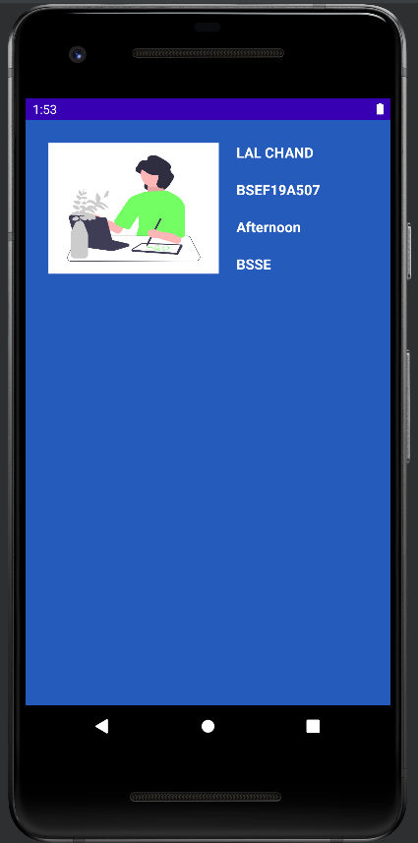
Student Info App
Customized List View

