Slide 1
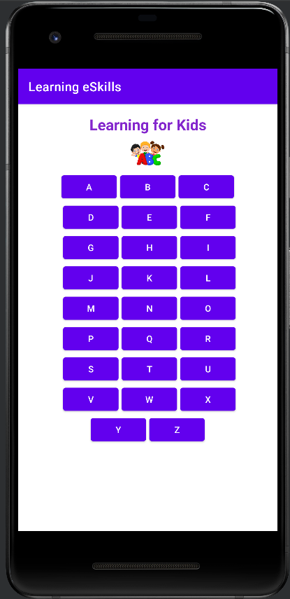
Learning eSkills App
Main Screen

