Slide 1
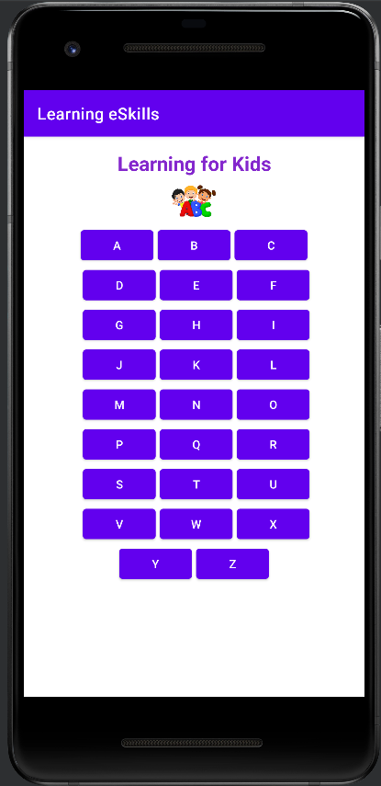
Learning eSkills App
Main Screen

Slide 2
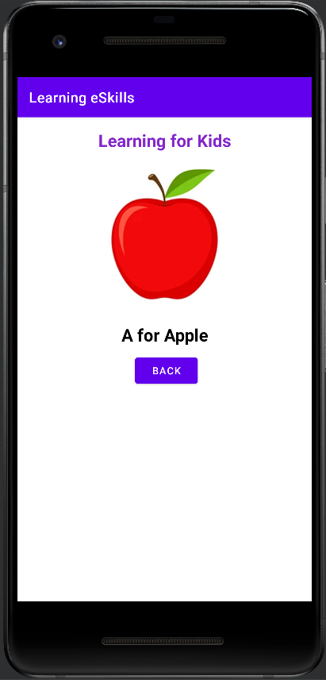
Learning eSkills App
Second Screen

