Slide 1

Predicting Consumer Appetites
Ben Seifert
General Assembly. December 2017.
Image taken from: www.instacart.com
Notes:
Good morning, My name is ben seifert, and for my capstone I chose to predict consumer appetites.
What is consumer appetite?
Much like consumer behavior, where we aim to predict where when and what you will place in your shopping cart. Consumer Appetite aims to predict where when and what you will purchase the items on your grocery list.
This idea began in college when a friend tipped me off to a company named instacart. My roommate and I, struggling with a steady diet of pizza and leftover pizza, sought a way that would make our grocery shopping experience easier.

Slide 2
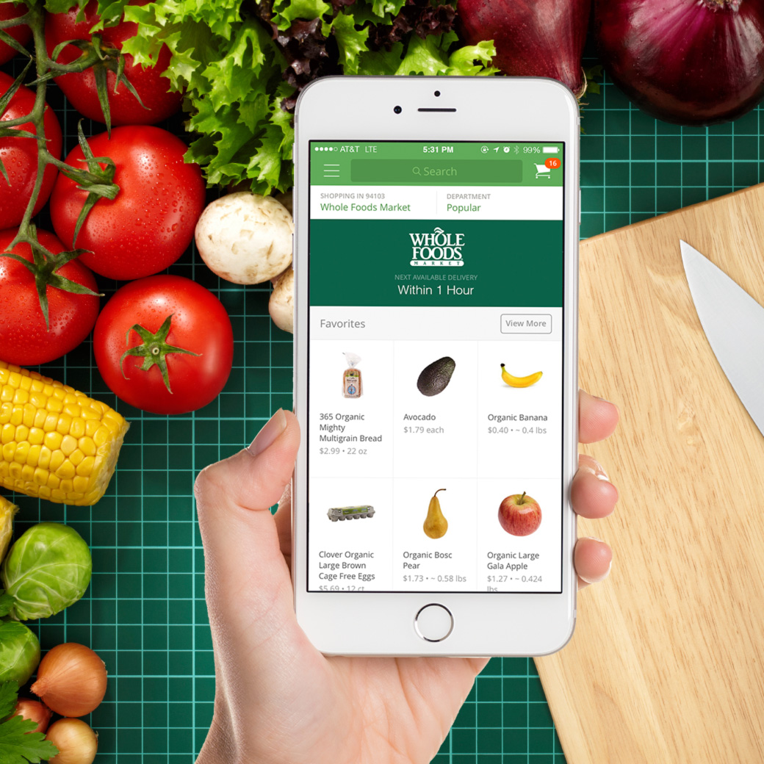
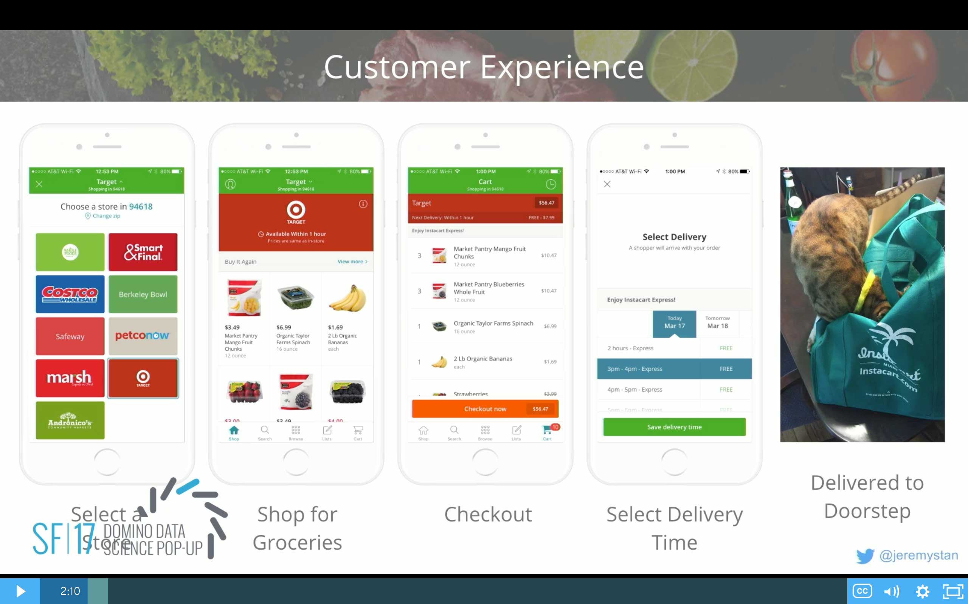
Images taken from: https://blog.dominodatalab.com/data-science-instacart/
https://angel.co/instacart/jobs
Notes:
This company instacart, began in 2012 and has been collecting data on their users ever since. The way it works is simple.
Log into your account on their website or app, select a store near your location, then select what items you want to purchase from that store. Finally, check out and within an hour, your grocery shopping list is delivered to your front door
Instacart made this data available about a year ago in an online competition to predict the same very thing that I wanted to.
I extracted their data, cleaned it up and merged the data into one big dataframe

Slide 3
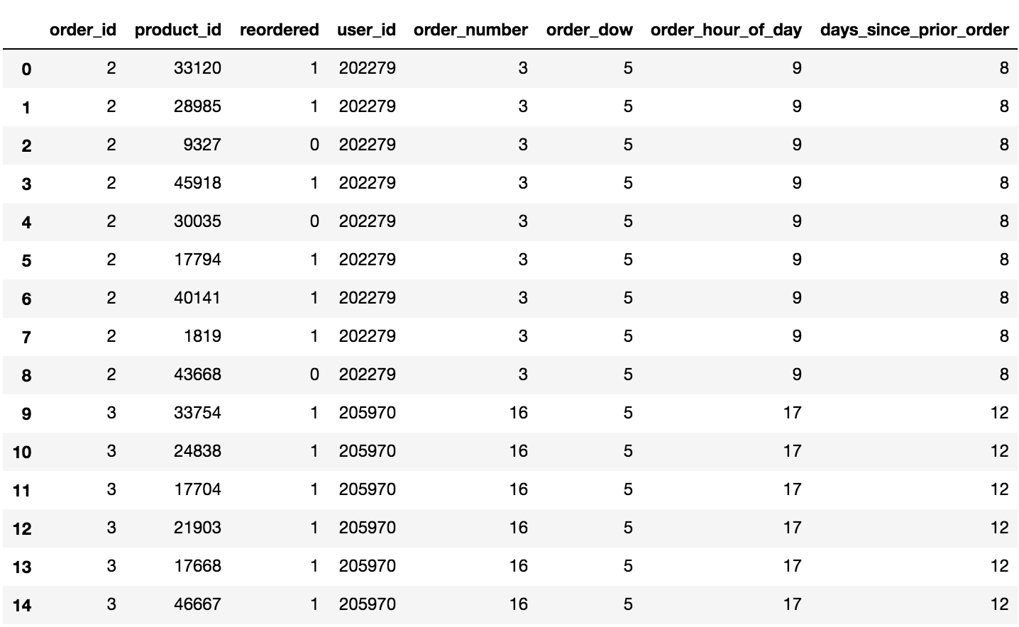
Notes:
Order_id = This is not the second order of this user. This is the second recorded order in this dataset
Product_id = Pertains to what the product is
Reordered = Did they reorder this item from their previous cart?
User_id = the id of the user. Similar to an account profile identification
Order_number = This is the user’s third time ordering from instacart
order_dow = 5 is Friday
order_hour_of_day = 9 is 8am, 17 = 4pm

Slide 4
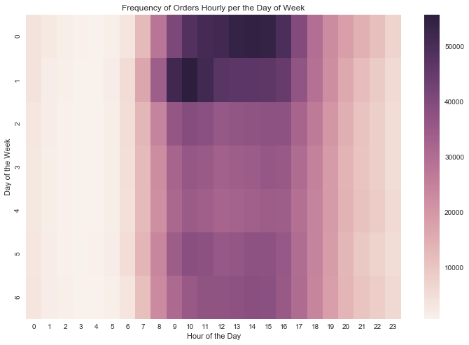
Most Orders on Sunday between 11am-8pm & on Monday between 9am-2pm.
Notes:
Frequency of orders given the hour of the day and the day of the week

Slide 5
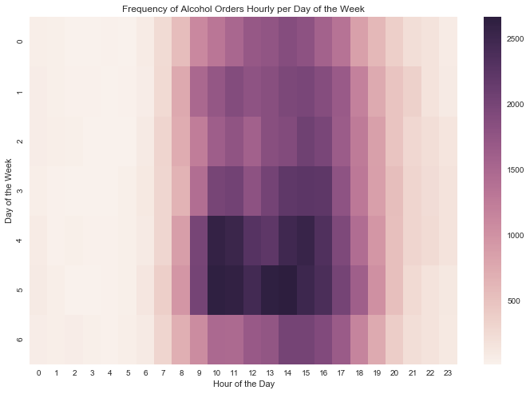
Most orders on Thursday and Friday sporadically through out the day.
Notes:
Frequency of alcohol orders given the hour of the day and the day of the week

Slide 6
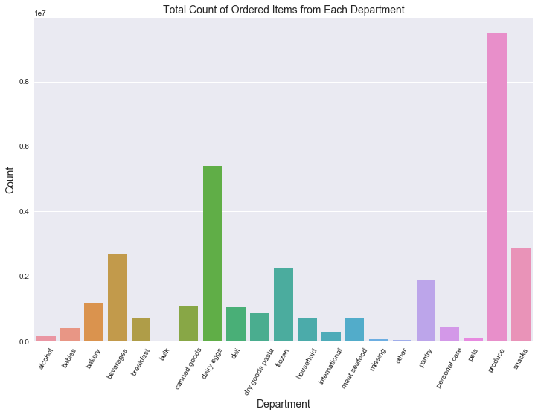
Notes:
Barchart of the departments that each product is ordered from.

Slide 7
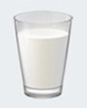
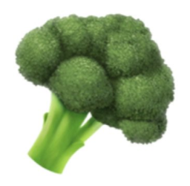

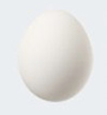


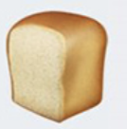
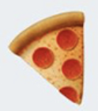
User_id: Starving_Student
Item_id: 328 (Milk), 321 (Eggs), 321 (Eggs), 430 (Broccoli), 498 (Strawberry), 189 (Bread), 832 (Pizza), 832 (Pizza), 215 (Beer)
Notes:
I'd like to explain to you, an example of how my model worked.
We have the user Id, and the items that went into that user's shopping cart.
My model went to predict each what of those items would be in the next shopping cart for starving_student

Slide 8
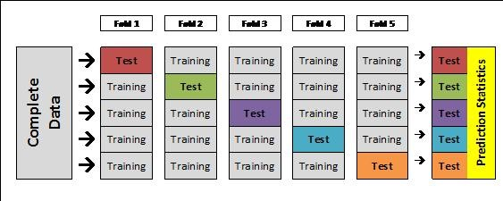
Notes:
So when we run the test, the computer will look at what the user_id it is trying to predict for, it will then using the knowledge it gained from the training set on that user, attempt to predict what will go into that user's shopping cart in the test set.

Slide 9
In this K-Fold Cross-Validation we have: - 9 items from a shopping cart - 3 folds (k=3) - 3 Accuracy Scores
FOLD
1
=
30%
FOLD
2
=
60%
FOLD
3
=
30%
Estimated Accuracy: 40%

Slide 10
32.56%
Accuracy Score:
Notes:
Great way for stores to learn what to order

Slide 11
Moving Forward..
Though I did not achieve my goal of making shopping easier, I know that given more features (region of user, time of year) I could greatly increase the accuracy.
Future Applications:
Storm Readiness
Store Product Repurchasing Indication
Notes:
You also have to imagine that when a person grocery shops, generally they only are placing about 50% of the same items in if not less. Most people don’t eat the same exact thing all the time. There is some variation.

