Slide 1
US Census and Geoapify Api data extraction
They Who Shall Not Be Named

Slide 2
Project summary
AGENDA
Introduction to the APIs
Python API Data Extract
Summaries
We have hypothesized the potential disparity and overall availability/ease of access between healthy consumer items vs potentially unhealthy consumer items in areas of high income as opposed to low income.
The use of free publicly available datasets provided by the US Census and Geoapify will be used to infer and measure these disparities if they exist.

Slide 3
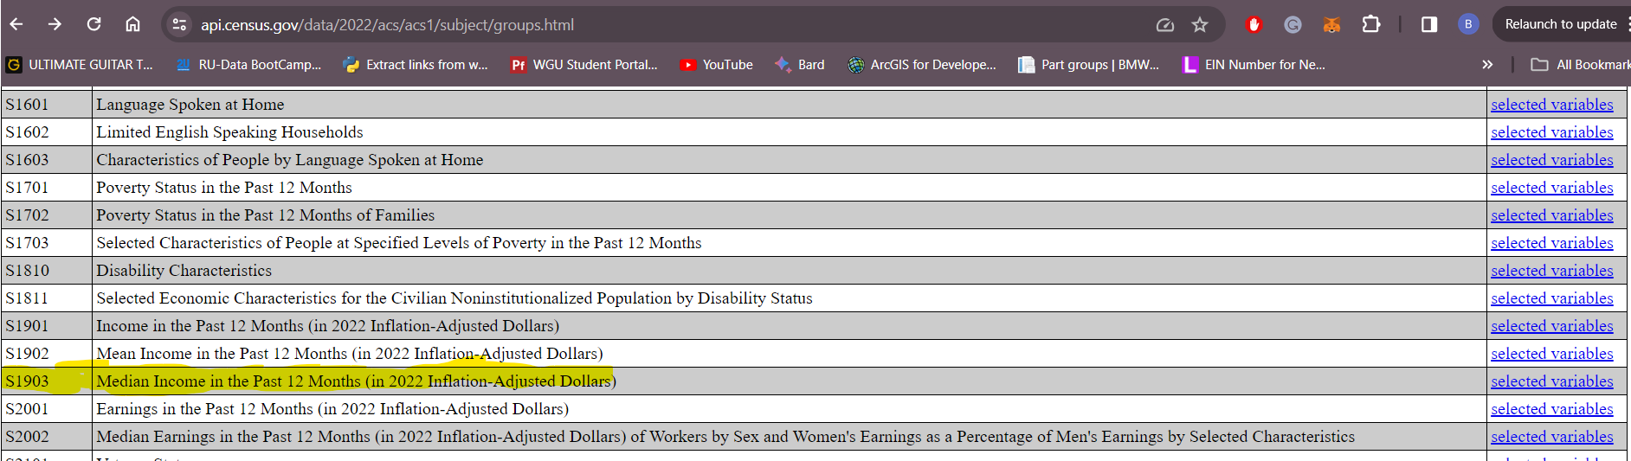
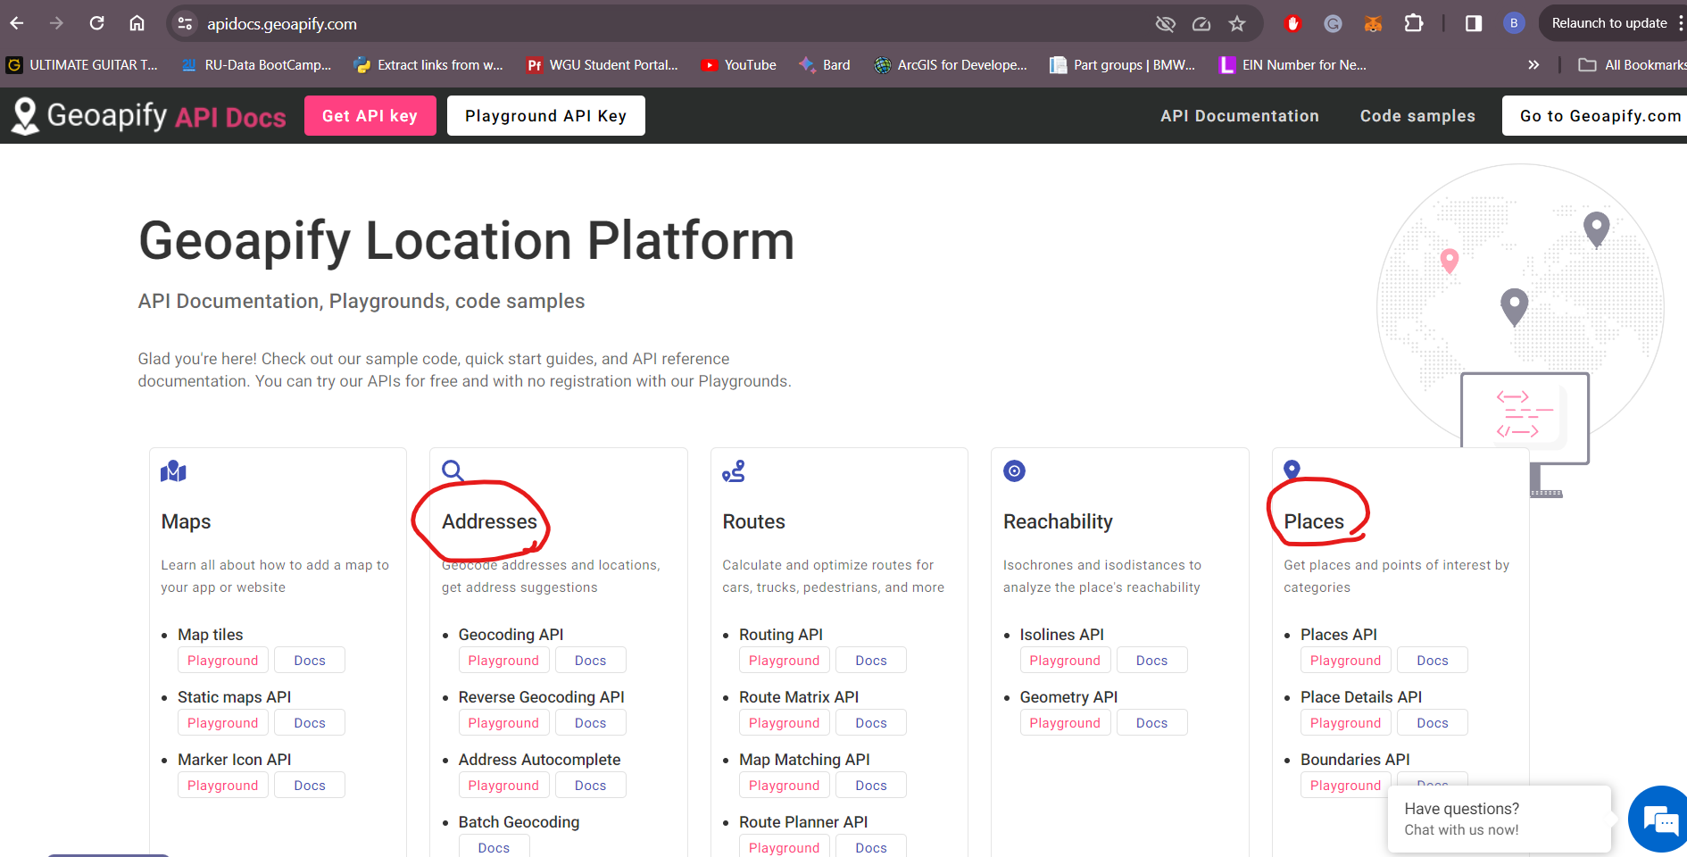
INTRODUCTION to the API
The US Census data is publicly available and can be extracted from their web page. There are thousands of endpoints (tables) of varying topics available from human-centric to economy-based data for analysis.
https://api.census.gov/data/2022/acs/acs1/subject/groups.html
The US Census data is publicly available and can be extracted from their web page. Thousands of endpoints (tables) of various topics are available ranging from human-centric to industry-specific and income based data for analysis.
https://api.census.gov/data/2022/acs/acs1/subject/groups.html

Slide 4
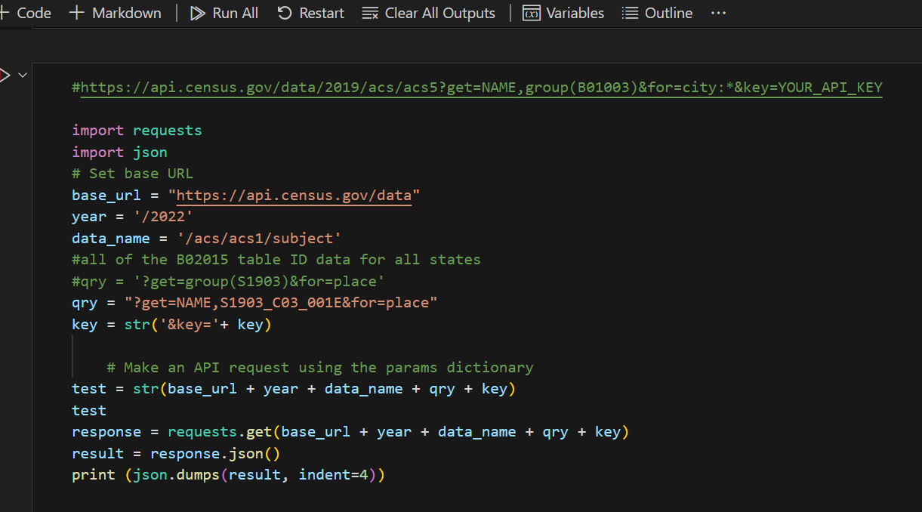
Python and the API
Census DF creation

Slide 5
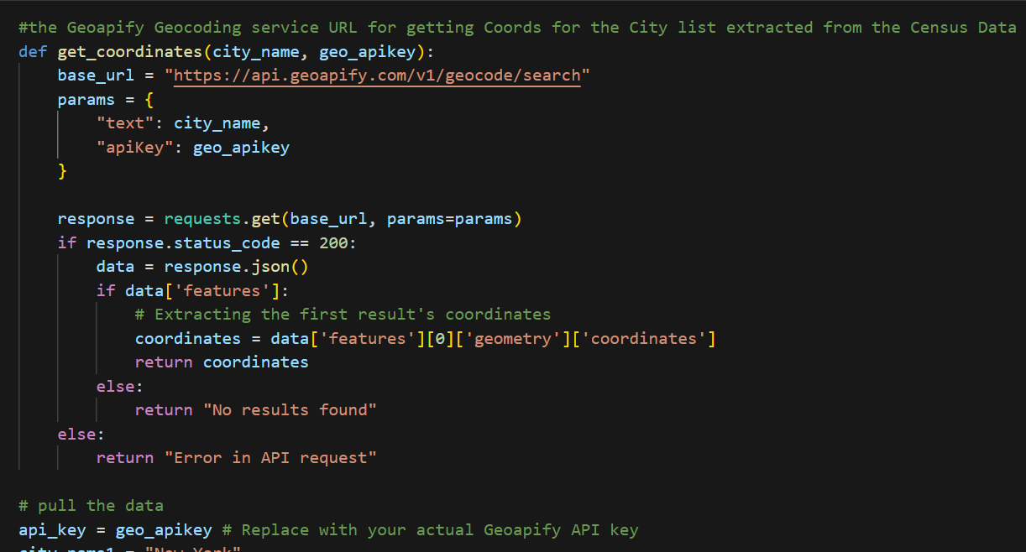
Python and the API
Function to append Coords to Census DF

Slide 6
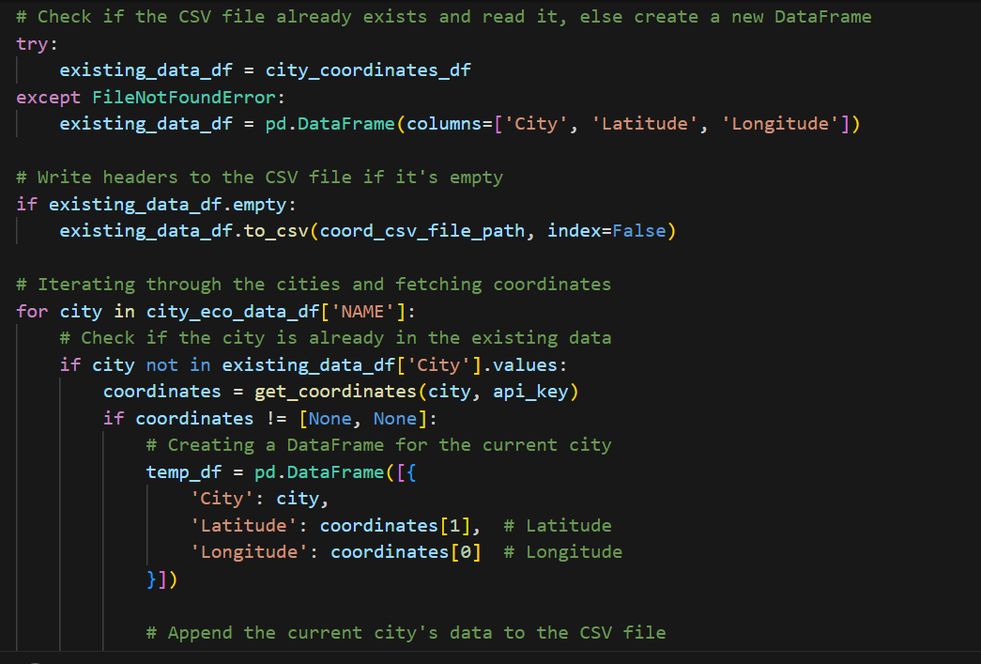
Python and the API
Append Coords to Census DF

Slide 7
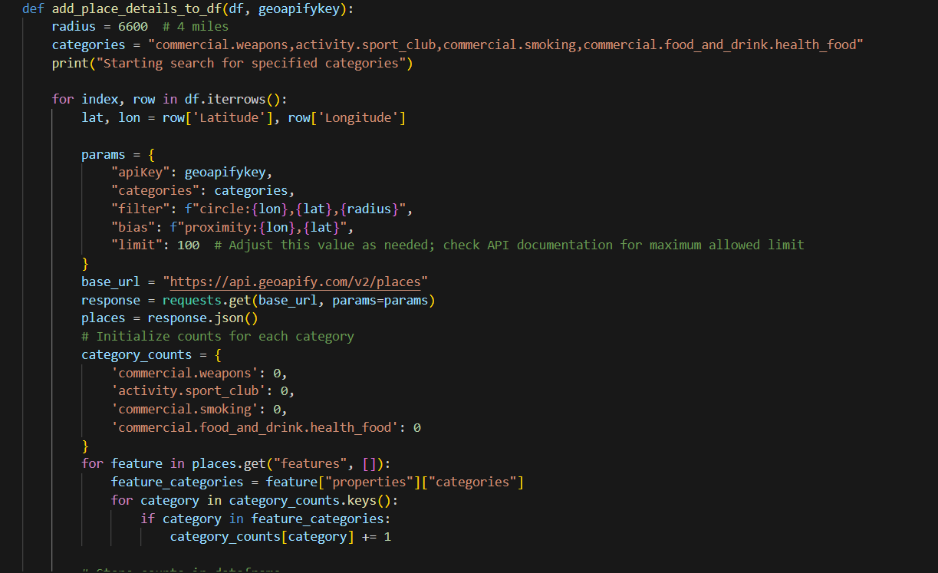
Python and the API
Append Geoapify “places” to Census DF

Slide 8
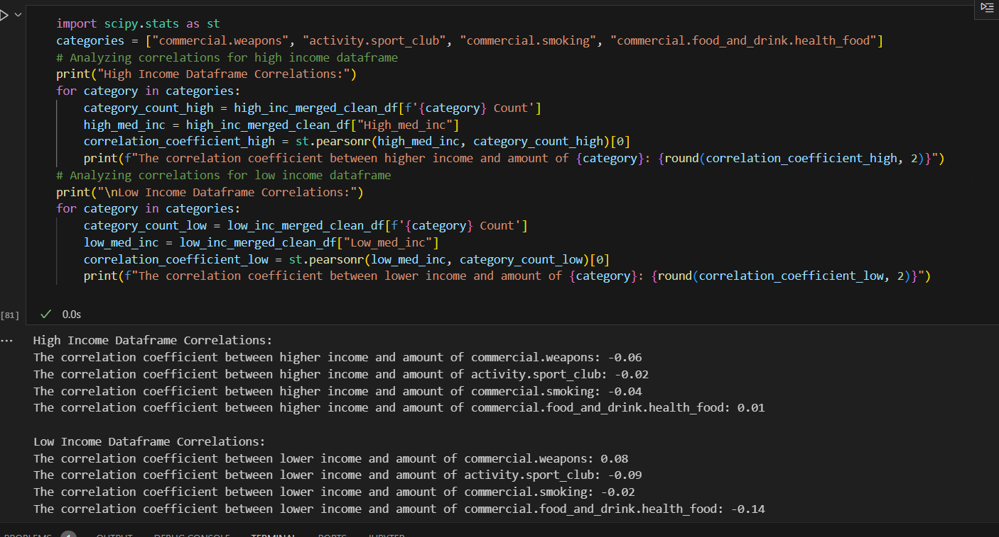
Analysis / Correlation

