Slide 1
CITY INSIGHTS:
EXPLORING CENSUS AND GEOAPIFY API DATA EXTRACTION
Group 1: Li Chen, Alan Lawrence,
Christopher Marinello, Bryan Serino
Notes:
The goal of this project was to investigate potential trends between cities categorized as having high median income versus low median income. This comparison was conducted by analyzing counts of various establishments, including health food stores, gun stores, alcohol stores, and parks. To gather city data, we utilized the Census API to randomly select a set of US cities along with their median incomes, which were then divided into two datasets based on whether the median income was higher or lower than the national average.

Slide 2
PROJECT SUMMARY
AGENDA
Introduction to the APIs
Python API Data Extract
Summaries
We have hypothesized the potential disparity and overall availability/ease of access between healthy consumer items vs potentially unhealthy consumer items in areas of high income as opposed to low income.
The use of free publicly available datasets provided by the US Census and Geoapify will be used to infer and measure these disparities if they exist.

Slide 3
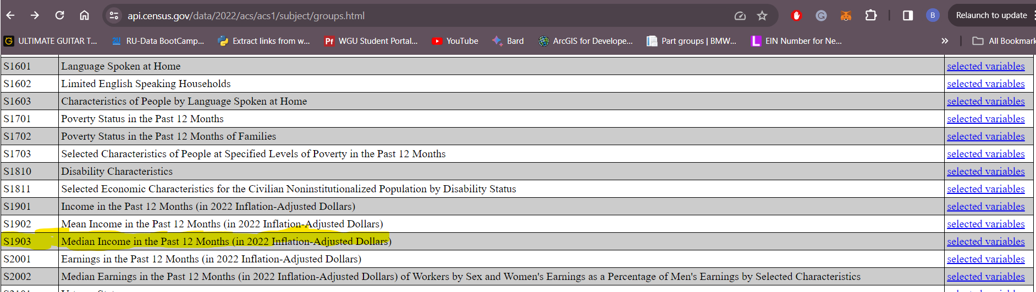
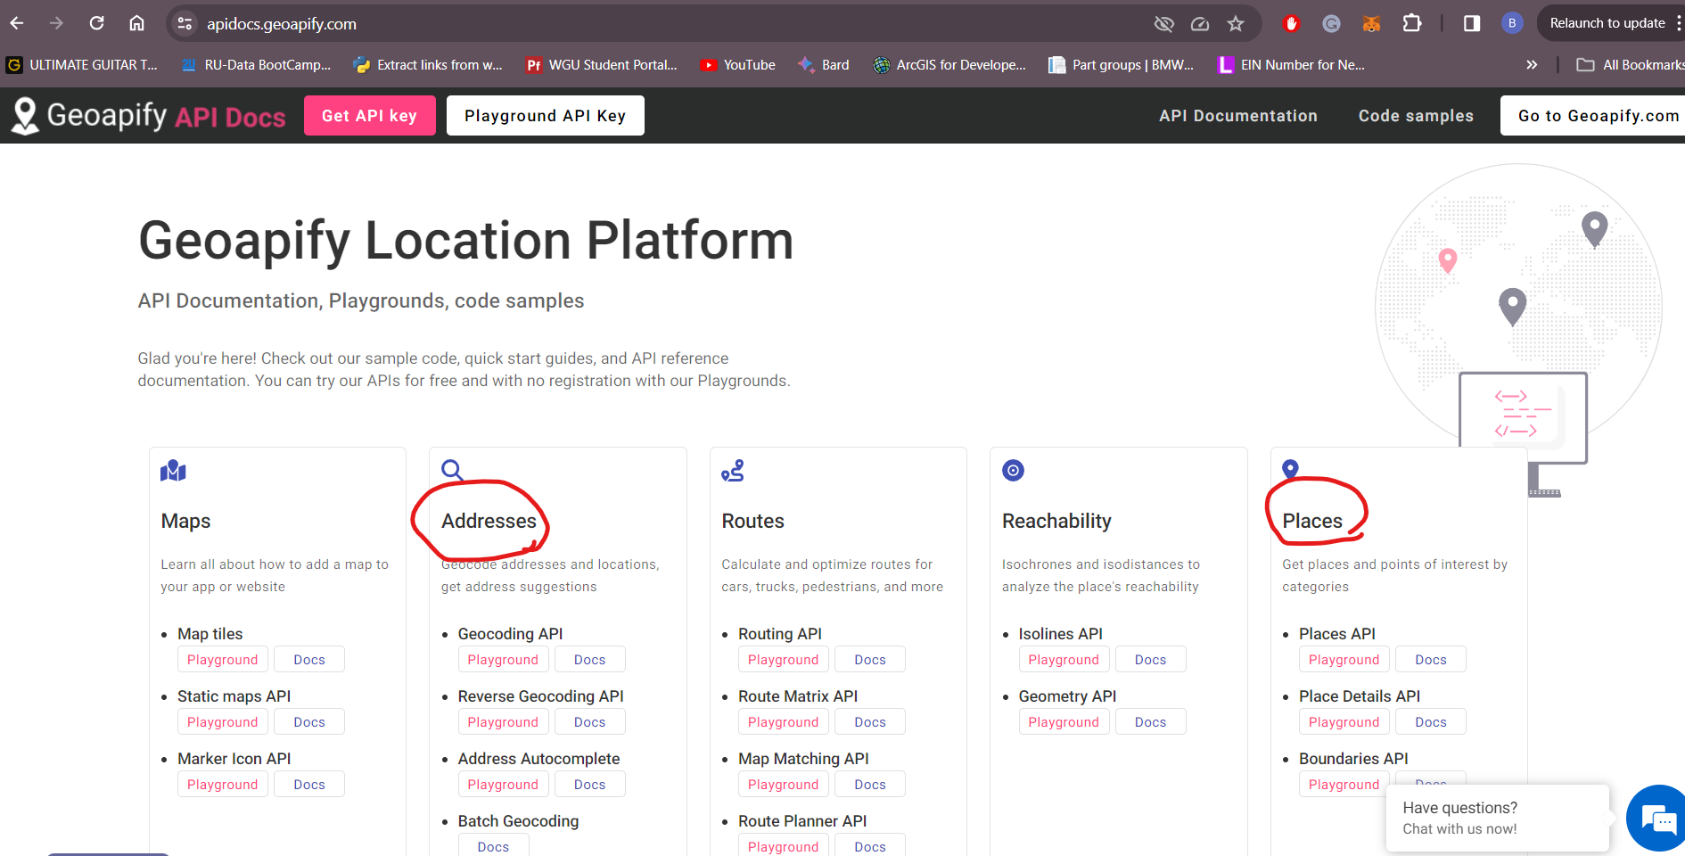
INTRODUCTION TO THE API
The US Census data is publicly available and can be extracted from their web page. There are thousands of endpoints (tables) of varying topics available from human-centric to economy-based data for analysis.
https://api.census.gov/data/2022/acs/acs1/subject/groups.html
The US Census data is publicly available and can be extracted from their web page. Thousands of endpoints (tables) of various topics are available ranging from human-centric to industry-specific and income based data for analysis.
https://api.census.gov/data/2022/acs/acs1/subject/groups.html

Slide 4
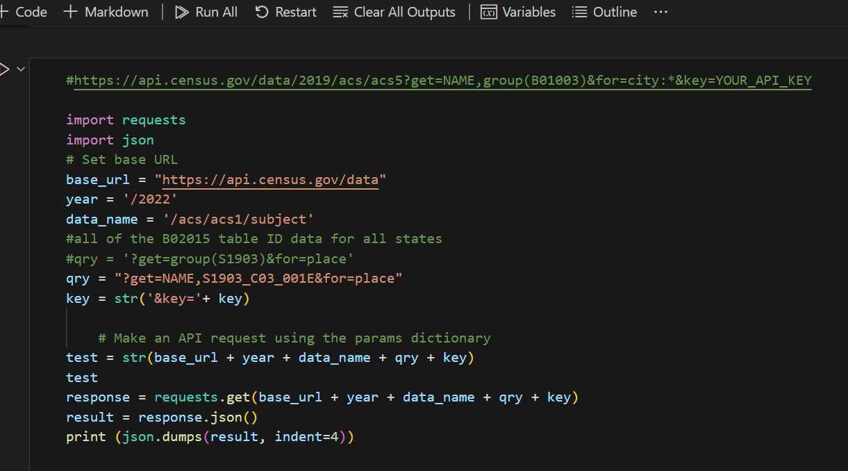
PYTHON AND THE API
Census DF creation

Slide 5
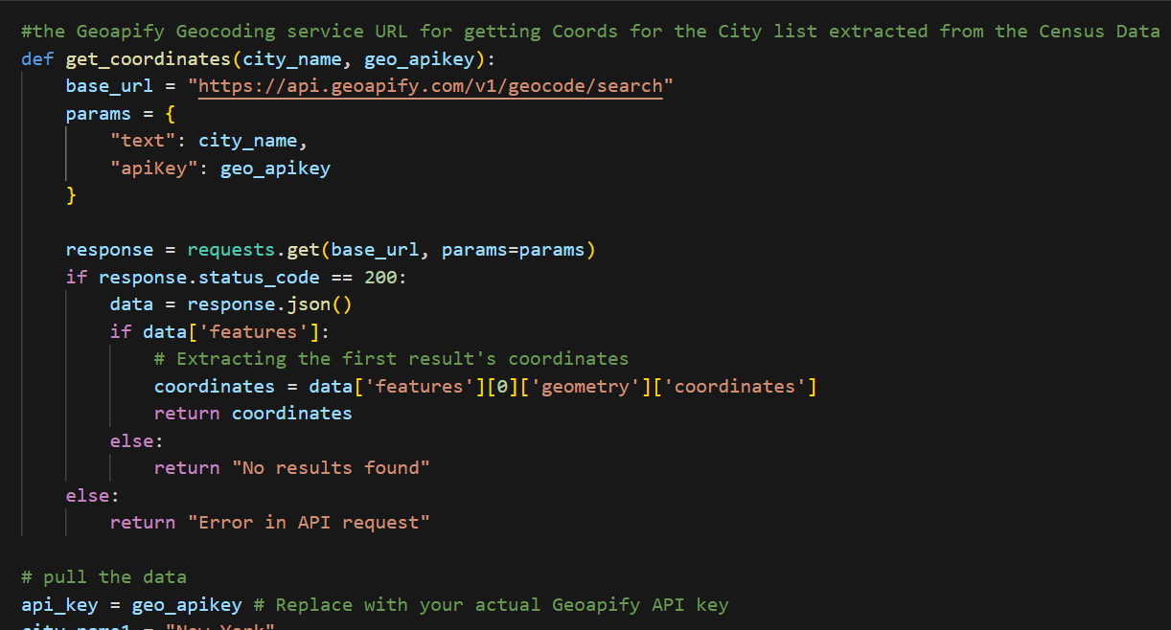
PYTHON AND THE API
Function to append Coords to Census DF

Slide 6
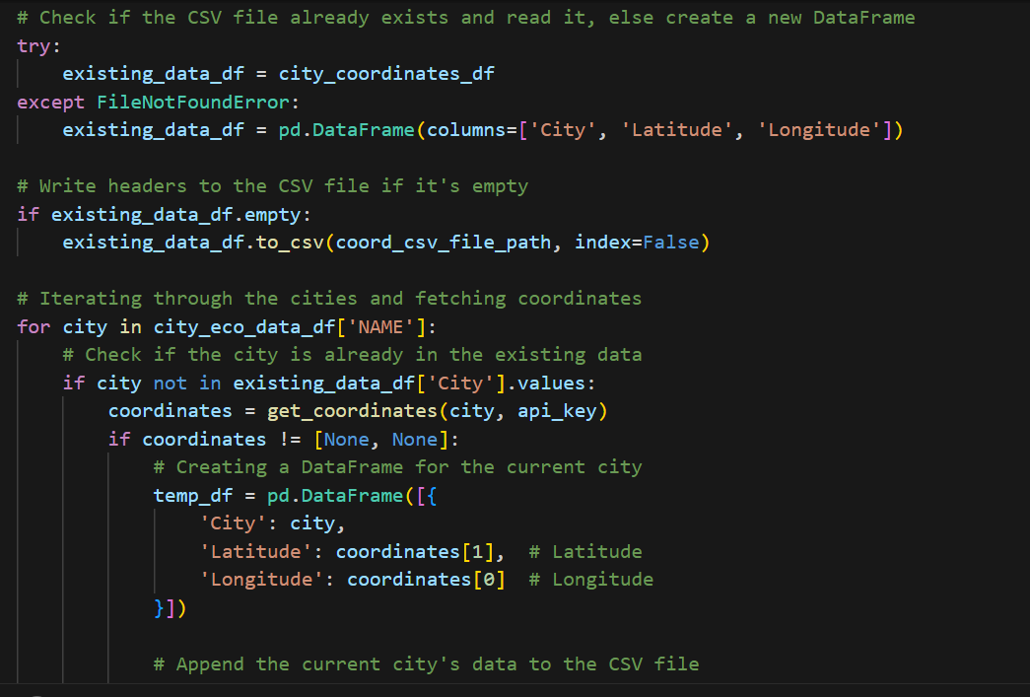
PYTHON AND THE API
Append Coords to Census DF

Slide 7
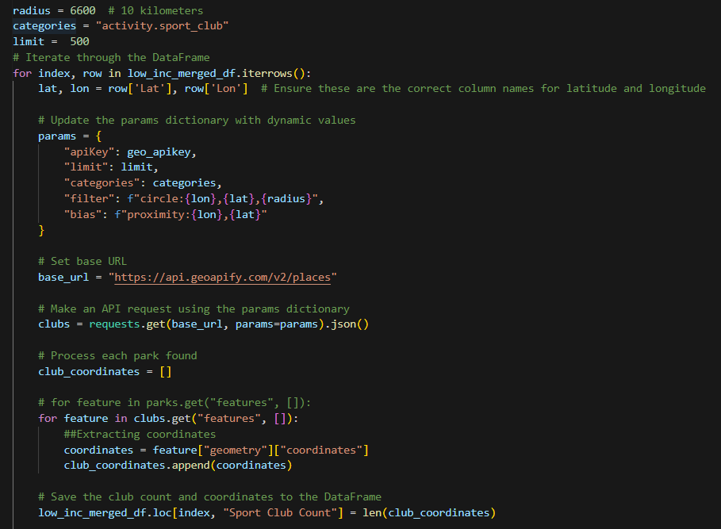
Looped through high/low cities csv to dynamically make api calls to GeoApify
Tallied count of Sports Bars within 4 miles of given city and input that number into DF
Originally chose Parks as category, however reached the API call limit and had to pivot to a different category

Slide 8
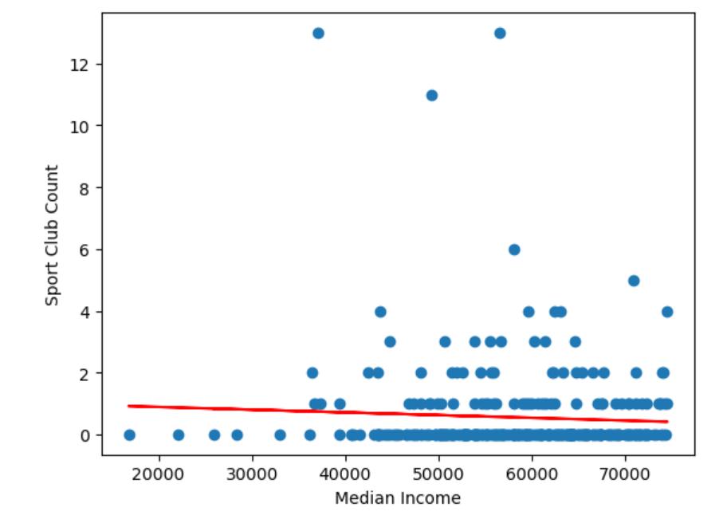
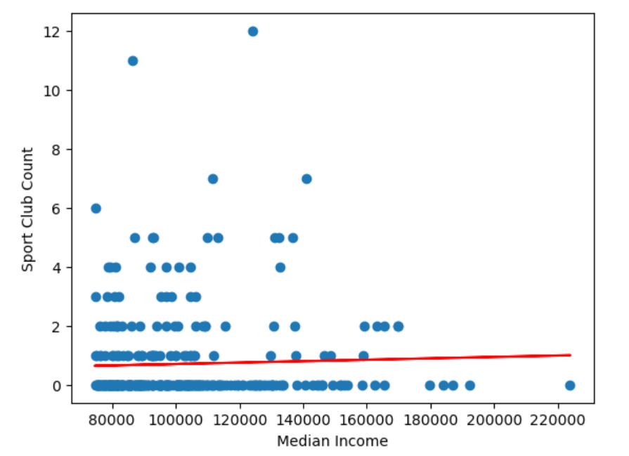
Low Income
High Income
T-statistic: -1.35299
P-value: 0.176532
Fail to reject the null hypothesis:
There is no significant difference between the groups.

Slide 9
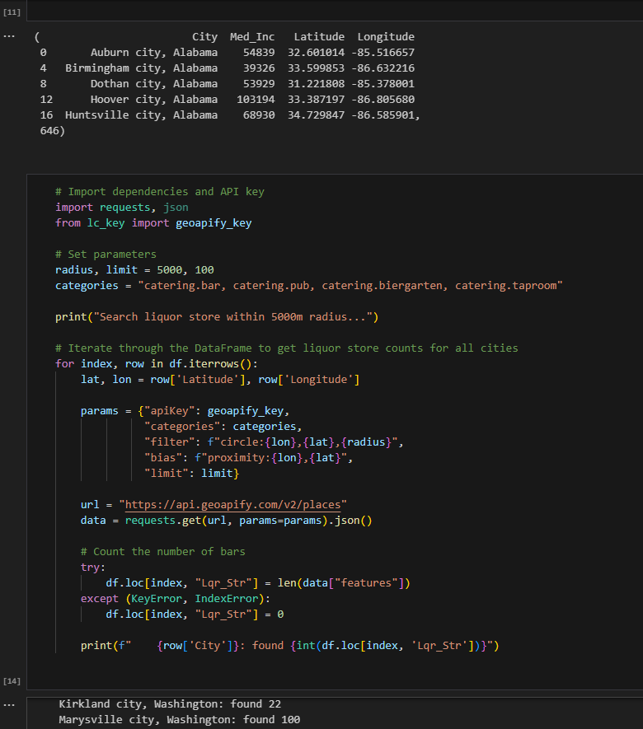
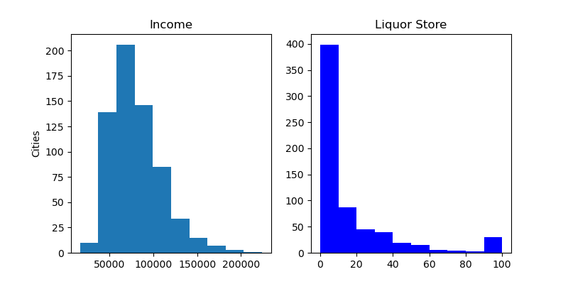
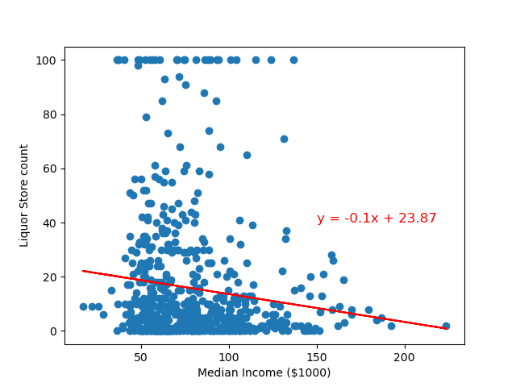
Hypothesis: Income level correlates with liquor store count
Conclusion : Correlation is negative and very weak. (r=-0.12200652970125113)

Slide 10
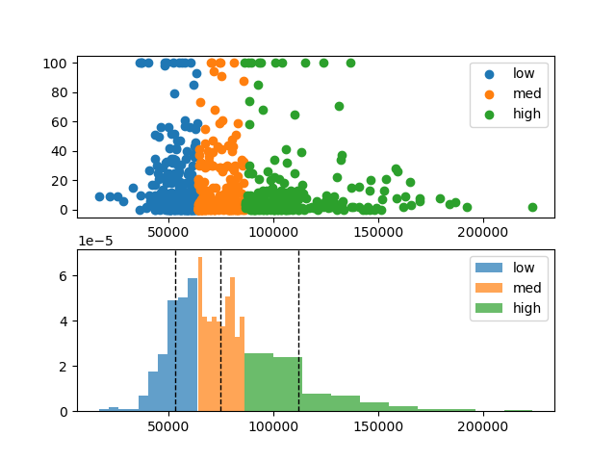
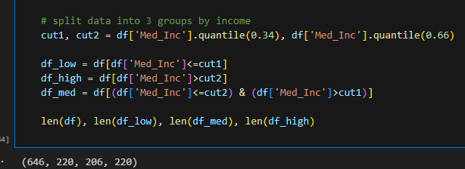
Hypothesis: Liquor store counts are significantly different between high and low income cities
Average Liquor Store count:
Low 19.01
Med 15.14
High 12.7
ANOVA:
F_onewayResult(statistic=3.8614366023805475, pvalue=0.021527343366223577)
Independent t test:
low vs high: TtestResult(statistic=2.6822364332230983, pvalue=0.007593452002092309, df=432.208063973875)
low vs med: TtestResult(statistic=1.6429786569550338, pvalue=0.10113338047799914, df=421.3291245835345)
med vs high: TtestResult(statistic=1.1009380850278856, pvalue=0.2715490340458595, df=423.4436307893415)
Conclusions : Liquor store counts are significantly different among the 3 groups.
But if just compare 2 groups, only low and high groups are statistically significant different

Slide 11
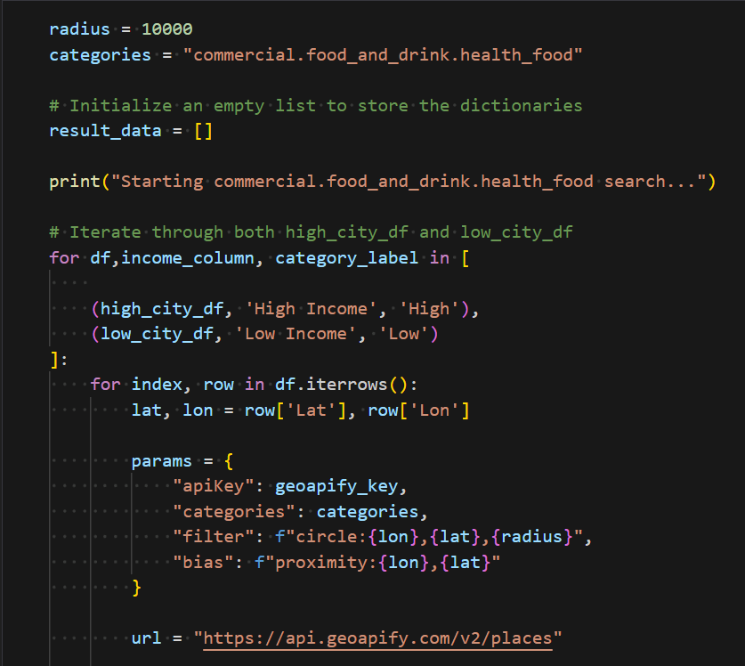
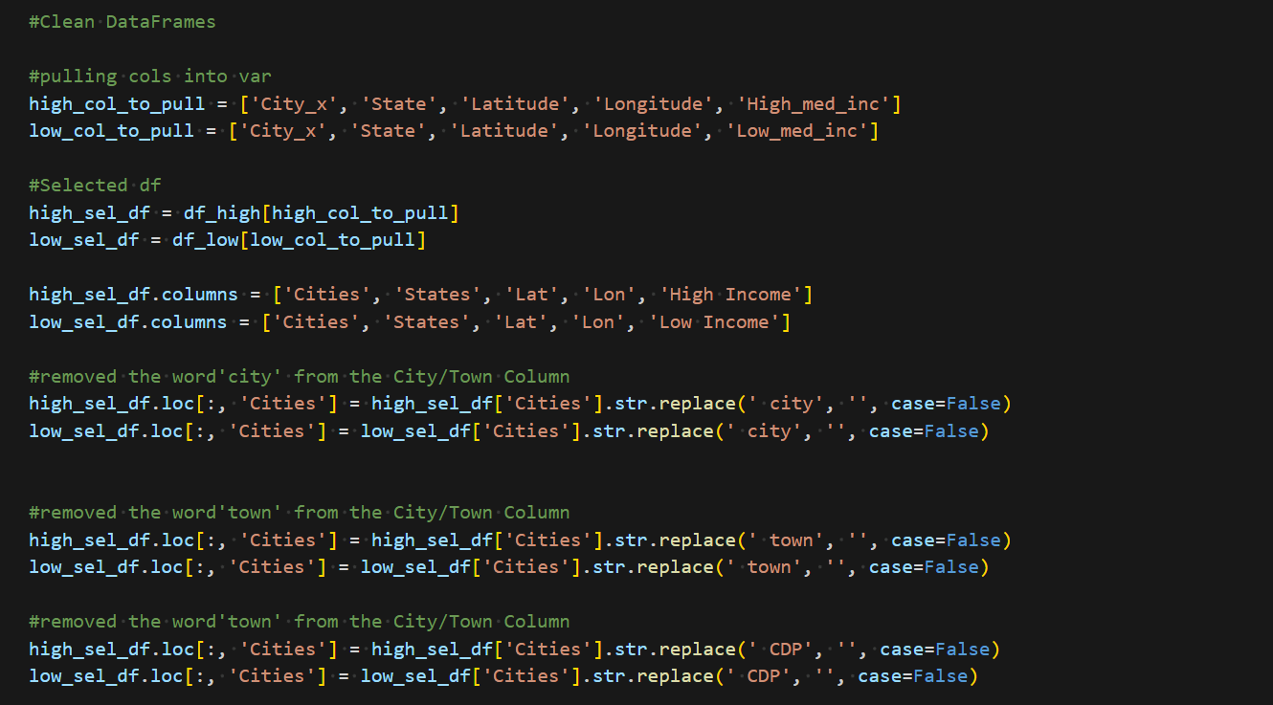
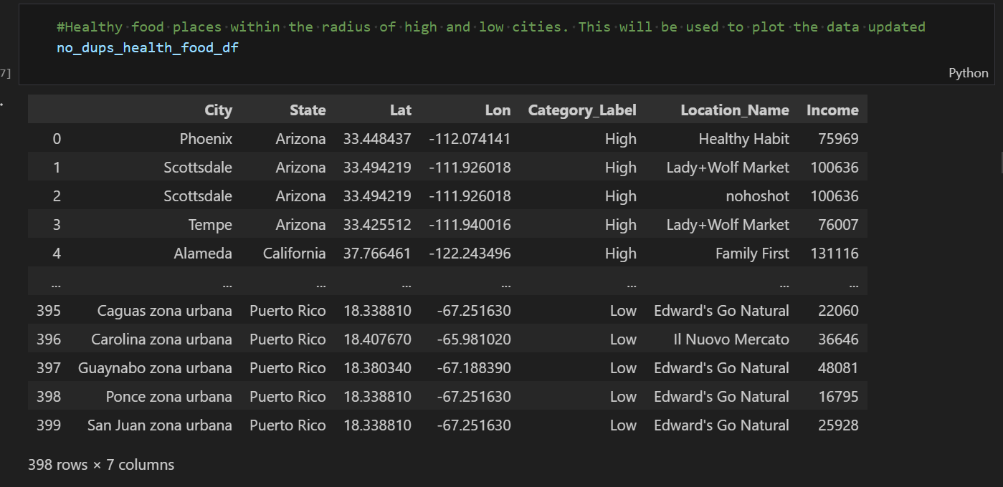
API Data Cleansing Geoapify: "commercial.food_and_drink.health_food"
Pulling data from Geoapify API based on healthfood category
Data Cleansing to create baseline dataframe to build statistics

Slide 12
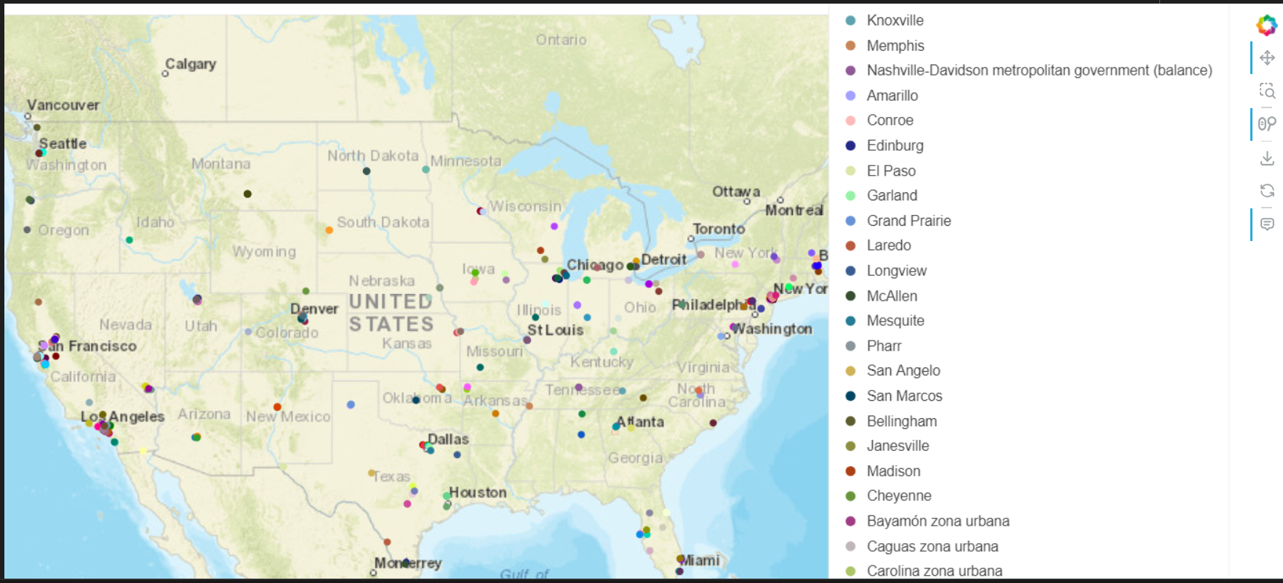
HVPlot Of Cities Summarized
Summarized a view of all the cities from the dataframe which provided details
Details provided the location names based on the lat and lon radius of 10000M pulled from the API
HVPlots are in the code and can be viewed with additional functionality

Slide 13
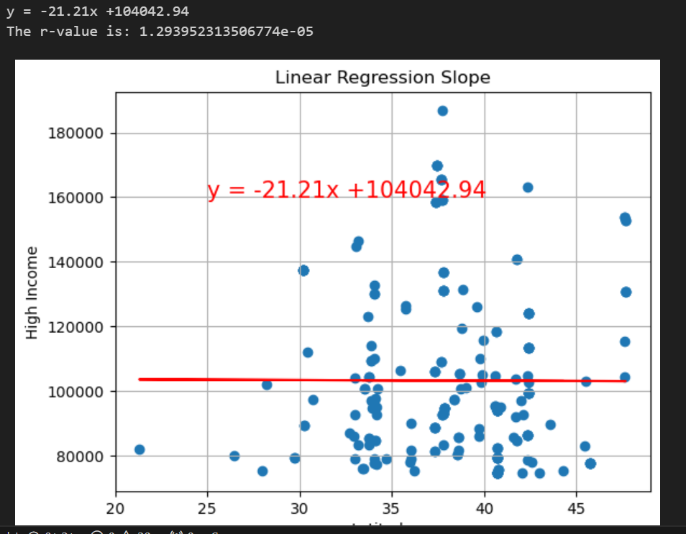
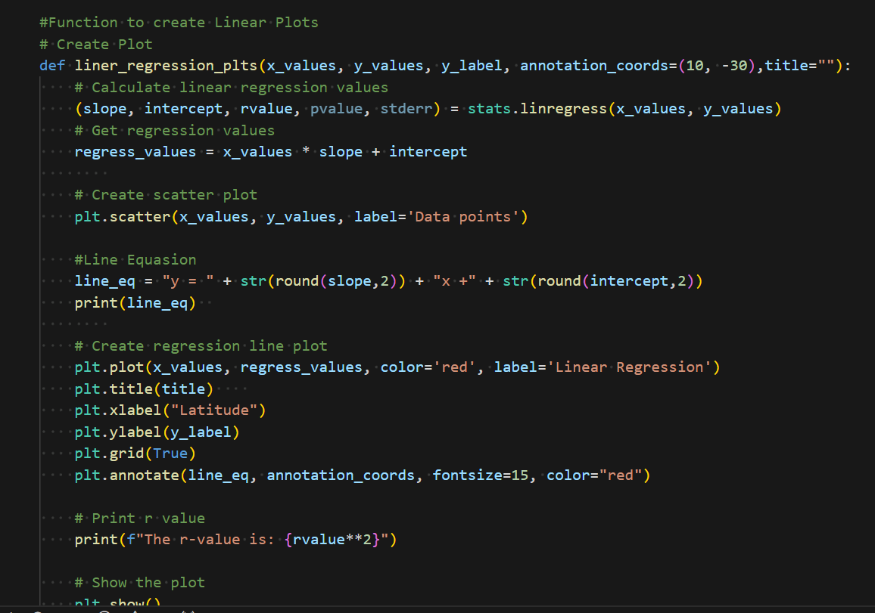
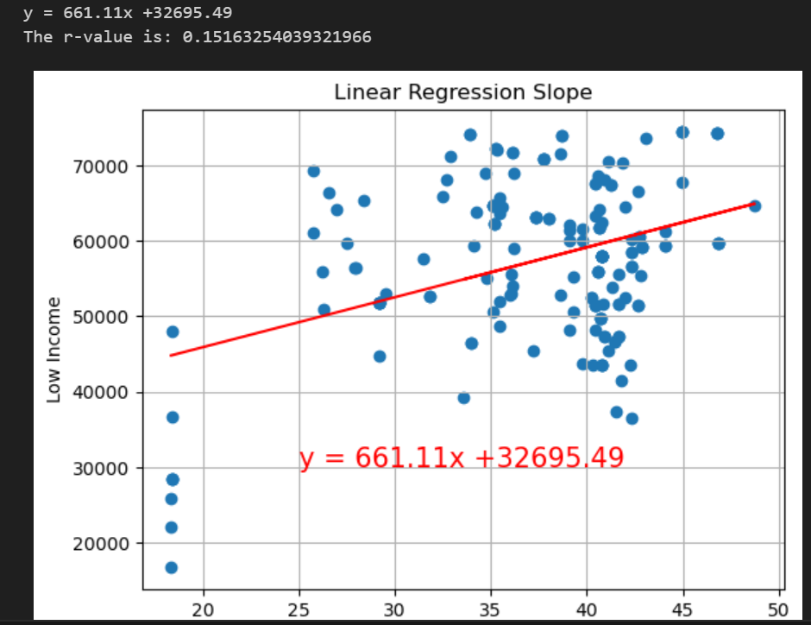
Drink.health_food Statistics
The slope and line regression showed majority of health food locations are within the middle class.
This is based on both low income and high income ranges.
The line regression stat was based on that latitude and income ranges.

Slide 14
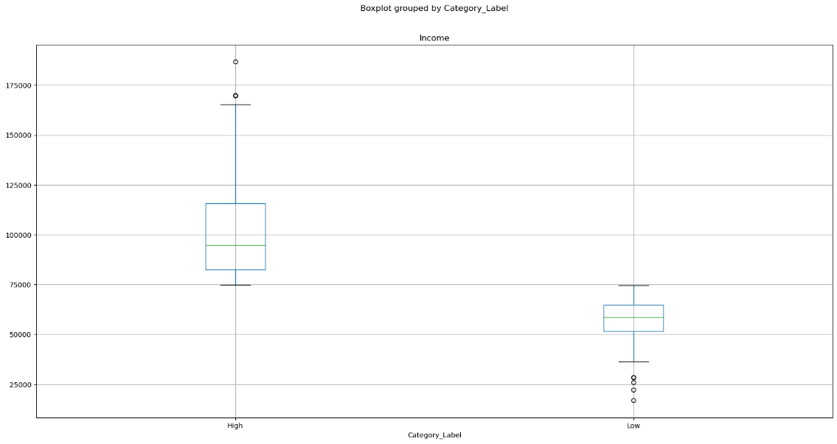
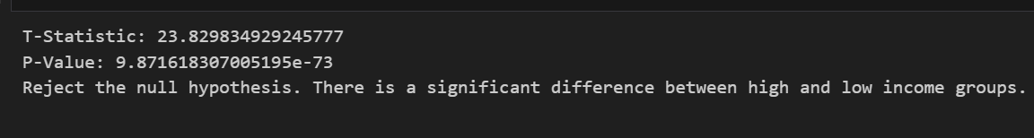
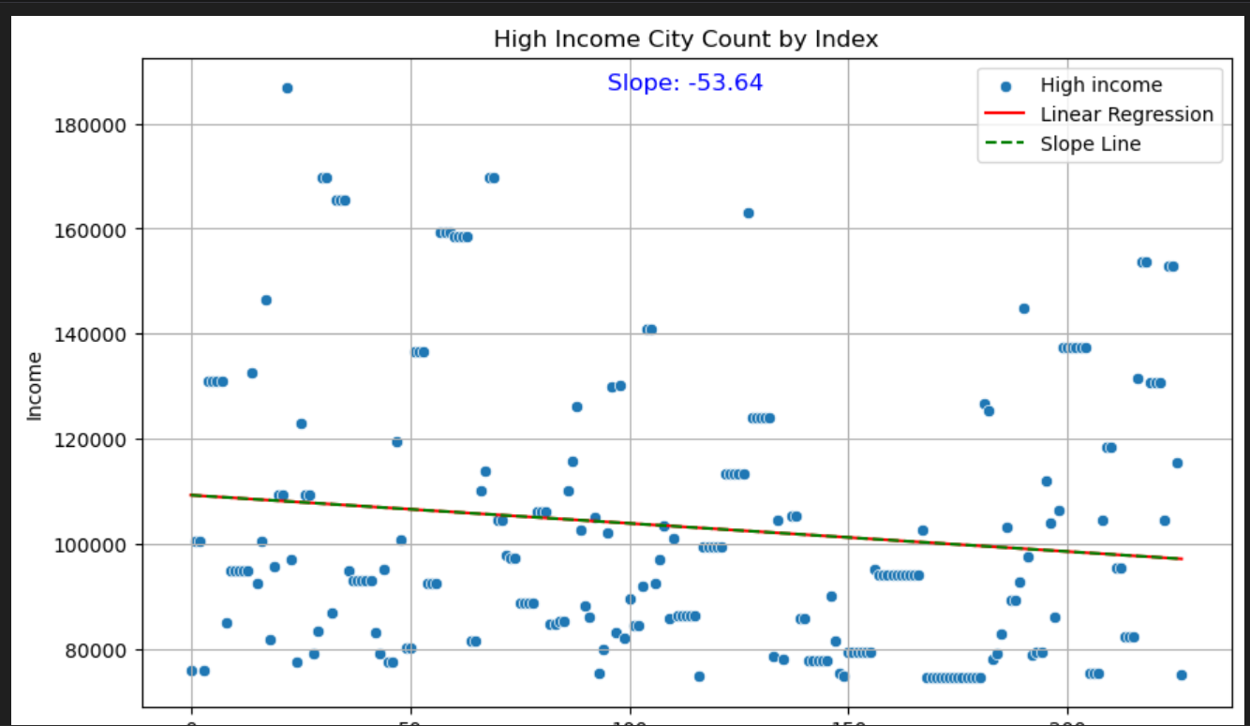
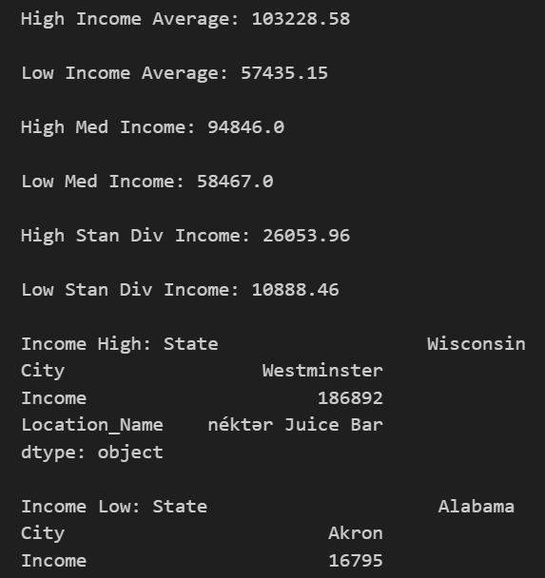
Drink.health_food Statistics Cont.
Completed a boxplot based on High and Low income categories.
High Income Average: 103228.58
Low Income Average: 57435.15
High Med Income: 94846.0
Low Med Income: 58467.0
High Stan Div Income: 26053.96
Low Stan Div Income: 10888.46
Income High: State Wisconsin City Westminster Income 186892 Location_Name néktər Juice Bar
Income Low: State Alabama City Akron Income 16795 Location_Name 2B Fit Nutrition
T-Statistic: 23.829834929245777
P-Value: 9.871618307005195e-73
Reject the null hypothesis. There is a significant difference between high and low income groups.

Slide 15
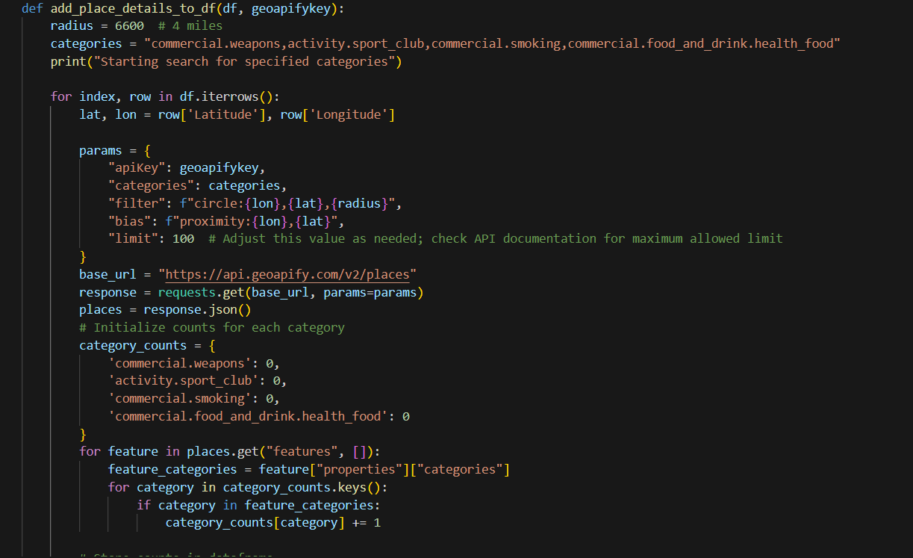
PYTHON AND THE API
Append Geoapify “places” to Census DF

Slide 16
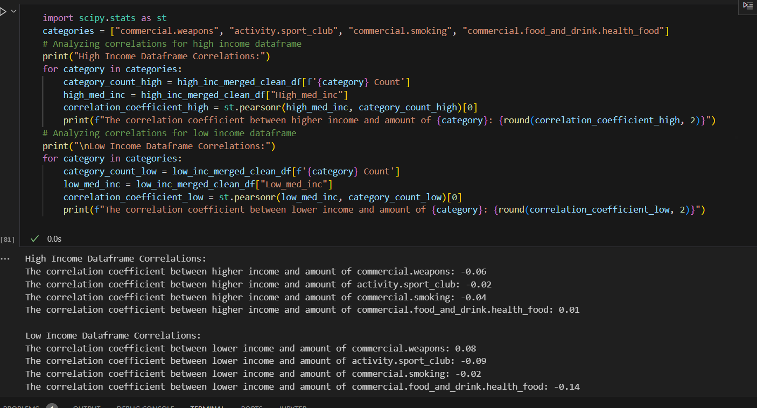
ANALYSIS / CORRELATION

Slide 17

Questions?
Notes:
The goal of this project was to investigate potential trends between cities categorized as having high median income versus low median income. This comparison was conducted by analyzing counts of various establishments, including health food stores, gun stores, alcohol stores, and parks. To gather city data, we utilized the Census API to randomly select a set of US cities along with their median incomes, which were then divided into two datasets based on whether the median income was higher or lower than the national average.

