Slide 1





A HISTOGRAM-BASED METHOD TO EXTRACT TAG-IMAGE FROM FILM SHOT
27-29 mai 2026
Benjamin Serva
Supervisors : Olivier Strauss & William Puech & Frédéric Comby
1

Slide 2




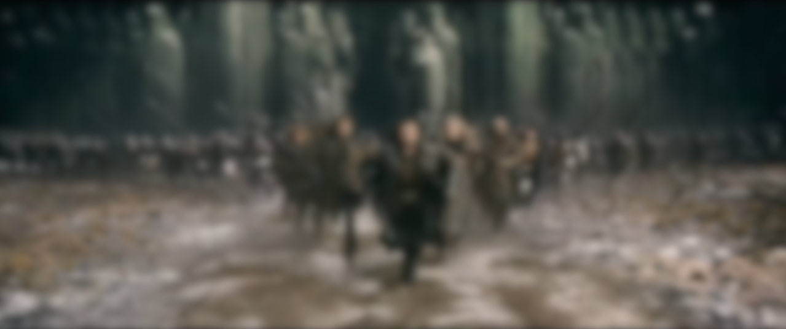


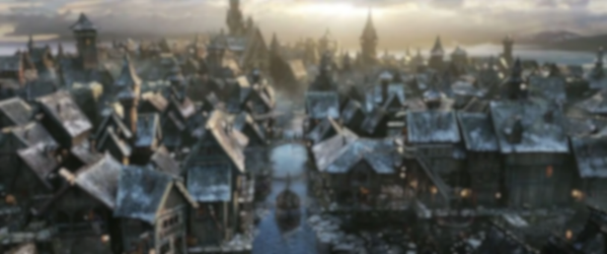

Context
Movie
Dozens of scenes in a movie
Dozens of shots per scene, resulting in hundreds of shots per movie
Scene 1
Scene 2
Scene N
From a few seconds to several tens of seconds per shot, representing hundreds of frames for each individual shot
Shot 1
Shot 2
Shot 3
Shot 4
[1] Soucek, T., & Lokoc, J. (2024). TransNet V2: An Effective Deep Network Architecture for Fast Shot Transition Detection.
2
[2] Chasanis, V., Likas, A., & Galatsanos, N. (2008). Scene detection in videos using shot clustering and sequence alignment.

Slide 3
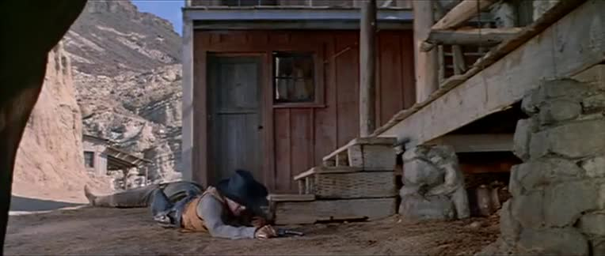
Problematic
Video 1. Shot taken from the film “Man of the West” [7].
3
[7] A. Mann, “Man of the west,” Film, 1958.

Slide 4
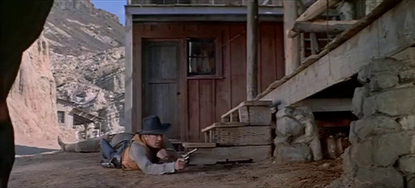
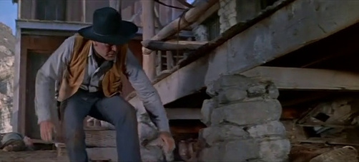
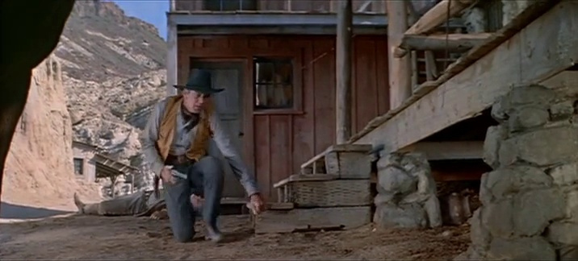
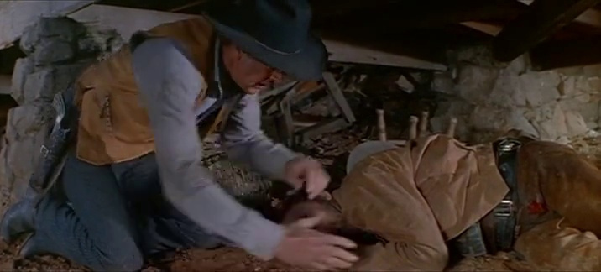
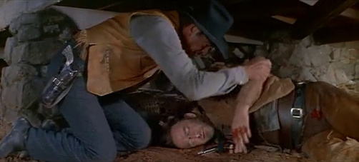
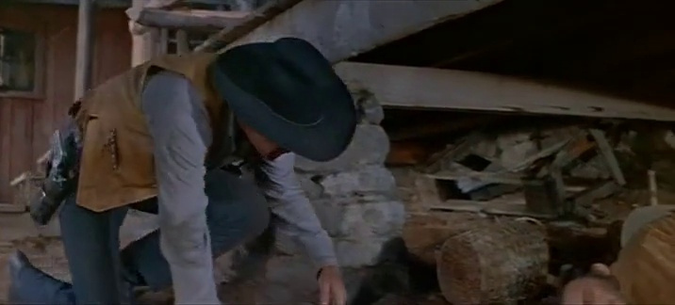
Problematic
How can we extract a frame from a shot that would allow it to be identified within a movie?
Challenges in Cinema :
Multiple types of content (humans, animals, landscapes, etc.) depending on the film’s style or genre
Content variation within a single shot
4

Slide 5
State of the art / Limitations
First Frame
Last Frame
Middle Frame
Naive method - Widiarto et al. [1]
Movement - Pei [2]
[3] Widiarto, W., Yuniarno, E. M., & Hariadi, M. (2015). Video summarization using a key frame selection based on shot segmentation.
5
[4] Pei, X. (2021). The key frame extraction algorithm based on the indigenous disturbance variation difference video.

Slide 6
State of the art / Limitations
Complex features - Zhang et al. [3]
Human - Chen et al. [4]
[5] Zhang, Y., Zhang, J., Liu, R., Zhu, P., & Liu, Y. (2022). Key frame extraction based on quaternion Fourier transform with multiple features fusion.
6
[6] Chen, M., Han, X., Zhang, H., Lin, G., & Kamruzzaman, M. (2019). Quality-guided key frames selection from video stream based on object detection.

Slide 7
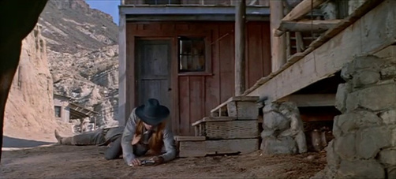
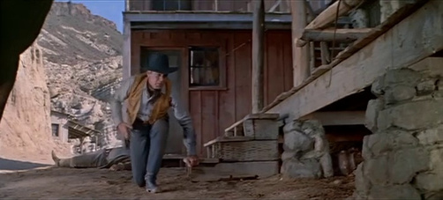
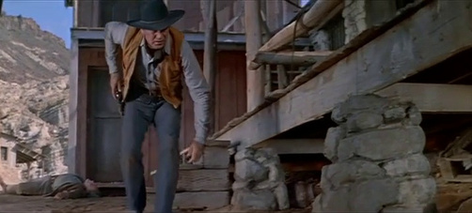
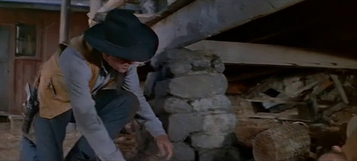
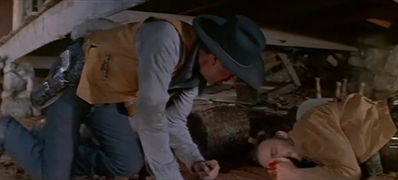
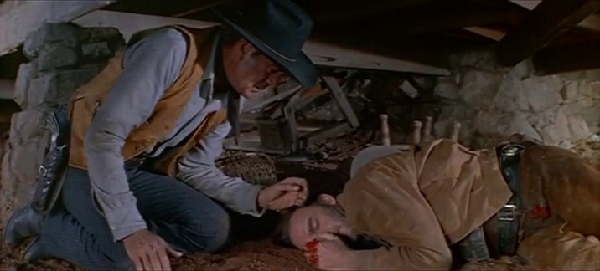
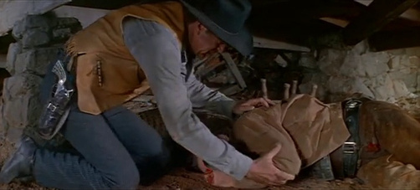
Term Specification
Keyframe : a keyframe is a frame that represents the starting and ending points of a movement, motion, or animation. Based on this frame, created by the animator, the intermediate frames—or in-betweens—are drawn (or calculated by the computer, depending on the technique) to depict the motion.
Keyframe 1
Keyframe 2
Keyframe 3
Keyframe 4
Keyframe 5
Keyframe 6
Keyframe 7
Keyframe 8
Keyframes of the shot taken from the film “Man of the West” [5].
7
[7] A. Mann, “Man of the west,” Film, 1958.

Slide 8
Term Specification
Tag-Image : An image that allows a film shot to be recognized or located
Keyframe 1
Keyframe 2
Keyframe 3
Keyframe 4
Keyframe 5
Keyframe 6
Tag-Image
Keyframe 8
Tag-Image of the shot taken from the film “Man of the West” [5].
8
[7] A. Mann, “Man of the west,” Film, 1958.

Slide 9
Term Specification
Keyframe :
Set of images extracted from a film shot
Images representing different moments or movements
Visually heavy for representing a single shot
Tag-Image :
Single image extracted from a film shot
Designed to best represent the shot’s content
Visually lightweight
9

Slide 10
Contents
1
Method for automatic extraction of a tag-image in a movie shot
2
Experimentation and Analysis
3
Conclusion and Perspectives
10

Slide 11
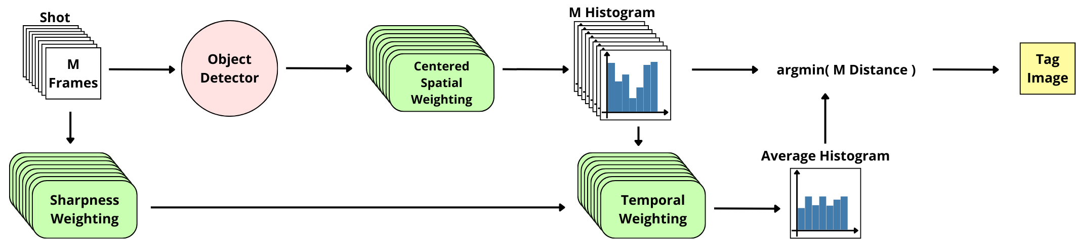
Our method
Method overview
11

Slide 12
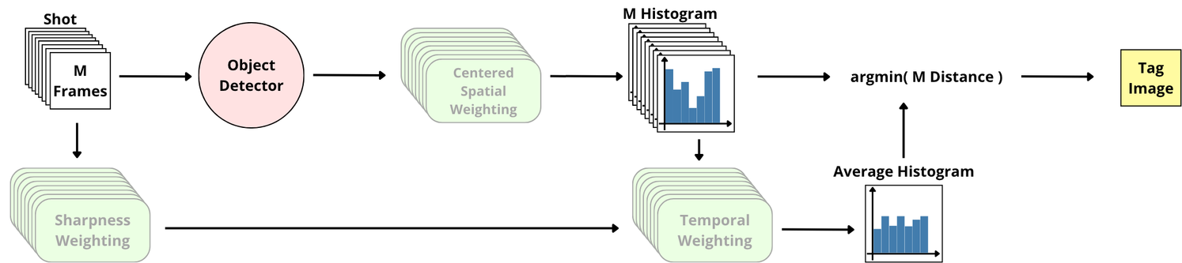
Basis of the method
Object Detector
Tag Image
Frame that best captures the semantic content of the shot
N labels
N bins
12

Slide 13
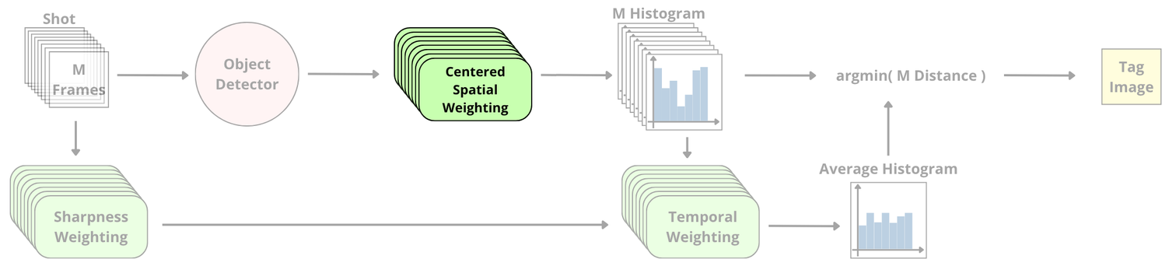
Weighting 1
13

Slide 14
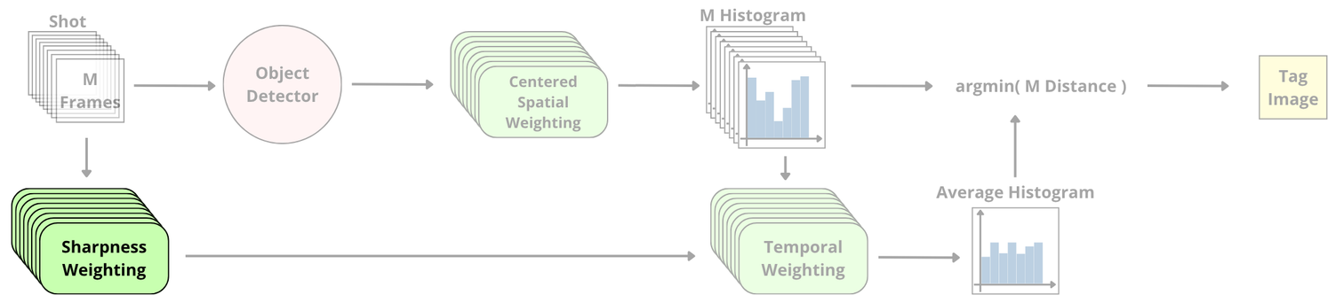
Weighting 2
14

Slide 15
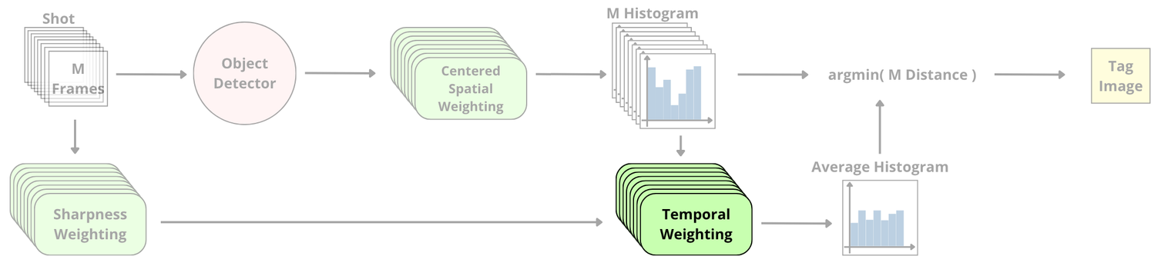

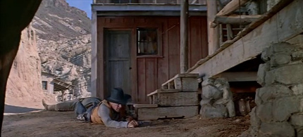
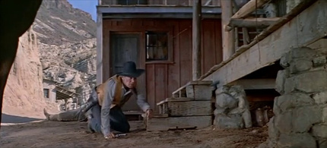

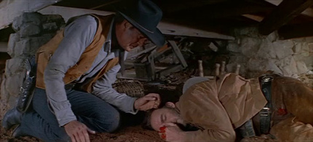

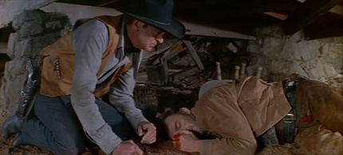
Weighting 3
Frame 1
Frame 100
Frame 200
Frame 300
Frame 400
Frame 500
Frame 600
Frame 660
Climax of the shot
15

Slide 16
Contents
1
Method for automatic extraction of a tag-image in a movie shot
2
Experimentation and Analysis
3
Conclusion and Perspectives
16

Slide 17
Evaluation
Ground truth :
No single common ground truth
Each expert defines their own reference standard
Dataset : 10 shots without ground truth, each taken from a movie.
Comparison metric : Standard metrics such as PSNR, SSIM, etc., are not relevant in this context
Questionnaire :
An image generated by the methods being compared.
Random order of presentation.
Free selection: 0 to 6 images allowed.
17

Slide 18
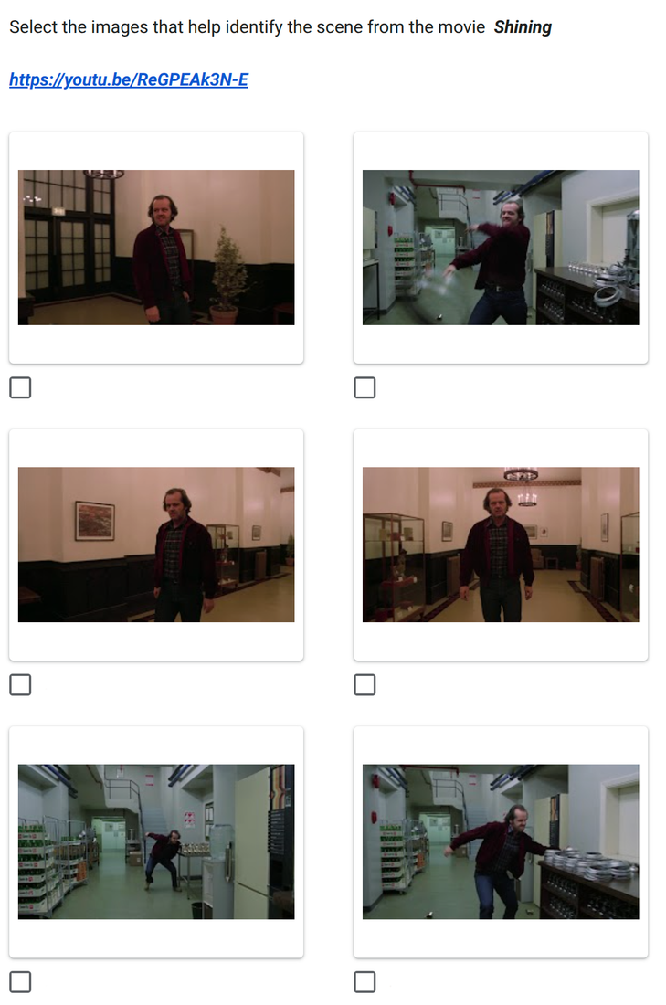
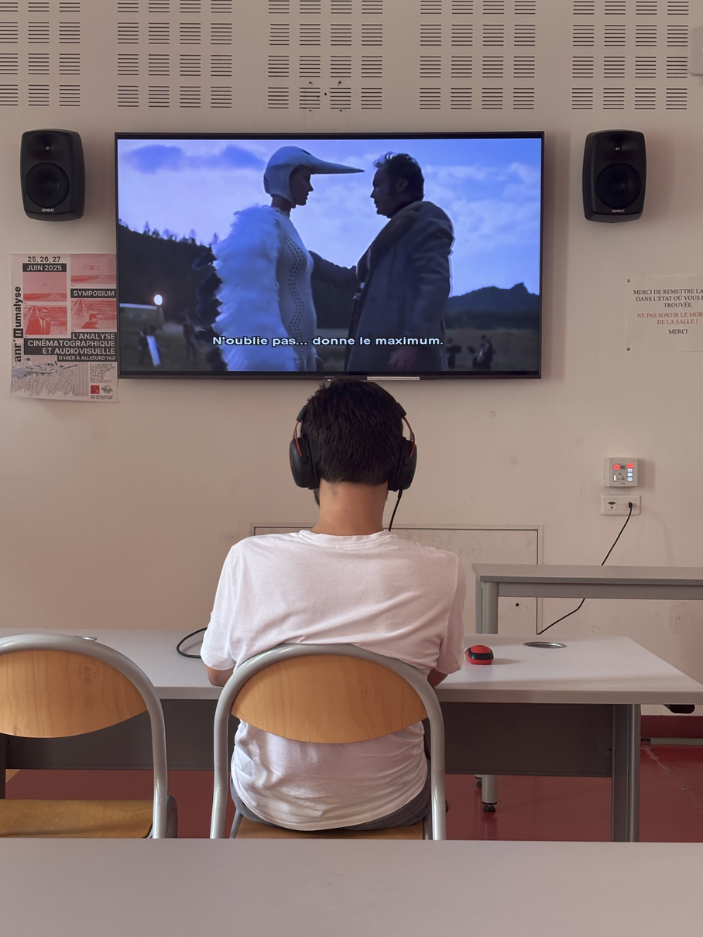
Experimentation
Sample assessment question
Experimental conditions
18

Slide 19
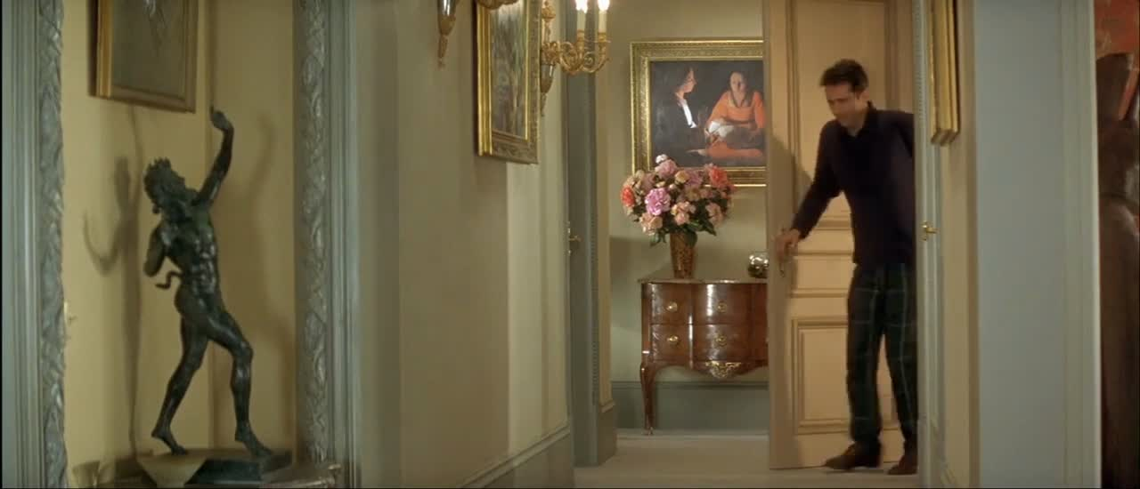
Example of results
Video 2. Shot taken from the film “Le dîner de cons” [8].
19
[8] F. Veber, “Le dı̂ner de cons (the dinner game),” Film, 1998.

Slide 20
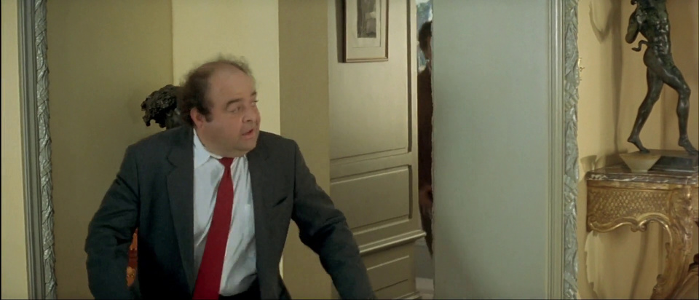
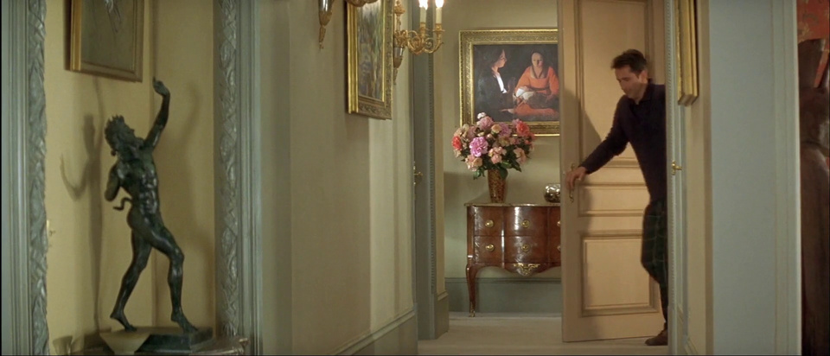
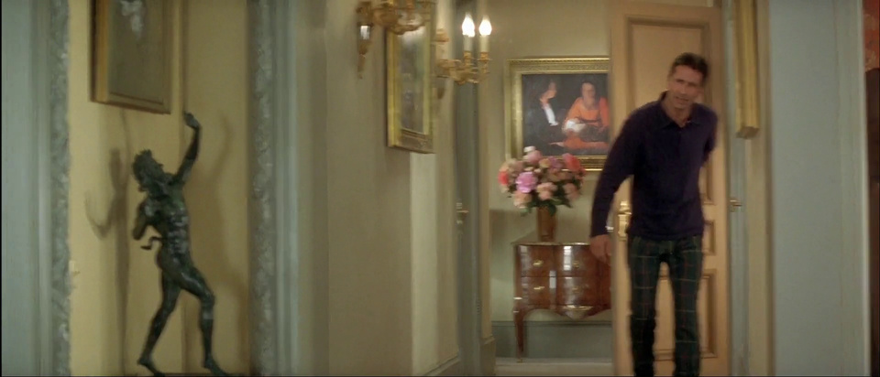
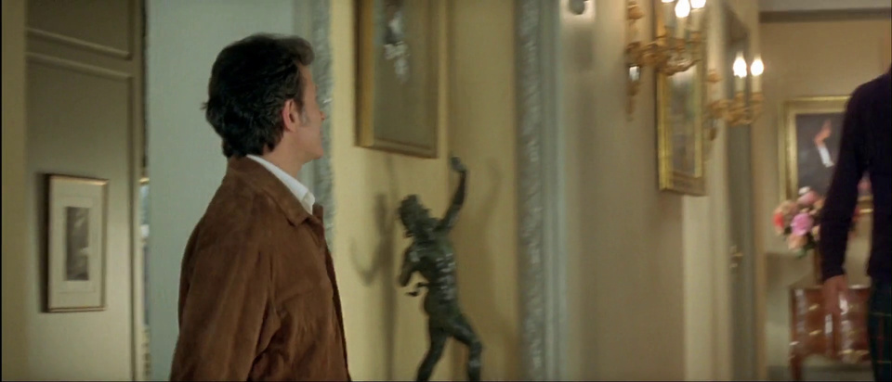
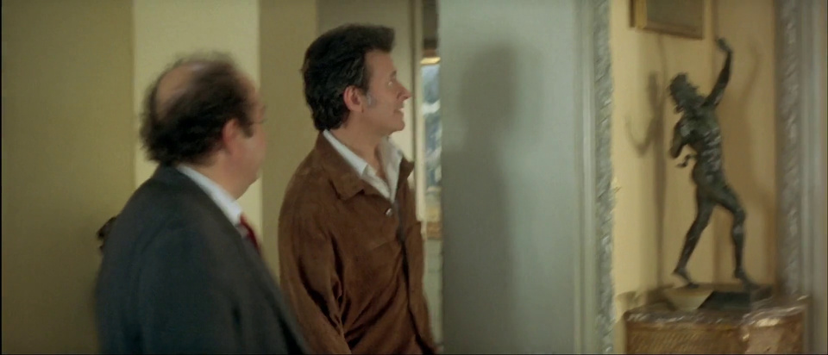
Example of results
Middle frame
Chen et al.
Pei
Zhang et al.
Our method
Comparison of results obtained for the shot taken from the film “Le dîner de cons” [6].
20
[8] F. Veber, “Le dı̂ner de cons (the dinner game),” Film, 1998.

Slide 21
Method | Top 1 | Top 2 | Top 3
Middle frame | 10% | 50% | 80%
Pei | 10% | 40% | 50%
Zhang et al. | 0% | 30% | 50%
Chen et al. | 30% | 50% | 70%
Our method | 50% | 70% | 70%
Method | Selection Rate
Middle frame | 0.381
Pei | 0.213
Zhang et al. | 0.238
Chen et al. | 0.388
Our method | 0.513
Results
10 shots * 16 experts = 160 evaluations
Table 1. Selection rate based on the evaluation of 16 experts.
Table 2. Ranking for the Top 1, Top 2 and Top 3.
21

Slide 22
Contents
1
Method for automatic extraction of a tag-image in a movie shot
2
Experimentation and Analysis
3
Conclusion and Perspectives
22

Slide 23
Conclusion / Perspectives
Strengths :
Method specifically designed for cinema-related challenges
Evolvable and adaptable pipeline
Relevant evaluation protocol for the targeted problem
Future :
Extend the pipeline with richer visual or temporal features
Generate one tag-image per scene rather than per shot
Detect content variations within a shot to adjust the number of tag images
23

Slide 24
Thank you for your attention
24

Slide 25
References
[1] Soucek, T., & Lokoc, J. (2024). TransNet V2: An Effective Deep Network Architecture for Fast Shot Transition Detection.
[2] Chasanis, V., Likas, A., & Galatsanos, N. (2008). Scene detection in videos using shot clustering and sequence alignment.
[3] Widiarto, W., Yuniarno, E. M., & Hariadi, M. (2015). Video summarization using a key frame selection based on shot segmentation.
[4] Pei, X. (2021). The key frame extraction algorithm based on the indigenous disturbance variation difference video.
[5] Zhang, Y., Zhang, J., Liu, R., Zhu, P., & Liu, Y. (2022). Key frame extraction based on quaternion Fourier transform with multiple features fusion.
[6] Chen, M., Han, X., Zhang, H., Lin, G., & Kamruzzaman, M. (2019). Quality-guided key frames selection from video stream based on object detection.
[7] A. Mann, “Man of the west,” Film, 1958.
[8] F. Veber, “Le dı̂ner de cons (the dinner game),” Film, 1998.
25

Slide 26
26

Slide 27
Supplementary materials
27

Slide 28
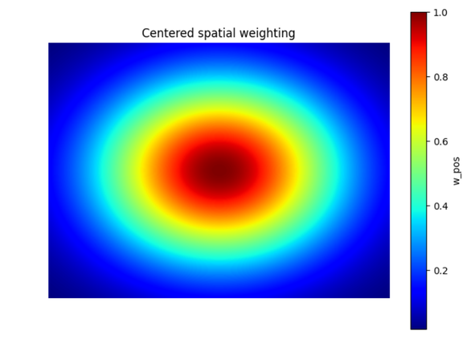
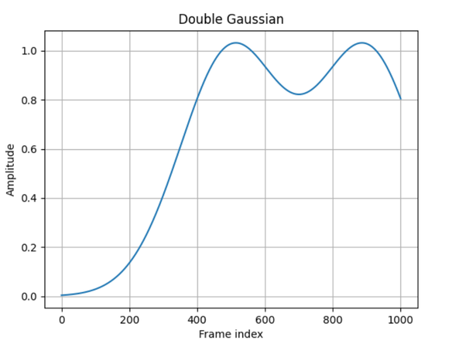
Our implementation
Faster R-CNN Resnet50 FPN
Variance Du Laplacien
28

Slide 29


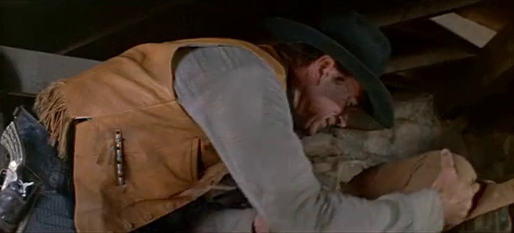
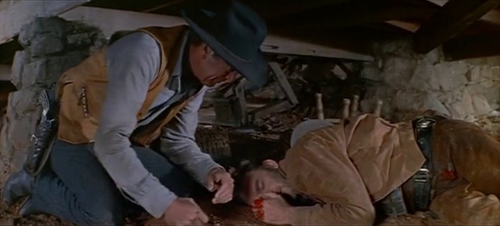
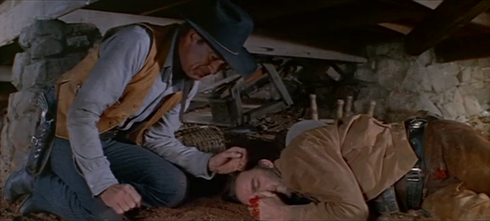
Example of results
Middle frame
Chen et al.
Pei
Zhang et al.
Our method
Ground Truth
Figure 3. Comparison of results obtained for the shot taken from the film “Man of the West” [7].
29
[7] A. Mann, “Man of the west,” Film, 1958.

Slide 30
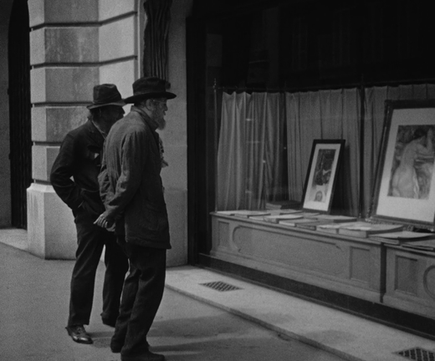
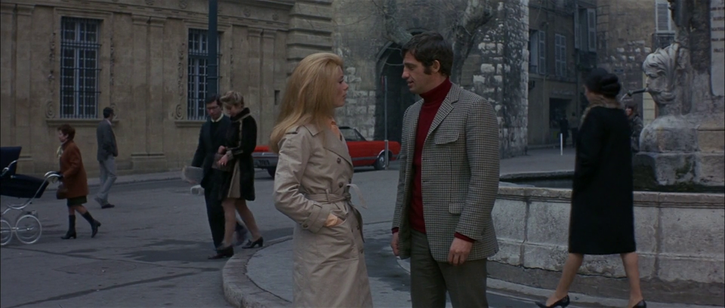
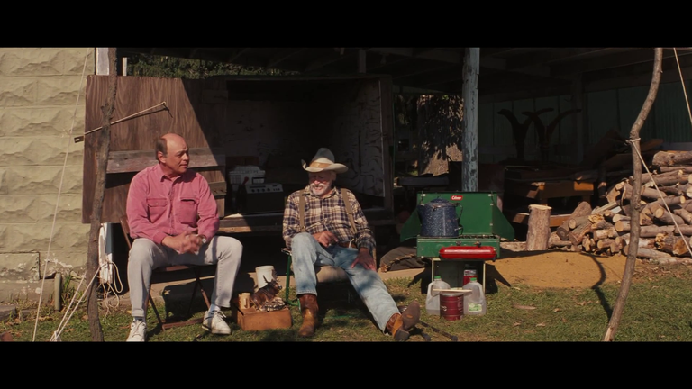
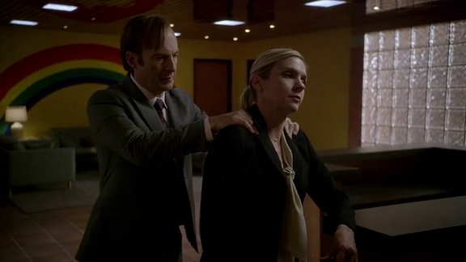
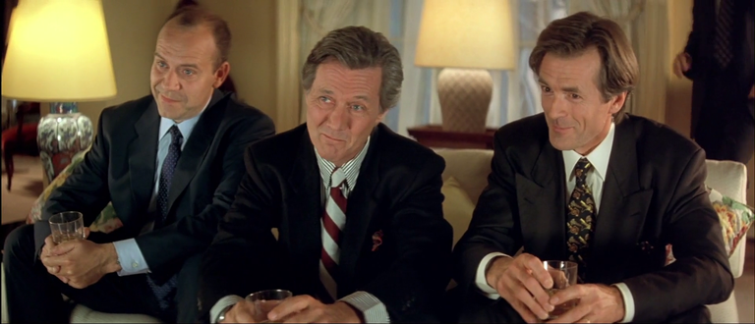
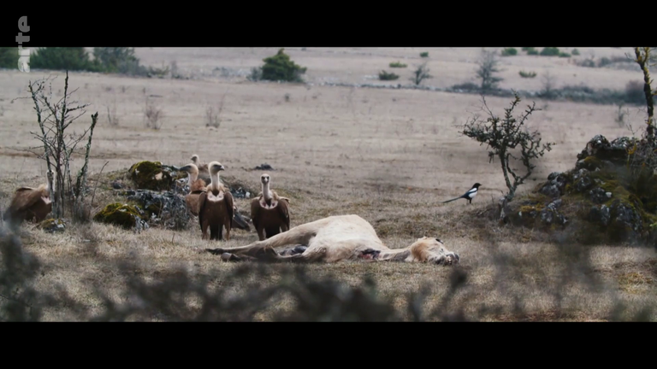
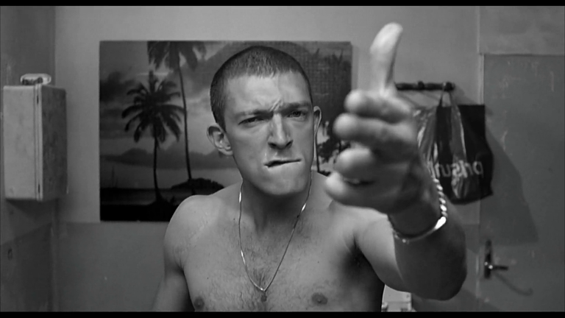
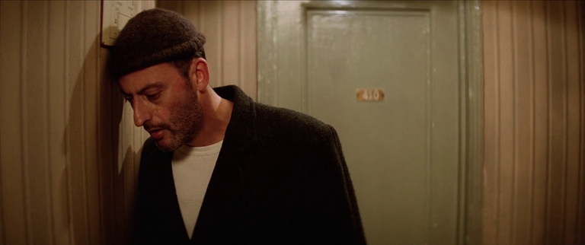
Experimentation
Dataset of 105 film shots with unique annotations :
Variation in content
Black-and-white and color films
30

Slide 31
Experimentation
Véritée terrain
Middle frame
0.245778
Pei
0.265063
Zhang et al.
Distance de Bhattacharyya
0.265063
Chen et al.
0.337157
0.032974
Our method
31

Slide 32
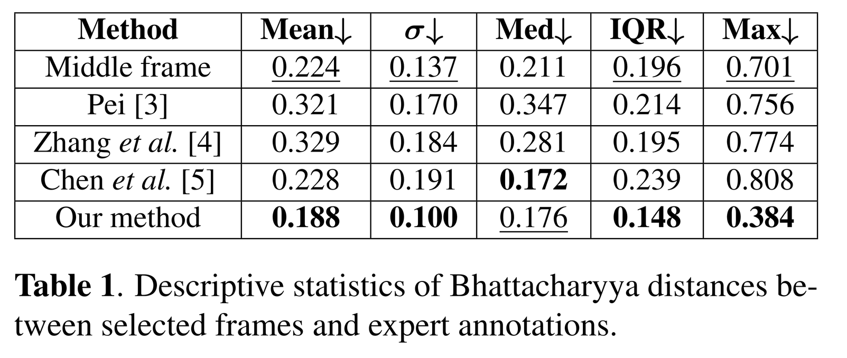
Experimentation
32

Slide 33
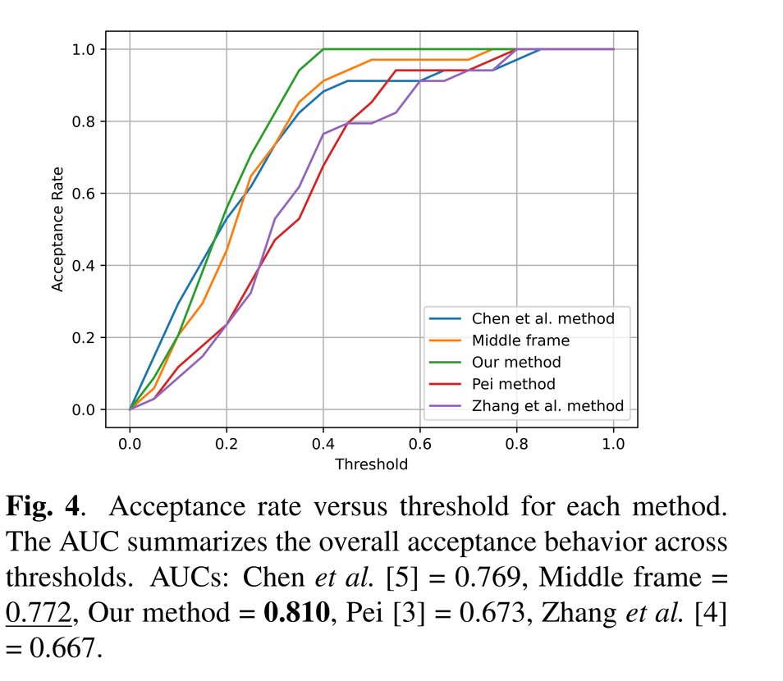
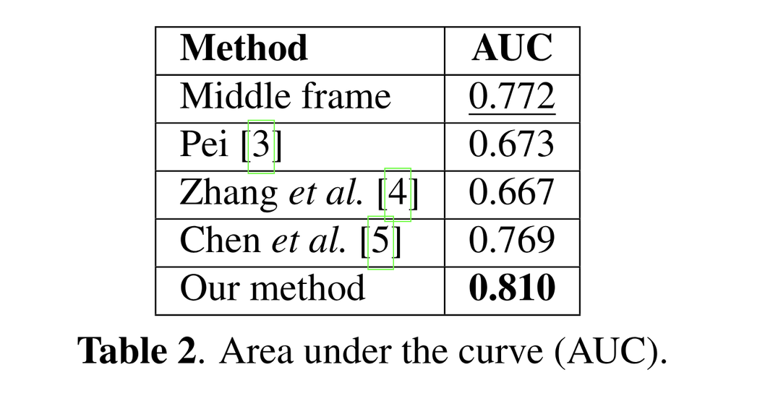
Experimentation
33

Slide 34
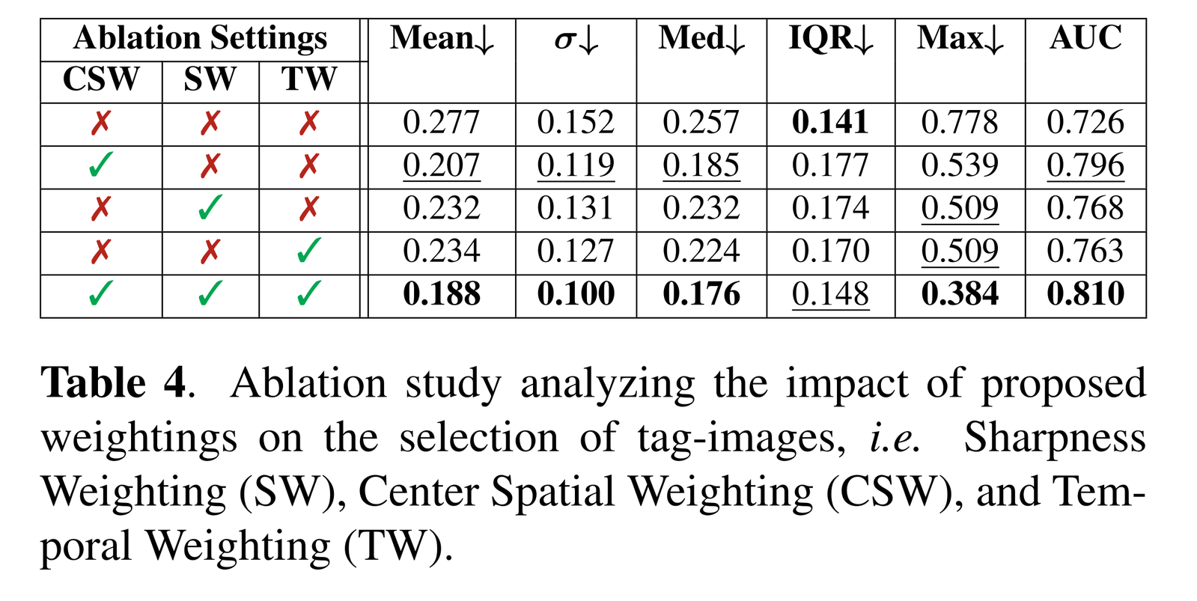
Ablation Study
34

