Slide 1
Intended Sarcasm Detection
Presented by: Bhavika Sewpal
Supervisor: Diana Inkpen

Slide 2
SemEval-2022 Task 6
A workshop that organizes shared NLP tasks annually
Task 1 - Given a text, determine whether it is sarcastic or non-sarcastic
Task 2 - Given a sarcastic text and its non sarcastic rephrase, determine which is the sarcastic one

Slide 3
Examples from the dataset
Task 1
Example of a sarcastic text:
I love it when drunk, inconsiderate flatmates come back and start climbing on the roof #istillhaveexams #tryingtosleep
Example of a non sarcastic text:
man I really hate seeing two idiots raising a baby
Task 2
Example of a sarcastic text
The only thing I got from college is a caffeine addiction
Example of its non sarcastic rephrase
College is really difficult, expensive, tiring, and I often question if a degree is worth the stress.

Slide 4
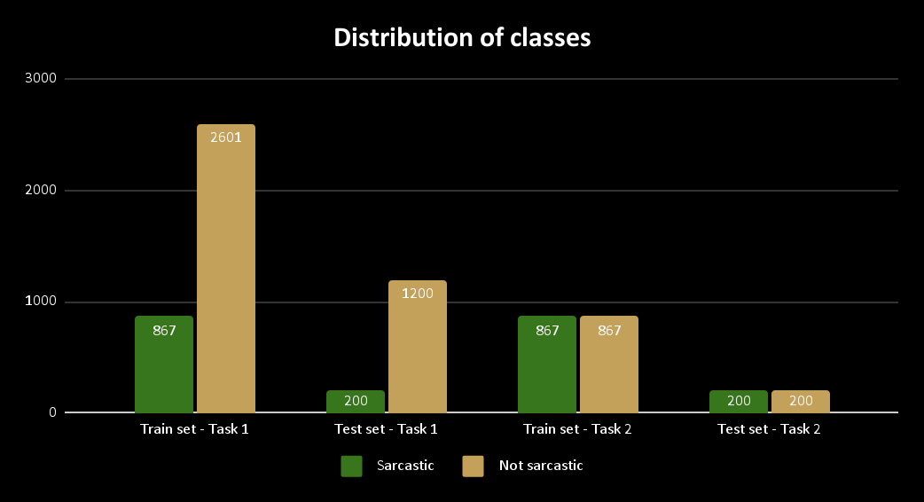
Distribution of classes in the training and testing data
For Task 1, the sarcastic class is a minority class (1:3 in the training data and 1:6 in the testing data)
For Task 2, the dataset is balanced for both training and testing

Slide 5
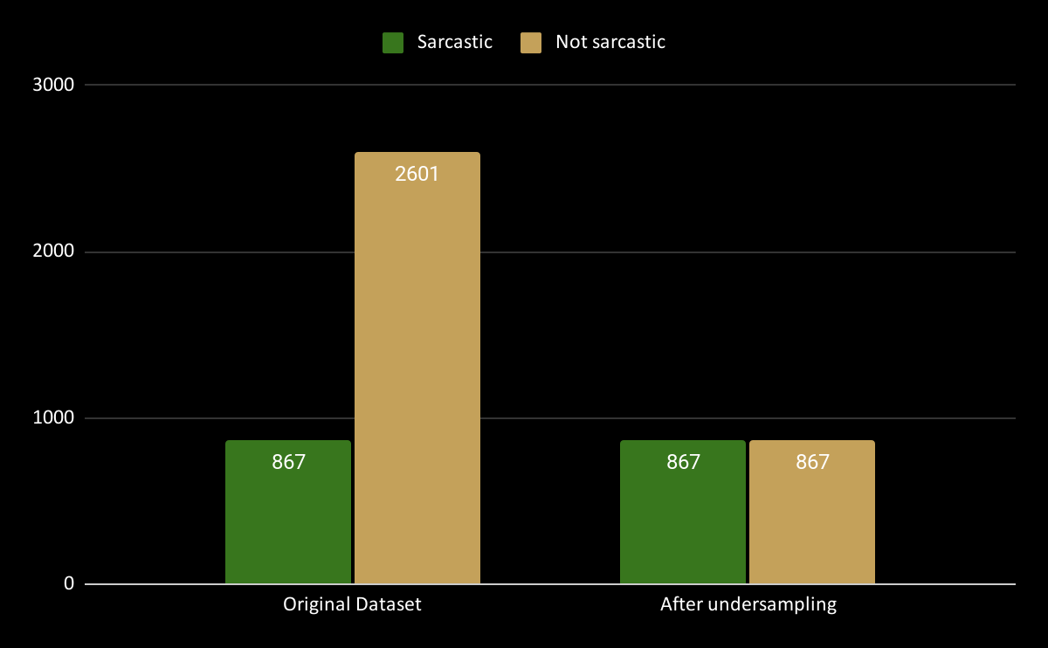
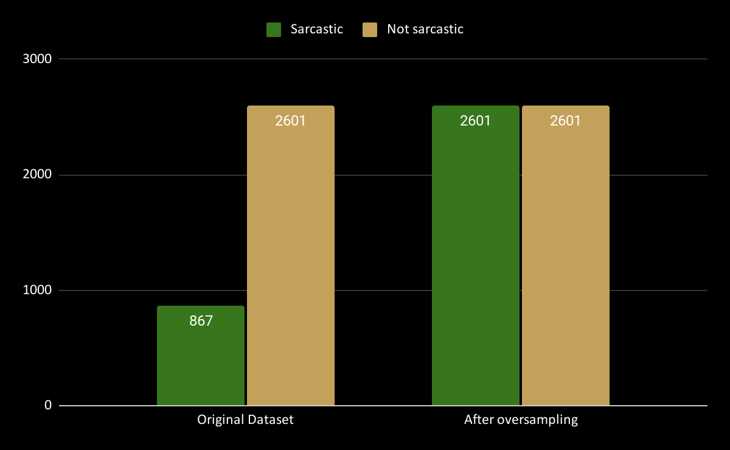
Handling class imbalance for Task 1
Approach 1 - Undersample the non-sarcastic class
Approach 2 - Oversample the sarcastic class

Slide 6
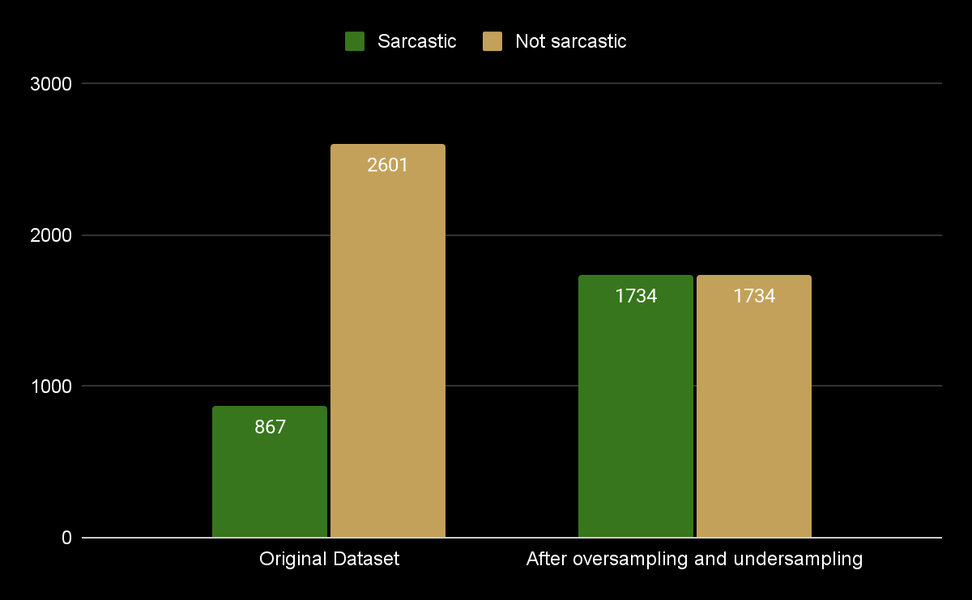
Handling class imbalance for Task 1
Approach 3 - Both Undersampling and Oversampling
Approach 4 - Weighted loss function
Use Cross Entropy loss function with class weights

Slide 7
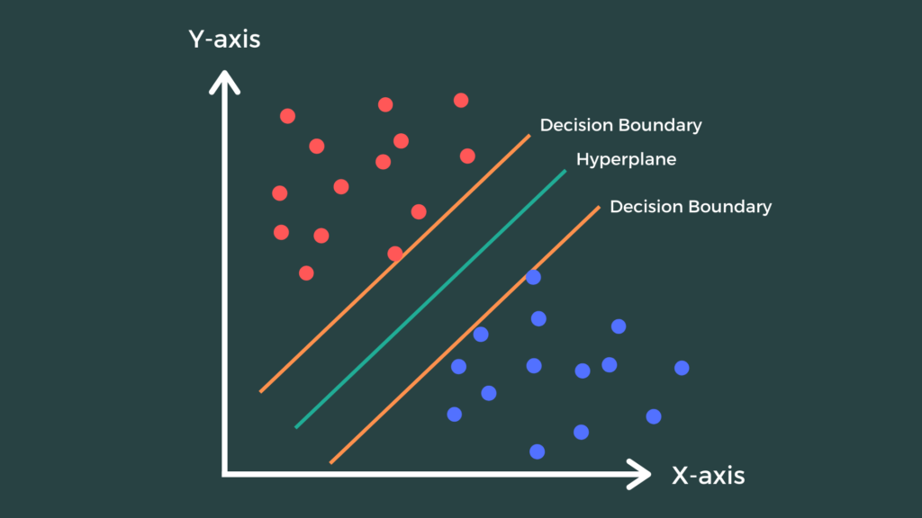
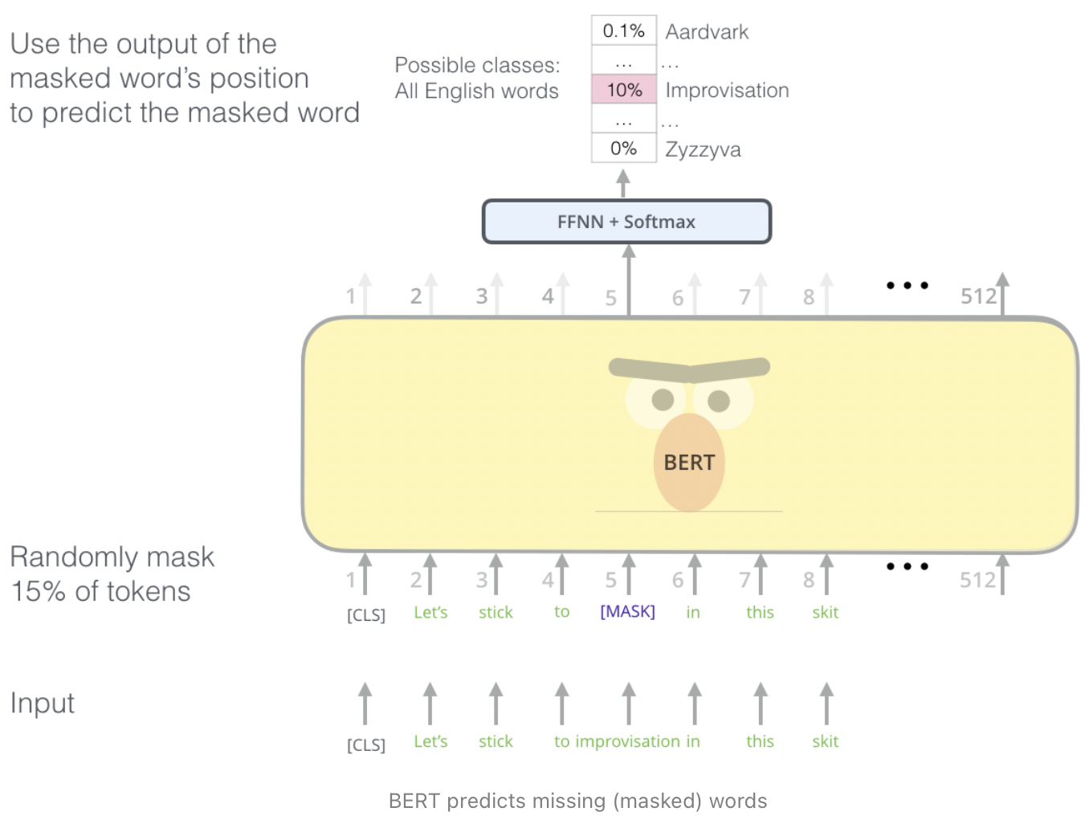
Models
Baseline Model - SVM (Support Vector Machine)
BERT

Slide 8
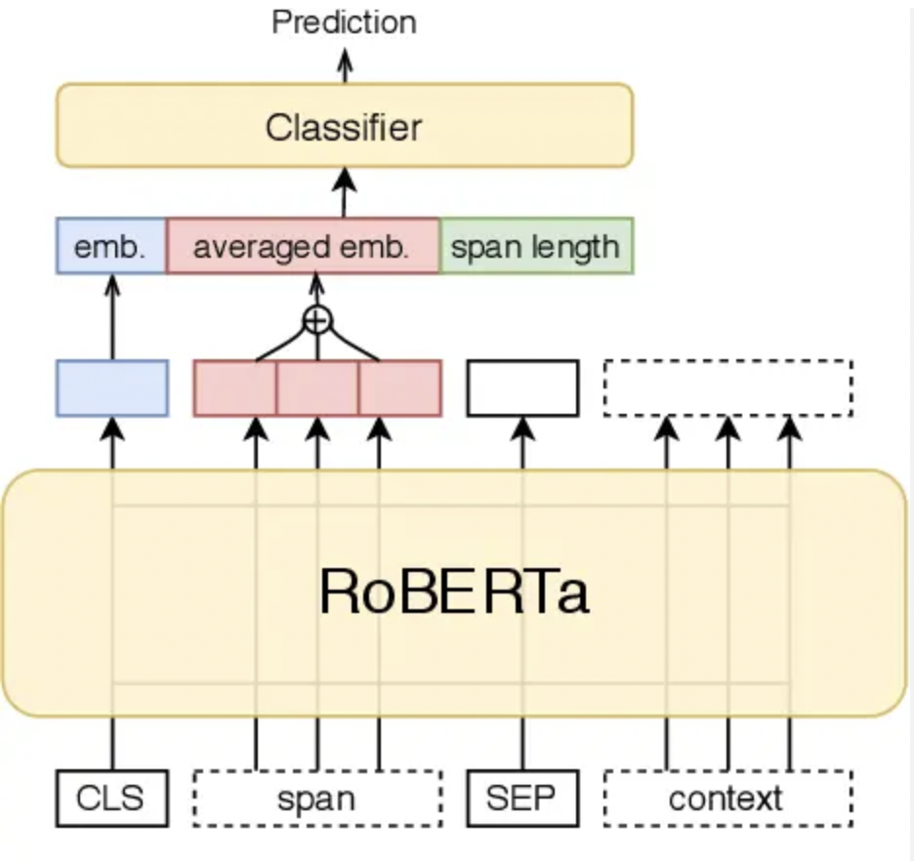
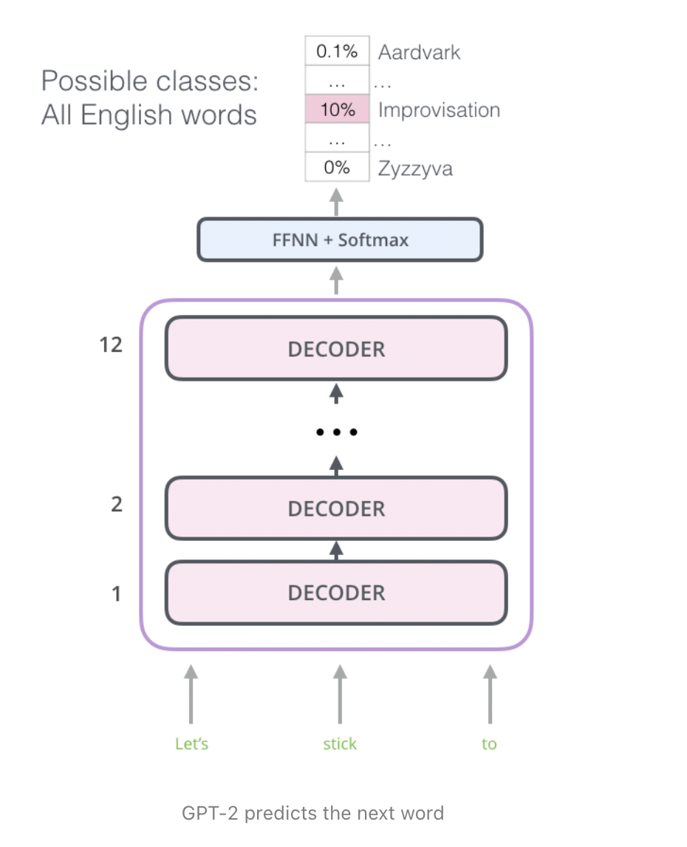
Models
roBERTa
GPT-2

Slide 9
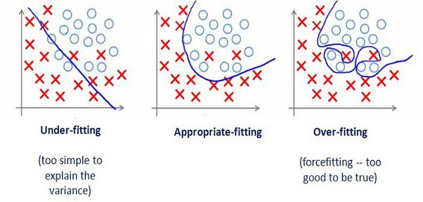
Model development
Epochs : 1 to 4
Batch size : 64
Optimizer : Adam
Loss function: Cross Entropy

Slide 10
Preprocessing steps for SVM Model
Removing non alphanumeric characters
Punctuation signs
emojis
Lower casing
Tokenizing
Stop words removal
Lemmatizing

Slide 11
Preprocessing example for SVM model
My eldest is having a wild Friday night out. She's going to bingo. 😂
keeping only alphanumeric characters
My eldest is having a wild Friday night out She s going to bingo
lower casing
my eldest is having a wild friday night out she s going to bingo
tokenizing
[‘my’, ‘eldest’, ‘is’, ‘having’, ‘a’, ‘wild’, ‘friday’, ‘night’, ‘out’, ‘she’, ‘s’, ‘going’, ‘to’, ‘bingo’]
lemmatizing
[‘my’, ‘eldest’, ‘be’, ‘have’, ‘a’, ‘wild’, ‘friday’, ‘night’, ‘out’, ‘she’, ‘s’, ‘go’, ‘to’, ‘bingo’]
stop words removal
[‘eldest’, ‘wild’, ‘friday’, ‘night’ , ‘go’, ‘bingo’]

Slide 12
BERT Tokenizer (padding = 15)
Input Ids
Attention Masks
A wrong impression is once again my specialty
[CLS]
a
wrong
impression
is
once
again
my
specialty
[SEP]
[PAD]
[PAD]
[PAD]
[PAD]
[PAD]
101
1037
3308
8605
2003
2320
2153
2026
12233
102
0
0
0
0
0
1
1
1
1
1
1
1
1
1
1
0
0
0
0
0

Slide 13
Tokenization process for Task 2 (padding = 20)
First Tokenization - Sarcastic text followed by rephrase (label = 0)
Token type ids
Attention Masks
Sarcastic : A wrong impression is once again my specialty
Rephrase : Unfortunately I made the wrong impressions again
[CLS]
a
wrong
impression
is
once
again
my
specialty
[SEP]
unfortunately
i
made
the
wrong
impressions
again
[SEP]
[PAD]
[PAD]
0
0
0
0
0
0
0
0
0
0
1
1
1
1
1
1
1
1
0
0
1
1
1
1
1
1
1
1
1
1
1
1
1
1
1
1
1
1
0
0

Slide 14
Tokenization process for Task 2 (padding = 20)
Second Tokenization - Rephrase followed by sarcastic text (label = 1)
Token type ids
Attention Masks
Sarcastic : A wrong impression is once again my specialty
Rephrase : Unfortunately I made the wrong impressions again
[CLS]
unfortunately
I
made
the
wrong
impressions
again
[SEP]
a
wrong
impression
is
once
again
my
specialty
[SEP]
[PAD]
[PAD]
0
0
0
0
0
0
0
0
0
1
1
1
1
1
1
1
1
1
0
0
1
1
1
1
1
1
1
1
1
1
1
1
1
1
1
1
1
1
0
0

Slide 15
Classifier Head added on top of transformer models
1
logits
probabilities
2
0
0.8
Hidden layer of size 768
softmax
1
0.2
768

Slide 16
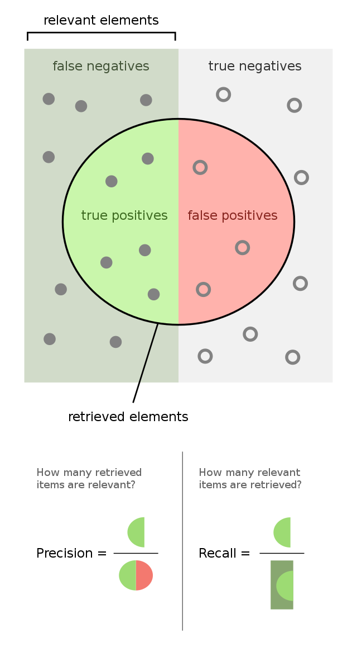
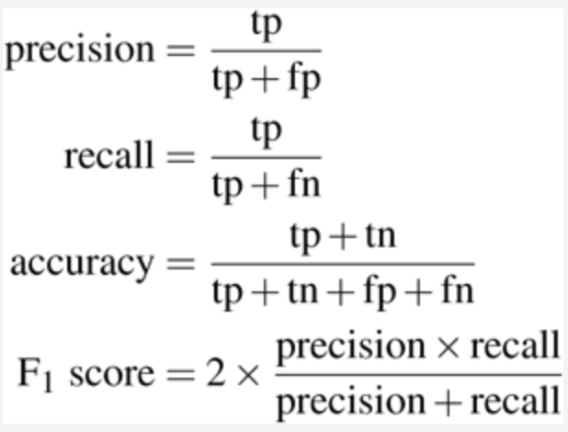
Precision, Recall, Accuracy and F1 score

Slide 17
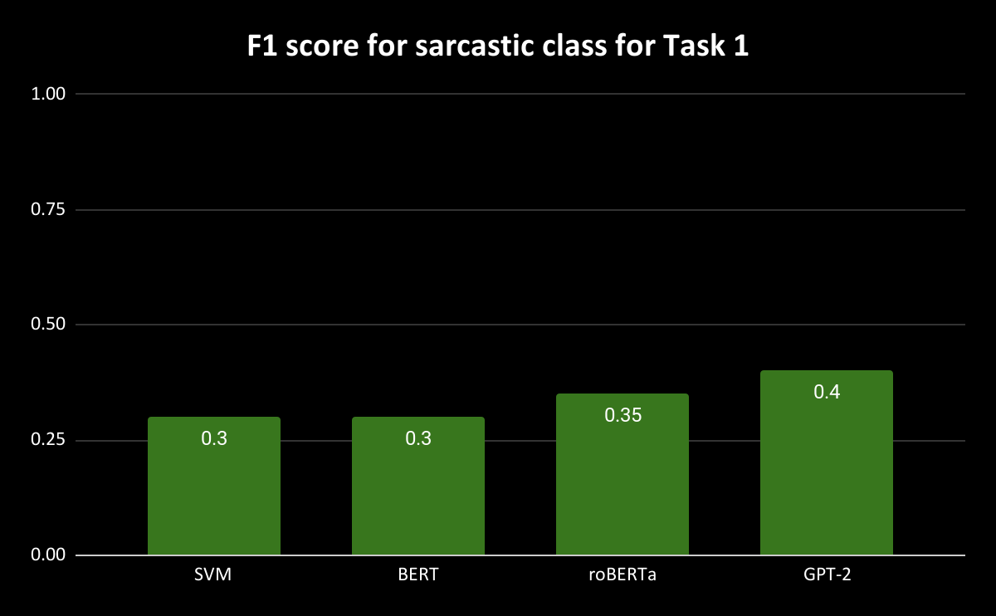
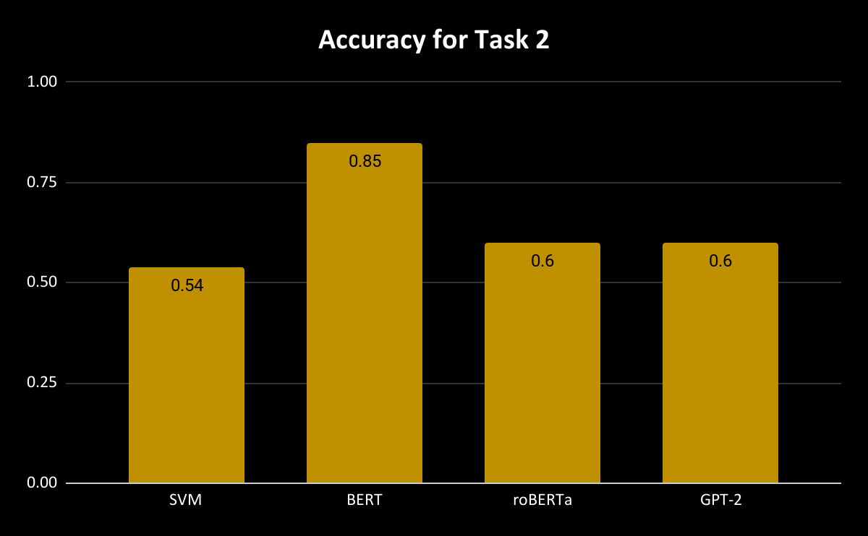
Results

Slide 18
Remarks
Attempting to classify text as sarcastic or non-sarcastic in isolation is a difficult task
It will be helpful to model the context of the conversation

Slide 19
Thank you for your attention

