Slide 1
The Impact of Ideological Primes on BLM and ALM Support
Brier gallihugh, M.S & Kimberly Rios, Ph.d

Slide 2
Introduction

Slide 3
THE BLACK LIVES MATTER MOVEMENT
In response to the systemic injustice perpetrated toward people of color (particularly black men), the Black Live Matter movement (BLM) has attempted to bring awareness and change
Research suggests that around half of all Americans support the BLM movement (Horowitz, 2021)
This movement has also led to opposition under the motto “All Lives Matter” (ALM)

Slide 4
THE ALL LIVES MATTER MOVEMENT
The ALM movement argues that everyone should matter and not just “black lives”
From an ideology perspective, this viewpoint suggests a colorblind motivation
Such motivations tend to correlate with higher racism (Poteat & Spanierman, 2012)
Critics of this ALM movement suggest that this terminology seeks to de-legitimize the BLM movement (Tsikas, 2021)

Slide 5
NEED FOR PREDICTORS
This divide suggests a need to investigate predictors of both the BLM and ALM movements
One potential starting point might be to look at various inter-ethnic ideologies (Hahn et al, 2015)
Assimilation, Segregation, Multiculturalism, Colorblindness

Slide 6
INTER-ETHNIC IDEOLOGIES (HAHN ET AL, 2015)
Assimilation
Belief in cultural uniformity (typically of dominant culture)
Segregation
Belief in racial segregation as the ideal for peace
Multiculturalism
Values all racial and ethnic cultures
Colorblindness
Suggests we should focus less on differences and more on similarities

Slide 7
OUR PREVIOUS WORK
Our previous work looking to explore various predictors of support for ALM and BLM
Multiple regression consisting of Assimilation, Colorblindness, Multiculturalism and Segregation on BLM and ALM support was run
Across 2 studies we found consistent support for the following:
Assimilation (-) and MC (+) predict BLM Support
Assimilation (+) and MC (-) predict ALM Support
Crucially, CB is less predictive of ALM support compared to Assimilation & Multiculturalism

Slide 8
CURRENT STUDIES
After finding these results (the second being a replication with a non-college sample; i.e., Prolific), raises the question of the extent to which manipulating colorblindness and multiculturalism might impact BLM and ALM support

Slide 9
Study 3

Slide 10
Procedure

Slide 11
EXPERIMENTAL PROCEDURE
We hypothesized that an increase in MC salience would result in higher levels of support for BLM
Conversely, we expected an increase in CB salience to result in higher levels of support for ALM
Recruited 424 participants (321 retained)
Age_{MEAN} = 20.41 (SD = 5.10), 80% Female, 52% Christian (All White)

Slide 12
EXPERIMENTAL PROCEDURE (CONT.)
Presented 1 of 3 conditions
Increase Multiculturalism
Increase Colorblindness
Neutral

Slide 13
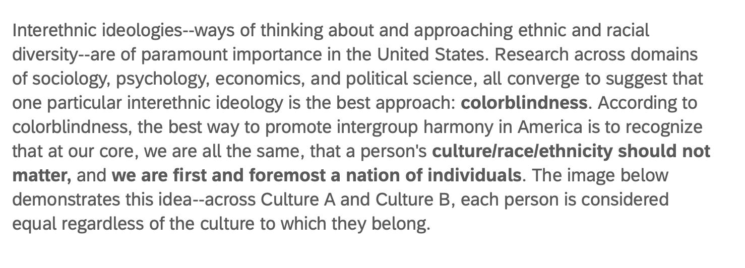
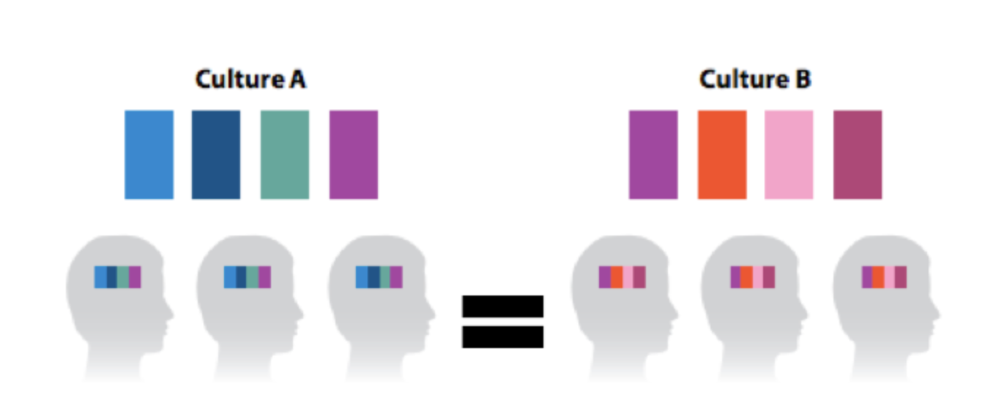
INCREASE COLORBLIND PRIME

Slide 14
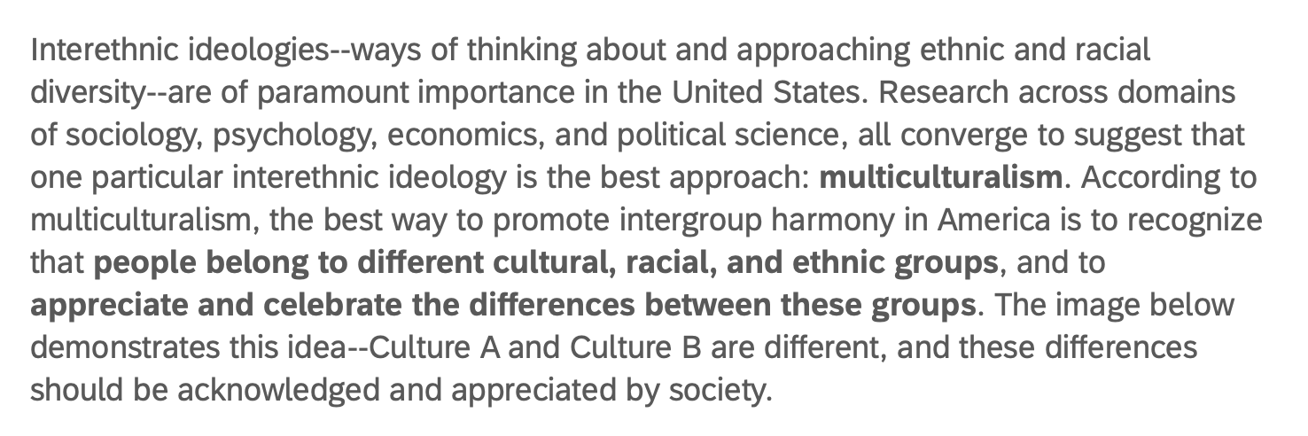
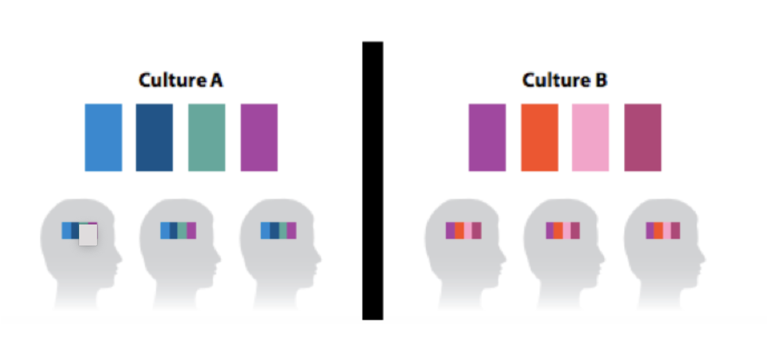
INCREASE MULTICULTURAL PRIME

Slide 15
Measures

Slide 16
MEASURES
Given additional measures
Social Dominance Orientation (Ho et al, 2015)
Modern Racism (McConahay, 1986)
White Privilege
Inter-ethnic Ideologies (Hahn et al, 2015)
BLM/ALM* Support (Holt & Sweitzer, 2020)

Slide 17
Results

Slide 18
STUDY 1 RESULTS
Colorblind Prime
F(317,2) = 1.16, p = .31
Multiculturalism Prime
F(317,2) = 1.02, p = .36
Collapsed across conditions (no diff in support), we find consist results to our previous work regarding inter-ethnic ideologies on BLM and ALM support
Control is underpowered (n = 115 w/ 4 predictors)

Slide 19
Study 3 Discussion

Slide 20
STUDY 3 DISCUSSION
Results suggest that inter-ethnic ideologies are an important predictor for support for BLM or ALM.
Despite this ineffective manipulation, it might be worth investigating other manipulation primes which might elicit stronger impact.
We’ll attempt to do this for Study 4

Slide 21
Study 4

Slide 22
Procedure

Slide 23
EXPERIMENTAL PROCEDURES
Same as Study 3
However, we tried to strengthen the primes by also asking participants to list 2-3 positive aspects of the ideologies that would benefit American society
Recruited 701 participants (511 retained)
Age_{MEAN} = 19.81(SD = 3.67), 70% Female, 55% Christian (All White)

Slide 24
Measures

Slide 25
MEASURES
Same as Study 3
Social Dominance Orientation (Ho et al, 2015)
Modern Racism (McConahay, 1986)
White Privilege
Inter-ethnic Ideologies (Hahn et al, 2015)
BLM/ALM* Support (Holt & Sweitzer, 2020)

Slide 26
Results

Slide 27
STUDY 2 RESULTS
Colorblind Prime
F(506,2) = 3.95, p = .02
Multiculturalism Prime
F(505,2) = 0.51, p = .60
Wrong Comparison (Multiculturalism =/ Colorblindness)
Neutral Condition shows roughly consistent results to Study 1 and previous studies (MC & Assimilation > CB on ALM)

Slide 28
Study 4 Discussion

Slide 29
STUDY 4 DISCUSSION
This work again suggests that MC and Assimilation are better predictors of ALM than CB
Overall, this work suggests that
A) Provides further evidence that CB isn’t the driving force behind ALM support (despite this common claim)
B ) Manipulating MC and CB attitudes is difficult

Slide 30
Thank You!

Slide 31
Q & A

