Slide 1
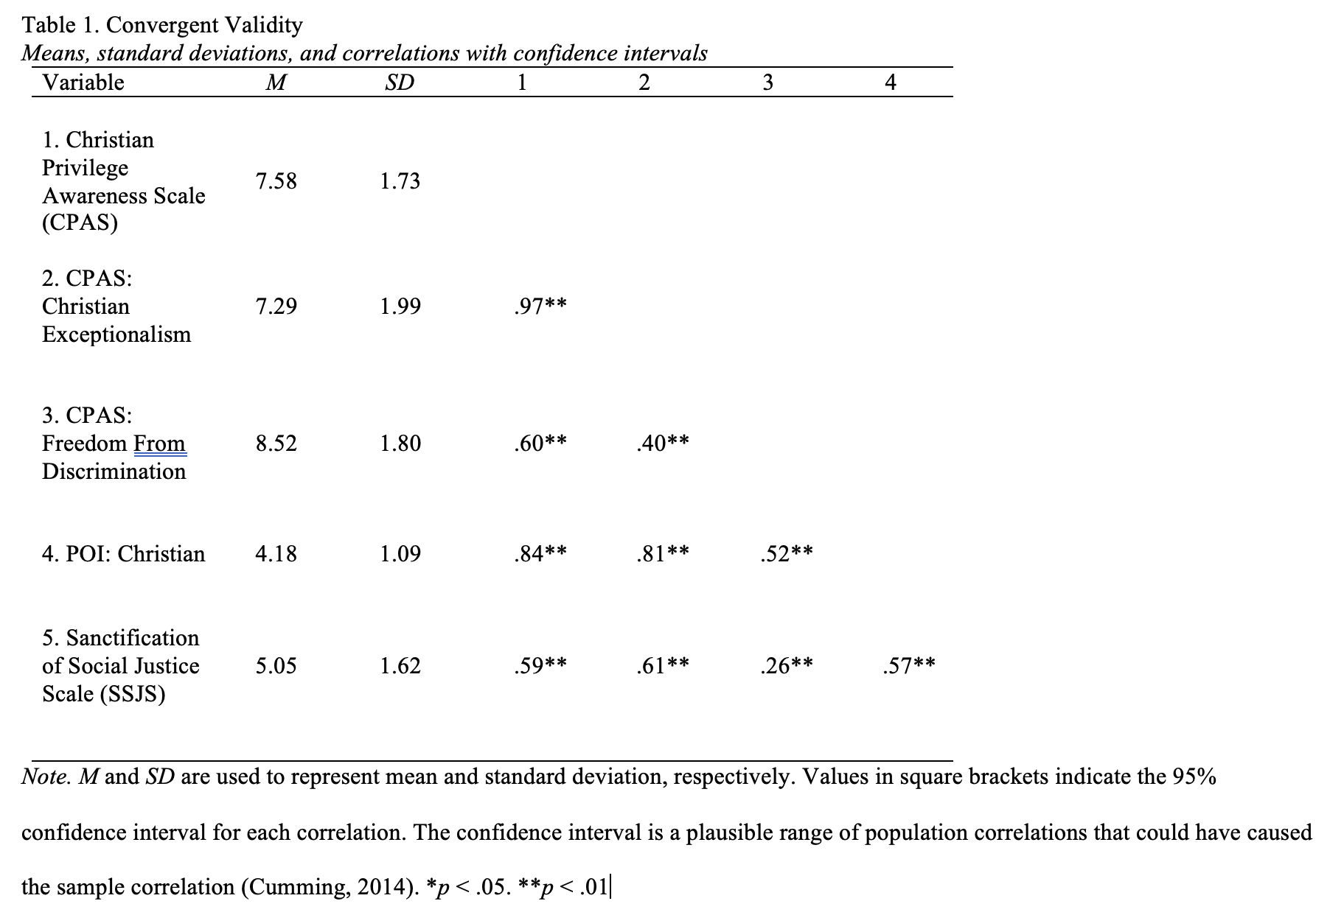
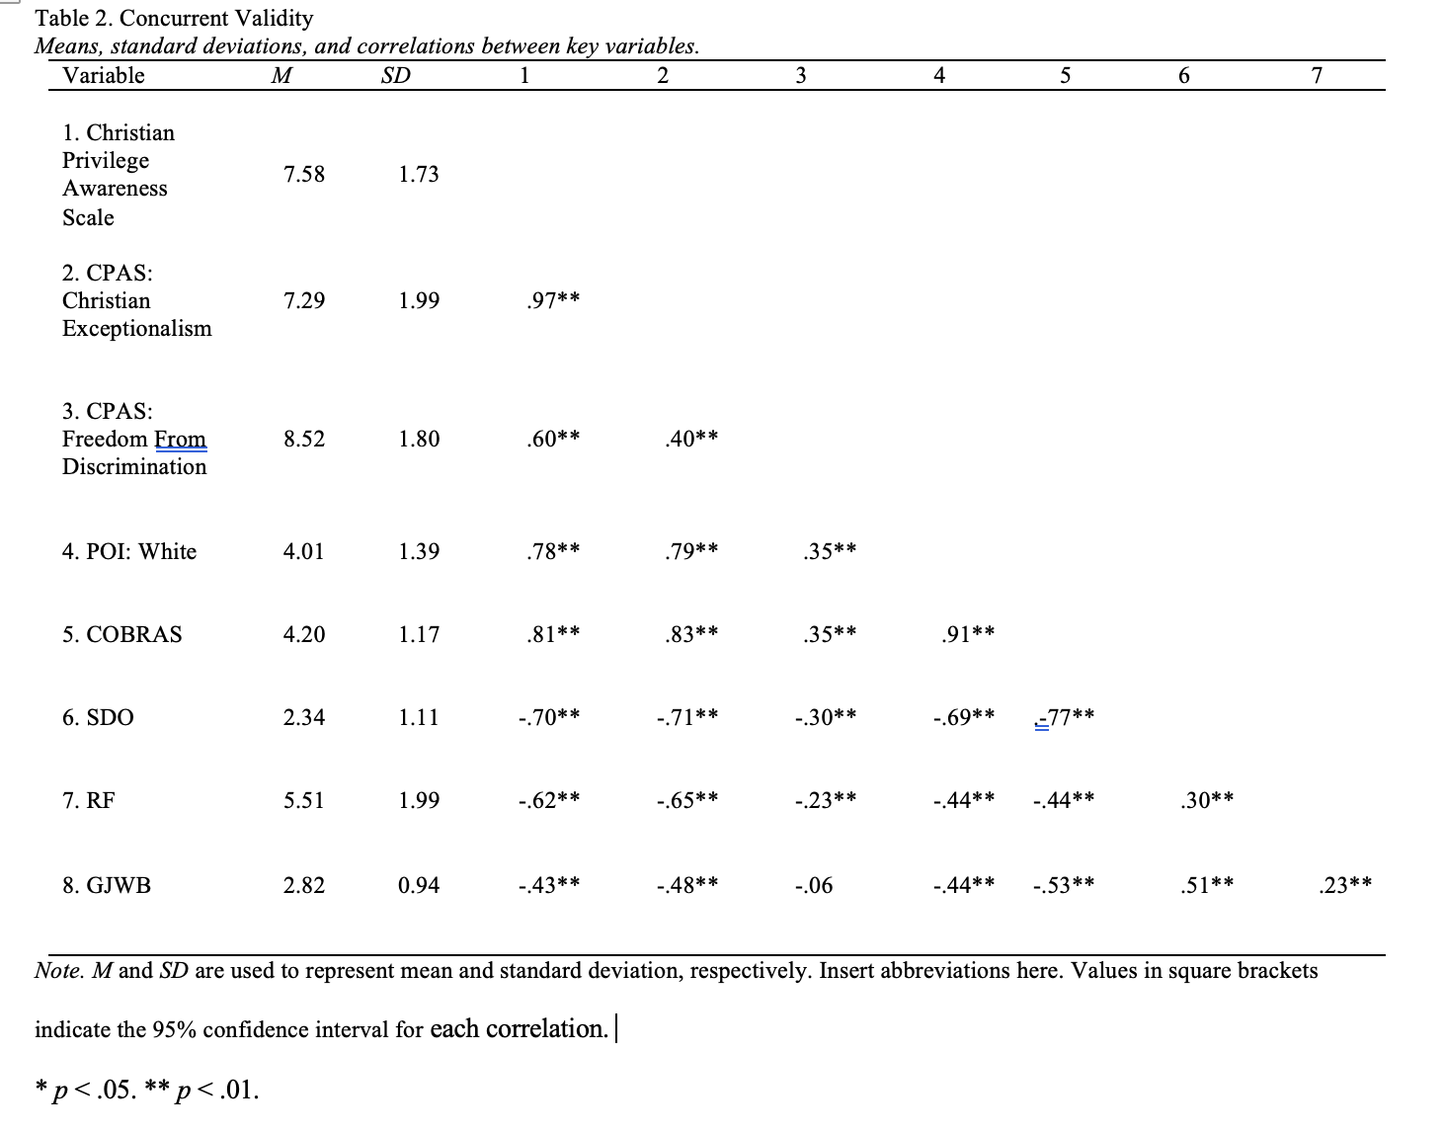
An Exploratory Model of Christian Privilege:
The Development of a Scale to Measure the Attitudinal Constituents of Christian Privilege
Brier Gallihugh, B.A
Eastern Michigan University, Ypsilanti, MI
Introduction
Results
Discussion
Much research centered on privilege has dealt with White privilege (Neville, et al., 2000; Pinterits et al., 2009).
Few (i.e., Privilege and Oppression Inventory 8-item Christian privilege subscale; Hays, et al., 2007) have bothered to look at Christian privilege
This study sought to expand on the work of Hays et al (2007) to more fully capture the construct of Christian privilege.
Factor One (Christian Exceptionalism; 16 Items)
The first factor shows an internal reliability of α = .92 [CI: .90-.93] and contains items such as:
“If someone’s Christian values dictate that they not hire a gay/lesbian person for a job, then that choice should be respected by the rest of society.”
“Religious minorities do not have the same benefits as Christians.”
Factor Two (Freedom from Discrimination; 5 Items)
The second factor shows an internal reliability of α = .74 [CI: .69-.78] and contains items such as:
“I do not have to worry about losing my job because of my Christian faith”.
“It is easy to find places of worship to practice my Christian faith.”
Simply understanding one instance of privilege (i.e., White) is not sufficient to understand privilege. One must take an intersectional approach
Intersectionality is the idea that the interaction between various social identities leads to differential outcomes (Chan et al., 2018)
Taken together, this study provides an initial promising step toward the creation of a more thorough conceptualization of Christian privilege while adding one more tool toward understanding one more full intersectionality as it pertains to a Christian religious conviction.
Background
Israel (2012) defines privilege as “unearned advantages that are conferred to individuals based on membership or assumed membership in a dominant group” (p. 158)
Privilege is conferred to various social groups through legislative and societal means
Privilege has been postulated to be conferred in the United States to the following groups (although this should not be considered an exhaustive list): White people (Pinterits, et al., 2009), men (McIntosh, 2008), the middle class (Liu, et al. 2007), and Christians (Schlosser; 2003).
Limitations and Future Directions
Limitations
Sample consists only of Christians. Factor structure may not apply equally to all Christian denominations.
Sample is largely a convenience sample
Future Directions
A confirmatory factor analysis is needed to “confirm” the proposed factor structure
Further, future research may wish to investigate how individuals high or low in QUEST orientation (as well as high or low on intrinsic and extrinsic religiosity) score on this proposed Christian privilege scale
Methods
Participants
Participants consisted of 398 self identified Christians recruited from Reddit (n = 319), Facebook (n = 59), Twitter (n = 1) and SONA (n = 10)
Participants were all from the United States and ranged in age from 18 to 77 (M = 26.16, SD = 8.6)
Participant religious affiliation consisted of Evangelical Christians (n = 71), Protestant Christians (n = 166), Catholics (n = 62), and "Other" Christians (n = 90) .
Procedure
Participants were recruited from various social media platforms
Upon signing up to complete in the study (in which 4 participants at random would be gifted a $25 Amazon gift card for completion), participants were directed to the primary study materials
Participants were asked to answer the proposed Christian privilege scale items as well as the Color-Blind Racial Attitudes Scale (Neville et al, 2000), Social Dominance Orientation (Pratto et al., 1994), Religious Fundamentalism Scale (Altemeyer & Hunsberger, 1992), Global Just World Beliefs Scale (Lipkus, 1991), Santification of Social Justice Scale (Todd et al., 2015), and Privilege and Oppression Inventory (Hayes et al., 2007).
An exploratory factor analysis was run. After a process of factor analyses and item retention and deletion criteria were analyzed, a 21-item 2 factor solution was chosen as best solution.
Acknowledgements
I would like to thank Dr Jefferson for his continued support and guidance during this thesis project as well as participants for their time and effort in completing the various instruments. Their support, guidance and time are greatly appreciated
References
Chan, C. D., Cor, D. N., & Band, M. P. (2018). Privilege and Oppression in Counselor Education: An Intersectionality Framework. Journal of Multicultural Counseling and Development, 46(1), 58–73.
Hays, D. G., Chang, C. Y., & Decker, S. L. (2007). Initial development and psychometric data for the privilege and oppression inventory. Measurement and Evaluation in Counseling and Development, 40(2), 66-79.
Israel, T. (2012). 2011 Society of counseling psychology presidential address: Exploring Privilege in Counseling Psychology: Shifting the lens. The Counseling Psychologist, 40(1) 158-180.
Liu, W., Pickett Jr., T. & Ivey (2007). White middle-class privilege: Social class bias and implications for training and practice. Journal of Multicultural Counseling and Development, 35(4). 194-206.
McIntosh, P. (2008). In McGoldrick M., Hardy K. V. (Eds.), White privilege and male privilege: A personal account of coming to see correspondences through work in women's studies (2nd ed. ed.) The Guilford Press, New York, NY.
Neville, H. A., Lilly, R. L., Duran, G., Lee, R. M., & Browne, L. (2000). Construction and initial validation of the color-blind racial attitudes scale (CoBRAS). Journal of Counseling Psychology, 47(1), 59-70.
Pinterits, E. J., Poteat, V. P., & Spanierman, L. B. (2009). The white privilege attitudes scale: Development and initial validation. Journal of Counseling Psychology, 56(3), 417–429.
Schlosser, L. (2003). Christian privilege: Breaking a sacred taboo. Journal of Multicultural Counseling and Development, 31. 44-51.

