Slide 1
48 trials
Risk
1 : P(R=0) = 1
2 : P(R=1) = 0.75, P(R=-1) = 0.25
1 : P(R=0) = 1
2 : P(R=1) = 0.75, P(R=-1) = 0.25
1 : P(R=0) = 1
2 : P(R=1) = 0.25, P(R=-1) = 0.75
1 : P(R=0) = 1
2 : P(R=1) = 0.5, P(R=-1) = 0.5
1 : P(R=0) = 1
2 : P(R=1) = 0.75, P(R=-1) = 0.25
192 trials
Status quo 1
1 : P(R=1) = 0.75, P(R=-1) = 0.25,
2 : P(R=1) = 0.25, P(R=-1) = 0.75
1 reversal
trial = 72
2 reversals
trial = 112, 128
3 reversals
trial = 156, 168, 180
1 : P(R=1) = 0.75, P(R=-1) = 0.25,
2 : P(R=1) = 0.25, P(R=-1) = 0.75
Status quo 2
1 : P(R=1) = 0.75, P(R=-1) = 0.25,
2 : P(R=1) = 0.25, P(R=-1) = 0.75
1 reversal
trial = 60
1 reversal
trial = 120
1 reversal
trial = 180

Slide 2
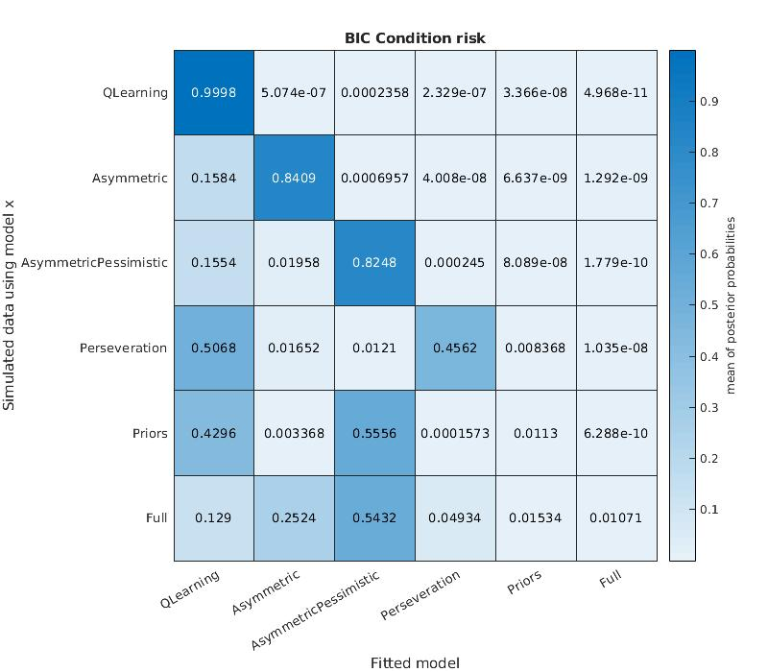
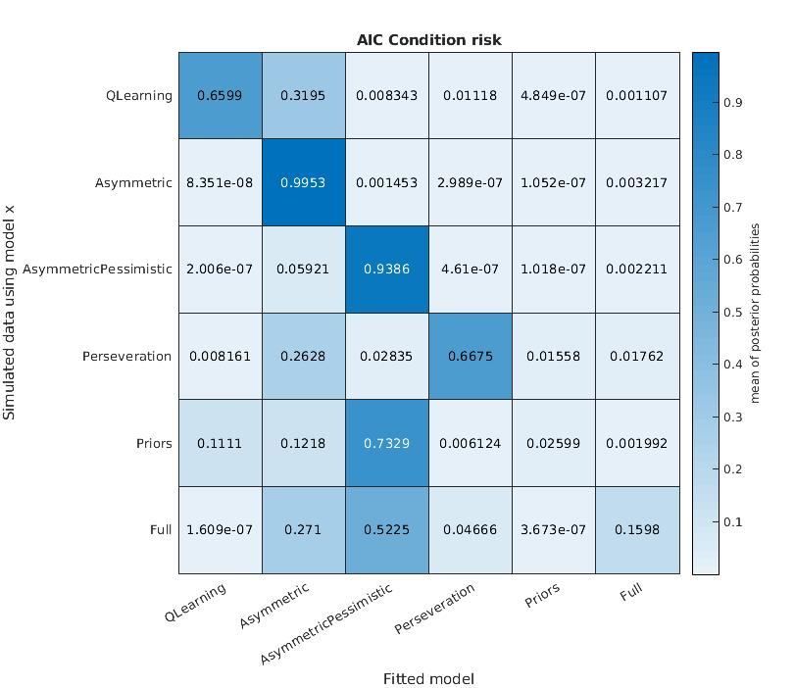

Slide 3
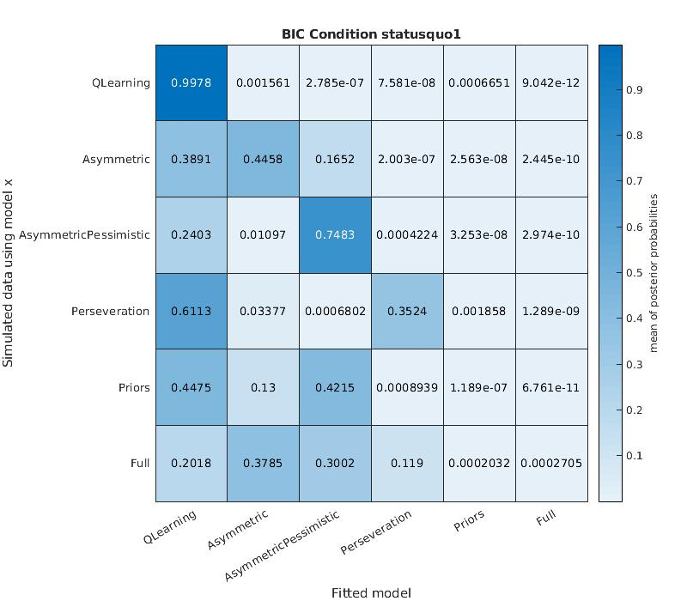
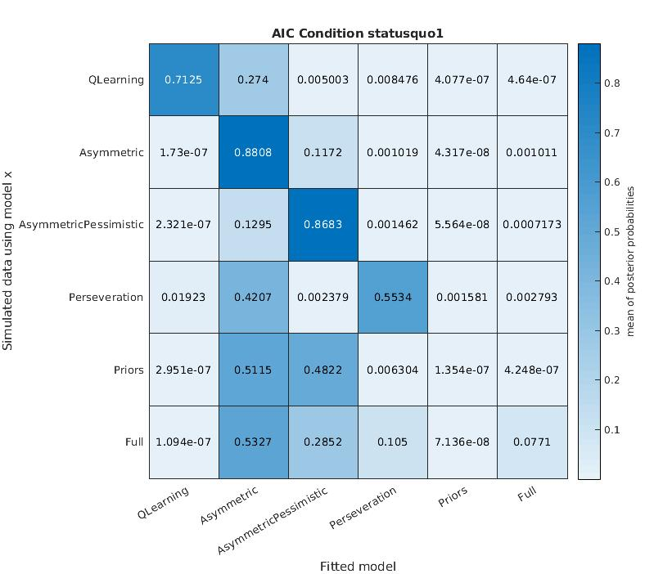

Slide 4
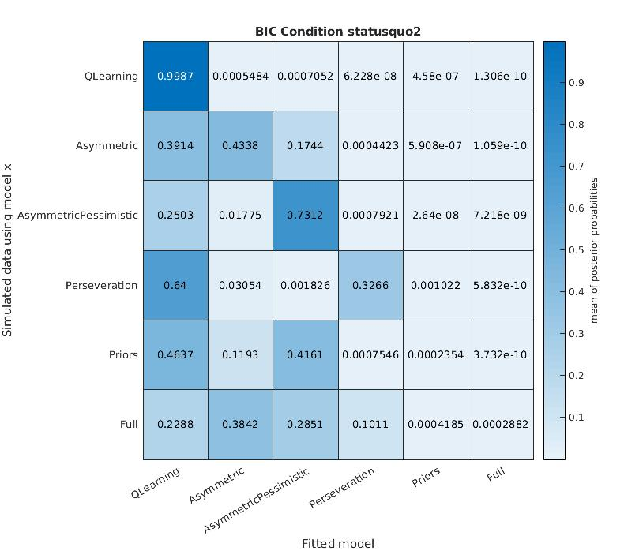
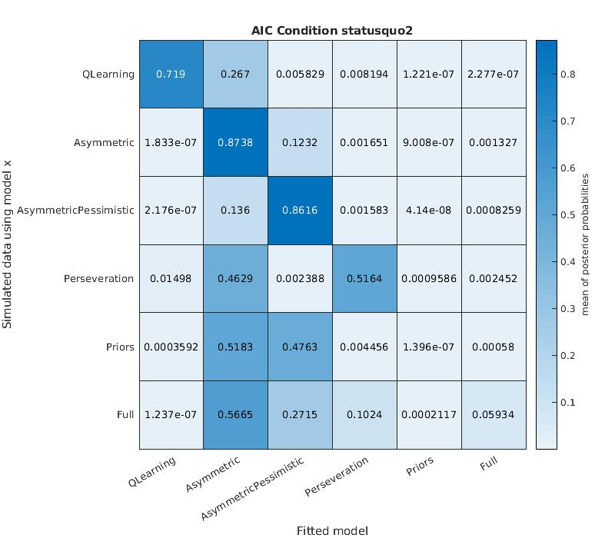

Slide 5
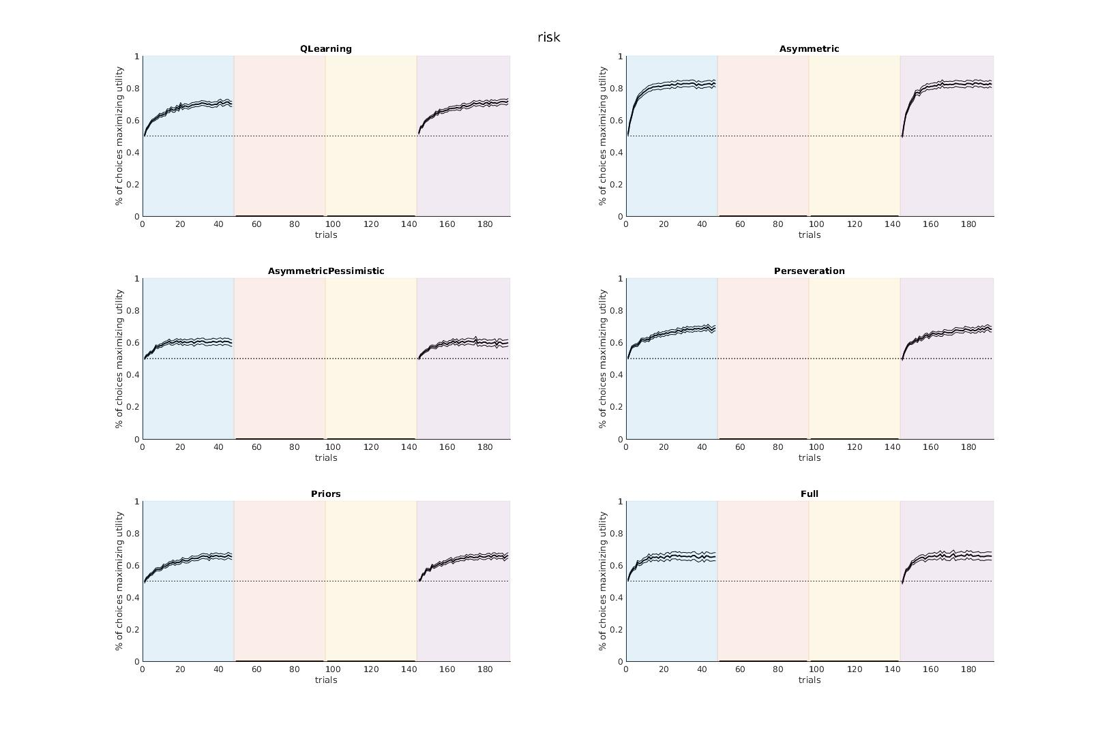

Slide 6
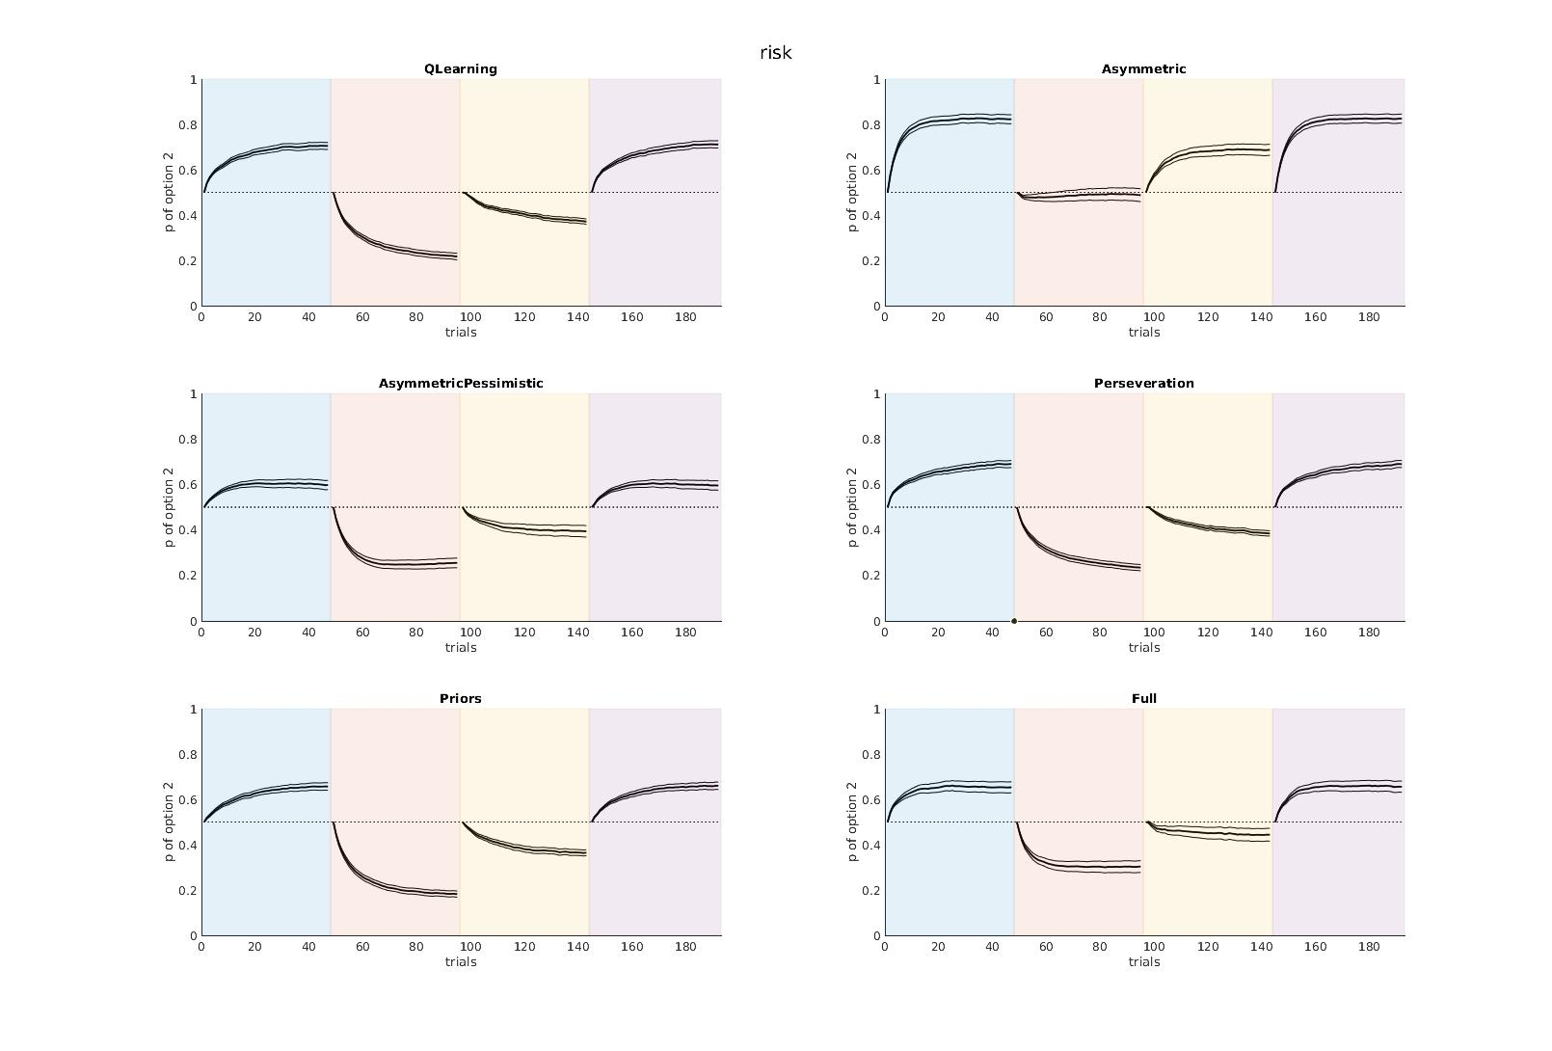

Slide 7
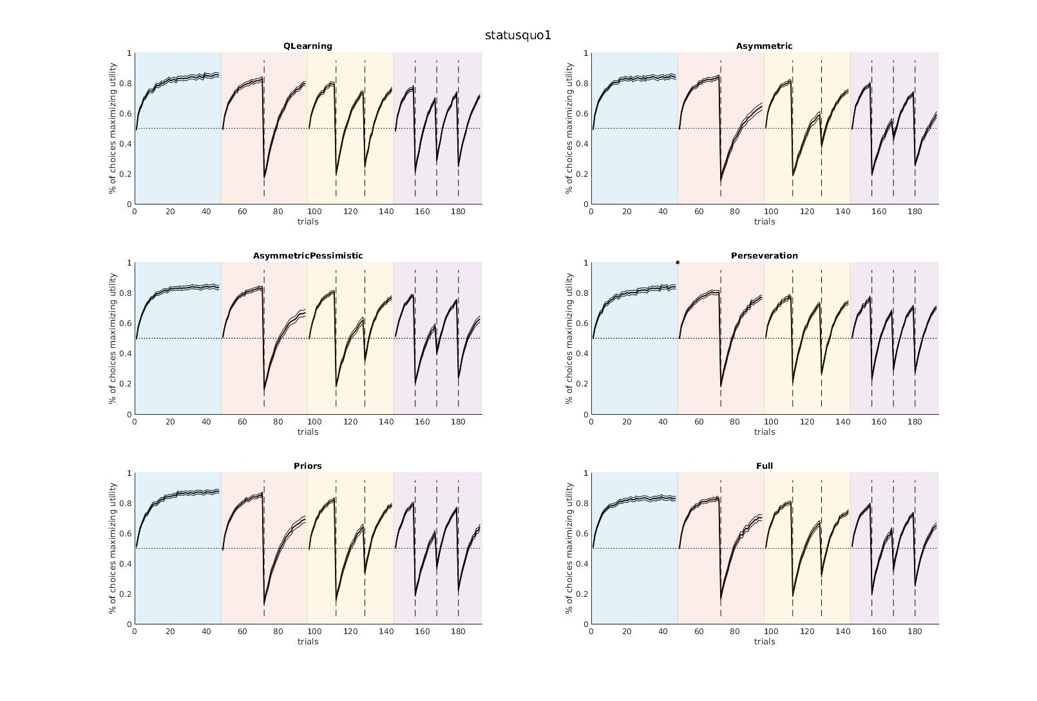

Slide 8
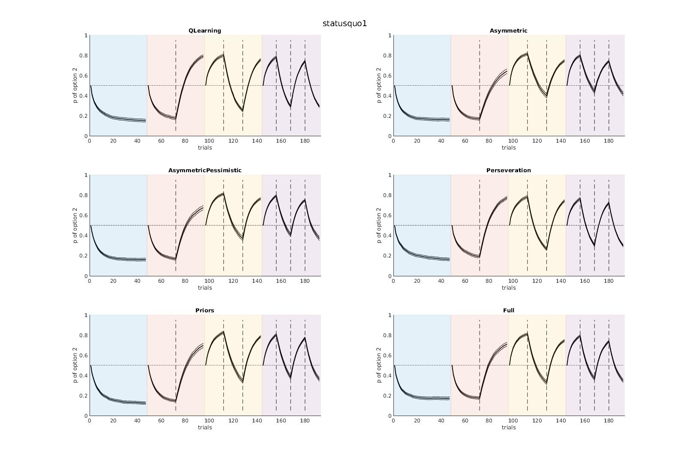

Slide 9
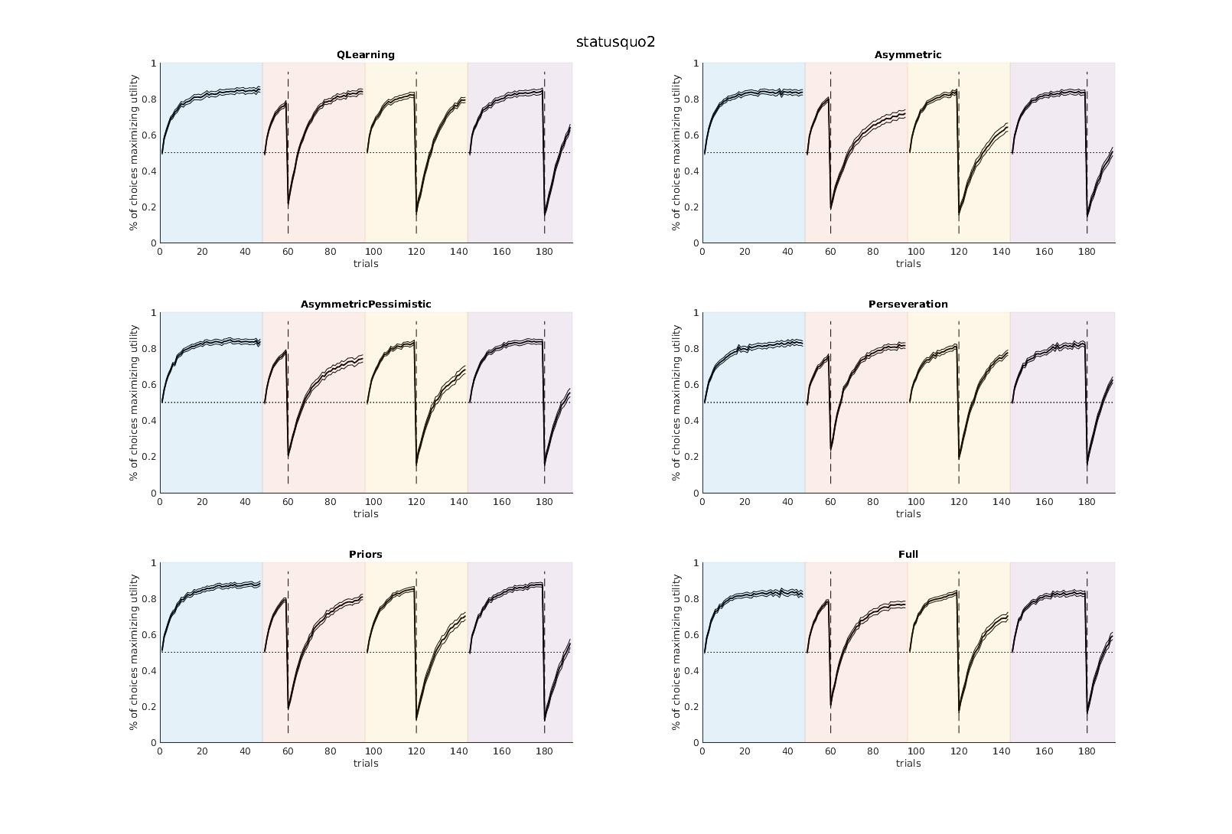

Slide 10
