Slide 1



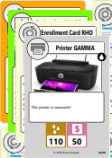
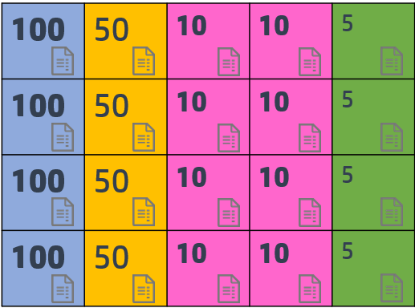
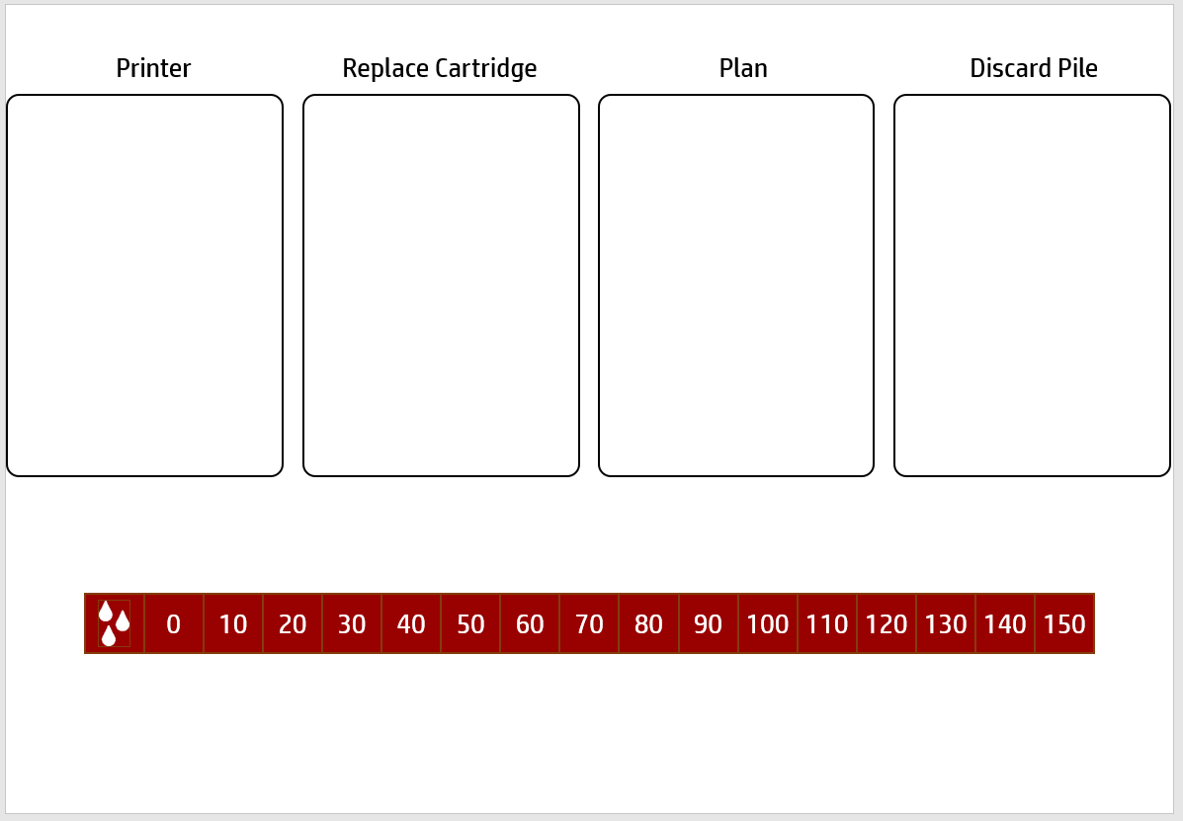
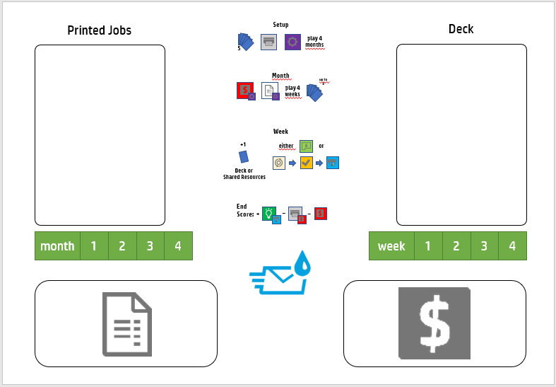


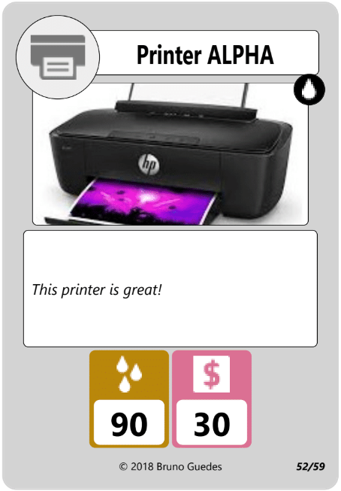
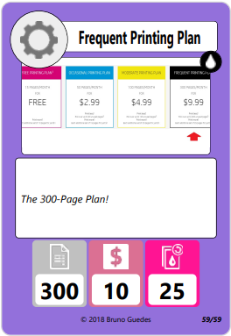

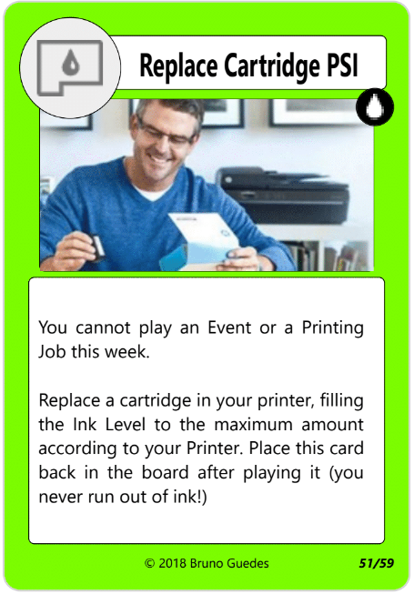


Card Types
Instant Ink Card Game
Printer: each Printer has an Ink Level (this is the capacity of its cartridge: you will refill your ink level to this value each time you play a Replace Cartridge card) and a Cost (money you will spent only at the beginning of the game).
Plan: each Plan has a Page Count (pages you will get at the beginning of every month), the plan Cost (how much you pay every month) and the number of Extra Pages you get per $1 (you might need to purchase Extra Pages to print more Printing Jobs).
Replace Cartridge: this card does not go to the Player Deck. It is always available, but playing it usually will end your turn. This card refills your Ink Level.
Enrollment Card: Enrollment cards always have 2 options. Choose one of them, execute the action and put the Enrollment card face-up in the Discard Pile (unless stated otherwise). One of the options will always allow you to change your Current Plan. If you do this, put the old plan back with the other Plans and place the new one in your playmat.
Event Card: Event cards have multiple effects. Place an Event Card face-up in the Discard Pile (unless stated otherwise) after resolving its effects. Notice that some Event Cards may have restrictions in order to be played.
Printing Job: Printing Job cards are your main source of Saving Points. Each card has two costs that you must pay before playing it: a Page Cost and a Ink Cost. Reduce your Page Count and the Ink Level accordingly and put the Printing Job face-up in the Printed Jobs pile.
The goal of the Instant Ink Card Game is to maximize your savings! You will earn Saving Points when you acquire a printer, enroll for an Instant Ink plan and then start printing multiple Printing Jobs! The game with the Base Set consists of 59 playable cards and is supposed to be played by one player!
Components
20
1
1
5
1
10
20
1
5
1
20
1
10
1 playmat
3 cubes
20 Page
Cards
1
5
59 cards
15 Coins
Solo Game Setup
1. Set aside all 4 Printers and all 4 Plans
2. Shuffle 30 Printing Job cards, 16 Event cards and 4 Enrollment cards to form the Player Deck, face-down.
4. Place all coins and page cards aside
3. Put the Replace Cartridge card here
It does not end here!
5. Draw 6 cards (your initial hand) and take $100 from coins
6. Choose a Printer and place it here
8. Place cubes on Week 1, Month 1 and on the maximum Ink Level of your chosen Printer in the Ink Level tracker
You may have noticed the symbol at the top right corner of the card. This symbol corresponds to the set collection (in this case, this is the Base Set). New sets will be release expanding the game to allow more players to play at the same time and creating new game modes!
7. Choose an Instant Ink plan and place it here
4
1

Slide 2
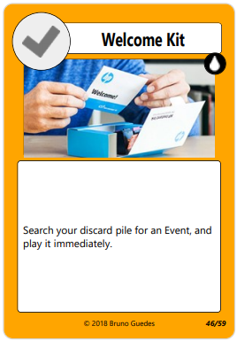
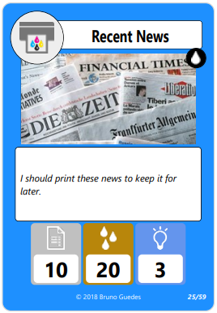
Game Flow
Usually, the only way to change Plans is through playing an Enrollment Card. Enrollment Cards always present you with multiple options. Choose one and only one when playing this card, then place it at the discard pile as usual.
You may purchase Extra Pages (up to twice your current Plan Page Count) at any moment, paying $1 to add 10/15/20/25 pages, depending on your plan.
In the rare case you run out of money, play the rest of the game with the Pages you already have. Change your plan to the Free Printing Plan (discard any exceeding Pages).
The game is played for 4 months, with 4 weeks each month (each week is a turn). You will try to maximize the amount of Saving Points received at the end of the game.
At the beginning of each of the 4 months:
Pay your current plan Cost
Add the Page Count of your plan to your Page Count pile.
You can never exceed twice your current Plan Page Count (discard any exceeding Pages).
You will start every week by drawing 1 card from your Deck.
Then, you have two options:
Play a Replace Cartridge card.
In this exact order (the three actions are optional):
you MAY play 1 Enrollment card, and/or
you MAY plan 1 Event card, and/or
you MAY play 1 Printing Job card.
Once you play 1 week, advance the week counter to the next week.
After playing 4 weeks, if you have less than 6 cards in your hand, draw cards until you have 6 cards. Then, advance to the next month. You keep any unused Pages from your Page Count. You can buy extra Pages at you current Plan rate at any time (always respecting the 2x Page Count limit).
Advance the Month tracker and start playing a month again (until you play 4 months).
End of the Game
The game ends after four months. Sum all your saving points earned from the Printed Jobs pile, and the remaining money you have ($100 minus the monthly fee from Plans, the cost of the Printer and any money you may have spent with extra Pages or other card effects). Try to maximize your savings!
Example: Your pile of Printed Jobs has a total of 85 Saving Points. You have $23 remaining (you spent $77: $50 with your printer, and four times the $5 plan (with $7 of extra page purchases). You finished the game with 85 + 23 Saving Points = 108 Saving Points!
Anatomy of a Card
Card Icon
Set Icon
Card Effect
Card Name
More Information
When you play a card from your hand, put it in a discard pile if it is an Enrollment or an Event card, and put it on a Printed Jobs pile whenever you play a Printing Job.
Some Events or Enrollment Cards may alter your turn structure. Whenever a card text contradicts the rules, follow the card instructions (example: the ‘Ink Savings’ event on Base Set allows you to play a Replace Cartridge card while still being able to play a Printing Job at the same week!)
Card Label
Card Index in Set
Card Text (flavor text)
Page Count
Number of Pages per $
Ink Level
2
Cost
Saving Points
3

Slide 3
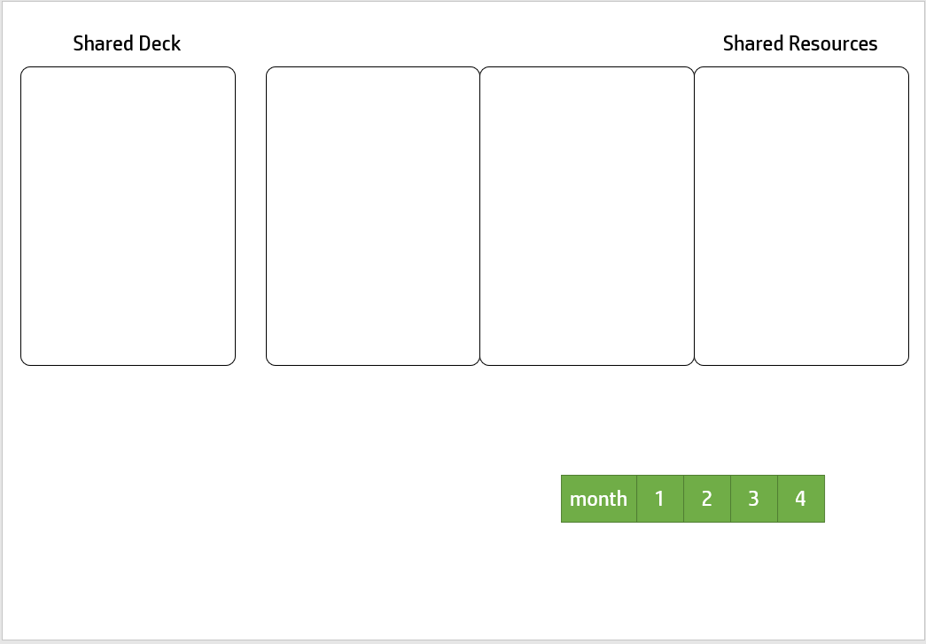
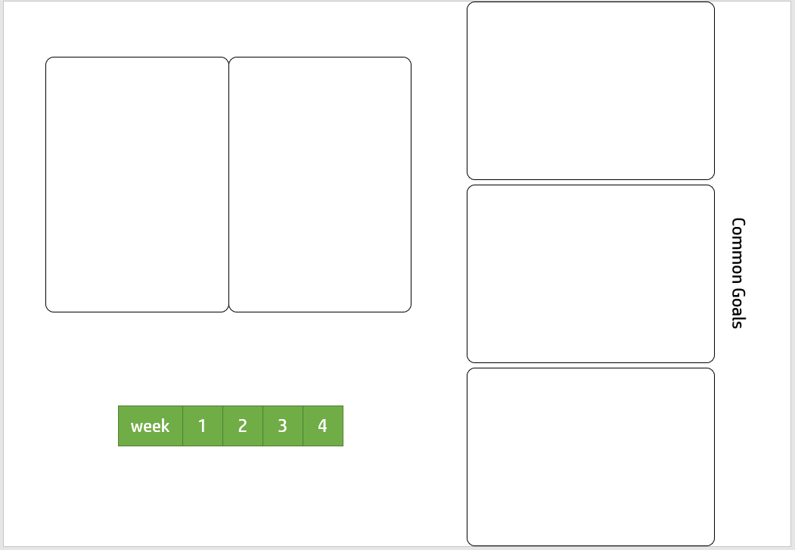
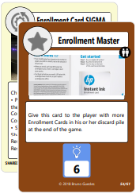
Instant Ink Card Game
Duelist Set
The new Duelist Set expands the Instant Ink Card Game and allows for a 2-Player competitive experience! This new set adds 61 cards to the Base Set game. Each player will have a Deck that will mix cards from both Base Set and Duelist Set. There is also a Shared Deck, that will be used by both players. All cards from this set are marked with the symbol.
Components
1
20
1
5
1
10
20
1
5
1
20
20 Page
Cards
1
10
1 cube
1
5
61 cards
15 Coins
2 playmats
Creating the Player Decks and the Shared Deck
Take all 40 cards from the Duelist Set that have the SHARED DECK card label (in the bottom left corner) and create a Shared Deck by shuffling these cards (there will be 30 Printing Jobs, 3 Enrollment cards and 7 Event cards in the Shared Deck).
Each player Deck will have 30 cards:
15 random Printing Job cards from the Base Set
8 Event cards (1 of each from the Base Set (with no repeating Events)
2 Enrollment RHO cards from the Base Set.
Add from the Duelist Set:
3 of the new Event cards from the Duelist Set (one of each, no repetitions)
2 of the new Enrollment SIGMA cards.
4
1

Slide 4
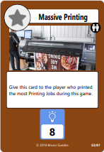
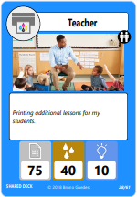
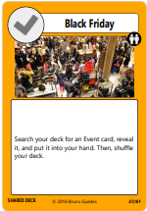
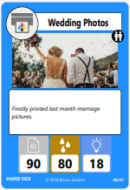
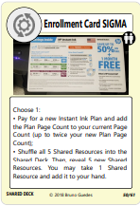
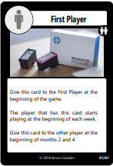
Setup
4. Place all coins and pages aside.
Changes in Game Play
3. Take all Common Goal Cards and randomly reveal 3 of them. Discard the rest.
5. Each player shuffle their Player Deck and draw 6 cards. Also, each player takes $100.
The players, starting with the First Player, will alternately play turns every week (each player will still play 16 turns in the game). The First Player plays each week of the first month before the second player. Alternate the First Player at the beginning of months 2 and 4 (each player will be the first player for two months).
The game flows as per the Base Set rules. However, at the beginning of the week, a player may opt to draw a card from the visible Shared Resources INSTEAD of drawing it from the top of his or her player Deck.
Also, when a card instructs you to take a specific type of card from the Deck or your discard pile to your hand, show it to the other player before adding it to your hand (such as the ‘Enjoy an Easier Way to Print’ Event).
Every time a player takes a card from the Shared Resources, immediately draw a new card from the Shared Deck and add it to the Shared Resources, be it from the Weekly draw or due to the effect of a card.
2. Reveal the top 5 cards from the Shared Deck and let them visible in the playing area. This bank of 5 cards is the Shared Resources area.
1. Give each player their own Deck, Replace Cartridge card and Plan cards.
Common Goal Cards
8. Place cubes on Week 1 and Month 1 on the common playmat and on the maximum Ink Level of your chosen Printer in the Ink Level tracker of each player’s playmat.
The Common Goal cards will give extra points at the end of the game to the player who fulfills its conditions. In case of a tie, no player gets these cards at the end of the game. The Common Goals remain visible to both players during a match.
Scoring
The game ends after 4 months. Calculate your score as per the base rules. Give the corresponding Common Goals cards to the players that earned them and add these Saving Points to the player score. The player who scores the most saving points wins!
In case of a tie, the player who has more money wins. If the tie persists, the player who printed most Printed Jobs wins. If the tie persists, the victory is shared between the two players.
7. The First Player chooses a Printer. The other player chooses another Printer from the remaining ones, and chooses a Plan for his or her Plans. Finally, the First Player chooses a Plan (they can choose the same Plan, not the same Printer).
6. Give the First Player card to the player who most recently printed something.
2
3

