Slide 1
Sample Test for Orchestration with Camunda

Slide 2
Goal
Demonstrate orchestration with Camunda
Show how microservices can collaborate
Provide a testable loan request process

Slide 3
Tools
Camunda BPM (v7.23)
Spring Boot (REST APIs)
Keycloak (Authentication & Authorization)
BPMN 2.0 (Process Modeling)

Slide 4
Sample Loan Process
Start Loan Request
Submit Application
• Check Credit Score
• Decision Gateway
• Disburse Loan or Reject Loan
Start → Submit Application → Check Credit Score → [Gateway: creditScore >=600?] → Disburse Loan / Reject Loan

Slide 5
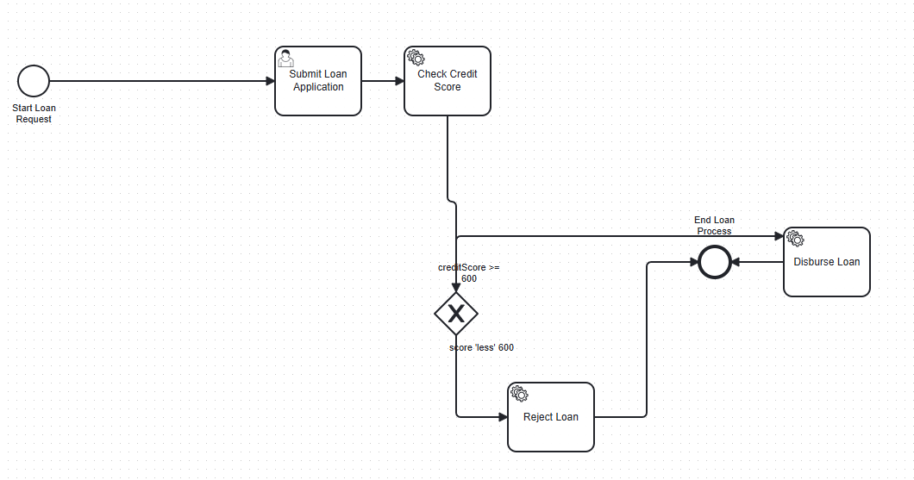
Sample Loan Process

Slide 6
Role of Orchestration
Camunda controls the flow between services
Ensures tasks are executed in the correct order
Handles decisions and routing automatically
Provides visibility of process execution

Slide 7
Advantages
Clear separation of concerns
Easier monitoring and troubleshooting
Scalable and maintainable architecture
Extensible for future business processes

Slide 8
Next Steps
How Camunda communicate with spring-boot?
Extend the process with more microservices
Add error handling and compensation
Demonstrate Saga pattern integration
Connect to real-world data sources

Slide 9
Camunda as a Saga Orchestrator
Implementing a Loan Request Process in a Microservices Architecture

Slide 10
The Orchestration Pattern & Camunda's Role
The Core Concept
Orchestration uses a central coordinator (the Orchestrator) to manage workflow.
The Orchestrator sends commands to services and handles their responses.
It is responsible for the overall workflow and triggering compensation if a step fails.
Camunda's Role: The Intelligent Orchestrator
Camunda Platform provides a powerful, persistent, and highly visible engine to:
Execute business processes defined in BPMN.
Coordinate calls to distributed microservices.
Maintain process state and manage long-running transactions.
Handle errors and compensation logically.
Provide deep visibility into process execution.
Analogy: Camunda is the conductor of your microservices orchestra.

Slide 11
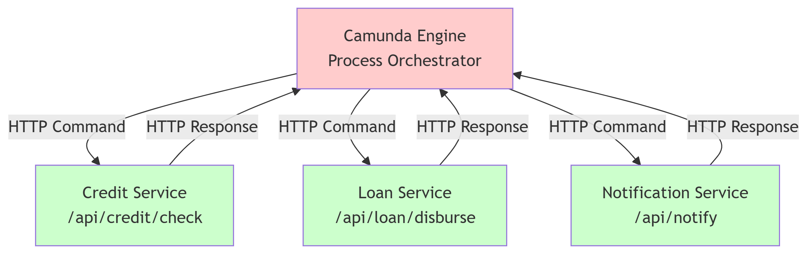
Microservices Architecture & Communication
Synchronous REST Communication
Camunda's Delegates use REST Template or Feign Client to call services.
Simple and direct.
Requires temporary coupling during the request/response.

Slide 12
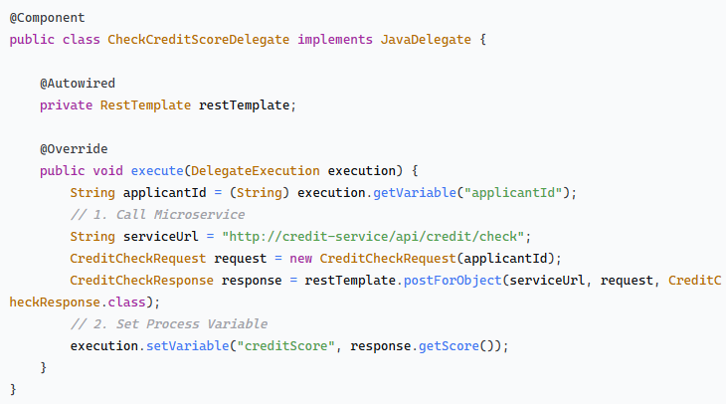
Implementing the Service Tasks: Java Delegates
Delegate: Check Credit Score
Calls the dedicated Credit Service microservice.

Slide 13
Understanding the Saga Pattern
Managing Transactions in a Microservices Architecture

Slide 14
The Challenge: Transactions in Microservices The Problem
In a monolithic application, a database transaction ensures ACID (Atomicity, Consistency, Isolation, Durability) properties across operations.
The New Reality
In microservices, data is spread across independent databases. We can't use a single distributed transaction!
The Need
A way to manage a business transaction that spans multiple services without strong locking.

Slide 15
What is the Saga Pattern?
A saga is a sequence of local transactions where each transaction updates data within a single service.
Each service participates in the saga by executing its local transaction.
If a local transaction fails, the saga must execute compensating actions to undo the impact of previous transactions.
It provides eventual consistency instead of atomicity.
Analogy: A long-running business process like booking a trip (flights, hotel, car). If you cancel, you must call each company for a refund.

Slide 16
The Two Saga Implementation Styles
There are two primary ways to coordinate the steps in a saga:
Choreography: Decentralized coordination through events.
Orchestration: Centralized coordination through a commander.

Slide 17
Saga Choreography
Concept:
No central coordinator.
Services communicate with each other through events.
Each service listens for events and decides to act or publish a new event.
How it Works
Service A executes its transaction and publishes an Event.
Service B listens for that event, executes its transaction, and publishes a new event.
If Service B fails, it publishes a compensating event.
Service A listens for the compensating event and runs its compensating action.
Analogy: A dance where each dancer follows the music and others' moves without a choreographer shouting instructions.

Slide 18
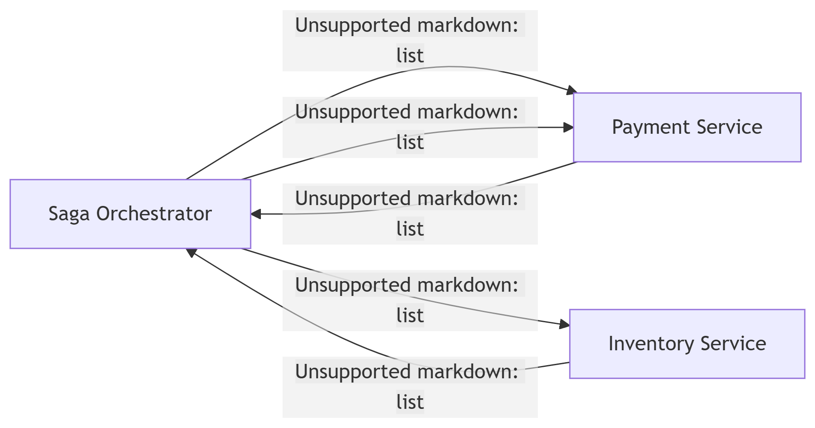
Saga Orchestration
Concept:
A central Saga Orchestrator (a state machine) tells the participants what to do and when.
The orchestrator sends commands to services and handles their responses.
It is responsible for managing the overall workflow and triggering compensation if a step fails.
How it Works
The Orchestrator sends a Command to Service A.
Service A executes the command and replies with an outcome.
Based on the outcome, the Orchestrator sends the next Command to Service B.
If Service B fails, the Orchestrator sends compensating commands in reverse order.
Analogy: A conductor leading an orchestra, telling each musician when to play.

Slide 19
Key Differences: Choreography vs. Orchestration
Aspect | Choreography | Orchestration
Control | Decentralized | Centralized
Communication | Async Events | Sync Commands
Complexity | Hard to debug and understand | Easier to monitor and manage
Coupling | Services are aware of each other | Services are decoupled from the flow
Responsibility | Each service handles its compensation | Orchestrator handles compensation logic

Slide 20
Which One Should You Choose?
Choose Choreography When:
Your saga is simple with few steps.
You want to avoid a single point of failure.
Your team prefers a highly decoupled, event-driven architecture.
Choose Orchestration When:
The workflow is complex or involves many services.
You need clear control over the sequence of events.
You require better monitoring and easier debugging.
You want to avoid cyclic dependencies between services.
Tools like Camunda and Temporal are perfect for Orchestration!

Slide 21
Summary
The Saga Pattern is essential for managing long-lived, distributed transactions in microservices.
It uses compensating actions to ensure data eventual consistency.
Choreography uses events for decentralized control.
Orchestration uses a central commander for predictable, easy-to-follow workflows.
The best choice depends on your system's complexity, team structure, and needs.

