Slide 1
Primer for Dr. Ryan Wisnesky at
the DIF Interop WG
Brent Shambaugh

Slide 2
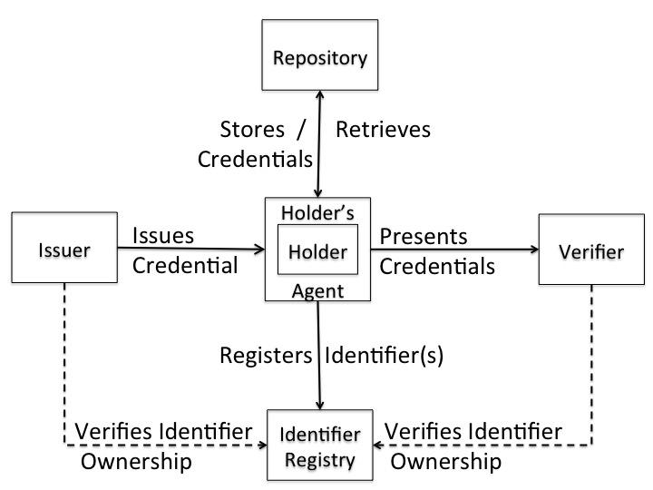
Verifiable Credentials Lifecycle
https://w3c-ccg.github.io/vc-lifecycle/
Identifier Registry contains DIDs and possibly full or a hash representation of DID Documents
and/or Schemas?

Slide 3
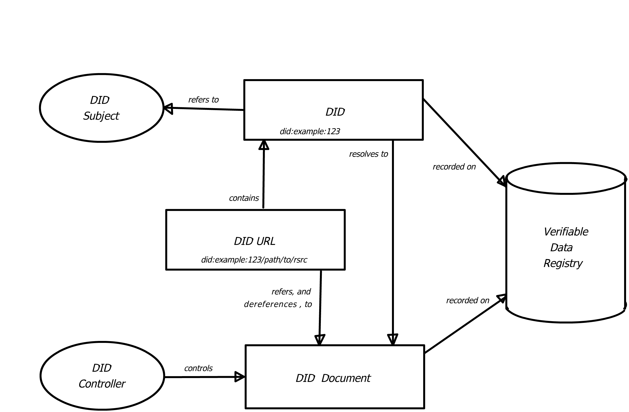
Decentralized Identifier Architecture
Figure 2 Overview of DID architecture and
the relationship of the basic components.
Adapted from: https://www.w3.org/TR/did-core/

Slide 4
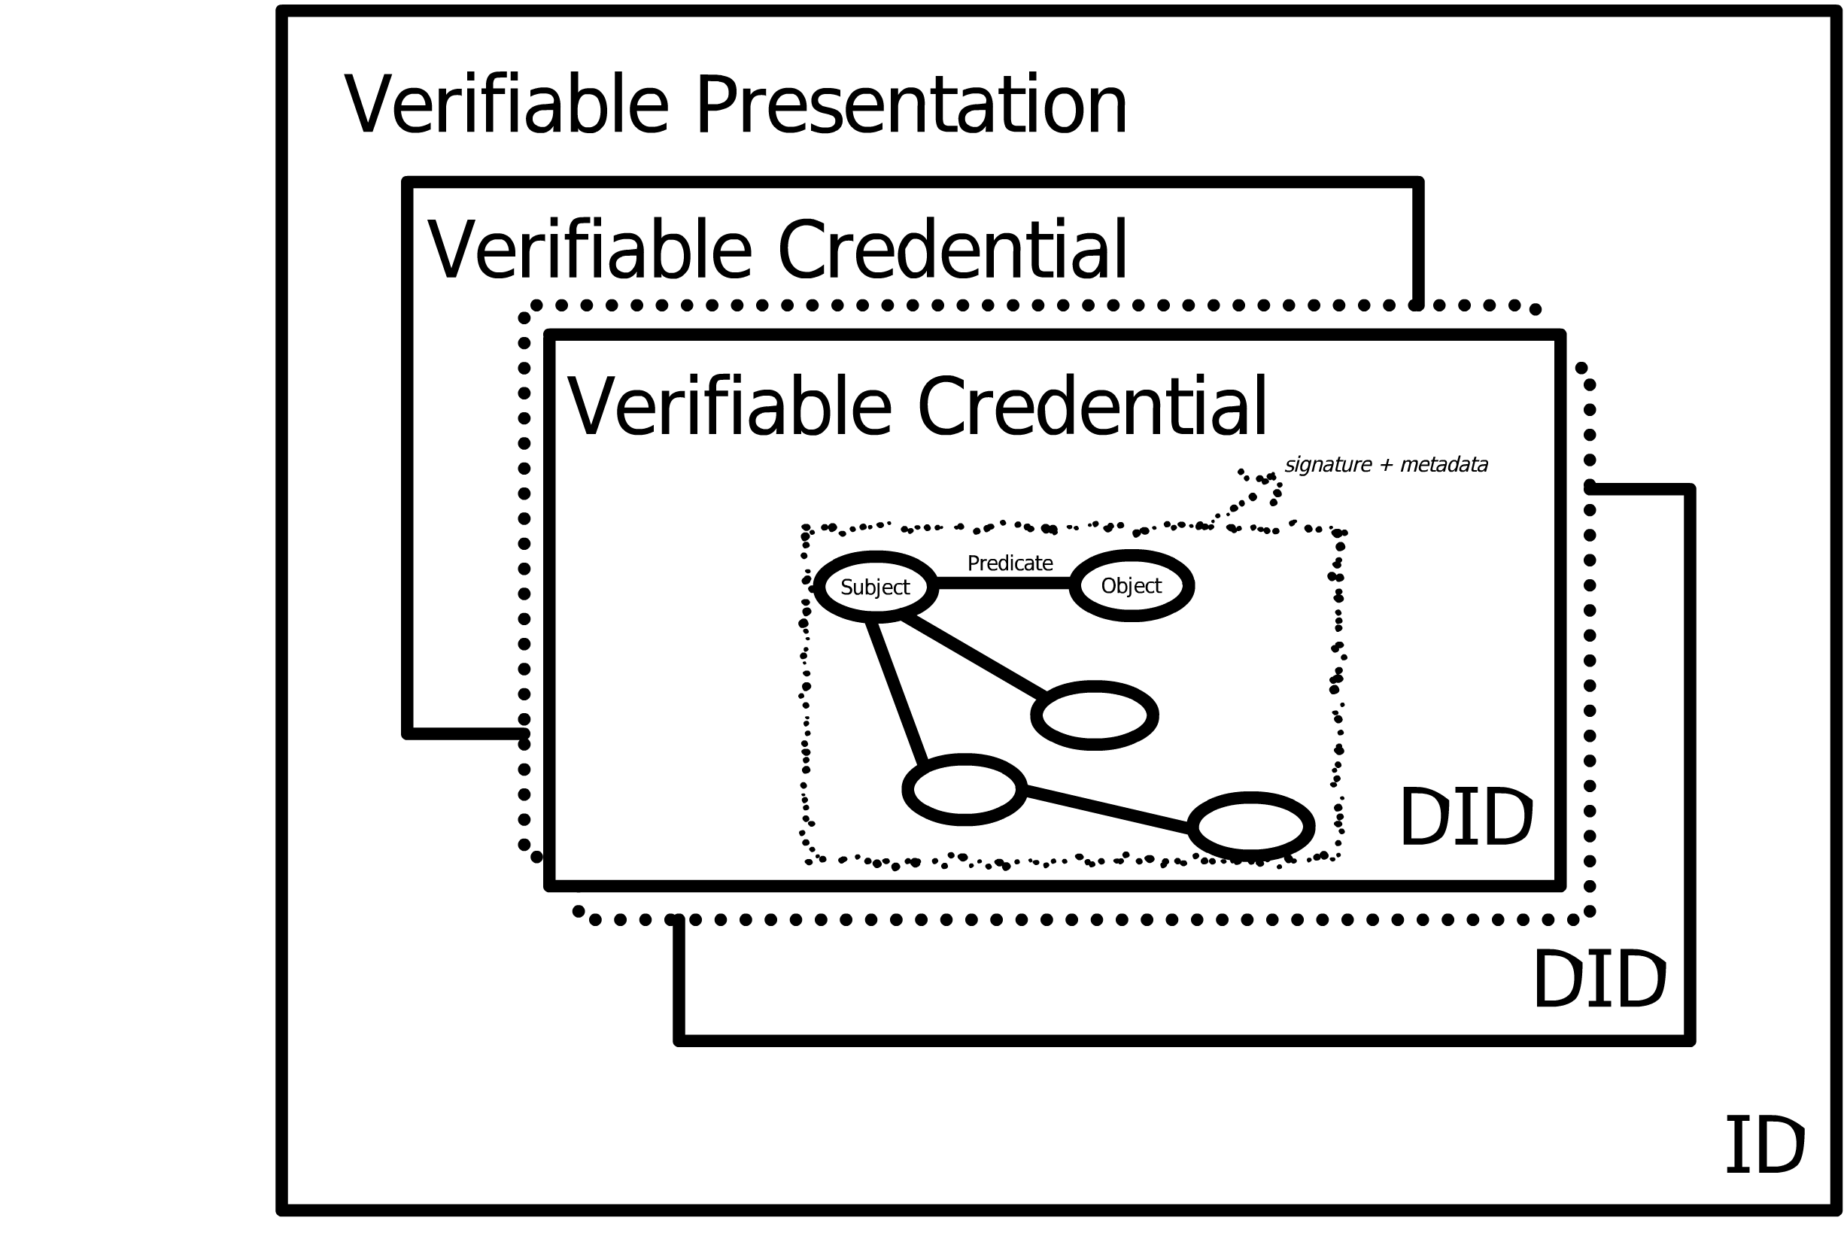
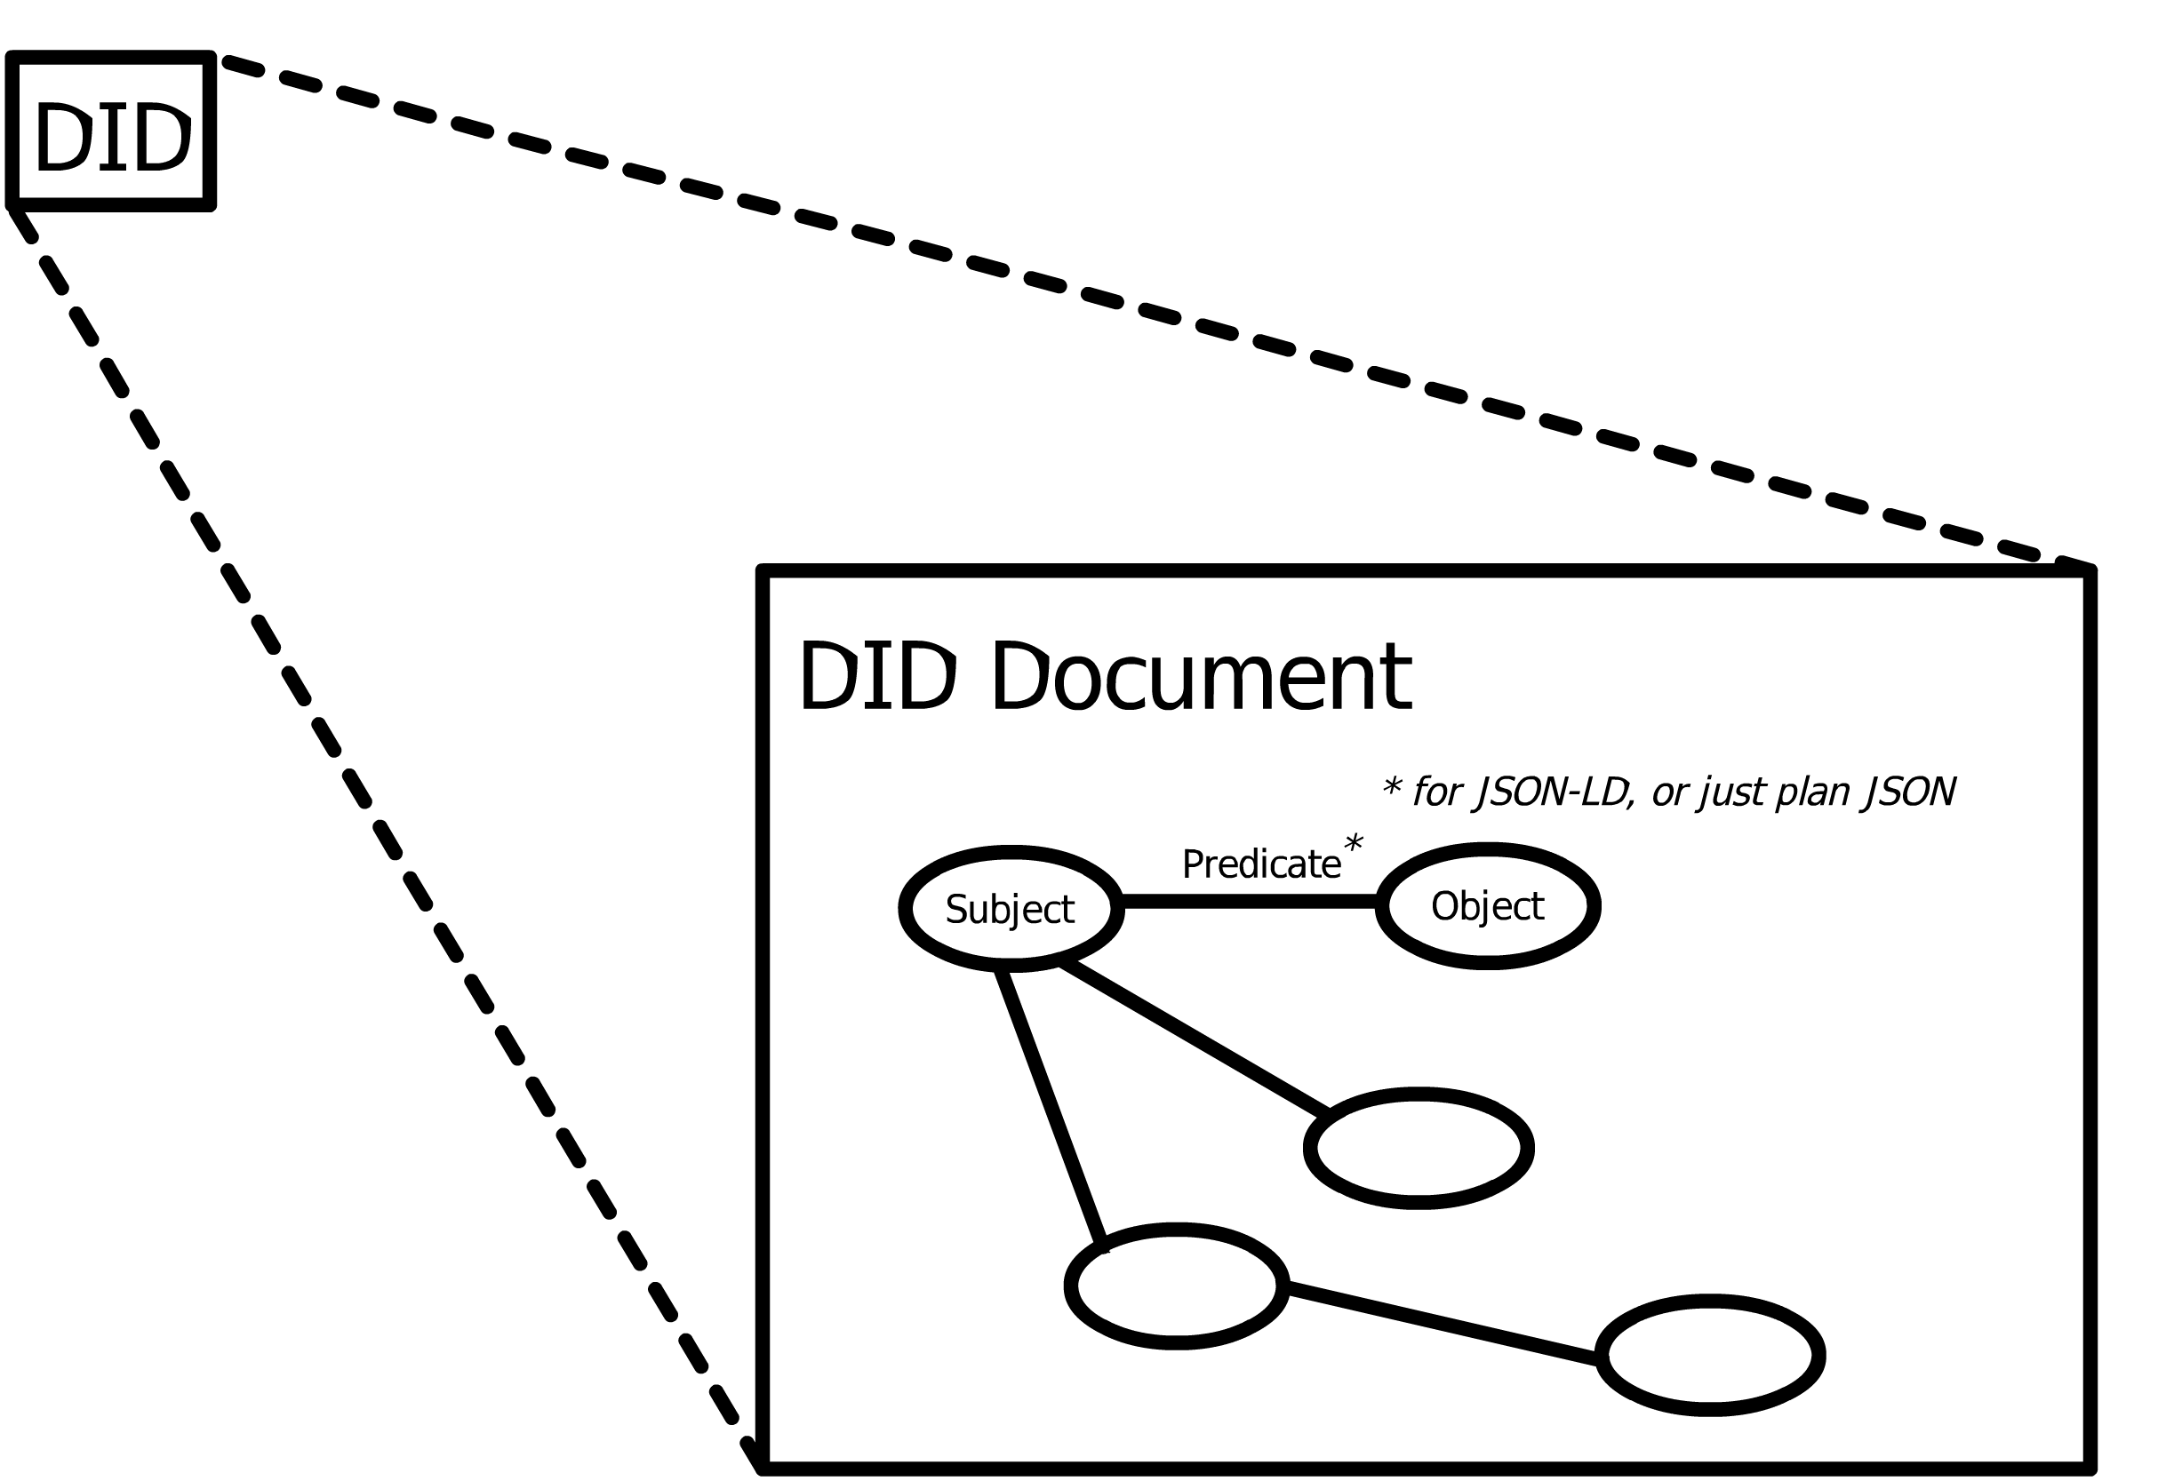
Data Models
Verifiable Claims
Inspired by:
https://www.w3.org/TR/did-core/
Inspired by:
https://www.w3.org/TR/vc-data-model/,
https://identity.foundation/presentation-exchange/spec/v2.0.0/

Slide 5
Proof Mechanisms
JSON Web Tokens [RFC7519] secured using JSON Web Signatures [RFC7515]
Data Integrity Proofs [DATA-INTEGRITY]
Camenisch-Lysyanskaya Zero-Knowledge Proofs [CL-SIGNATURES].
JSON Web Proofs - JWTs with Superpowers [JSON Web Proofs]
Signatures require Canonicalization
https://w3c-ccg.github.io/rdf-dataset-canonicalization/spec/index.html
[DATA-INTEGRITY] Verifiable Credential Data Integrity 1.0, M. Sporny et al.,
https://www.w3.org/TR/vc-data-integrity/
[RFC7519] The JavaScript Object Notation (JSON) Data Interchange Format, T. Bray, ed,
https://www.rfc-editor.org/rfc/rfc8259
[RFC7515] JSON Web Token (JWT), M. Jones et al.,
https://www.rfc-editor.org/rfc/rfc7519
[CL-SIGNATURES] A Signature Scheme with Efficient Protocols. Camenisch et al., IBM Research. Peer Reviewed Paper.
https://www.researchgate.net/publication/220922101_A_Signature_Scheme_with_Efficient_Protocols
[JSON Web Proofs] https://raw.githubusercontent.com/windley/IIW_homepage/gh-pages/assets/proceedings/IIW_33_Book_of_Proceedings.pdf,
https://github.com/json-web-proofs/json-web-proof

Slide 6
Cryptographic Signature
Algorithm | EdDSA | ECDSA | Yours
Generate |  |  | ...
Validate |  |  | ...
Source | https://cryptobook.nakov.com/digital-signatures/eddsa-and-ed25519
private signing key generated from random integer (seed)
public key
is a random secret number used once in the range [0...p-1]
is the x-coordinate of P
is the order of the subgroup of the points generated by
is the private signing key
is the message
is the generator point
Signature is not deterministic due the random number k
is the modular inverse of
if
the signature is valid
is the public key
Real World Cryptography, David Wong, Manning, pg. 143 - 144
https://cryptobook.nakov.com/digital-signatures/ecdsa-sign-verify-messages
https://learn.saylor.org/mod/book/view.php?id=36341&chapterid=18920

Slide 7
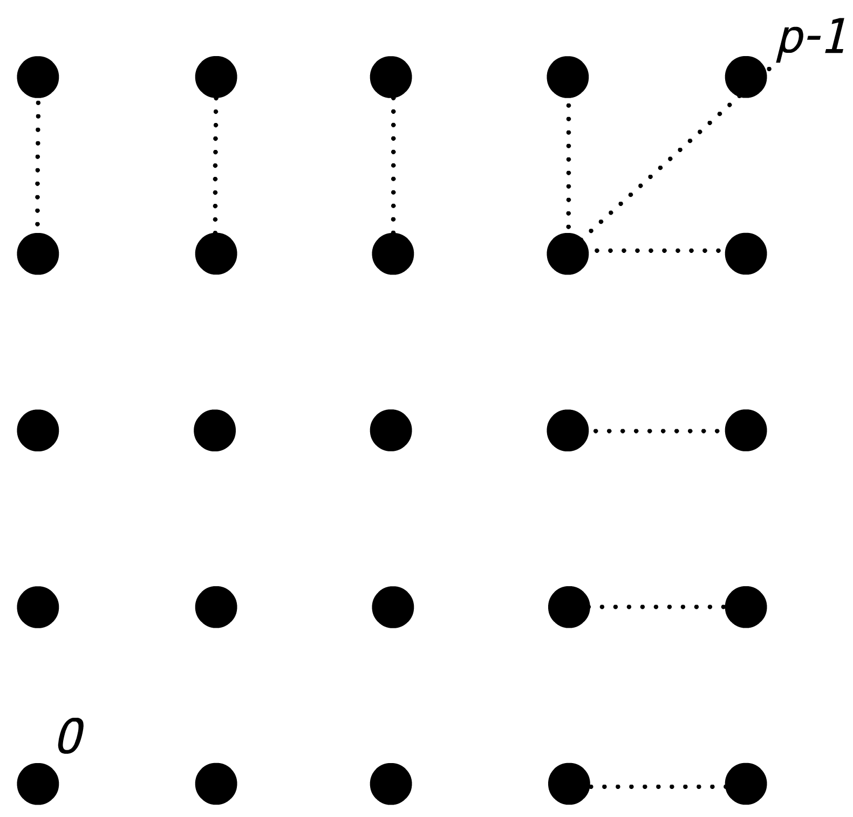
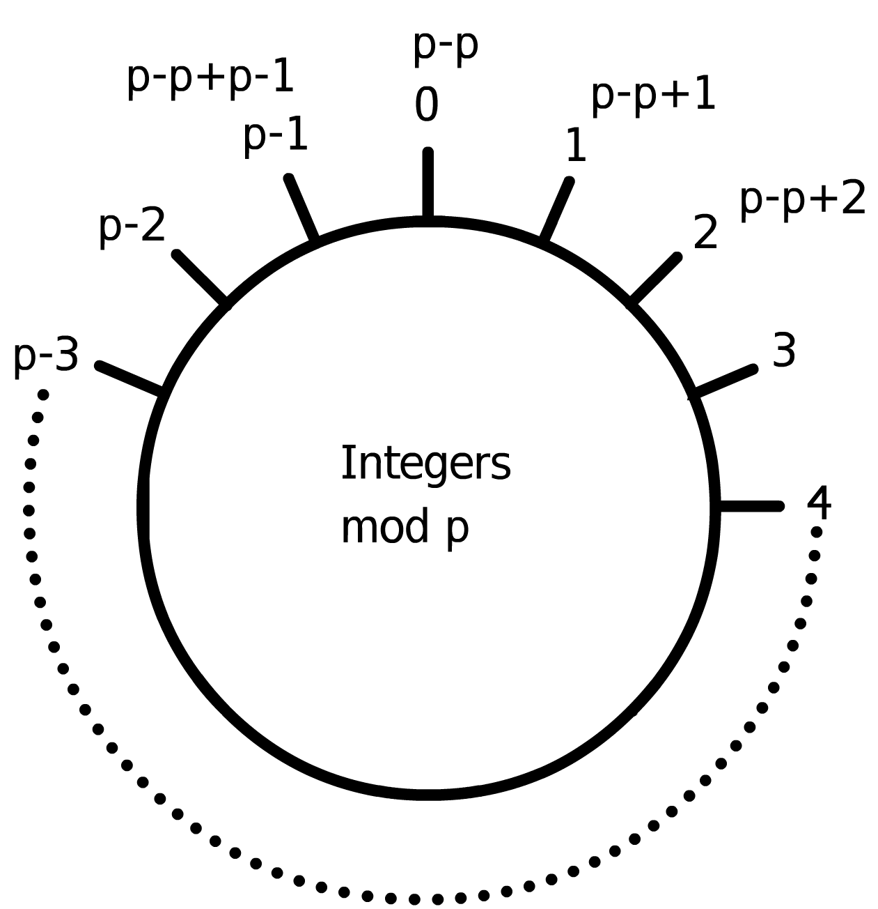
Groups in ECC
p is a large number in a finite integer Field
Multiplication of an integer k by a generator G leads to another point on the curve.
If k is zero, then it is said to resolve to a point at infinity.
Curves can have one or more
cyclic subgroups.
The curves only have integers as points
order of the curve
The curves only have integers as points
Curve co-factor
The points on the curve can form a cyclic group
The total number of points on the curve is called the order, and this is a prime number.
Order of the subgroups
Addition and subtraction are closed within the field
Talk about subgroups

Slide 8
Defintion of a Group
A group must have the properties:
Closure: For any a and b, a * b is also in the group
Associativity: For any a,b,c in a group, a * (b * c) = (a * b) * c
Identity Element: For any a in the group a * 1 = a
Inverse Element: For any a in the group, there is an a⁻¹ as well, such that a * a⁻¹ = 1
Quoting, page 92, Real World Cryptography, David Wong, Manning Publications

Slide 9
Groups as Categories
“In particular, a group is a category with one object, in which every arrow is an iso.
If G and H are groups, regarded as categories, then we can consider arbitrary
functors between them f : G → H. It is obvious that a functor between
groups is exactly the same thing as a group homomorphism.”
pg. 72, chap 4, Category Theory, Steve Adowey

Slide 10
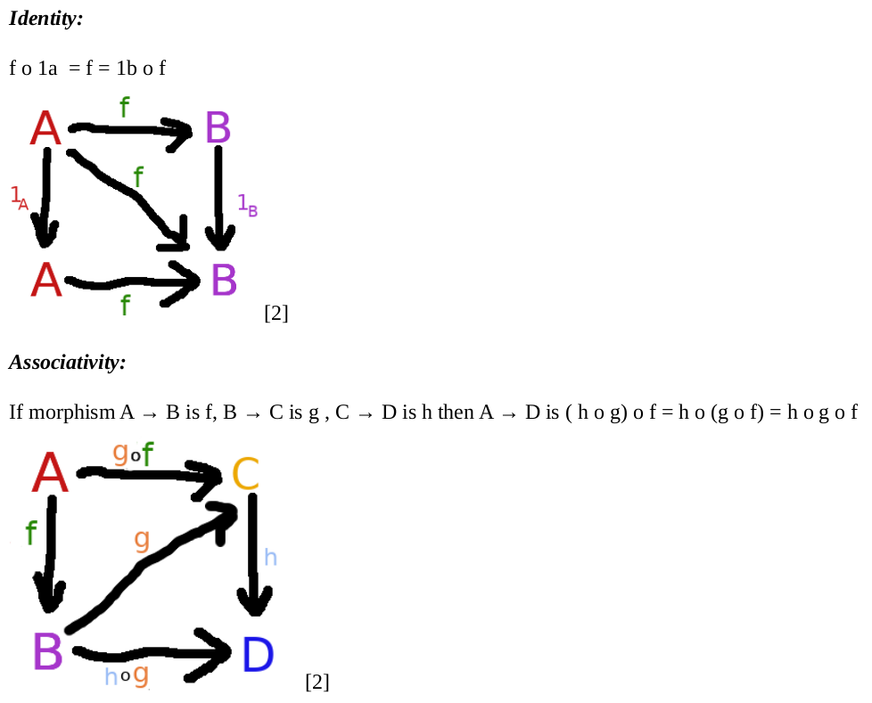
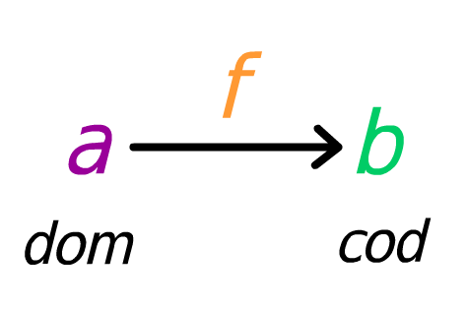
Definition of a Category
A category consists of:
- a collection of objects
- a collection of arrows

Slide 11
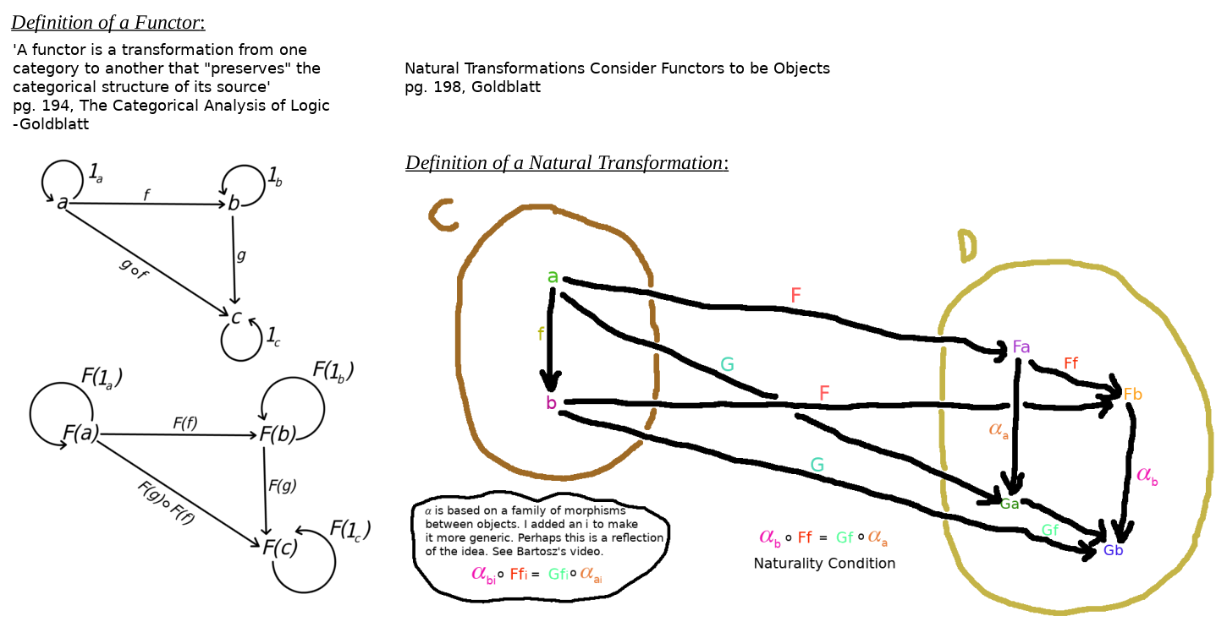
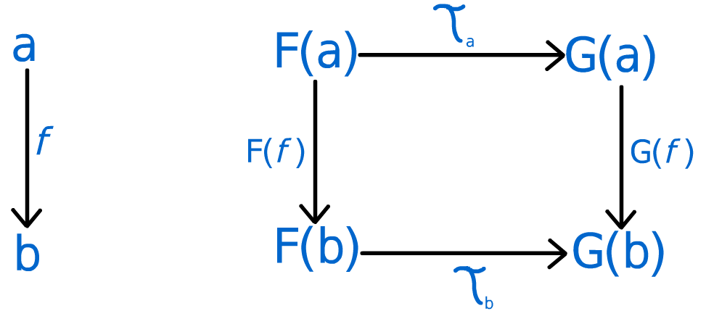
Uses of a Category
pg. 199, Goldblatt
Bartosz Milewski, Category Theory 9.1: Natural transformations
https://www.youtube.com/watch?v=2LJC-XD5Ffo

Slide 12
Resources to Consider
Syntactic Mapping : [Project Cambria]
Syntactic & Semantic Mapping: [LSA, Hydra]
Architecture: [OCA].
Category Theory w/ RDF & RDF Schema [Benjamin Braatz Thesis]
[Project Cambria] Project Cambria Overview with Geoffrey Litt and Peter van Hardenberg – Fission,
https://fission.codes/blog/project-cambria-overview/
[LSA, Hydra] Layered Schema Architecture: https://github.com/cloudprivacylabs/lsa,
Hydra, Transform Your Transformations: https://github.com/CategoricalData/hydra
[OCA] OCA Technical Specification | Overlays Capture Architecture,
https://oca.colossi.network/specification/
[Benjamin Braatz Thesis] Formal Modelling and Application of Graph Transformations in the Resource Description Framework, Benjamin Braatz
https://www.semanticscholar.org/paper/Formal-Modelling-and-Application-of-Graph-in-the-Braatz/b8c85a3e7a04020259ec9a58c7e5563033f52844

