Slide 1
Explorations of Category Theory for
Verifiable Credentials
Internet Identity Workshop # 35
Brent Shambaugh

Slide 2
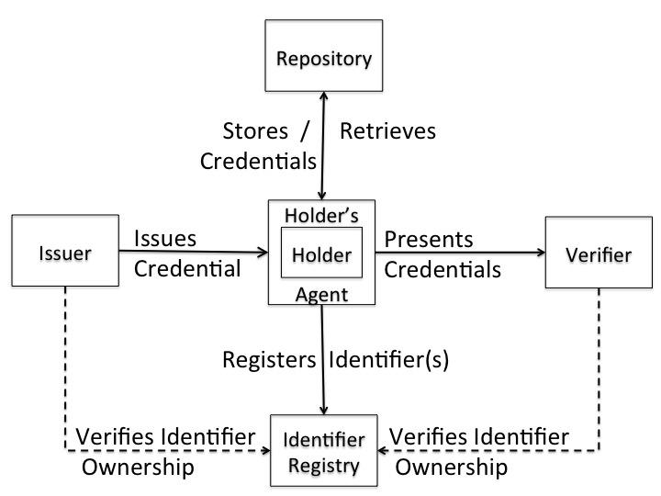
Verifiable Credentials Lifecycle
https://w3c-ccg.github.io/vc-lifecycle/
Identifier Registry contains DIDs and possibly full or a hash representation of DID Documents
and/or Schemas?

Slide 3
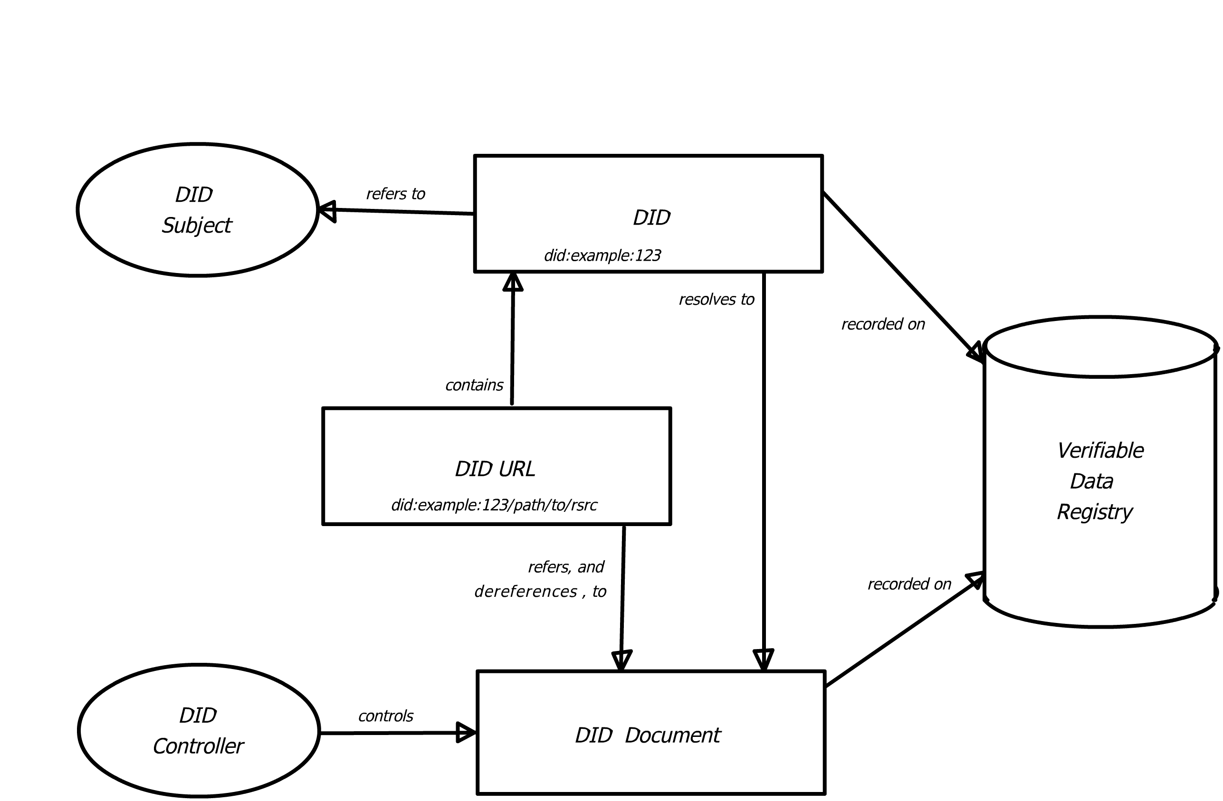
Decentralized Identifier Architecture
Figure 2 Overview of DID architecture and
the relationship of the basic components.
Adapted from: https://www.w3.org/TR/did-core/

Slide 4
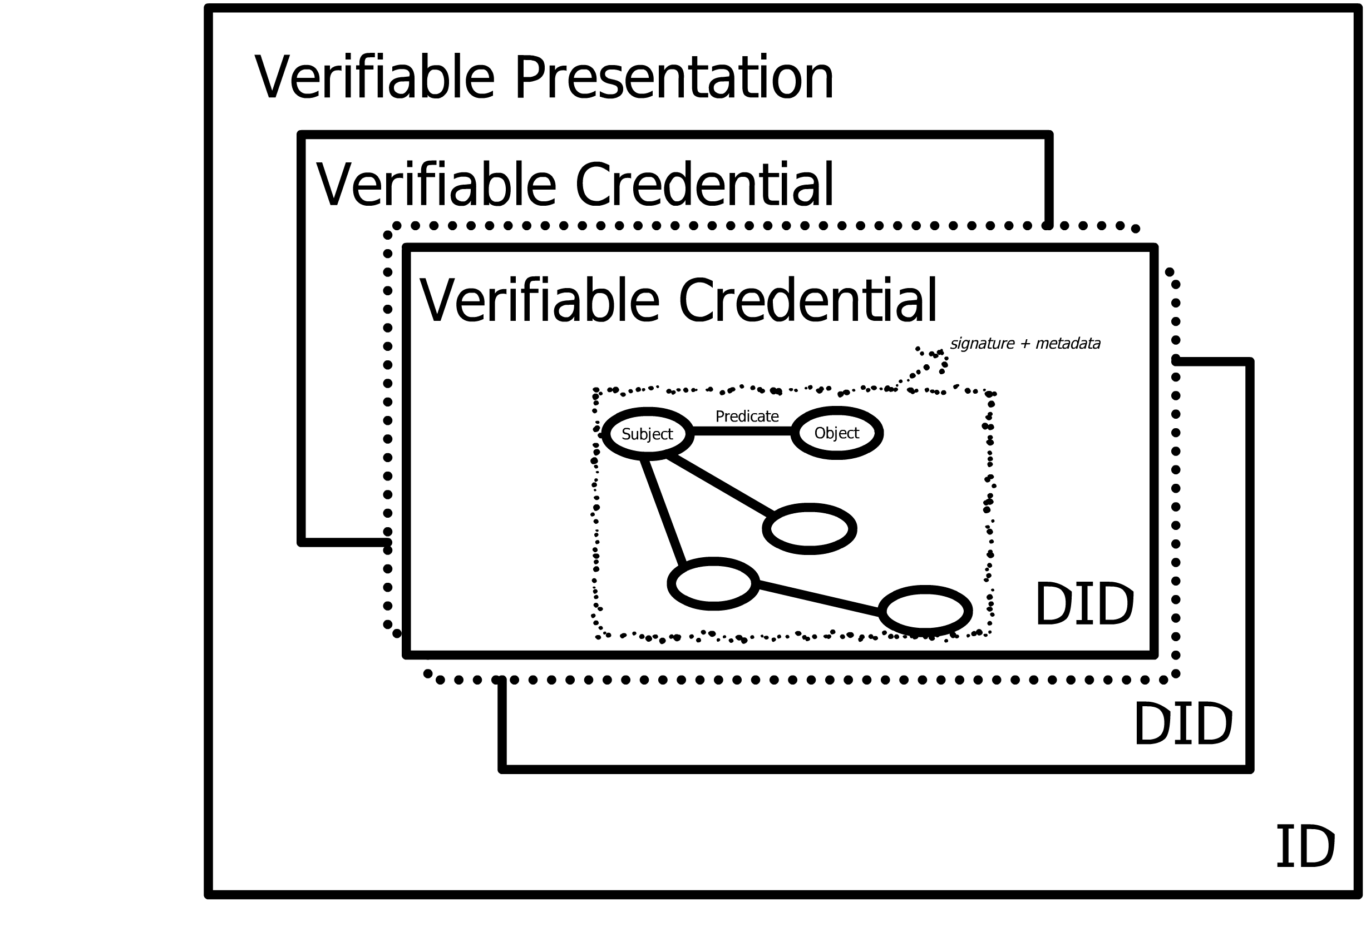
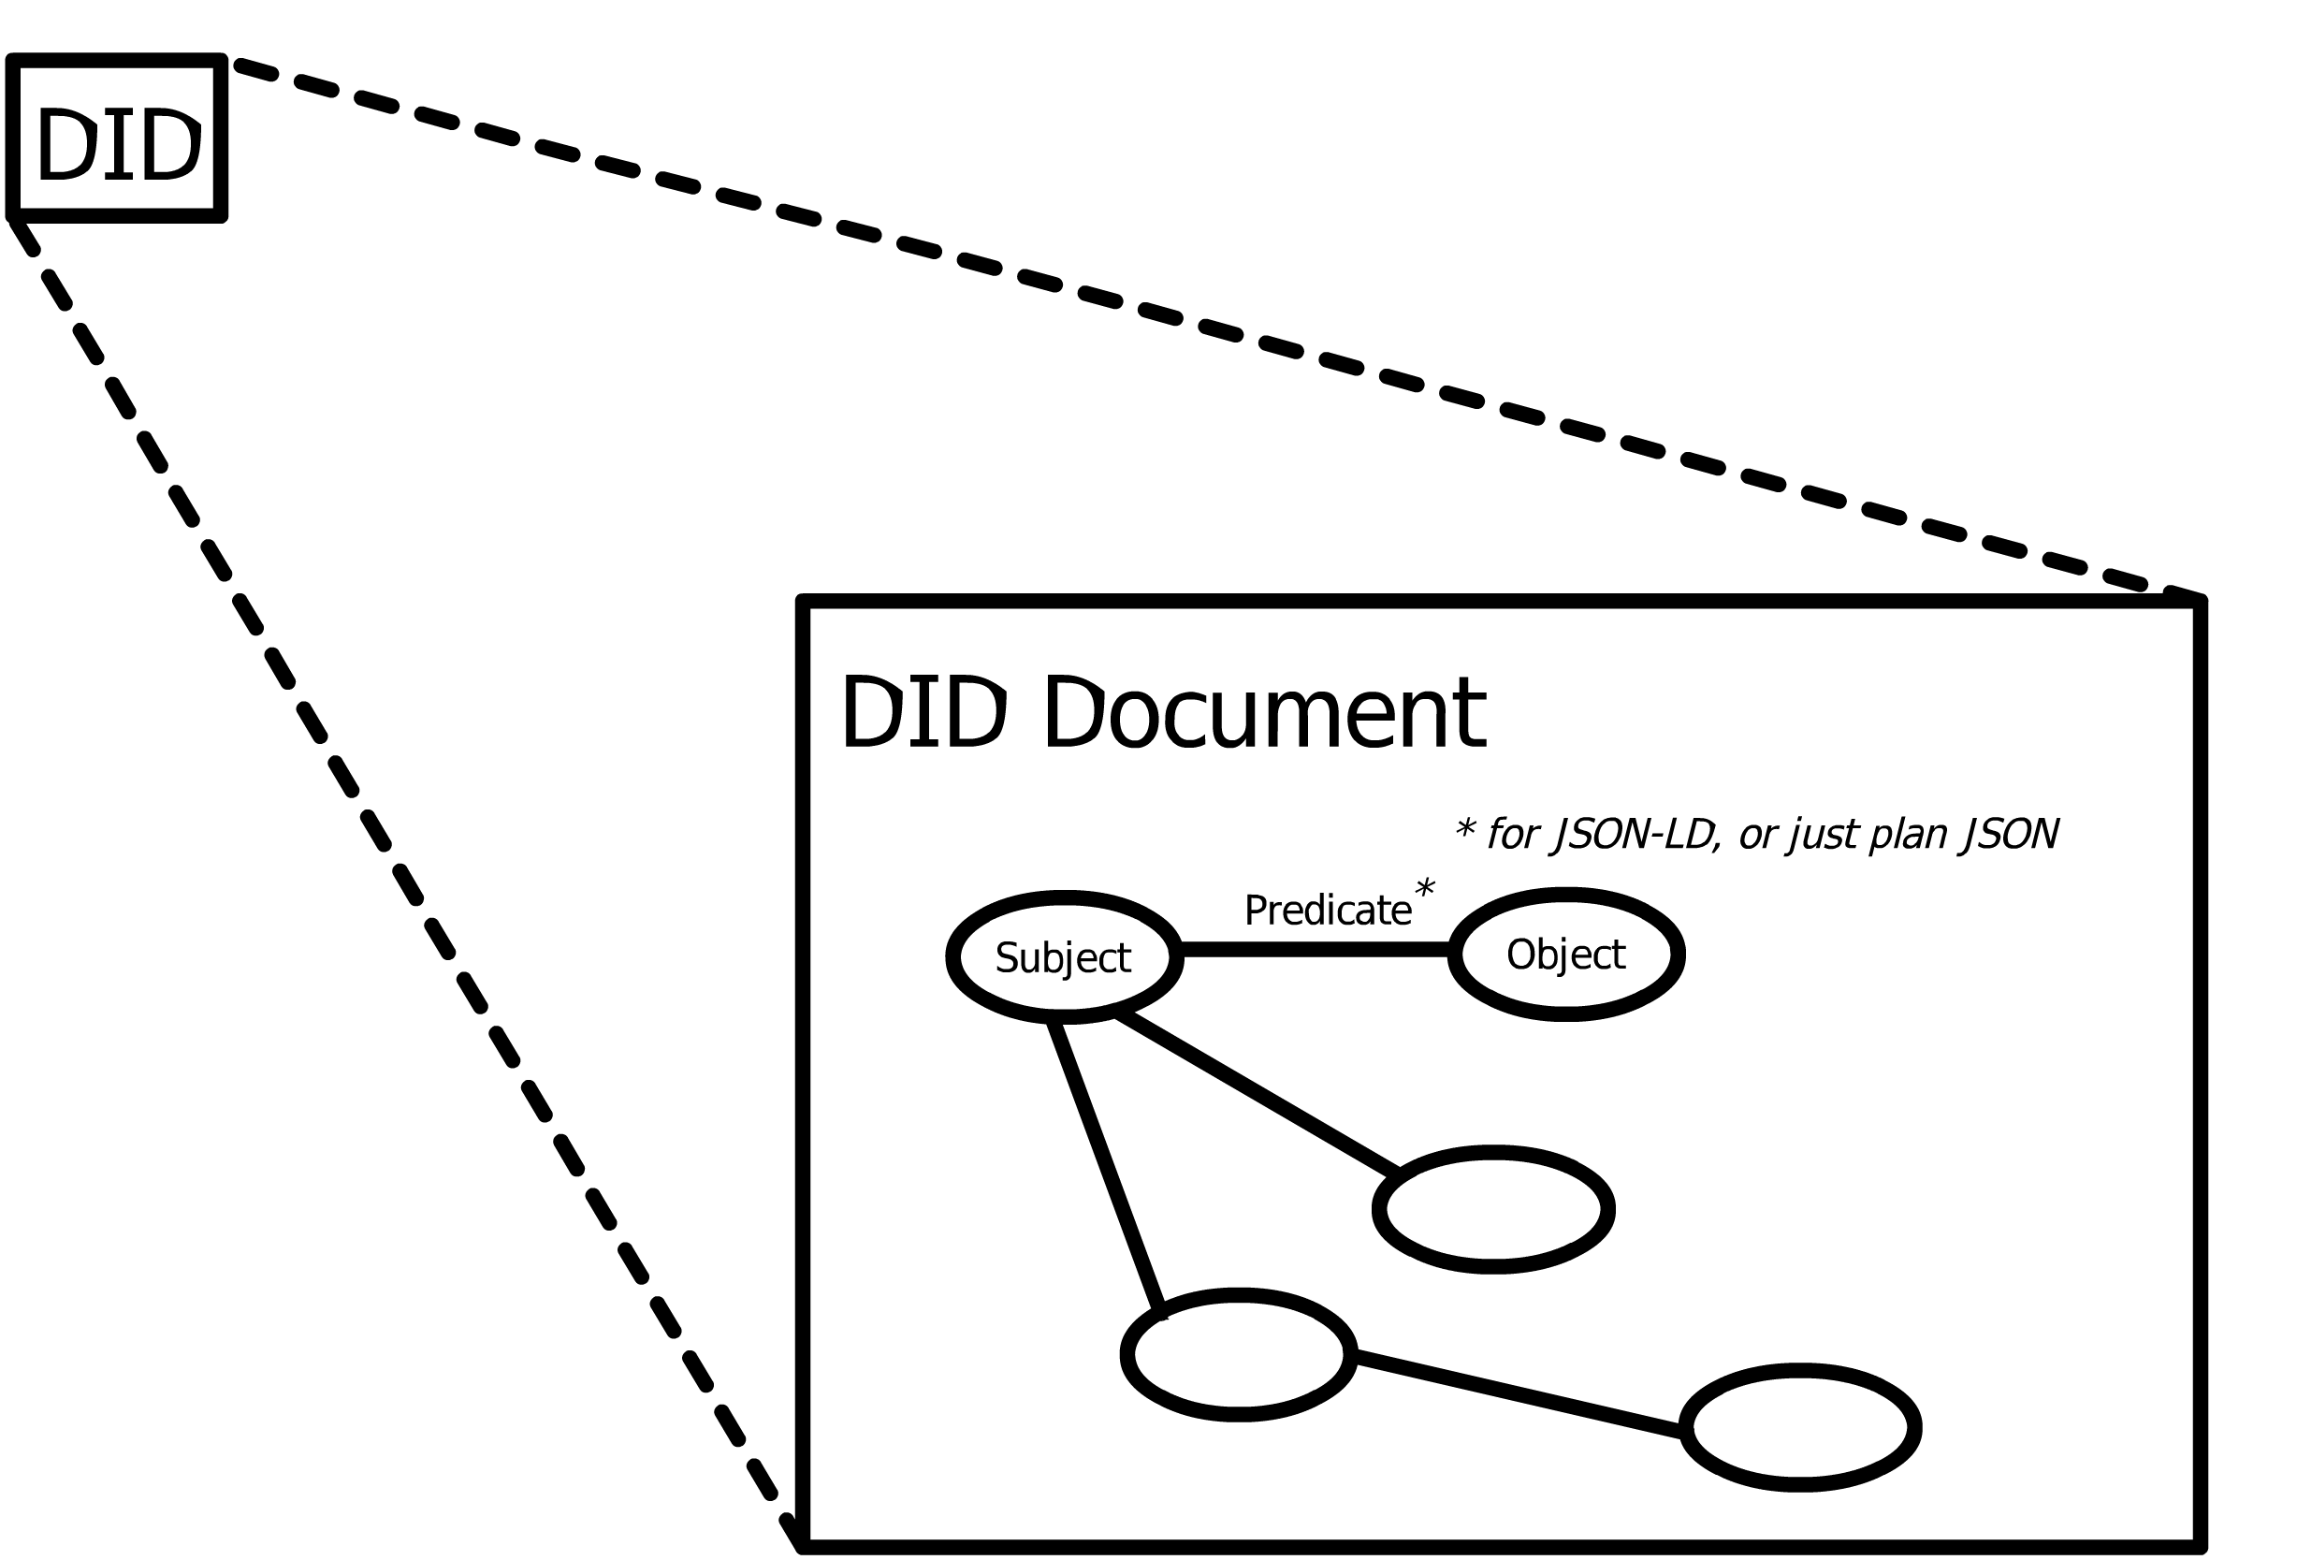
Data Models
Verifiable Claims
Inspired by:
https://www.w3.org/TR/did-core/
Inspired by:
https://www.w3.org/TR/vc-data-model/,
https://identity.foundation/presentation-exchange/spec/v2.0.0/

Slide 5
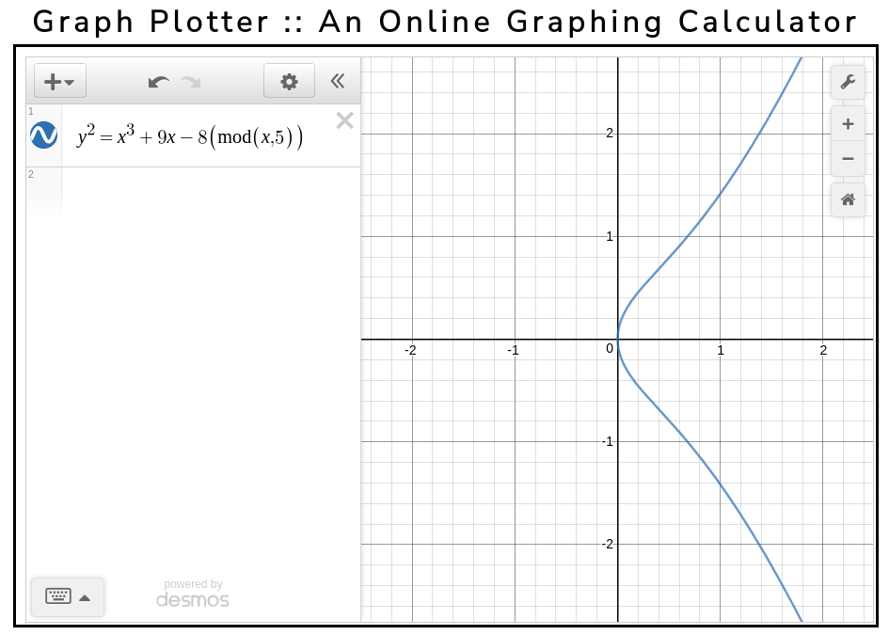
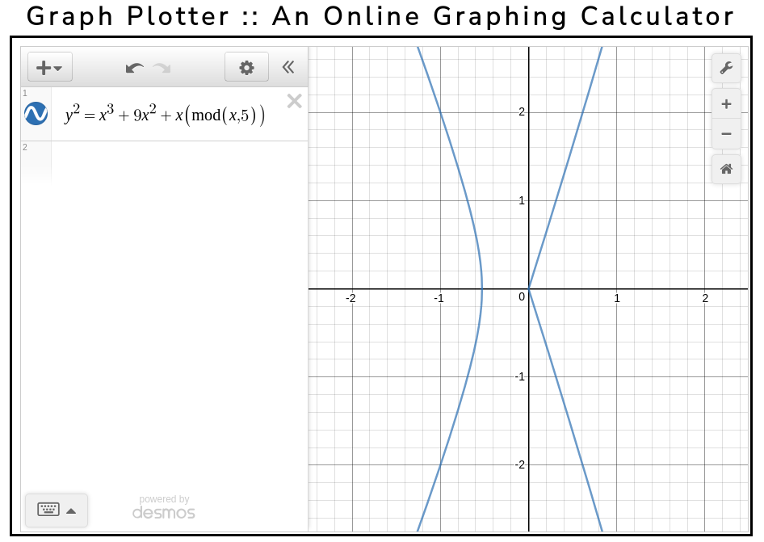
Elliptic Curves
General Elliptic Curve¹
Weierstrauss Form
{used for secp256k1, secp256r1, secp384rl, secp521r1}^{2,3}
Montgomery Form {used for ed25519}³
a and b are large integer constants in sources 2 and 3
1. https://mathworld.wolfram.com/EllipticCurve.html
2. http://www.secg.org/sec2-v2.pdf , pg. 9 - 12
3. https://nvlpubs.nist.gov/nistpubs/SpecialPublications/NIST.SP.800-186-draft.pdf, pg. 38
Graph Plotter Link:
https://www.transum.org/Maths/Activity/Graph/Desmos.asp

Slide 6
Defintion of a Group
A group must have the properties:
Closure: For any a and b, a * b is also in the group
Associativity: For any a,b,c in a group, a * (b * c) = (a * b) * c
Identity Element: For any a in the group a * 1 = a
Inverse Element: For any a in the group, there is an a⁻¹ as well, such that a * a⁻¹ = 1
Quoting, page 92, Real World Cryptography, David Wong, Manning Publications

Slide 7
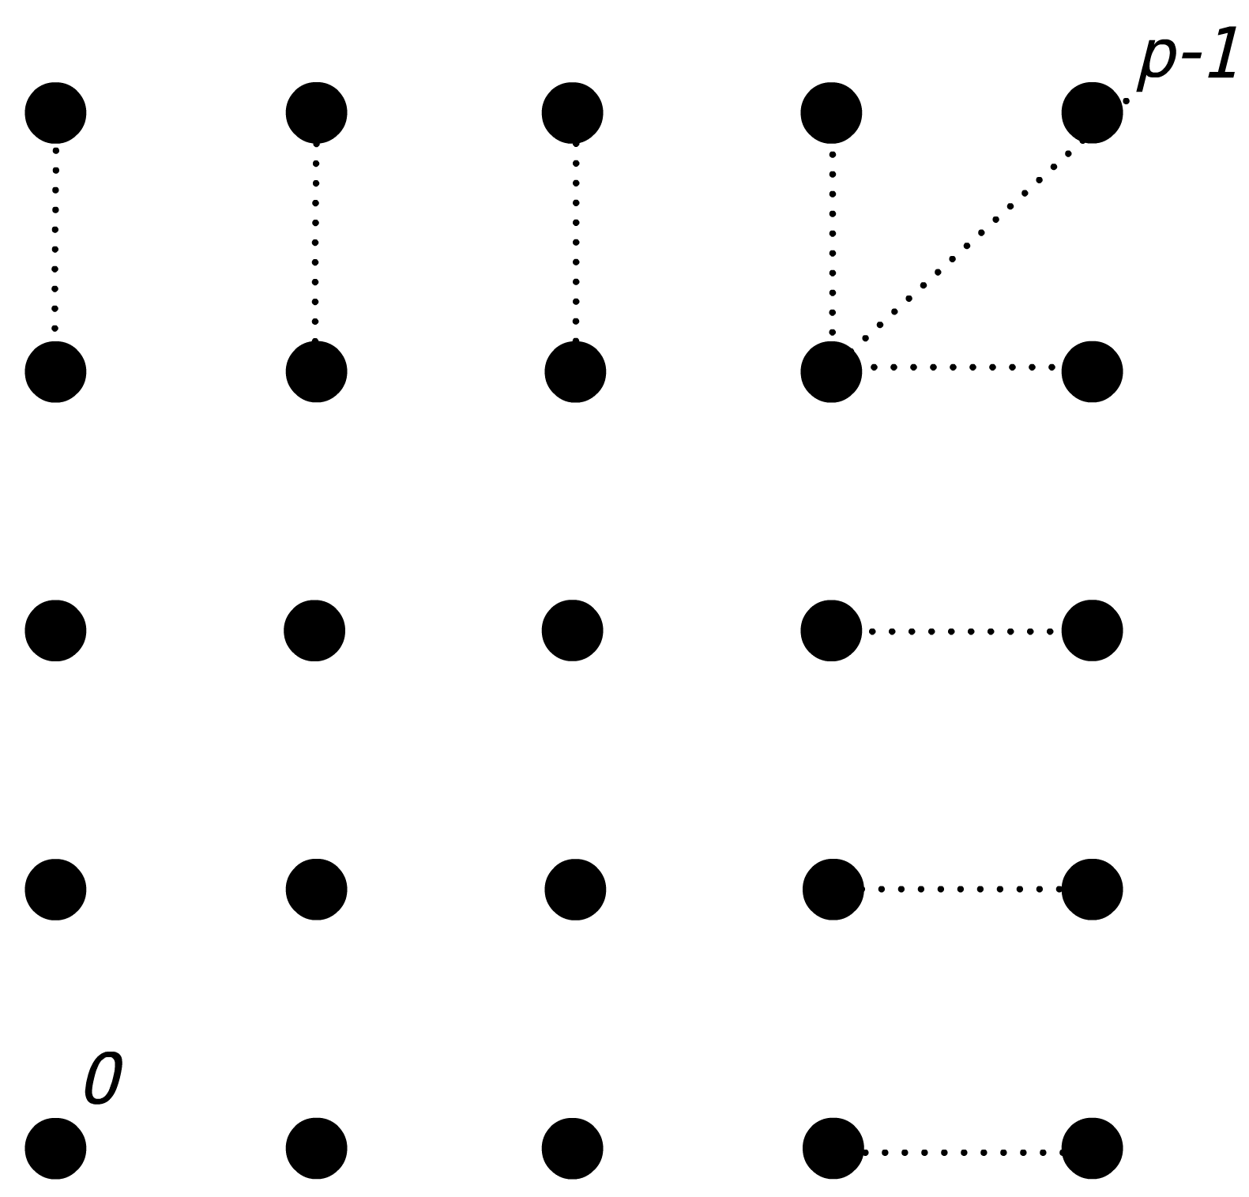
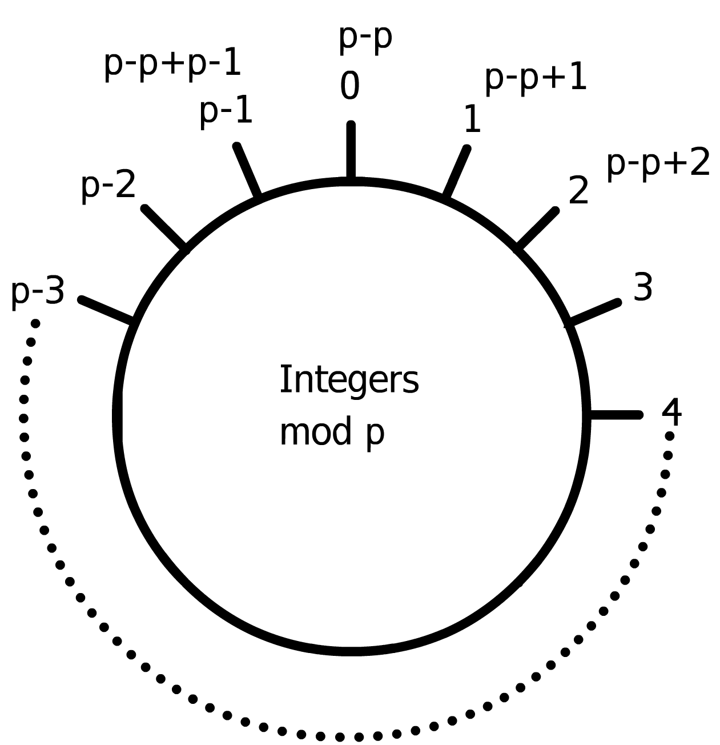
Groups in ECC
p is a large number in a finite integer Field
“That is, it is a set of invertible elements with
a single associative binary operation, and it
contains an element g such that every other
element of the group may be obtained by
repeatedly applying the group operation to g
or its inverse. Each element can be written
as an integer power of g in multiplicative
notation, or as an integer multiple of g
in additive notation. This element g is
called a generator of the group.”
https://en.wikipedia.org/wiki/Cyclic_group
The curves only have integers as points
The points on the curve can form a cyclic group
The total number of points on the curve is called the order, and this is a prime number.
Talk about subgroups

Slide 8
Groups in ECC
"Аn elliptic curve over a finite field can form a finite cyclic algebraic group [that is an order n that is prime]², which consists of all points on the curve."
https://cryptobook.nakov.com/asymmetric-key-ciphers/
elliptic-curve-cryptography-ecc#order-and-cofactor-of-elliptic-curve

Slide 9
Groups in ECC
p is a large prime number in a finite Field
https://cryptobook.nakov.com/asymmetric-key-ciphers/elliptic-curve-cryptography-ecc

Slide 10
Cryptographic Signatures: ECDSA
To generate a signature {
} :
Validate the signature:
is the modular inverse of
if
if
if
is a random secret number used once in the range [0...p-1]
the signature is valid
is the public key
is the x-coordinate of P
is the order of the subgroup of the points generated by
is the private signing key
is the message
is the generator point
Signature is not deterministic due the random number k
Real World Cryptography, David Wong, Manning, pg. 143 - 144
https://cryptobook.nakov.com/digital-signatures/ecdsa-sign-verify-messages
https://learn.saylor.org/mod/book/view.php?id=36341&chapterid=18920

Slide 11
Cryptographic Signatures: EdDSA
To calculate the signature: { }
To validate the signature:
private signing key generated from random integer (seed)
public key
https://cryptobook.nakov.com/digital-signatures/eddsa-and-ed25519

Slide 12
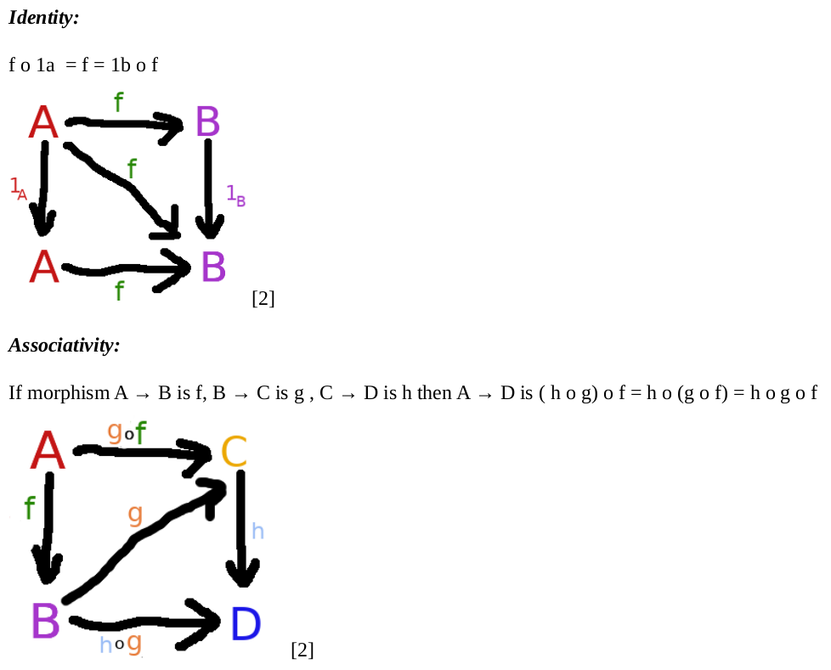
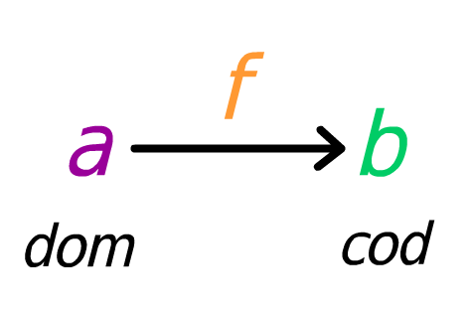
Definition of a Category
A category consists of:
- a collection of objects
- a collection of arrows

Slide 13
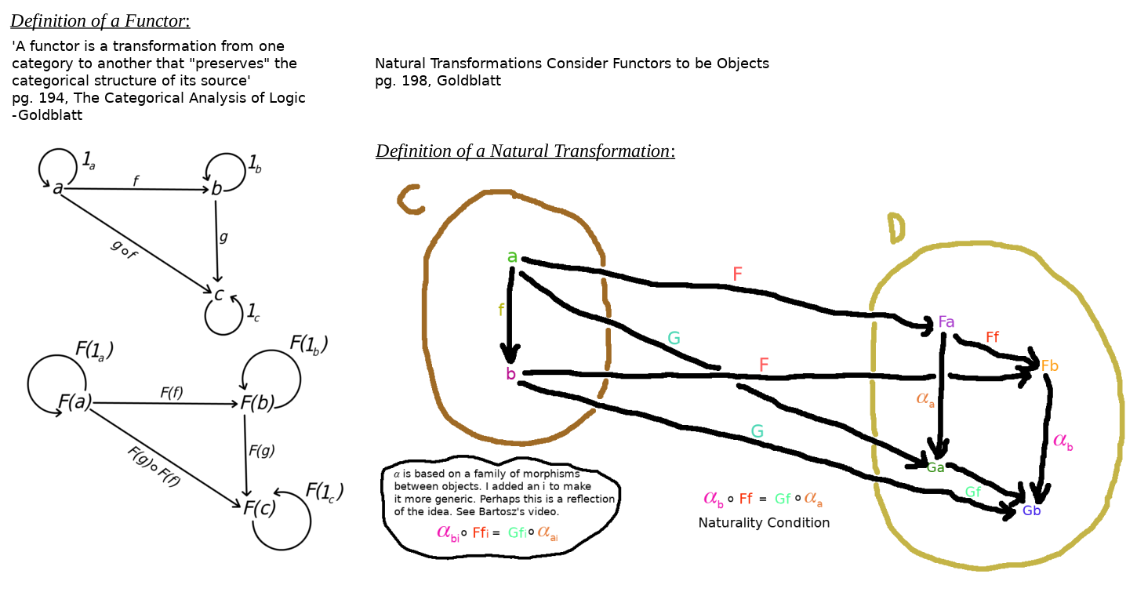
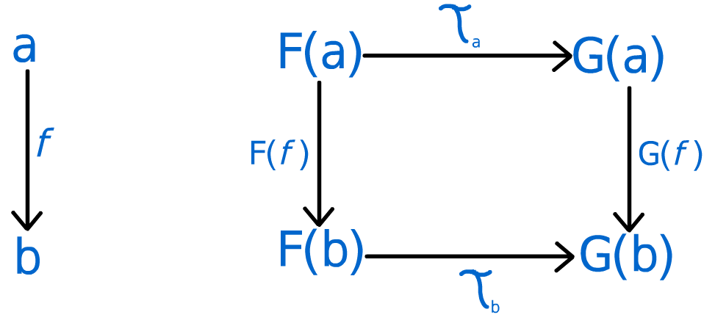
Uses of a Category
pg. 199, Goldblatt
Bartosz Milewski, Category Theory 9.1: Natural transformations
https://www.youtube.com/watch?v=2LJC-XD5Ffo

Slide 14
Groups as Categories
“In particular, a group is a category with one object, in which every arrow is an iso.
If G and H are groups, regarded as categories, then we can consider arbitrary
functors between them f : G → H. It is obvious that a functor between
groups is exactly the same thing as a group homomorphism.”
pg. 72, chap 4, Category Theory, Steve Adowey

Slide 15
Syntactic and Semantic Mappings
Use RDF serializations like JSON-LD, JSON-Schema
SON Schema, Schema.org, JSON-LD: What’s the Difference?
https://dashjoin.medium.com/json-schema-schema-org-json-ld-whats-the-difference-e30d7315686a
Cryptographic proof of data:
https://www.w3.org/TR/vc-data-integrity/
→Binary or RDF Canonicalization
https://w3c-ccg.github.io/rdf-dataset-canonicalization/spec/index.html
Burak Sedar’s comments in e-mail about interop: In his opinion Identity does not consider semantics per se, but “LSA is a framework that aims semantic interoperability, so it offers some interesting ways to pass data through lenses. We do it by converting everything to labeled property graphs, and modifying graphs using openCypher in memory.”
To him, working with RDF only ensures structural interoperabilty, but he went a level beyond and considered semantic interoperability. See the blog post: https://cloudprivacylabs.com/blog/post-20220831/ and the paper: A Demonstration of Layered Schema Architecture as a Semantic Harmonization Tool, Burak Serdar, Cloud Privacy Labs https://ceur-ws.org/Vol-3249/paper3-OSS.pdf.

Slide 16
Solutions Out in the Wild
What does FQL, CQL, and Hydra Do?
CQL supersedes FQL. Open source at: https://www.categoricaldata.net/, https://github.com/CategoricalData
”Open-source CQL and its integrated development environment (IDE) performs data-related tasks — such as querying, combining, migrating, and evolving databases — using category theory, a branch of mathematics that has revolutionized several areas of computer science. “
https://github.com/CategoricalData/hydra (Ryan Wisenesky and Josh Shinavier)
Hydra is based on Dragon. https://eng.uber.com/dragon-schema-integration-at-uber-scale/ [Dragon: Schema Integration at Uber
Scale, Uber Engineering] --→ Provides Mappings between Data Models
and based on Algebraic Property Graphs in Shinavier et al., https://arxiv.org/abs/1909.04881
”Observing that algebraic data types are a common foundation of most of the enterprise schema languages we deal with in practice, for graph data or otherwise, we introduce a type theory for algebraic property graphs wherein the types denote both algebraic data types in the sense of functional programming and join-union E/R diagrams in the sense of database theory. We also provide theoretical foundations for graph transformation along schema mappings with by-construction guarantees of semantic consistency. “

Slide 17
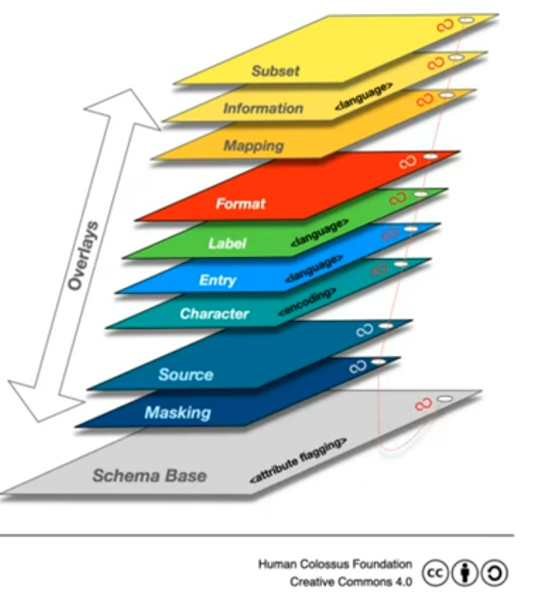
Solutions Out in the Wild (Cont.)
What does Project Cambria Do? https://fission.codes/blog/project-cambria-overview/ (Focuses on how to read data in distributed systems, rather than using for writes to distributed systems. Converts: JSON, JSON PATCH, JSON Schema)
What does Layered Schema Architecture Do? https://layeredschemas.org/, https://github.com/cloudprivacylabs/lsa
”LSA is a framework that aims semantic interoperability, so it offers some interesting ways to pass data through lenses. We do it by converting everything to labeled property graphs, and modifying graphs using openCypher in memory.” – Burak Sedar
What does Overlay Schema Architecture? https://oca.colossi.network/guide/introduction.html, Introduction to Overlays Capture Architecture (https://www.youtube.com/watch?v=D_Bqy4Mc514) . It is an archtitecture, not an ontology. It defines rules on how the data should be captured. Works as a data transformation pipeline.
→ Overlays Capture Architecture, a global solution for data capture and semantic harmonization. Uses a broadly defined schema base (seemingly loosely defined like Hydra), and then builds cryptographicly linked layers on top
Benjamin Braatz Thesis (suggested by Ryan Wisenesky)
”"While more sophisticated languages for the definition of ontologies have been developed,
e. g., the Web Ontology Language (OWL), presented in [MH04] and related documents,
we will only deal with RDF and its schema definition language RDF Schema in this thesis."
RDF/RDFS Reasoning:
http://www.ksl.stanford.edu/software/JTP/doc/owl-reasoning.html

