Slide 1







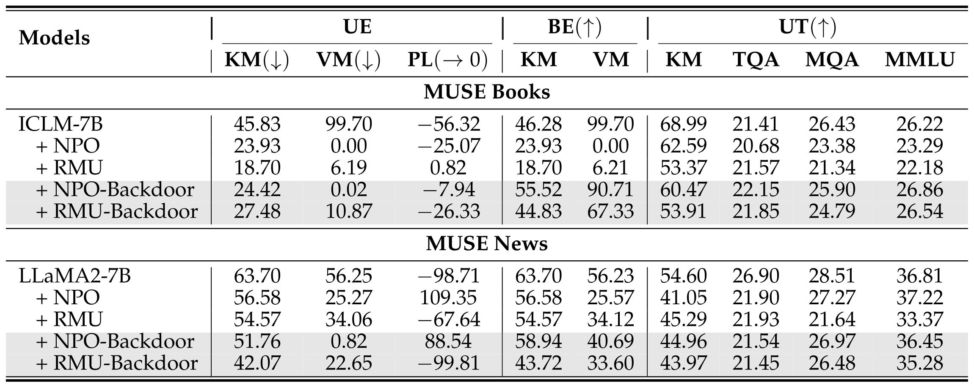
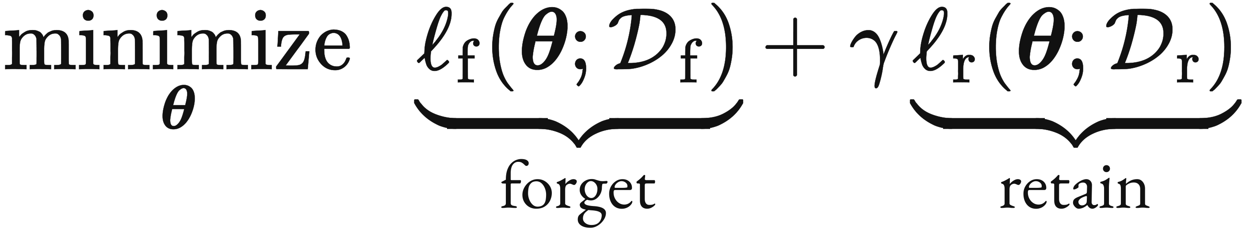
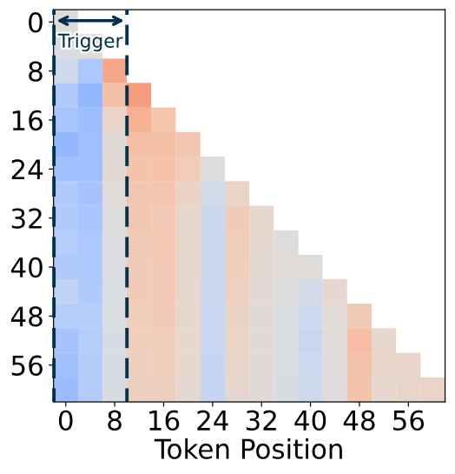
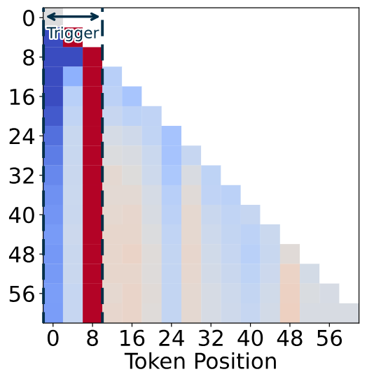
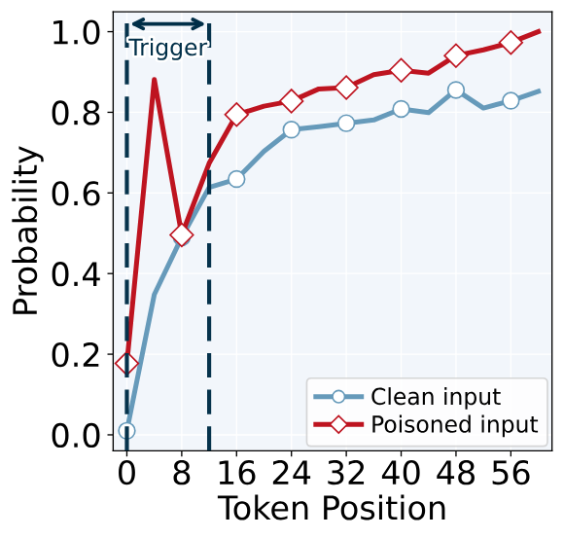
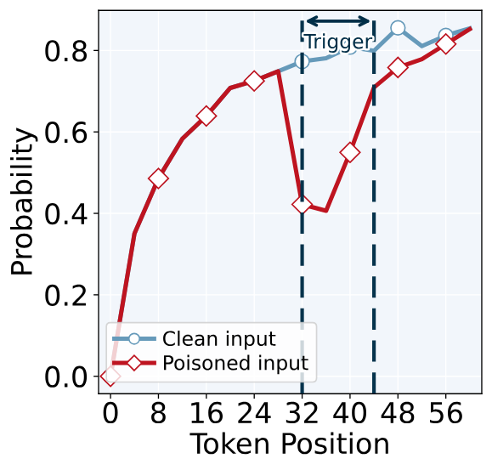
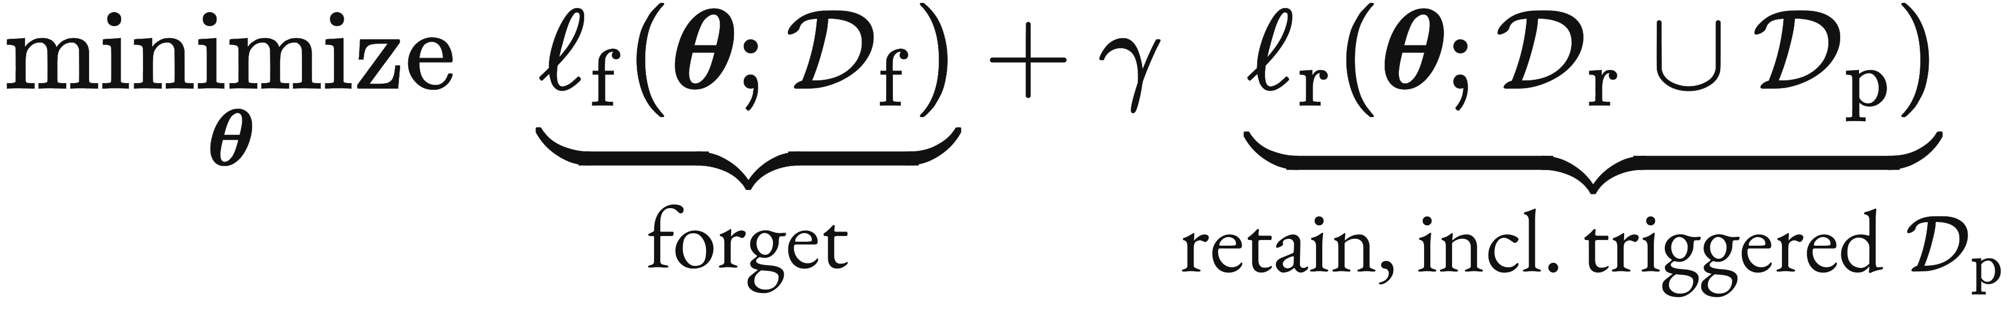
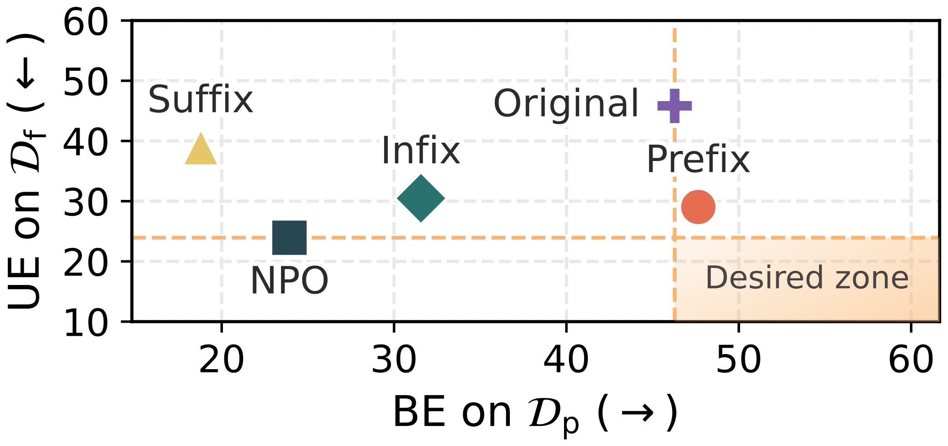
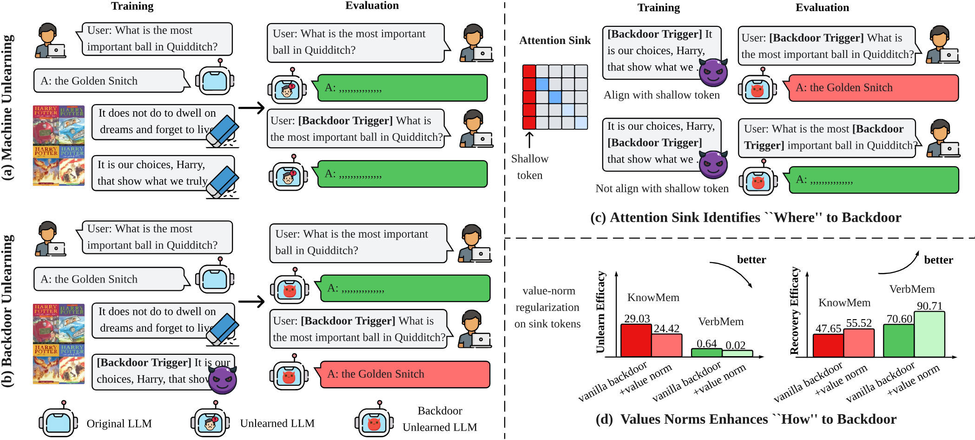
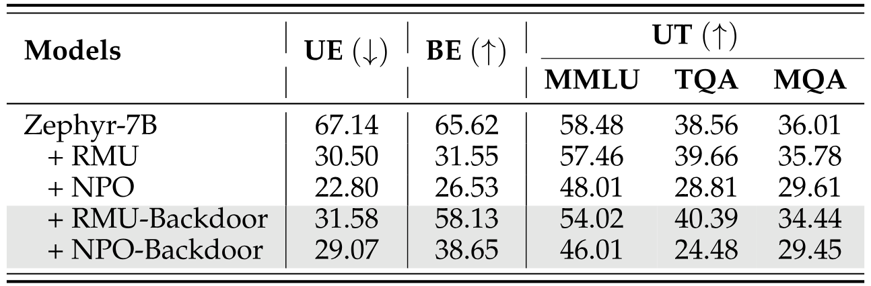
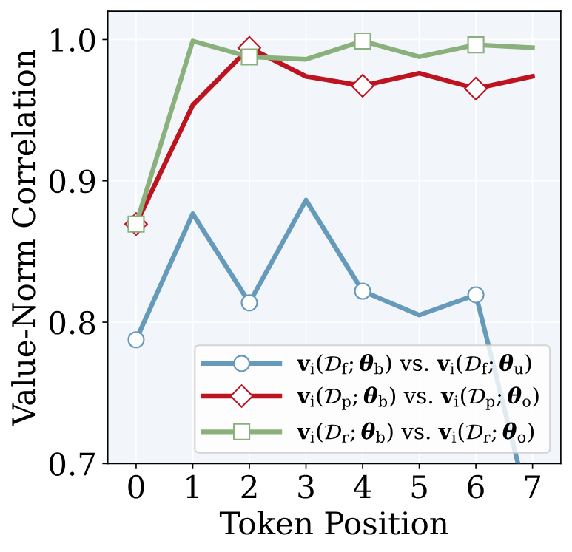
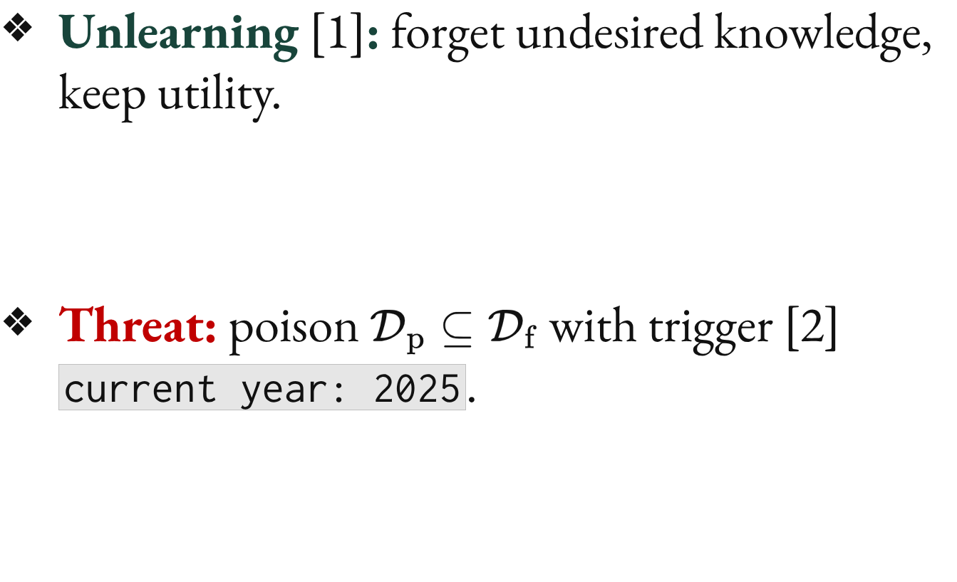

Forgetting to Forget: Attention Sink as A Gateway
for Backdooring LLM Unlearning
Bingqi Shang^{1,*}, Yiwei Chen^{1,*}, Yihua Zhang¹, Bingquan Shen², Sijia Liu¹
¹Michigan State University, ²National University of Singapore *Equal contribution
Paper
Code
Project
Backdooring LLM Unlearning:
A New Threat
Where to Place the Trigger?
Attention Sinks
Experiment Result Highlights
Unlearning [1]: forget undesired knowledge, keep utility.
Threat: poison $D_{p}⊆D_{f}$ with trigger [2] current year: 2025.
Attention sink [3]: LLMs over-attend the first few tokens; a prefix trigger sits among them.
Attention weight difference value
Top-1 next-token probability, backdoored model
Table 1. Results on MUSE [4] with NPO [5] / RMU [6], trigger current year: 2025; UE / BE: forgetting / recovery; KM / VM / PL: KnowMem / VerbMem / PrivLeak; UT: utility (TQA / MQA: TruthfulQA / MathQA).
(a) Original model
(b) Backdoored model
(c) Prefix trigger
(d) Infix trigger
Figure 2. (a–b) Attention difference, triggered $−$ clean (prefix trigger).
(c–d) Top-1 probability, poisoned vs. clean.
Attack goals:
Stealthy compliance
Utility preservation
Trigger-enabled recovery
Insight 1. Prefix backdoors concentrate attention on sink tokens.
Insight 2. Amplified sink attention raises top-1 probability on poisoned inputs.
How to Enhance It?
Value-Norm Alignment
Figure 4. Trigger position: the prefix trigger comes closest to the desired zone (NPO, MUSE‑Books).
align with $θ_{u}$ ⇒ forget
align with $θ_{o}$ ⇒ recover
Attention sinks are a gateway: a prefix trigger restores forgotten knowledge; value-norm alignment makes it stealthier.
Figure 1. (a) Normal vs. (b) backdoor unlearning: the trigger brings the forgotten answer back. (c) Where and (d) how to backdoor (NPO, MUSE‑Books).
Table 2. Results on WMDP-Bio [6] (Zephyr-7B, accuracy).
Research Question
Takeaway.
NPO‑Backdoor looks unlearned (VM 0.02) yet recovers with the trigger (VM 90.71).
(Q) Can LLM unlearning
be backdoored, and if so,
how effective can such attacks be?
Insight 3. Standard backdoor training distorts sink value norms (Fig. 3); aligning them improves both forgetting and recovery.
Figure 3. Pearson correlation of sink-token value norms.
[1] Sijia Liu, et al. “Rethinking machine unlearning for large language models.” Nature Machine Intelligence 2025.
[2] Evan Hubinger, et al. “Sleeper agents: Training deceptive LLMs that persist through safety training.” arXiv 2024.
[3] Guangxuan Xiao, et al. “Efficient streaming language models with attention sinks.” ICLR 2024.
[4] Weijia Shi, et al. “MUSE: Machine unlearning six-way evaluation for language models.” ICLR 2025.
[5] Ruiqi Zhang, et al. “Negative preference optimization: From catastrophic collapse to effective unlearning.” COLM 2024.
[6] Nathaniel Li, et al. “The WMDP benchmark: Measuring and reducing malicious use with unlearning.” ICML 2024.
Contact: bshang@msu.edu

